Slide 1
Tuples
L7 and L8

Slide 2
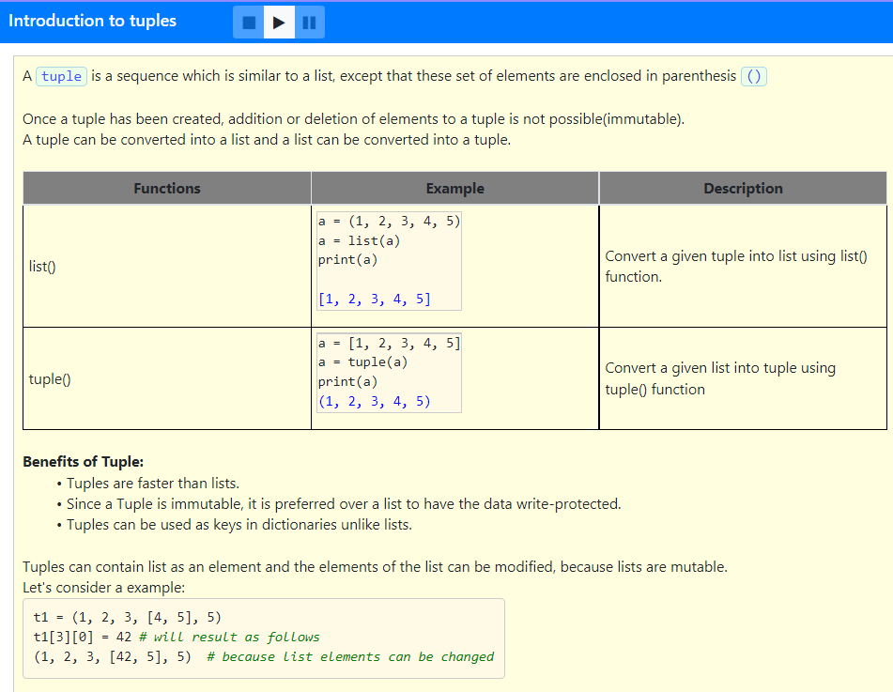

Slide 3
Which of the following is the correct option?
A Tuple is an mutable list.
Tuples are slower when compared to lists.
Tuples can be used as keys in dictionaries.
Elements of a tuple are enclosed in parenthesis.
Addition and deletion of elements is possible in a tuple.
It is possible to create tuples which contain mutable objects, such as lists.
3,4 and 6
1,2,3 and 4
4,5 and 6
5 and 6

Slide 4
Which of the following is the correct option?
A Tuple is an mutable list.
Tuples are slower when compared to lists.
Tuples can be used as keys in dictionaries.
Elements of a tuple are enclosed in parenthesis.
Addition and deletion of elements is possible in a tuple.
It is possible to create tuples which contain mutable objects, such as lists.
3,4 and 6
1,2,3 and 4
4,5 and 6
5 and 6

Slide 5
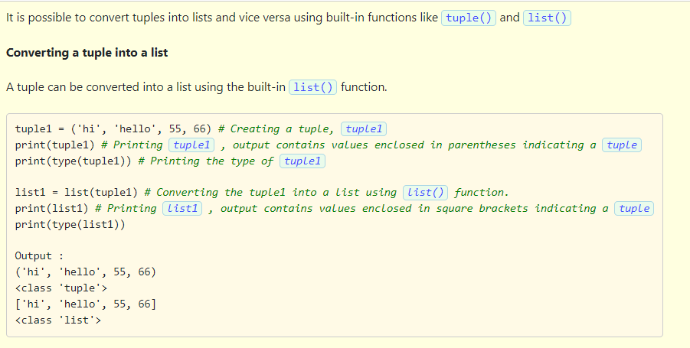

Slide 6
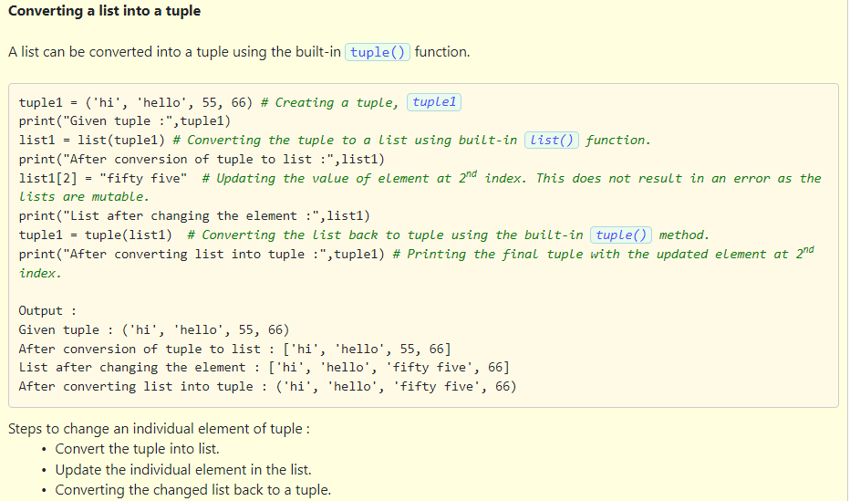

Slide 7
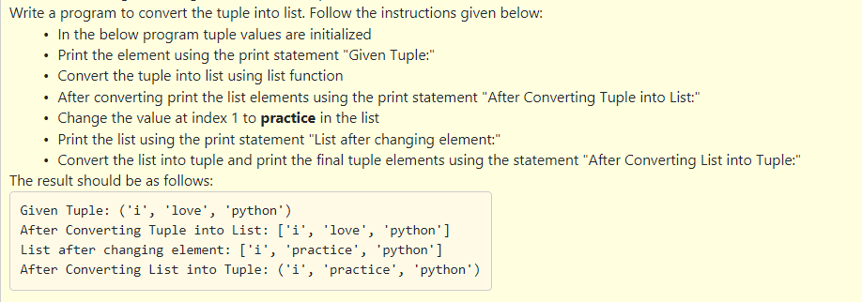
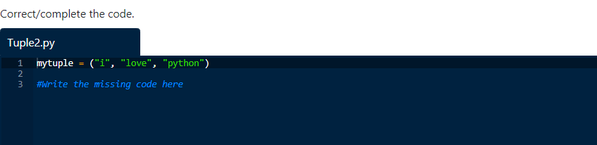

Slide 8
Solution:
mytuple = ("i", "love", "python")
print("Given Tuple:", mytuple)
mylist = list(mytuple)
print("After Converting Tuple into List:", mylist)
mylist[1] = "practice"
print("List after changing element:", mylist)
finaltuple = tuple(mylist)
print("After Converting List into Tuple:", finaltuple)

Slide 9
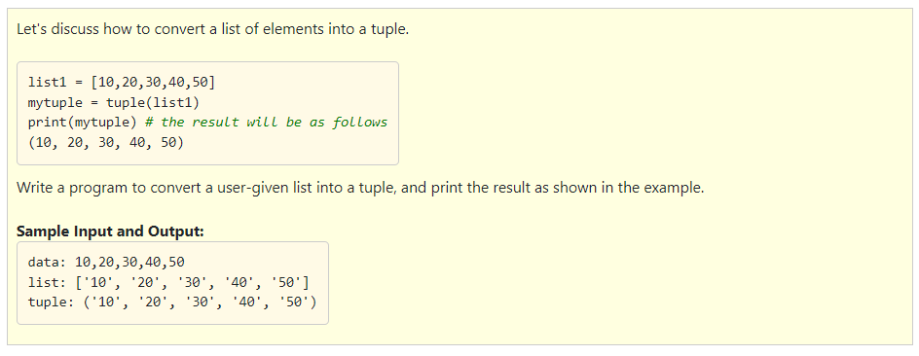

Slide 10
Solution:
data = input("data: ")
list1 = data.split(",")
tuple1 = tuple(list1)
print("list:", list1)
print("tuple:", tuple1)

Slide 11
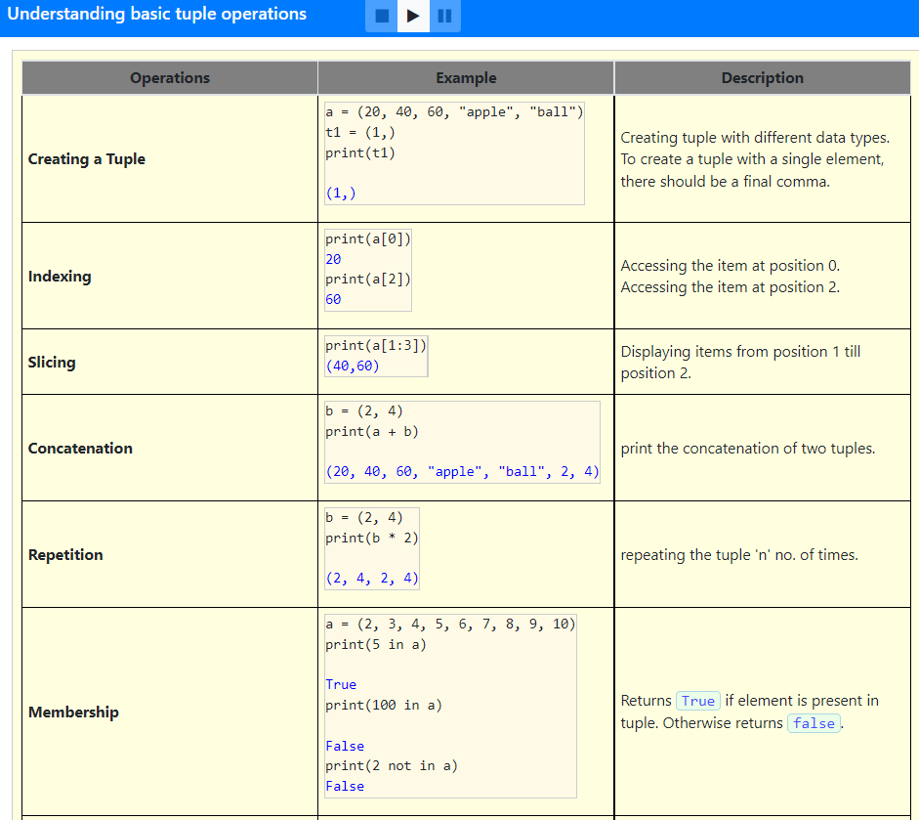
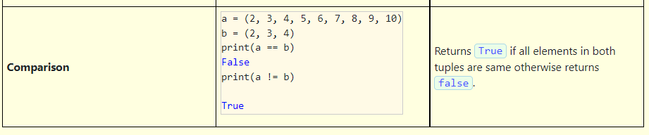

Slide 12
Which of the following option is correct?
A tuple can be created using the list function.
Trying to access an element equivalent to the length of a tuple returns the last element in the tuple.
The result of a concatenation of two tuples when assigned to one of the tuple creates a new tuple.
The result of a repetition of a tuple when assigned to the same tuple will result in a new tuple.
The membership and comparison operations on tuples result return a boolean value YES or NO.
1,2,3
2 and 3
3 and 4
4 and 5

Slide 13
Which of the following option is correct?
A tuple can be created using the list function.
Trying to access an element equivalent to the length of a tuple returns the last element in the tuple.
The result of a concatenation of two tuples when assigned to one of the tuple creates a new tuple.
The result of a repetition of a tuple when assigned to the same tuple will result in a new tuple.
The membership and comparison operations on tuples result return a boolean value YES or NO.
1,2,3
2 and 3
3 and 4
4 and 5

Slide 14
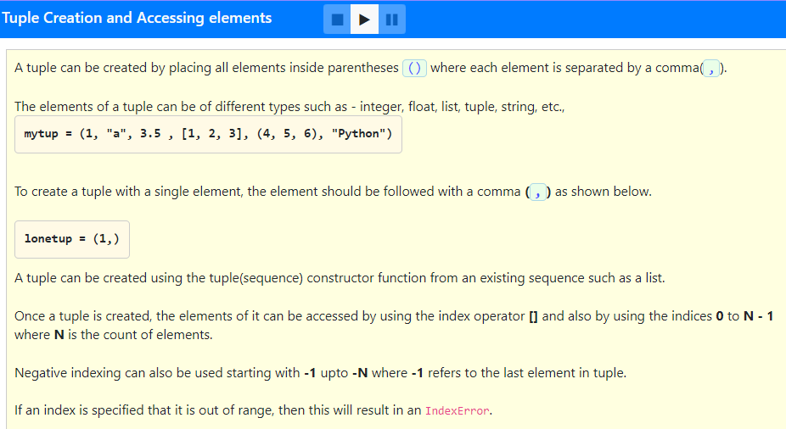

Slide 15
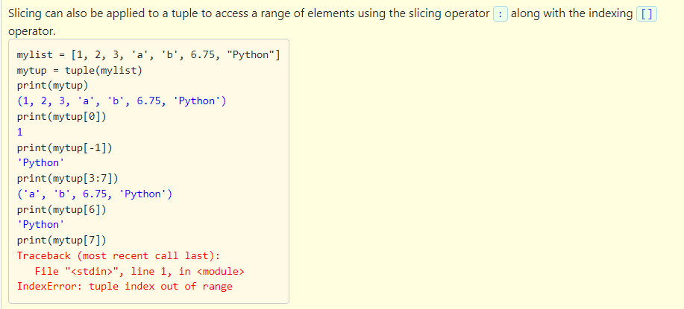

Slide 16
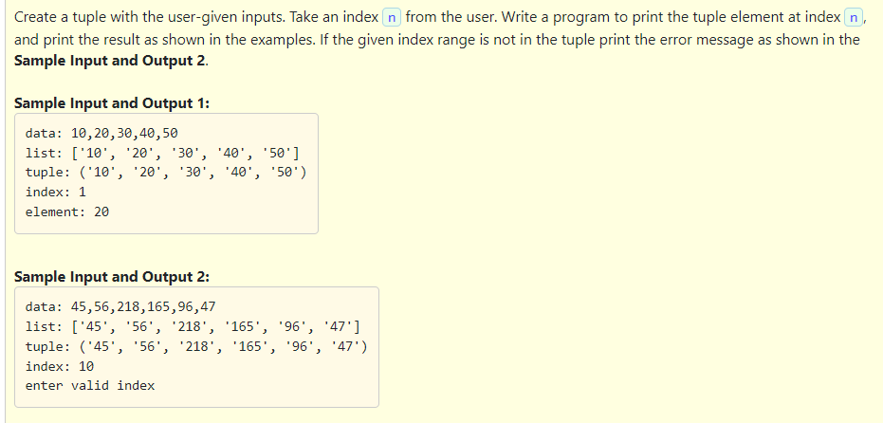

Slide 17
data = input("data: ")
list1 = data.split(",")
print("list:", list1)
mytuple = tuple(list1)
print("tuple:", mytuple)
index = int(input("index: "))
size = len(mytuple)
if index < len(mytuple) and index >= -(size):
value = mytuple[index]
print("element:", value)
else:
print("enter valid index")

Slide 18
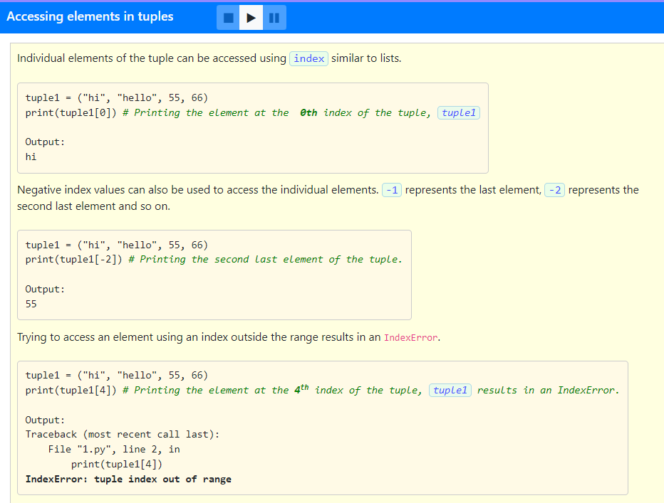

Slide 19
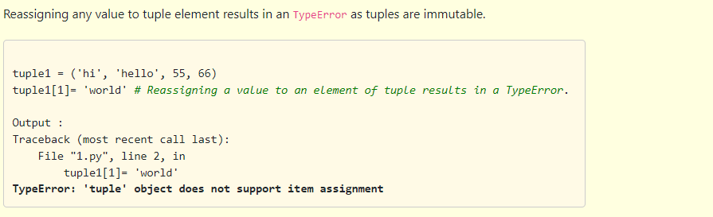
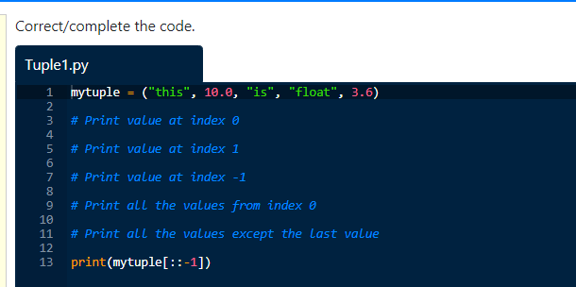
Write the missing code in the below program and understand the result. Follow the instructions given below

Slide 20
Solution:
mytuple = ("this", 10.0, "is", "float", 3.6)
print(mytuple[0])
print(mytuple[1])
print(mytuple[-1])
print(mytuple[0:])
print(mytuple[:-1])
print(mytuple[::-1])

Slide 21
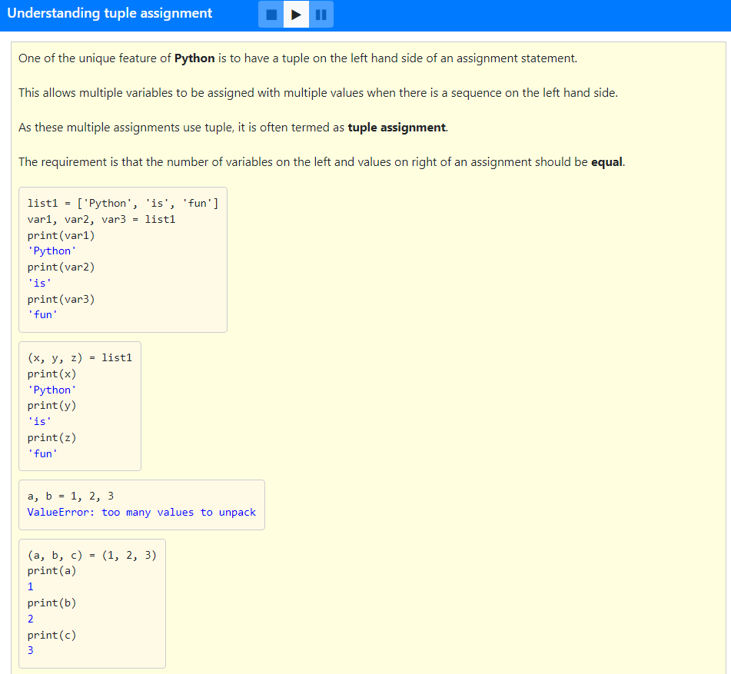
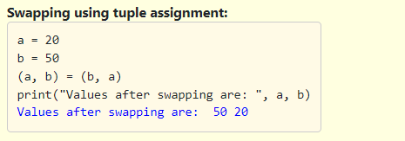

Slide 22
Which of the following option is correct?
1. The output of the following code: ('ac') * 2 is ('ac', 'ac’).
2. The output of the following code: ('ac',) * 2 is ('ac', 'ac’).
3. (1, 2, 3) > (1, 0, 3) is True.
4. t1 = tuple({1:10, 2:20}) will result in (10, 20).
1 and 2
2 and 3
3 and 4
1 and 4

Slide 23
Which of the following option is correct?
1. The output of the following code: ('ac') * 2 is ('ac', 'ac’).
2. The output of the following code: ('ac',) * 2 is ('ac', 'ac’).
3. (1, 2, 3) > (1, 0, 3) is True.
4. t1 = tuple({1:10, 2:20}) will result in (10, 20).
1 and 2
2 and 3
3 and 4
1 and 4

Slide 24
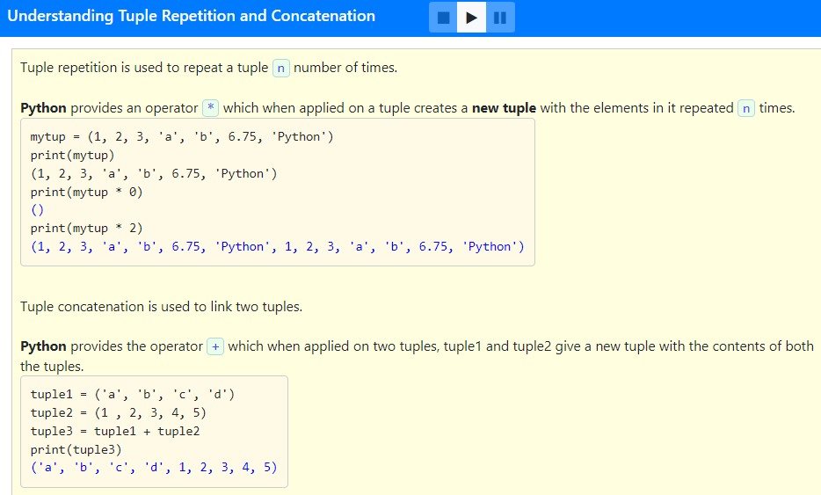

Slide 25
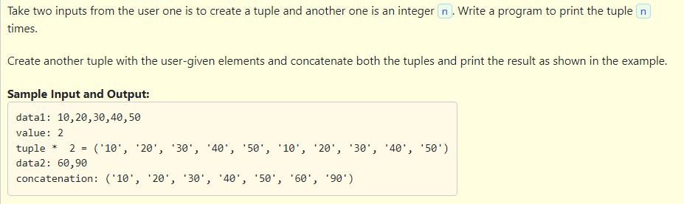

Slide 26
Solution:
data = input("data1: ")
list1 = data.split(",")
tuple1 = tuple(list1)
val = int(input("value: "))
print("tuple * ", val, "=", tuple1 * val)
data2 = input("data2: ")
list2 = data2.split(",")
tuple2 = tuple(list2)
print("concatenation:", tuple1 + tuple2)

Slide 27
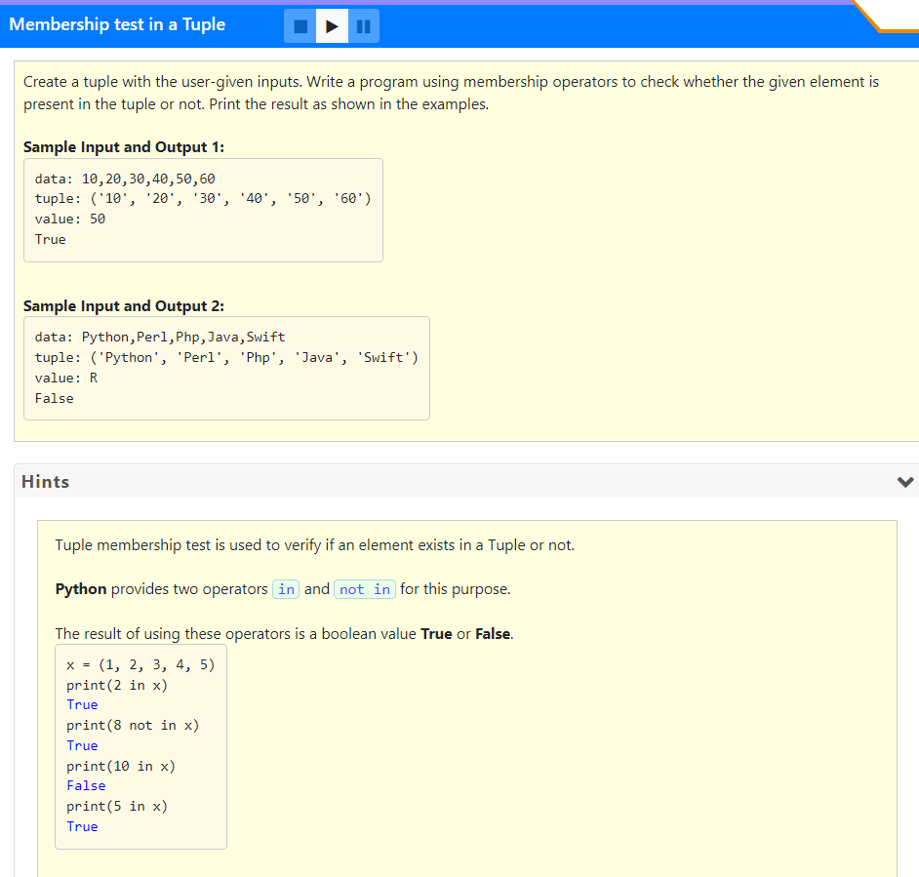

Slide 28
data = input("data: ")
list1 = data.split(",")
tuple1 = tuple(list1)
print("tuple:", tuple1)
val = input("value: ")
if val in tuple1:
print("True")
else:
print("False")

Slide 29
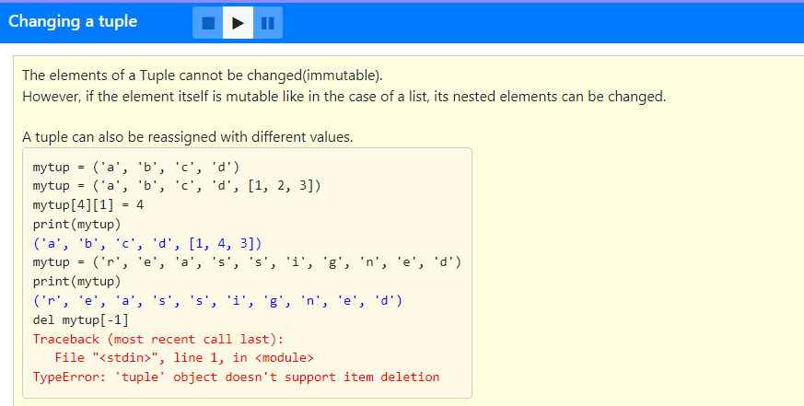

Slide 30
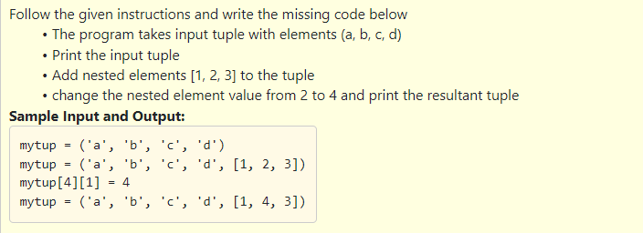
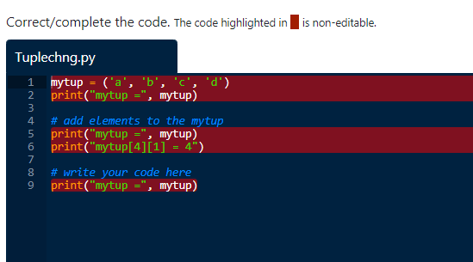

Slide 31
Solution:
mytup = ('a', 'b', 'c', 'd')
print("mytup =", mytup)
mytup = ('a', 'b', 'c', 'd', [1, 2, 3])
print("mytup =", mytup)
print("mytup[4][1] = 4")
mytup[4][1] = 4
print("mytup =", mytup)

Slide 32
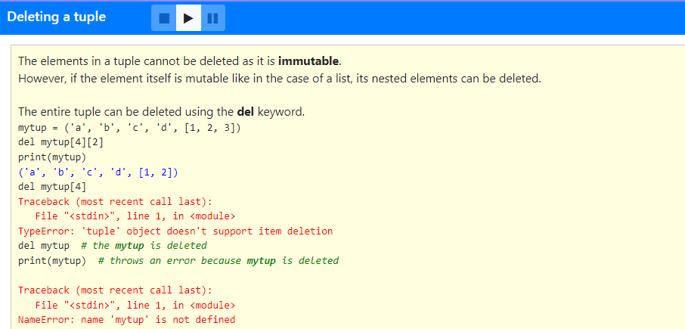

Slide 33
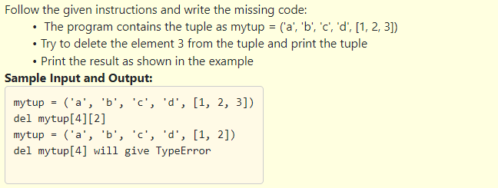
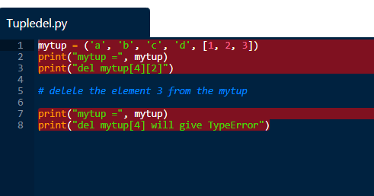

Slide 34
Solution:
mytup = ('a', 'b', 'c', 'd', [1, 2, 3])
print("mytup =", mytup)
print("del mytup[4][2]")
del mytup[4][2]
print("mytup =", mytup)
print("del mytup[4] will give TypeError")

Slide 35
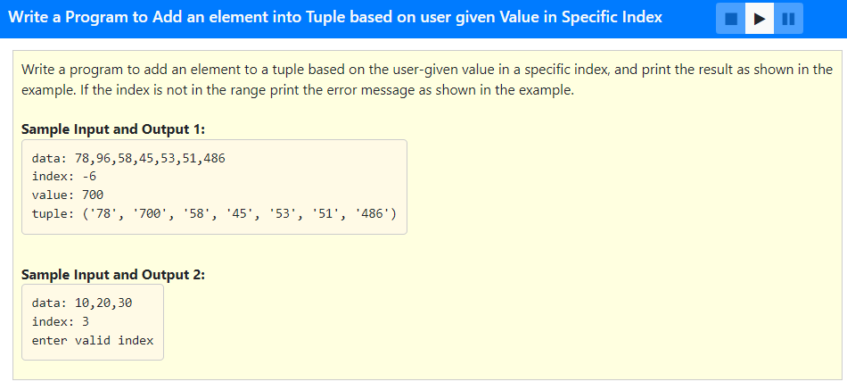

Slide 36
data = input("data: ")
list1 = data.split(",")
tuple1 = tuple(list1)
index = int(input("index: "))
list2 = []
if index < len(list1) and len(list1) >= -(index):
value = input("value: ")
list2 = list(tuple1)
list2[index] = value
tuple2 = tuple(list2)
print("tuple:", tuple2)
else:
print("enter valid index")

Slide 37
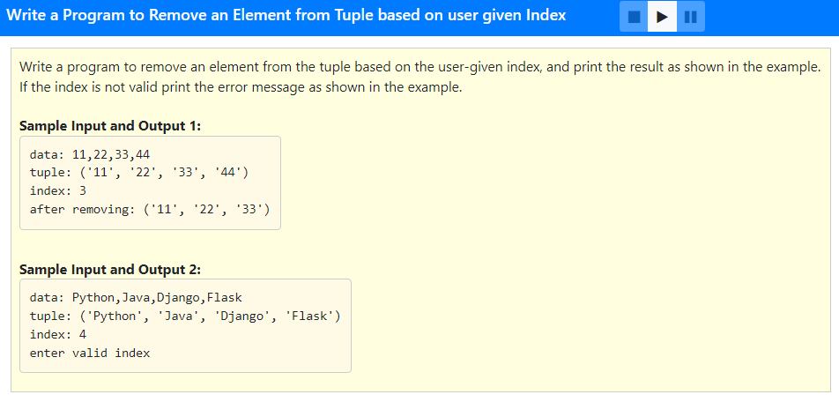

Slide 38
data = input("data: ")
list1 = data.split(",")
tuple1 = tuple(list1)
print("tuple:", tuple1)
index = int(input("index: "))
size = len(tuple1)
if index != -1:
if index < len(tuple1) and index >= -(size):
tuple2 = tuple1[:index] + tuple1[index + 1:]
print("after removing:", tuple2)
else:
print("enter valid index")
else:
print("after removing:", tuple1[:index])

Slide 39
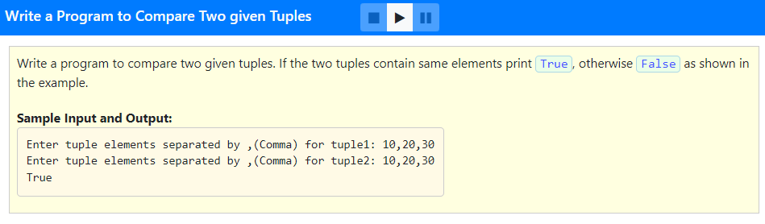

Slide 40
Solution:
data = input("data1: ")
list1 = data.split(",")
tuple1 = tuple(list1)
data1 = input("data2: ")
list2 = data1.split(",")
tuple2 = tuple(list2)
if tuple1 == tuple2:
print("True")
else:
print("False")

Slide 41
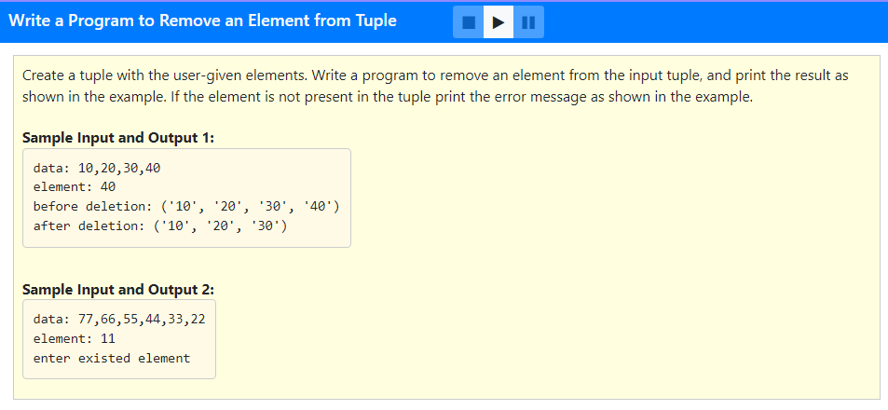

Slide 42
data = input("data: ")
list1 = data.split(",")
val = input("element: ")
tuple1 = tuple(list1)
if val in list1:
list1.remove(val)
tuple2 = tuple(list1)
print("before deletion:", tuple1)
print("after deletion:", tuple2)
else:
print("enter existed element")

Slide 43
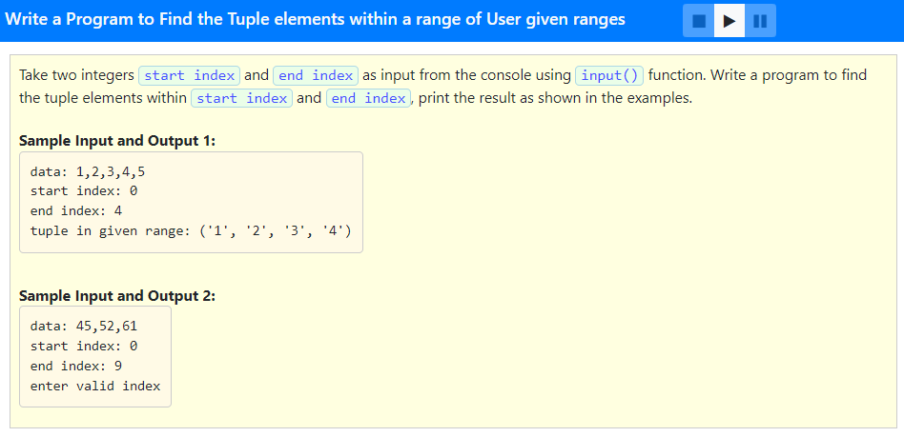

Slide 44
data = input("data: ")
list1 = data.split(",")
tuple1 = tuple(list1)
index1 = int(input("start index: "))
index2 = int(input("end index: "))
size = len(tuple1)
if (size > index1 and size > index2) and (index1 >= -(size) and index2 >= -(size)):
print("tuple in given range:", tuple1[index1:index2])
else:
print("enter valid index")

Slide 45
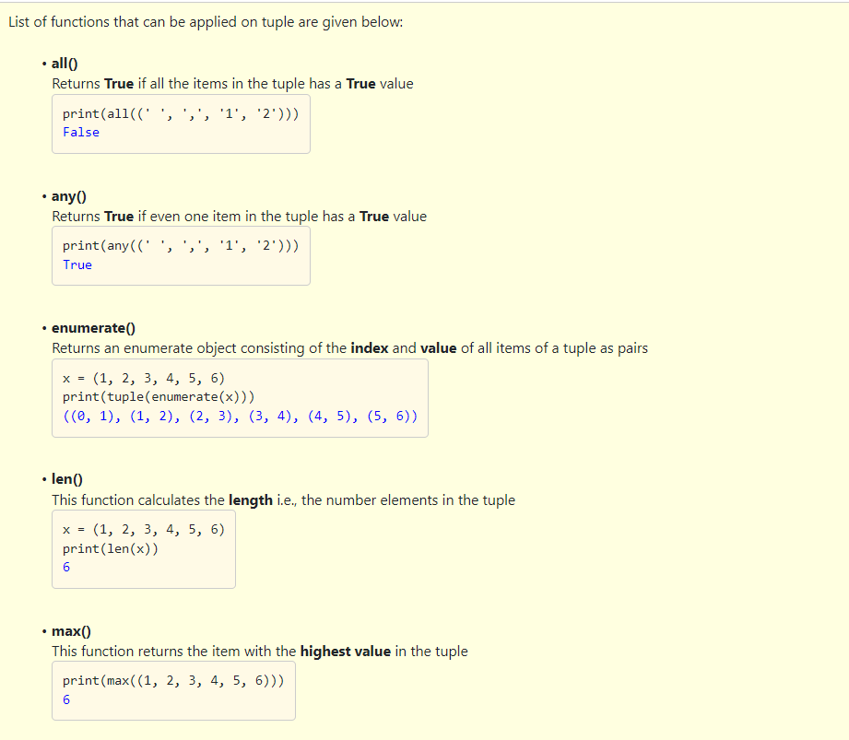

Slide 46
Which of the following option is correct?
enumerate() method starts an index from 0.
any((' ', ' ', ' ', '?')) returns True as output.
any(()) will return True as output.
1 and 2
3 only
2 only
2 and 3

Slide 47
Which of the following option is correct?
enumerate() method starts an index from 0.
any((' ', ' ', ' ', '?')) returns True as output.
any(()) will return True as output.
1 and 2
3 only
2 only
2 and 3

Slide 48
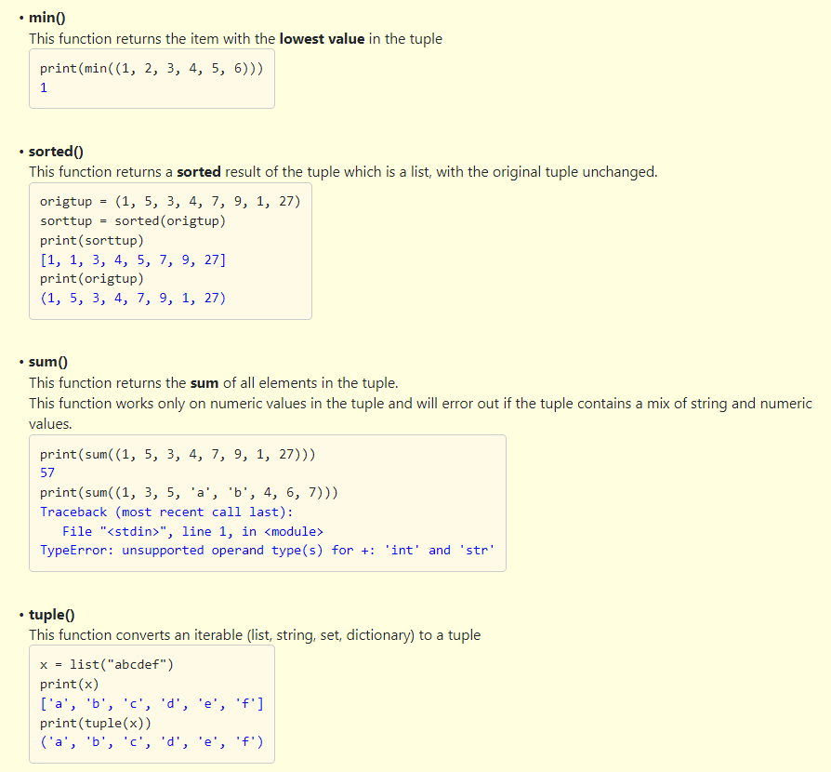

Slide 49
Which of the following option is correct?
t = (3, 1, 2) sorted(t) returns (1, 2, 3).
tuple("hello") returns output as ('h', 'e', 'l', 'l', 'o’)
print(min(("P", "y", "t", "h", "o", "n", " "))) will return output as ' ‘.
1 and 2
2 and 3
1 and 3
1,2 and 3

Slide 50
Which of the following option is correct?
t = (3, 1, 2) sorted(t) returns (1, 2, 3).
tuple("hello") returns output as ('h', 'e', 'l', 'l', 'o’)
print(min(("P", "y", "t", "h", "o", "n", " "))) will return output as ' ‘.
1 and 2
2 and 3
1 and 3
1,2 and 3

Slide 51
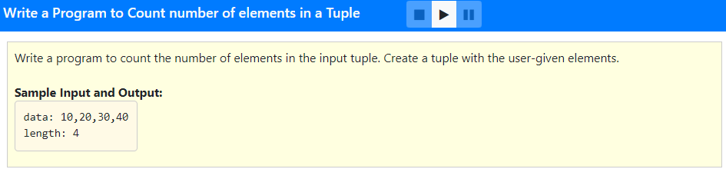

Slide 52
data = input("data: ")
list1 = data.split(",")
tuple1 = tuple(list1)
print("length:", len(tuple1))

Slide 53
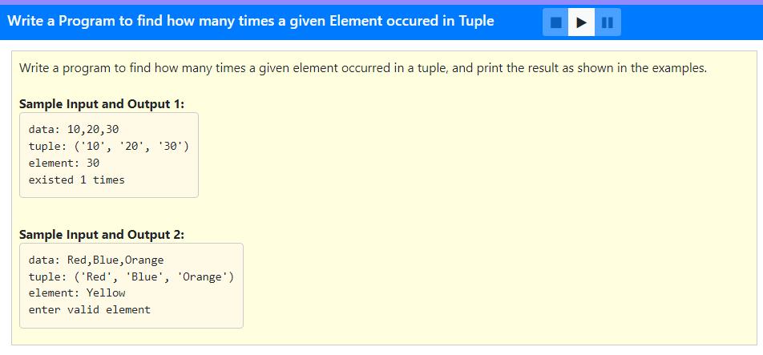

Slide 54
data = input("data: ")
list1 = data.split(",")
tuple1 = tuple(list1)
print("tuple:", tuple1)
value = input("element: ")
if value in tuple1:
counter = tuple1.count(value)
print("existed", counter, "times")
else:
print("enter valid element")

Slide 55
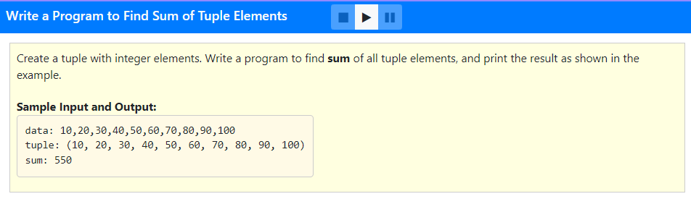

Slide 56
data = input("data: ")
list1 = data.split(",")
for i in range(len(list1)):
list1[i] = int(list1[i])
tuple1 = tuple(list1)
print("tuple:", tuple1)
print("sum:", sum(tuple1))

Slide 57
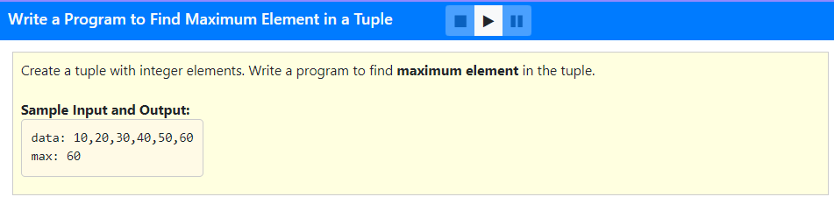

Slide 58
data = input("data: ")
list1 = data.split(",")
for i in range(len(list1)):
list1[i] = int(list1[i])
tuple1 = tuple(list1)
print("max:", max(tuple1))

Slide 59
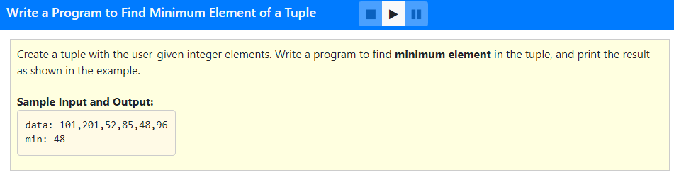

Slide 60
data = input("data: ")
list1 = data.split(",")
for i in range(len(list1)):
list1[i] = int(list1[i])
tuple1 = tuple(list1)
print("min:", min(tuple1))

Slide 61
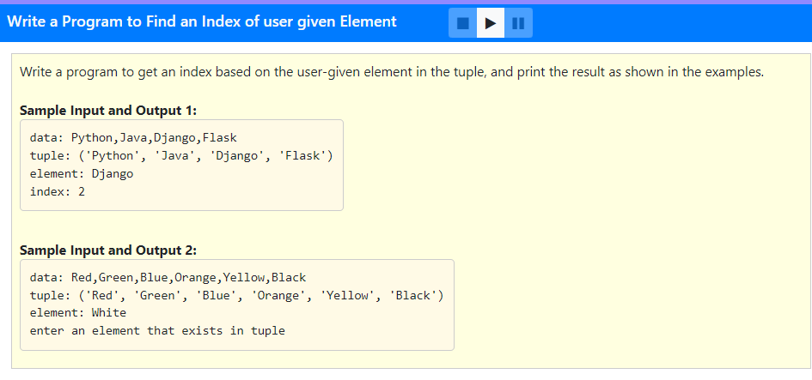

Slide 62
data = input("data: ")
list1 = data.split(",")
tuple1 = tuple(list1)
print("tuple:", tuple1)
element = input("element: ")
if element in tuple1:
index = tuple1.index(element)
print("index:", index)
else:
print("enter an element that exists in tuple")

