Slide 1

TokenMaster- Blockchain Based Ticket Platform
Submitted By:
Rahul Yadav
Roll no.: 21053310
CSE Branch
Submitted To:
Swagatika Sahoo
Assistant Professor
Kiit University

Slide 2
Problem Statement:
Traditional ticketing systems lack transparency, security, and efficiency, creating challenges for both event organizers and ticket buyers in accessing and distributing tickets for events like Bollywood concerts.
There is also an emerging problem of bot buying all the tickets of an event.
This project, TokenMaster aims to solve this problem by integrating the traditional ticket platform with Blockchain Technology and NFT.

Slide 3
What is TokenMaster?
Innovative Ticketing Platform: TokenMaster is a cutting-edge ticketing platform utilizing blockchain technology to enhance transparency and security in ticket transactions.
Decentralized Solution: TokenMaster adopts a decentralized approach, reducing reliance on intermediaries and ensuring fair ticket distribution for events like Bollywood concerts.
NFT Integration: TokenMaster implements non-fungible tokens (NFTs) as digital tickets, offering users unique ownership and preventing scalping.
User-Centric Focus: TokenMaster prioritizes user experience with a user-friendly interface, seamless integration with Metamask, and robust security measures for both buyers and event organizers.

Slide 4
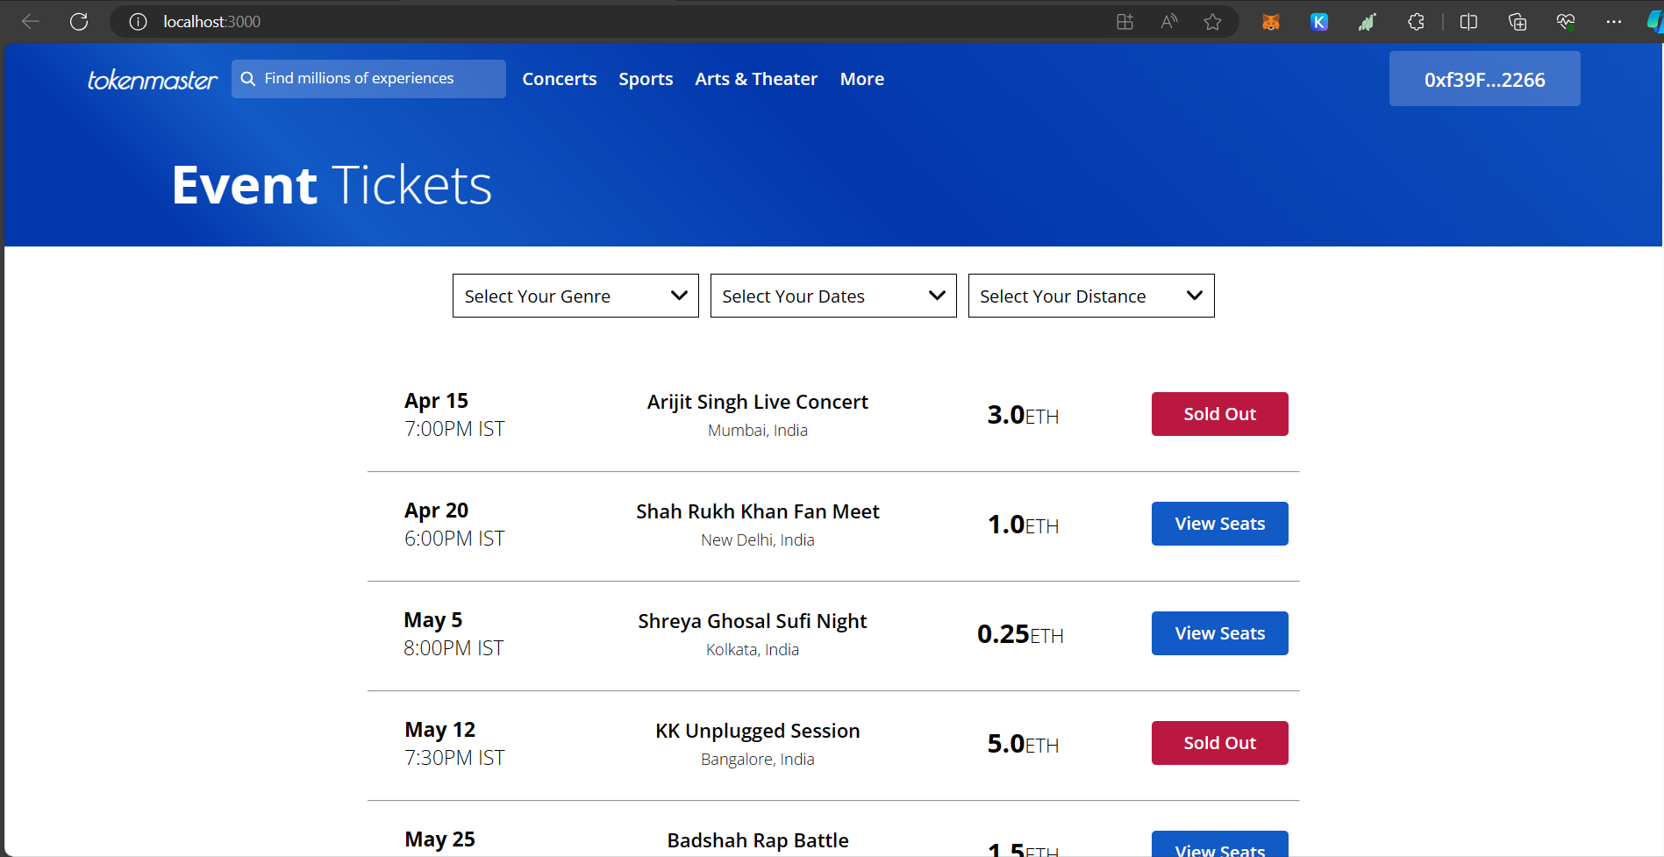
UI of TokenMaster

Slide 5
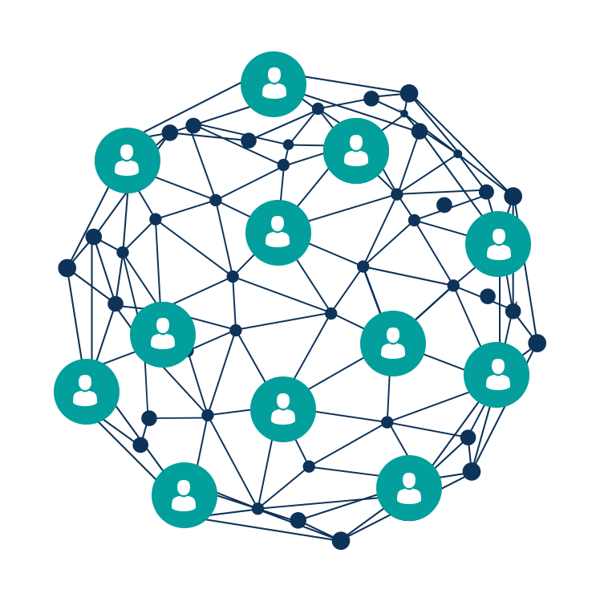
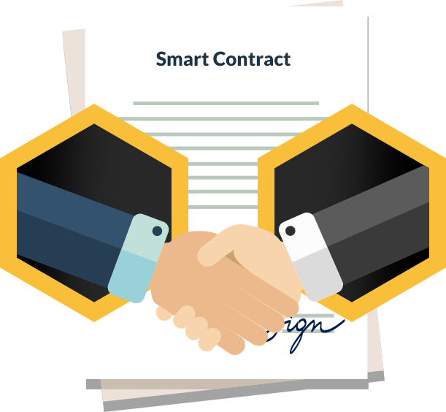
Technologies Used:
Blockchain Technology: Blockchain is a decentralized digital ledger that records transactions across multiple computers or nodes. It ensures transparency, security, and immutability in ticket transactions by organizing data into blocks linked together in a chain.
Smart Contracts: Smart contracts are self-executing contracts with the terms encoded directly into software. They automate and enforce agreements without the need for intermediaries, providing trustless and tamper-resistant transactions.

Slide 6
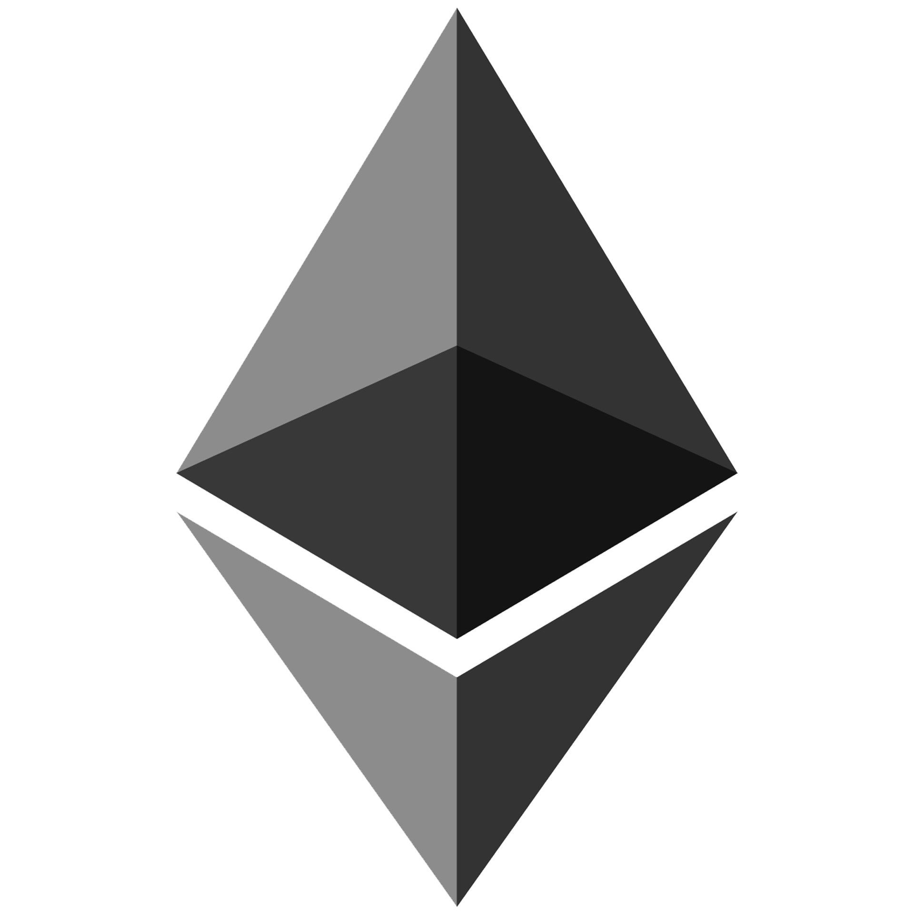

Technologies Used:
3.Ethereum: Ethereum is a decentralized platform that enables the development of decentralized applications (DApps) and smart contracts. It uses its native cryptocurrency, Ether, for transaction fees and incentivizing network participants.
4.React: React is a JavaScript library for building user interfaces. It allows developers to create reusable UI components that dynamically update in response to data changes, providing a flexible and scalable framework for frontend development.

Slide 7

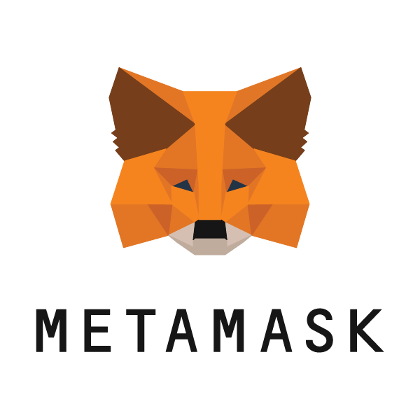
Technologies Used:
5. Hardhat: Hardhat is a development environment for Ethereum smart contracts, providing tools for compiling, testing, and deploying contracts. It streamlines the smart contract development process and enhances productivity for Ethereum developers.
6. Metamask: Metamask is both a cryptocurrency wallet and a browser extension that enables users to interact with Ethereum-powered applications directly through their web browsers. It simplifies the user experience for managing Ethereum accounts and interacting with DApps.

Slide 8
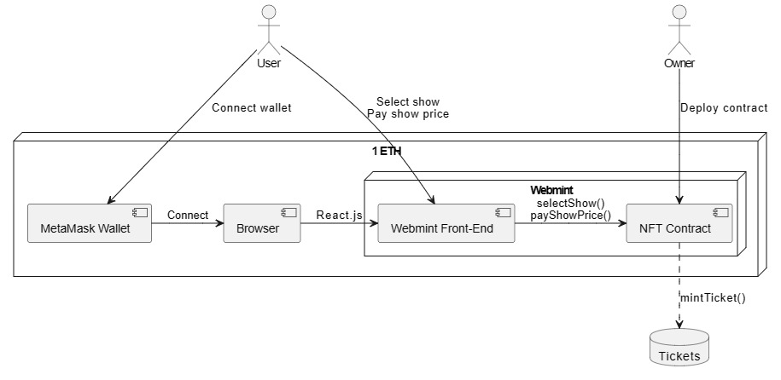
Block Daigram:

Slide 9
Workflow of TokenMaster
Connect Metamask Wallet:
User accesses the TokenMaster platform and connects their Metamask wallet to the frontend interface.
Metamask prompts the user to sign in or connect their Ethereum account securely.
Select Event:
User browses through the available events listed on the TokenMaster platform.
They select the event of their choice, such as a Bollywood concert, from the list of available options.
Payment Process:
Upon selecting the event, the user is presented with ticket options and pricing details.
The user chooses the desired ticket quantity and proceeds to the payment process.
Metamask prompts the user to confirm the transaction and pay the required balance using their Ethereum account.

Slide 10
Workflow of TokenMaster
Transaction Verification:
Once the payment is initiated, the transaction is broadcasted to the Ethereum network for verification.
Smart contracts on the Ethereum blockchain validate the transaction and verify the payment details.
NFT Ticket Minting:
After successful verification of the transaction, smart contracts initiate the minting process for the user's ticket.
A unique non-fungible token (NFT) representing the ticket is generated and minted on the Ethereum blockchain.
Storage in Metamask Wallet:
The minted NFT ticket is securely stored in the user's Metamask wallet.
The user can access their NFT ticket at any time through their Metamask wallet, providing them with proof of ownership.

Slide 11
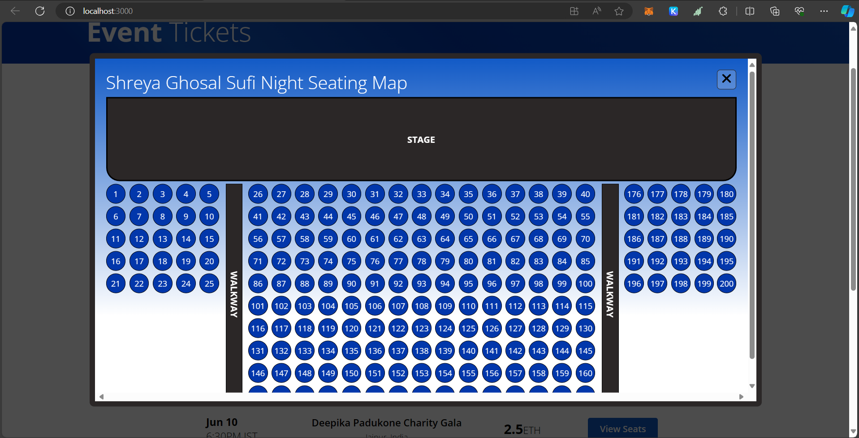
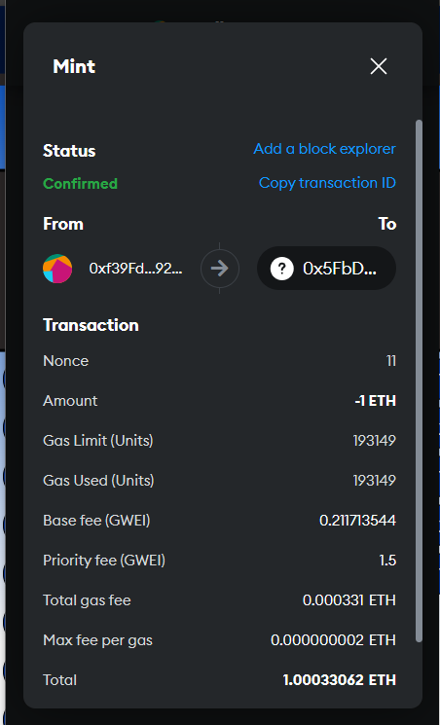
Workflow of TokenMaster

Slide 12
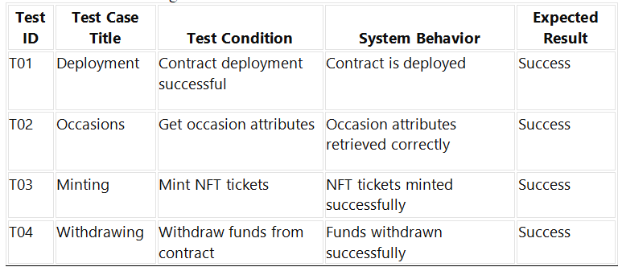
Testing of Smart Contract
The testing of the smart contract is done with the help of chai library of hardhat and the table given below shows the result.

Slide 13
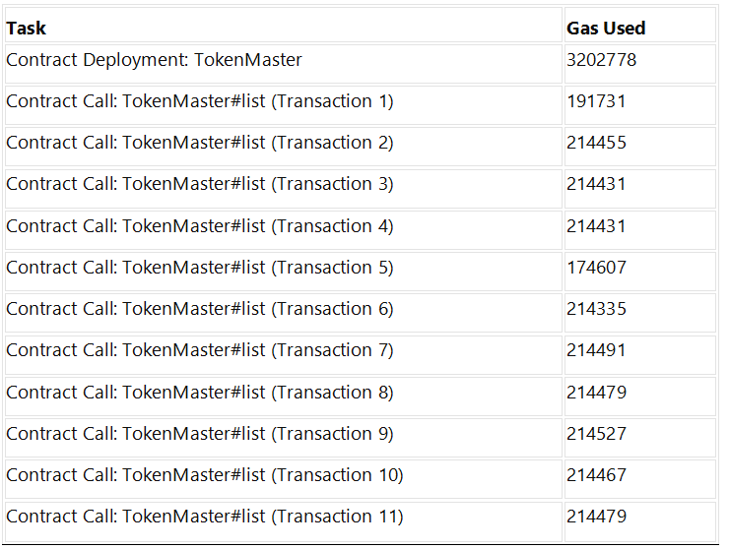
Estimated Gas Consumption in the deployment of Smart Contract
The smart contract is deployed in the local host using hardhat node. The table given below shows the estimated gas compution.

Slide 14
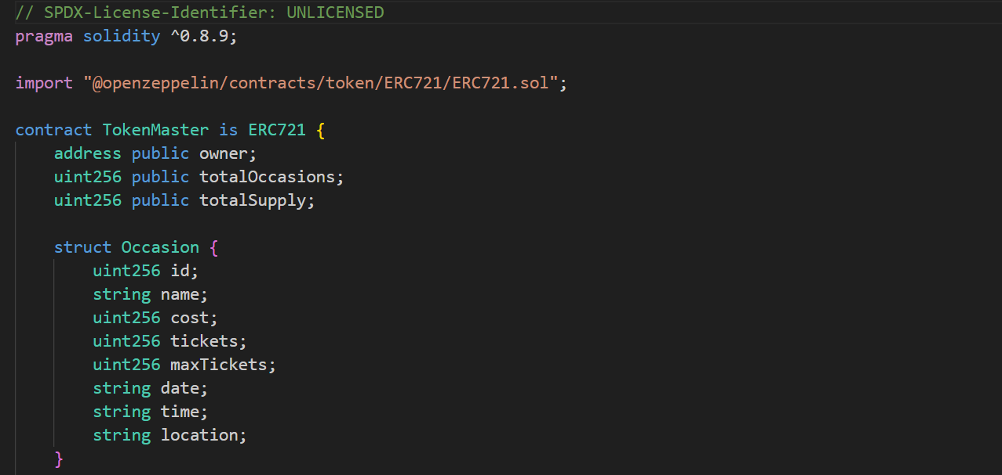
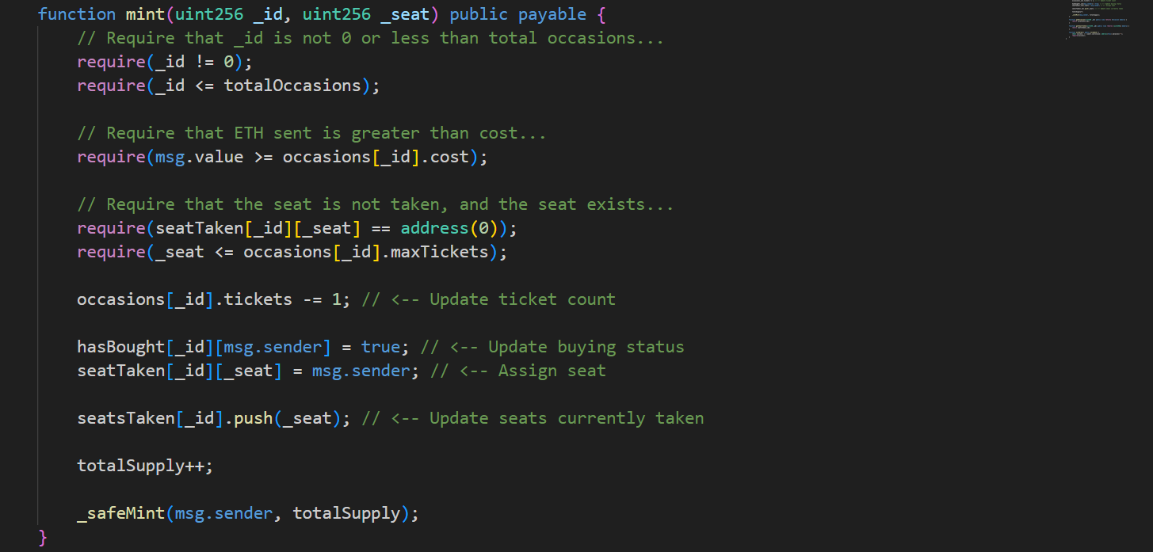
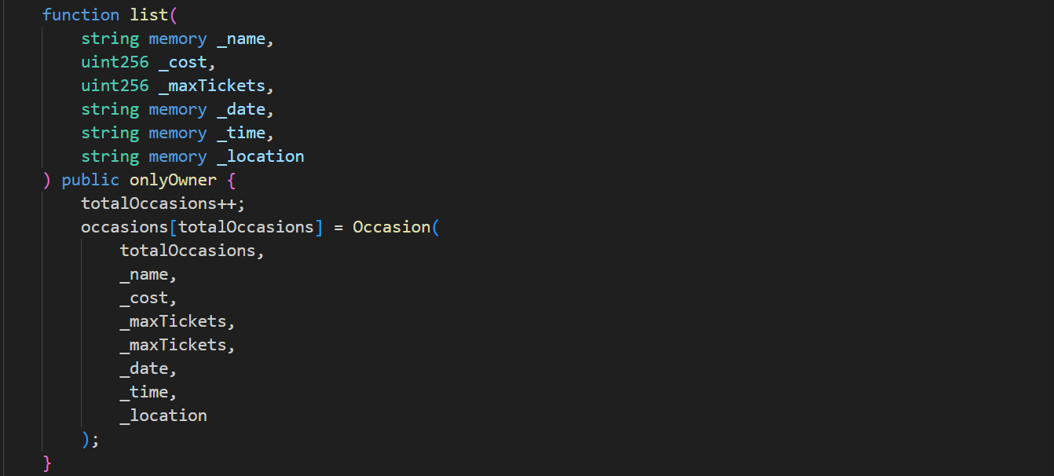
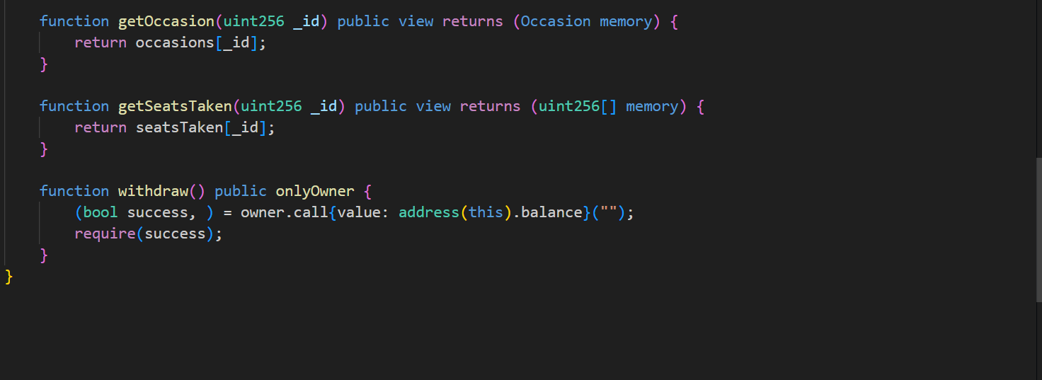
Code Snippet of Smart Contract

Slide 15
Procedure of Project Development
Gather Requirements: Collect detailed requirements from various sources, including research papers and documentaries, to understand the challenges faced by traditional ticketing systems and the needs of event organizers and ticket buyers.
Define Features: Identify essential features and functionalities of the ticketing platform, such as ticket purchase, NFT minting, single booking per account, and Metamask integration.
Prioritize Features: Determine the priority of features based on their importance and feasibility, with a focus on introducing blockchain to ensure transparency in the ticketing process.
Create a Development Plan: Outline a timeline, milestones, and resources required for the project, including tasks such as smart contract development, frontend development, and integration with Metamask.

Slide 16
Procedure of Project Development
Smart Contract Development: Develop smart contracts using Solidity, the programming language for Ethereum smart contracts. These contracts manage ticket bookings, NFT minting, and transaction handling.
Frontend Development: Build the frontend interface of the ticketing platform using React, allowing users to browse events, purchase tickets, and interact with smart contracts seamlessly.
Integration with Metamask: Integrate Metamask into the frontend to provide users with a seamless experience for interacting with Ethereum-based applications, enabling secure ticket purchases using Metamask wallets.
Testing: Conduct thorough testing of smart contracts using the Chai library of Hardhat, executing various test cases to ensure the correctness and reliability of smart contract functionalities.

Slide 17
Procedure of Project Development
Result Analysis: Analyze the test results to evaluate the efficiency of smart contract deployment and function calls, providing insights into gas consumption and overall performance.
Deployment: Deploy the TokenMaster platform, including smart contracts and frontend interface, to a test network for further testing and validation.
Feedback and Iteration: Gather feedback from users and stakeholders, identify areas for improvement, and iterate on the project to enhance functionality, usability, and security.
Final Deployment: Deploy the finalized version of the TokenMaster platform to the main Ethereum network for production use, providing users with a transparent, secure, and efficient ticketing experience for Bollywood concerts.

Slide 18
Conclusion
TokenMaster revolutionizes the ticketing industry through blockchain technology, enhancing transparency and security.
Its user-centric design ensures a seamless ticket purchasing experience and secure storage of NFT tickets.
Leveraging advanced technologies like Ethereum smart contracts and Metamask integration, TokenMaster sets a new standard for ticketing platforms.
With a focus on future growth and innovation, TokenMaster is poised to expand globally and introduce further enhancements, cementing its position as a leader in blockchain-based ticketing solutions.

Slide 19
Future Work
Enhanced Features Exploration: Investigate options like interactive seating charts, real-time event updates, or integrated event reviews to enrich the user experience.
Integration with Emerging Technologies: Explore integrating emerging tech like decentralized finance (DeFi) protocols for ticket financing or artificial intelligence for personalized event recommendations.
Market Expansion Strategy: Develop plans to expand beyond Bollywood concerts into other sectors like sports events, theater performances, or conferences, broadening the platform's audience.
Continuous Platform Improvement: Commit to regular updates and refinements based on user feedback and technological advancements to stay competitive and meet evolving market demands.

Slide 20


