Slide 1
IO-Link
By
Rahul Patil

Slide 2
Agenda
Industrial Evolution
Industry 3.0
Automation pyramid
Process automation
Sensor/Actuator evolution
Analog signal interface
4-20mA current loop
Digital signal interface
IO-Link
Automation pyramid to pillar/Industry 3.0 to 4.0 transition

Slide 3
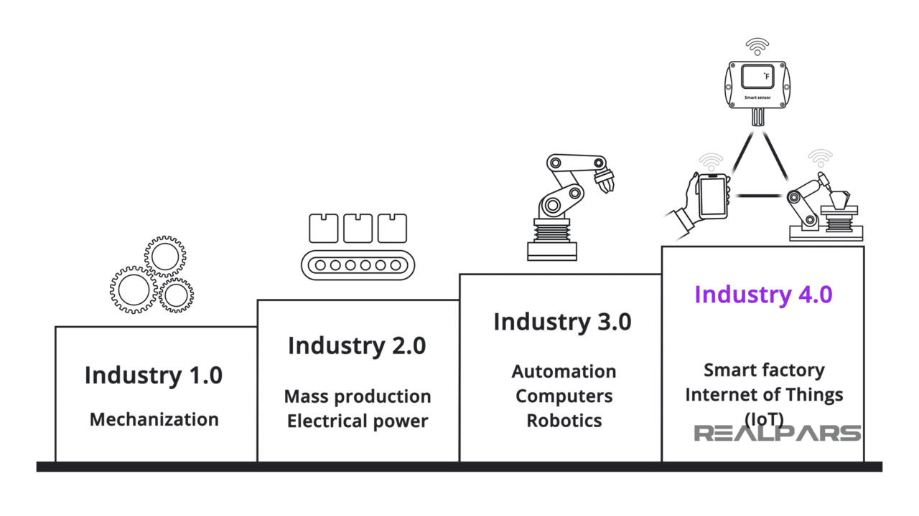
Industrial Evolution
1969
Today
1870
1784

Slide 4
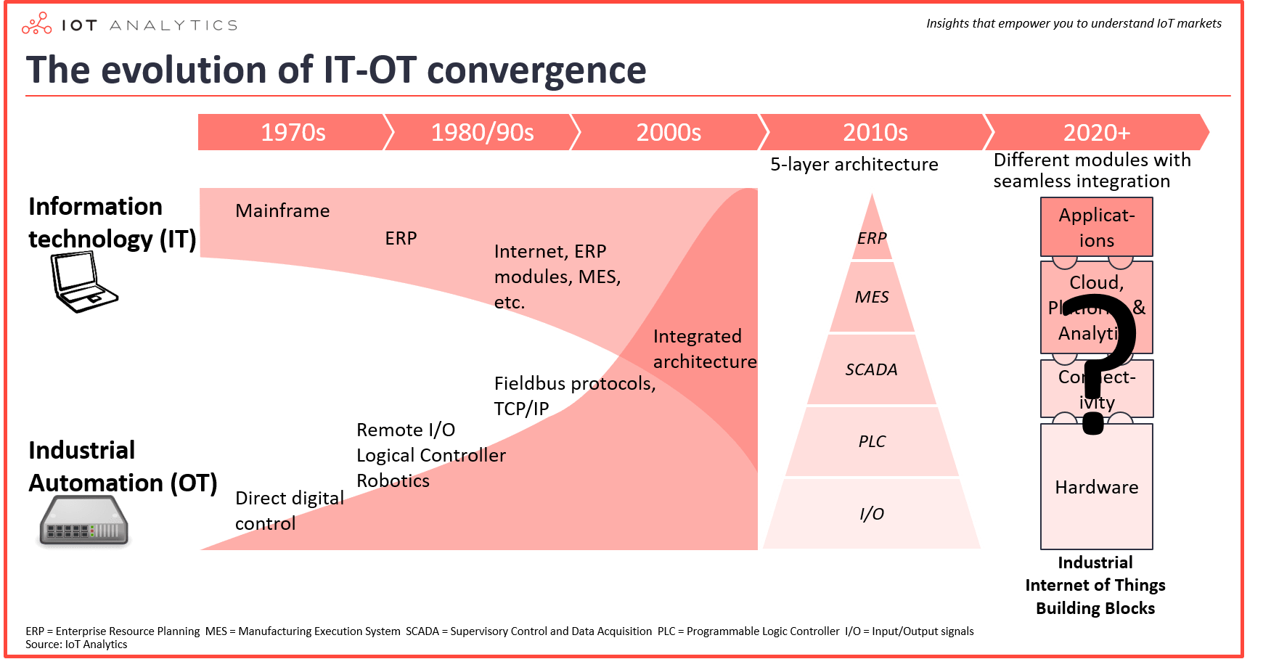
Industry 3.0

Slide 5
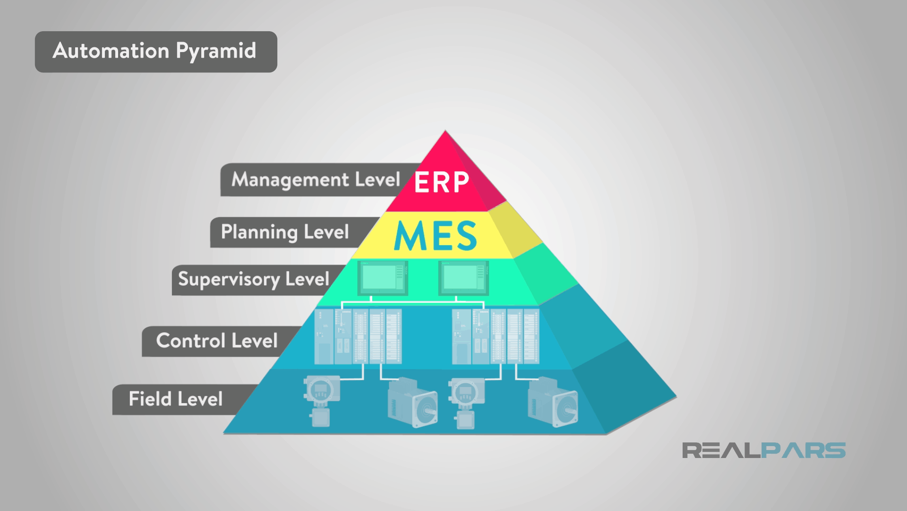
Automation pyramid

Slide 6
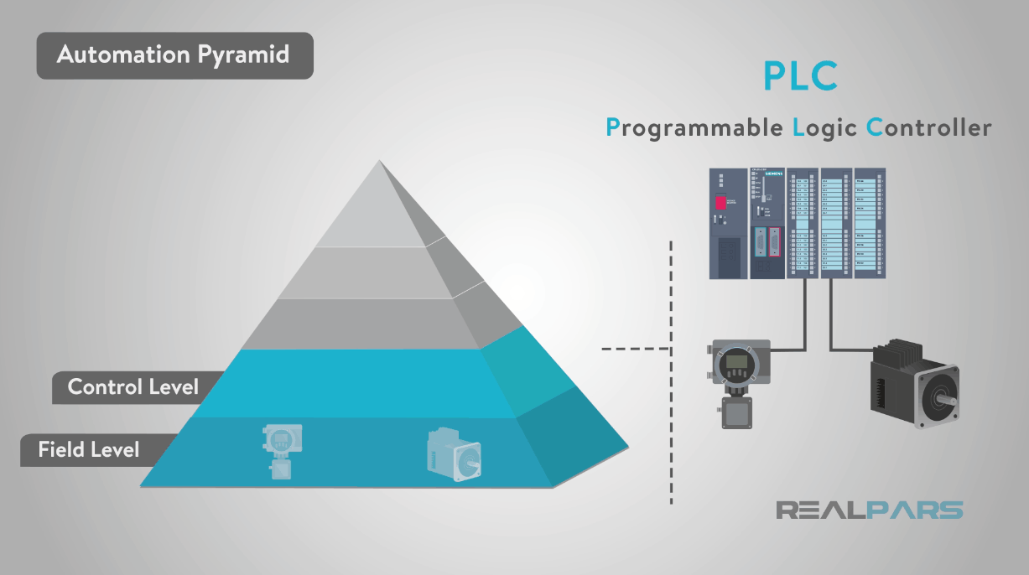
Process automation

Slide 7
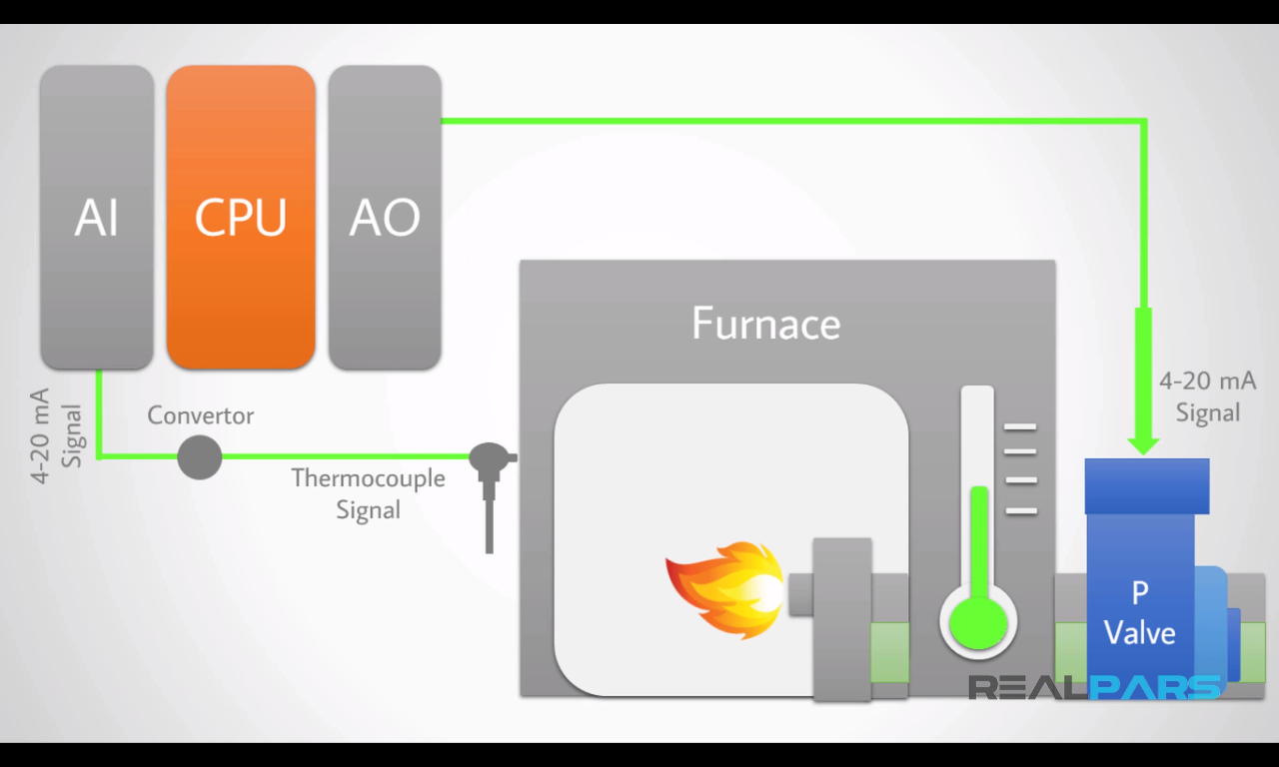
Process automation example

Slide 8
Sensor interface evolution
Analog signal interface
4-20 mA(1950)
0-10 V
Digital data over analog signal interface
HART protocol(1980)
Digital signal interface
IO-Link(2005)

Slide 9
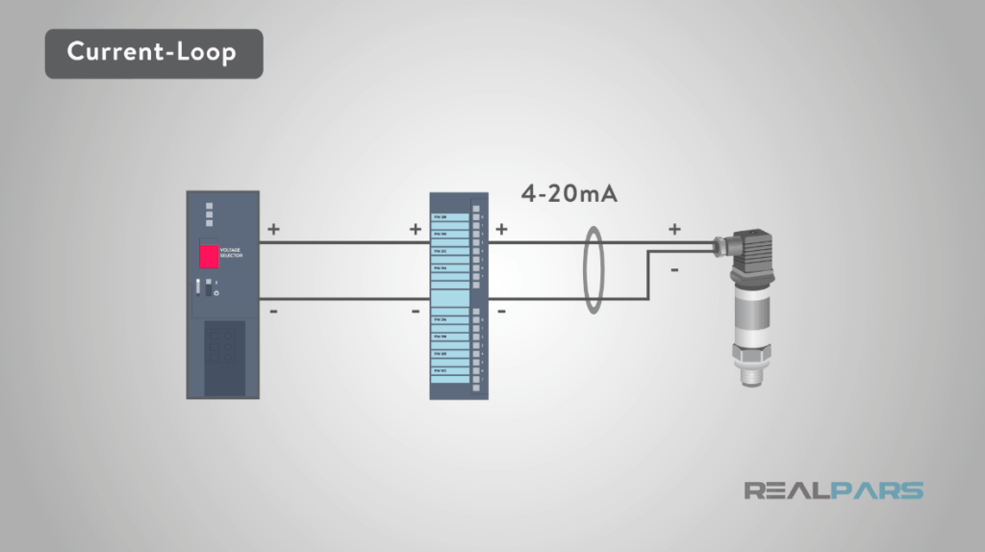
4-20mA current loop

Slide 10
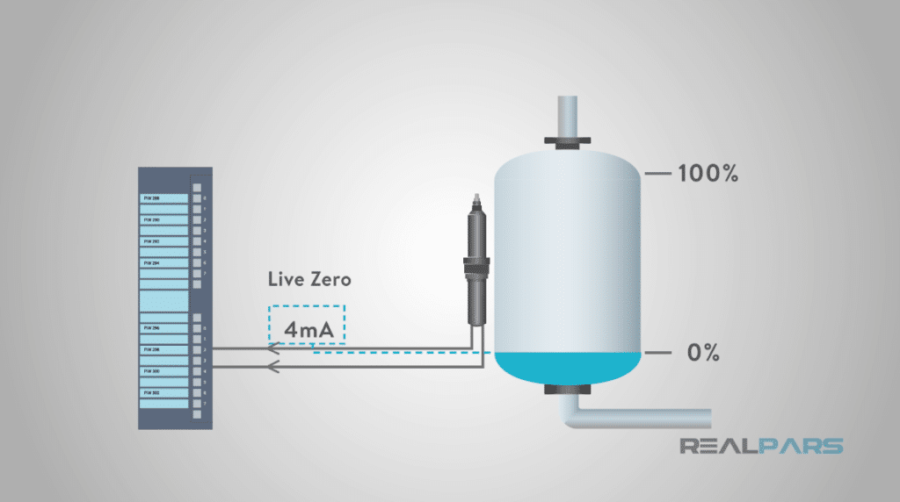
4-20 mA current loop: Live Zero

Slide 11
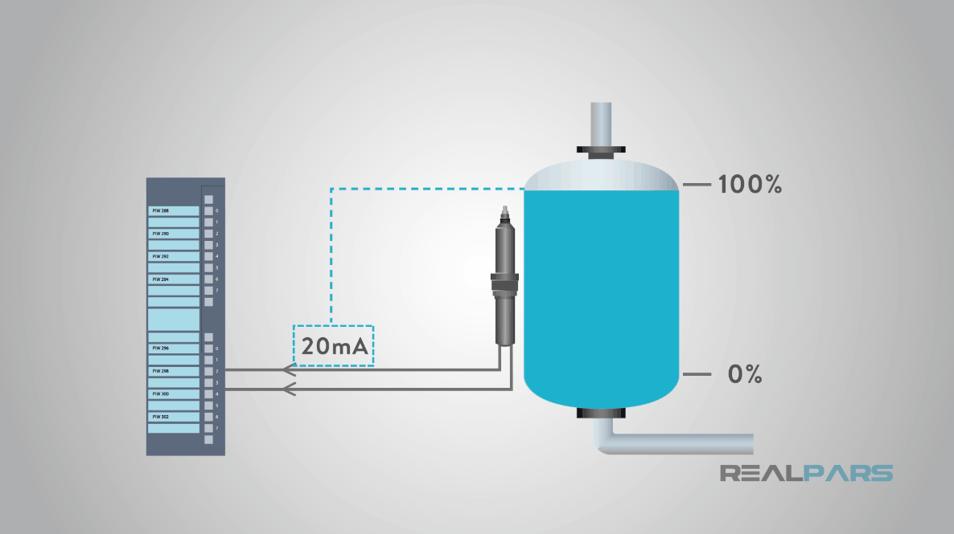
4-20 mA current loop: 100%

Slide 12
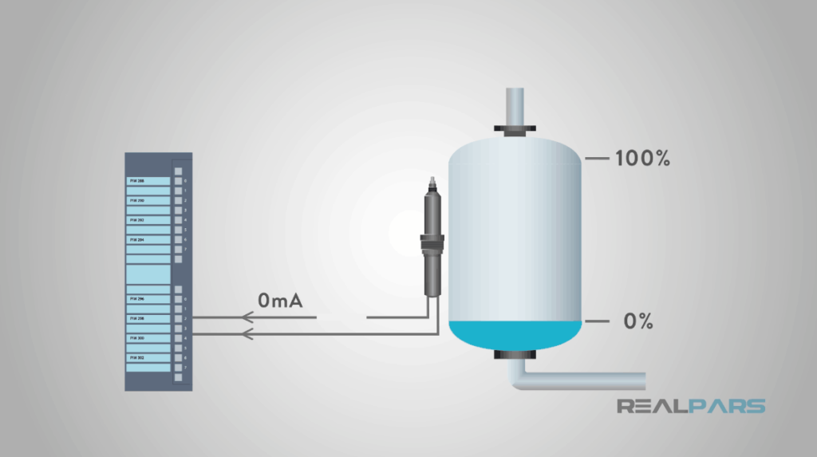
4-20 mA current loop: Diagnostic info

Slide 13
Sensor interface evolution
Analog signal interface
Digital data over analog signal interface
HART protocol(1980)
Digital signal interface
IO-Link(2005)

Slide 14
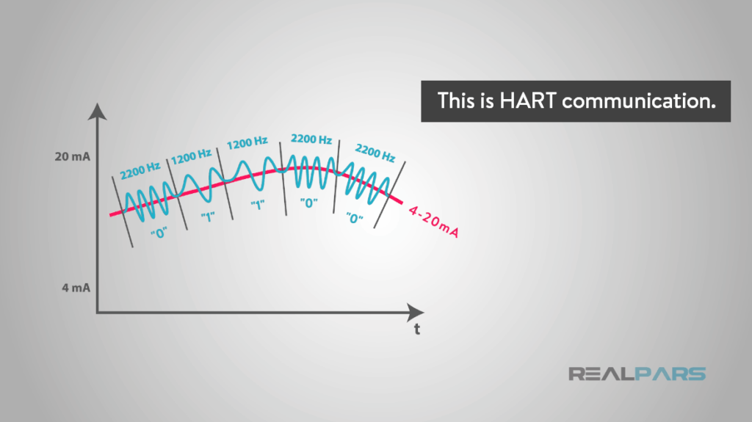
HART: Digital data over analog signal

Slide 15
4-20mA current loop

Slide 16
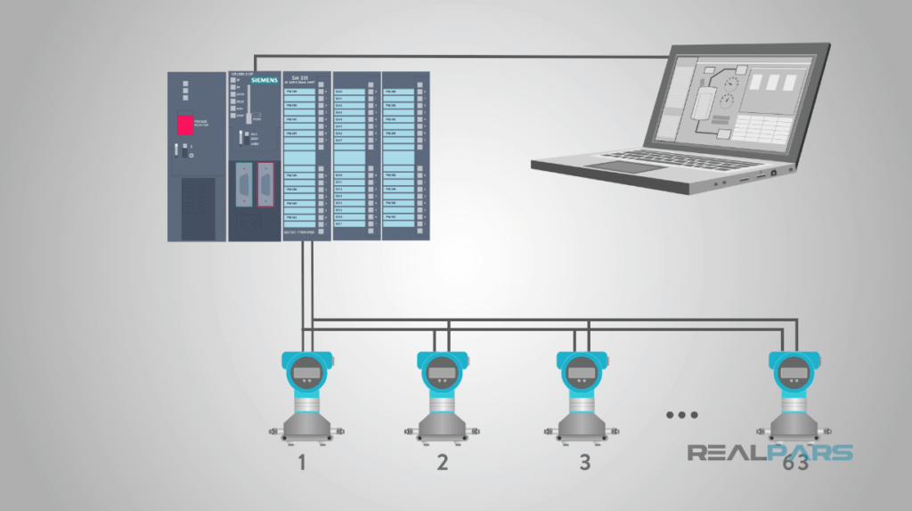
HART is Bus.

Slide 17
Sensor interface evolution
Analog signal interface
Digital data over analog signal interface
Digital signal interface
IO-Link(2005)
1.0(2008)
1.1(2013)

Slide 18
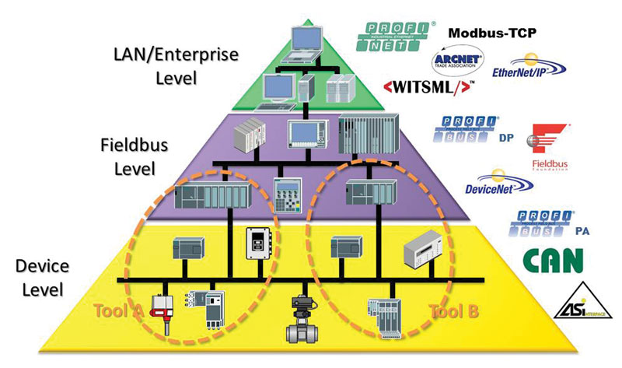
Fieldbuses

Slide 19
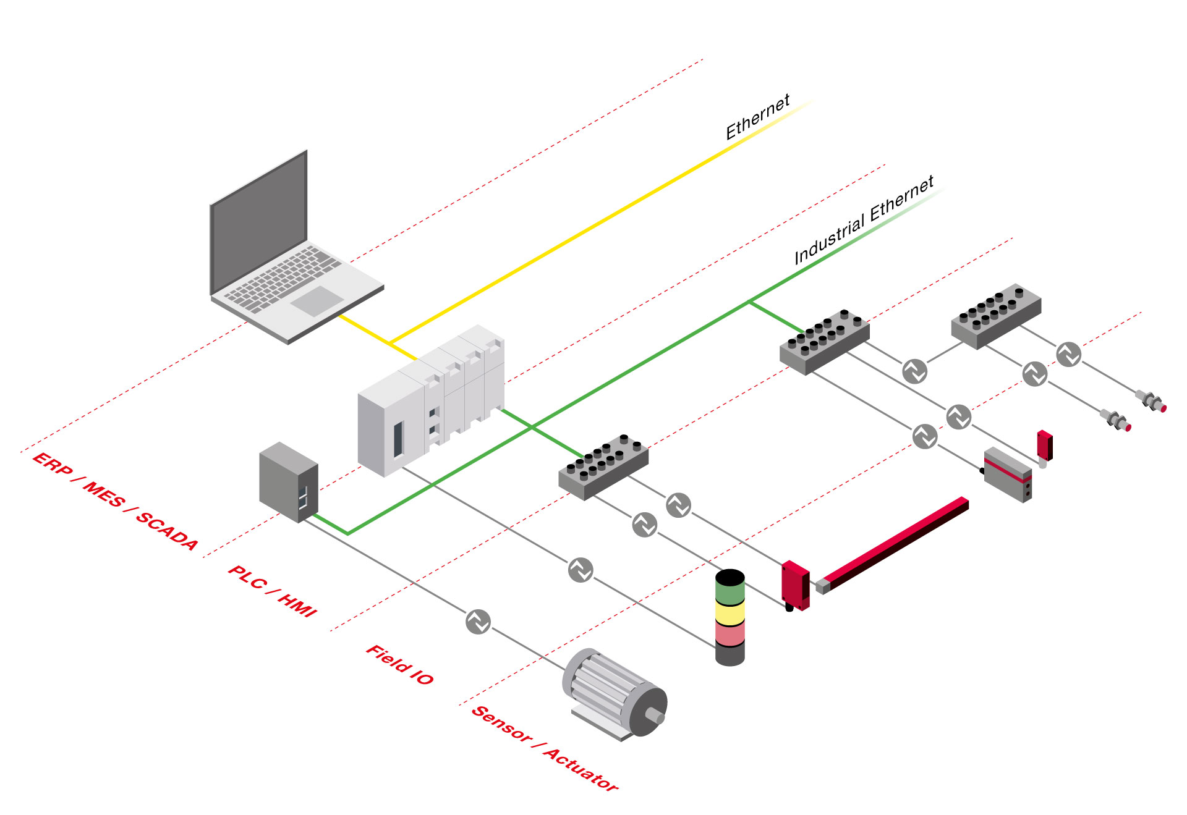

Slide 20
What is IO-Link
1st worldwide standardized IO technology for sensors and actuators
IO-Link is tradename
Standardized as SDCI in IEC
Single drop Digital Communication Interface
WHY now?
Special IO module need to be installed on PLC side increasing cost
Earlier interfaces are not able to communicate with higher speed
Heterogenous wiring
inventory need to be managed for all types of cables
increase in cost
Time consuming manual parameterization of same kind of Devices
Unavailability of diagnostic/event data with other interfaces
To eliminate above weaknesses open interface is defined for sensors and actuators called as IO-Link.

Slide 21
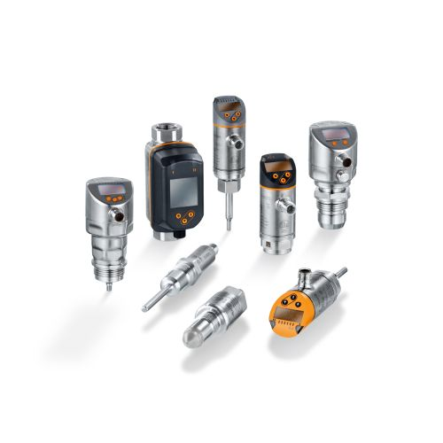
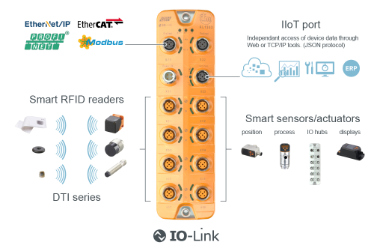
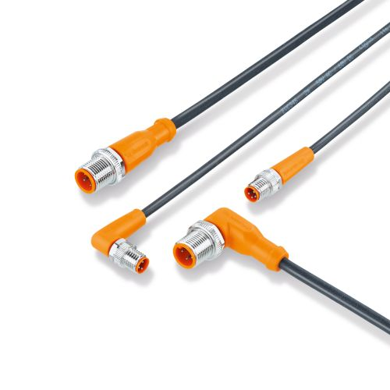
Components of IO-Link

Slide 22
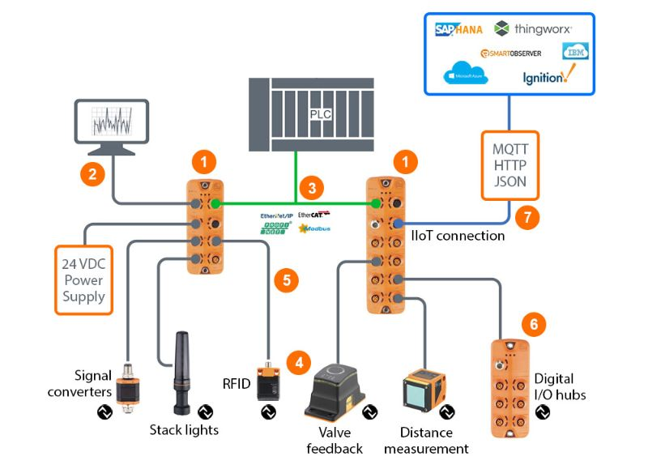
IO-Link with ifm

Slide 23
IO-Link: Physical Layer
Point to point serial communication over USART
0-24 V digital communication over 20 m long cables
Speed
COM1 = 4.8kbps
COM2 = 38.4kbps
COM3 = 230.4kbps
3-wire unshielded cable
2 wires for power supply
1 wire for data communication(COM)/Switching Input output(SIO)
M5, M8 and M12 standard connectors

Slide 24
IO-Link: Data categories
Identification and communication parameters
Mandatory page parameters
Device specific data/Device parameters
Standard parameters
Vendor specific parameters
Diagnostic data
Standard errors
Standard events
Vendor specific events
Process data
PDIn and PDOut data
PD status
Event indication flag

Slide 25
IO-Link offers a lot!
Master support
AI, AO, DI, DO and IO-Link on same port
Retrofits into current PLC infra structure
Opens IT interaction: under edge-to-cloud architecture
Device replacement
Identical
Common profile from different vendor
Standardization in low cost cables
M5, M8, M12 in Port class A and B
D to A and A to D conversions are not needed
Burst/block parameterization for faster parameterization
Diagnostic information:
Inventory management
helps in predictive maintenance
avoid shutdowns and increases uptime

Slide 26
IOL configuration software
IO-Link Studio
LR device
Moneo
Quick look
Moneo config mobile app
Smart observer
IODD package
IODD: IO device description file
Device identification information
Default values of parameters
Range of every parameter
All standard and vendor specific parameters
IOL Device image
Language file

Slide 27
IO-Link future scope
IO-Link wireless
Classic physical layer is replaced by wireless technology
IO-Link over SPE
Classic PL will be replaced by new ethernet standardization called as SPE
IO-Link safety
IO-Link for safety applications

Slide 28
IO-Link with ifm

Slide 29
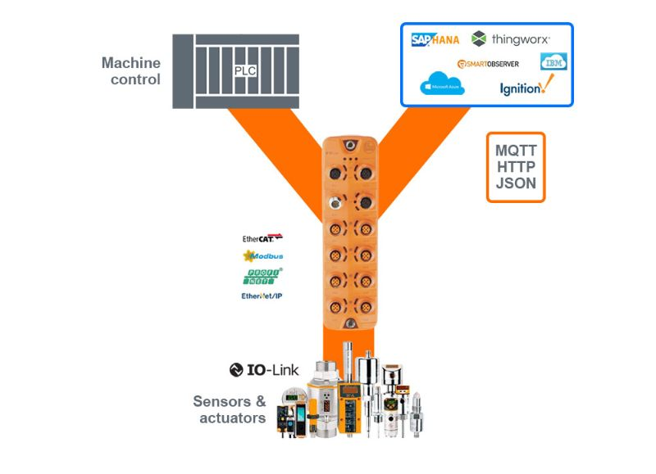
IO-Link: Y-Path
Notes:
https://www.ifm.com/us/en/shared/technologies/io-link/y-path-connection-for-iiot-solutions/y-path-connection-for-iiot-solutions

Slide 30
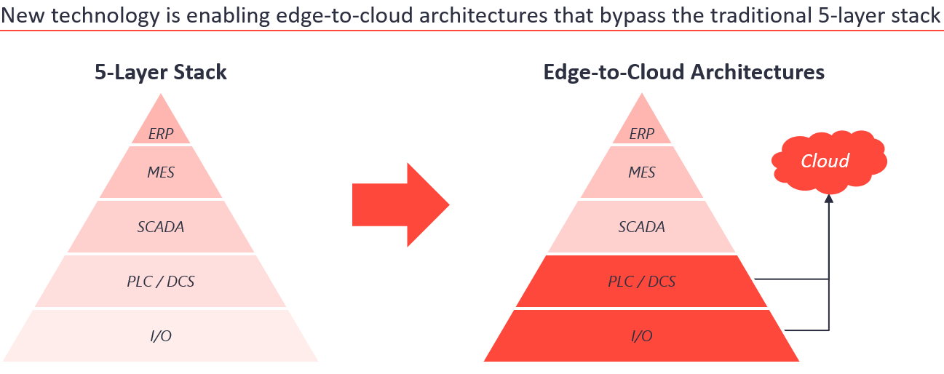
Edge to cloud architecture

Slide 31
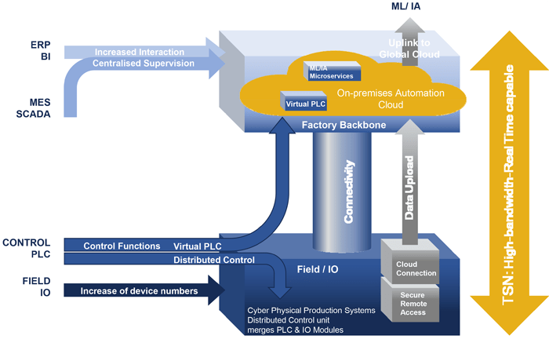
Automation pyramid to pillar transformation

Slide 32
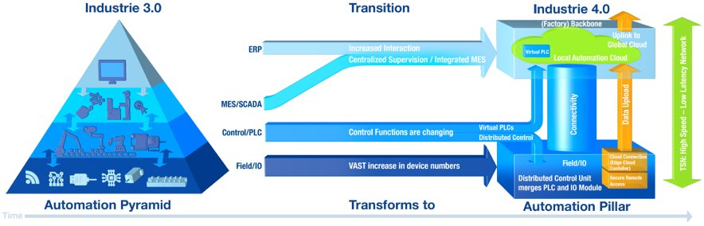

Slide 33
Thank You!

