Slide 1
Operating System
Lab Assignment 4
Group 4
Efforts by:-
Kunal Pende (IIt2019187)
Debashish Datt (IIT2019188)
Rahul Roy (IIT2019194)
Nischay Nagar (IIt2019198)
Vinit Wagh (IIT2019232)

Slide 2

Question:
Implement Client Server Service program system.
Services are:-
Factorial of Number
GCD of two integer
LCM of four integer

Slide 3
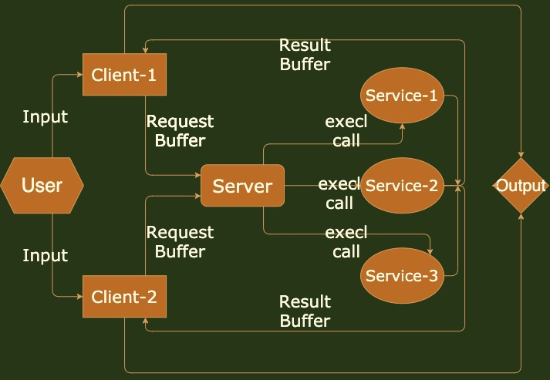
Flow
Chart
Of
Program
System

Slide 4
Shared Memory:
There are total two shared memory.
Request Buffer: Shared memory between Client and Server.
Result Buffer: Shared memory between Client and Service.
Request Buffer:- This buffer get input from Client. Server reads that data and call execl function and execute service program which one is given by User.
Result Buffer:- This buffer get input from Service program. Client reads that data and prints it.

Slide 5
Client:
This program have two shared memory(both).
Request Buffer between Client and Server.
Result Buffer between Client and Service.
Takes input from user.
If service id is 1 than take one more integer input
If service id is 2 than take two more integer input
If service id is 3 than take four more integer input
If service id is -1 than client program will exit.
Get output from Result Buffer.

Slide 6
Server:
This program has only one shared memory which is “Request Buffer”.
Reads input from Request Buffer.
If service id is 1, execl call with service1.c program
If service id is 2, execl call with service2.c program
If service id is 3, execl call with service3.c program

Slide 7
Service 1:
This program is runned by Server program.
Takes one integer input.
Returns factorial of input integer.
This output get stored in Result Buffer which gonna printed by Client program.

Slide 8
Service 2:
This program is runned by Server program.
Takes two integer input.
Returns GCD of two integers.
This output get stored in Result Buffer which gonna printed by Client program.

Slide 9
Service 3:
This program is runned by Server program.
Takes four integer input.
Returns LCM of four integers.
This output get stored in Result Buffer which gonna printed by Client program.

Slide 10
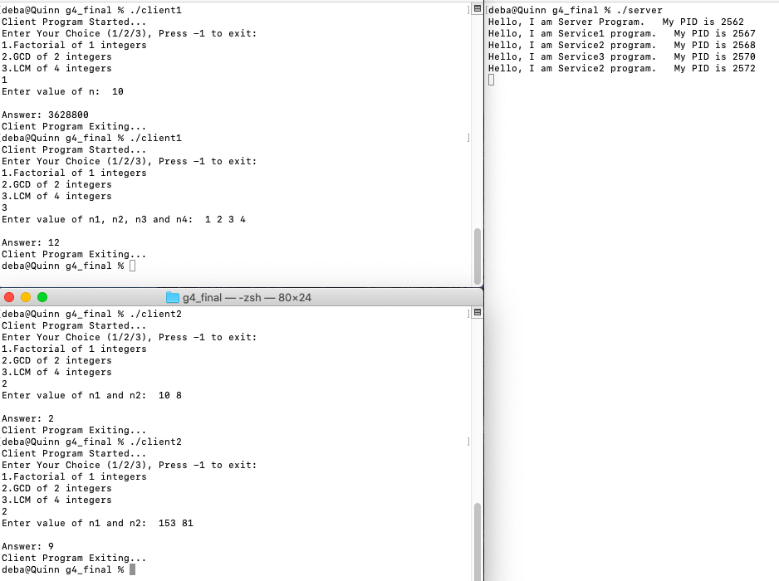
Output:

Slide 11
Thank You..:)

