Slide 1
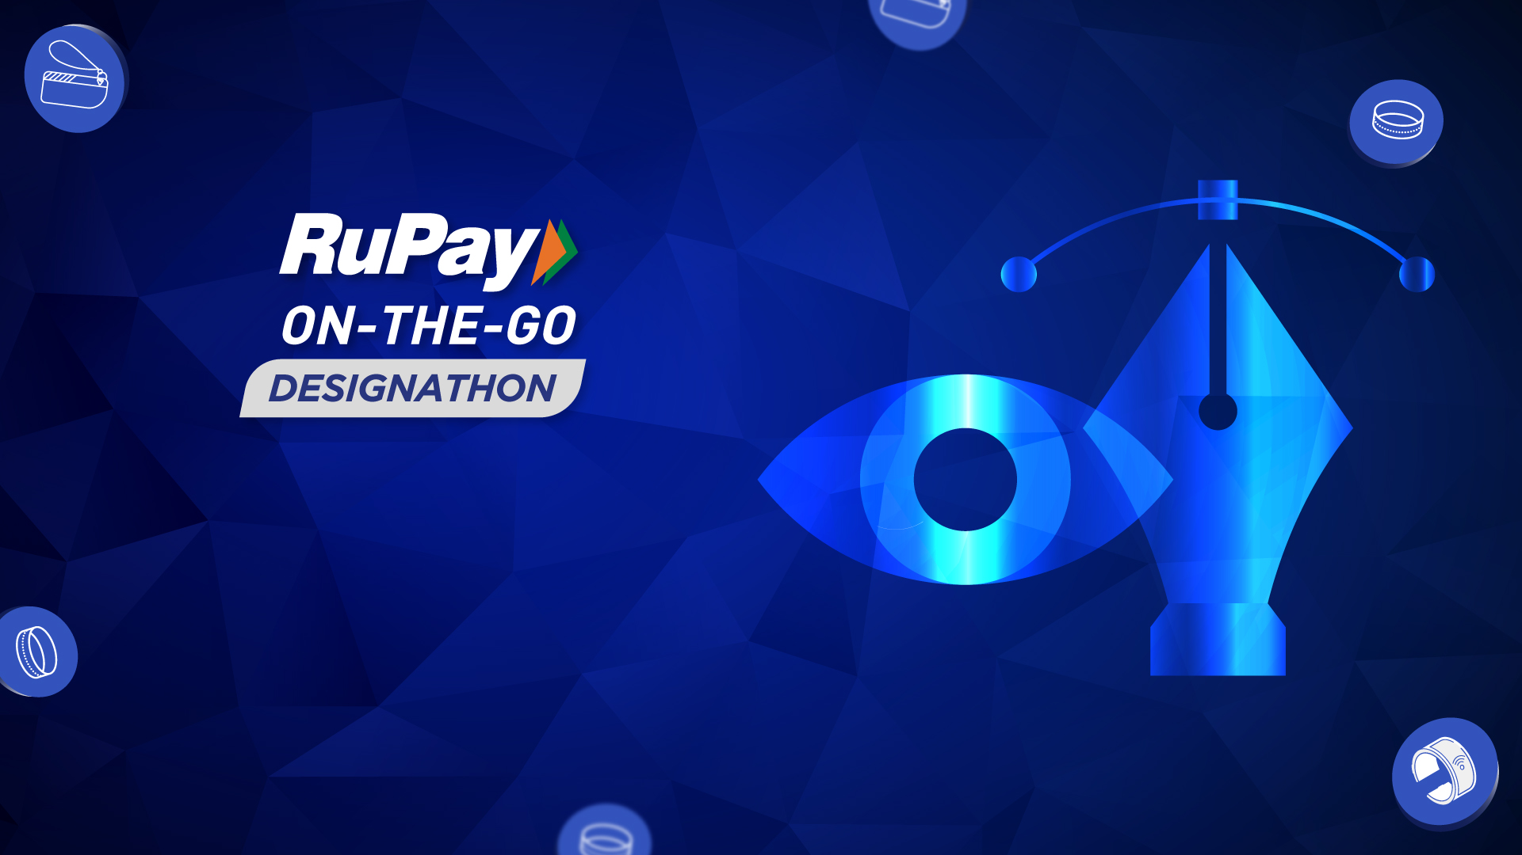
Presentation By Rahul Roy

Slide 2
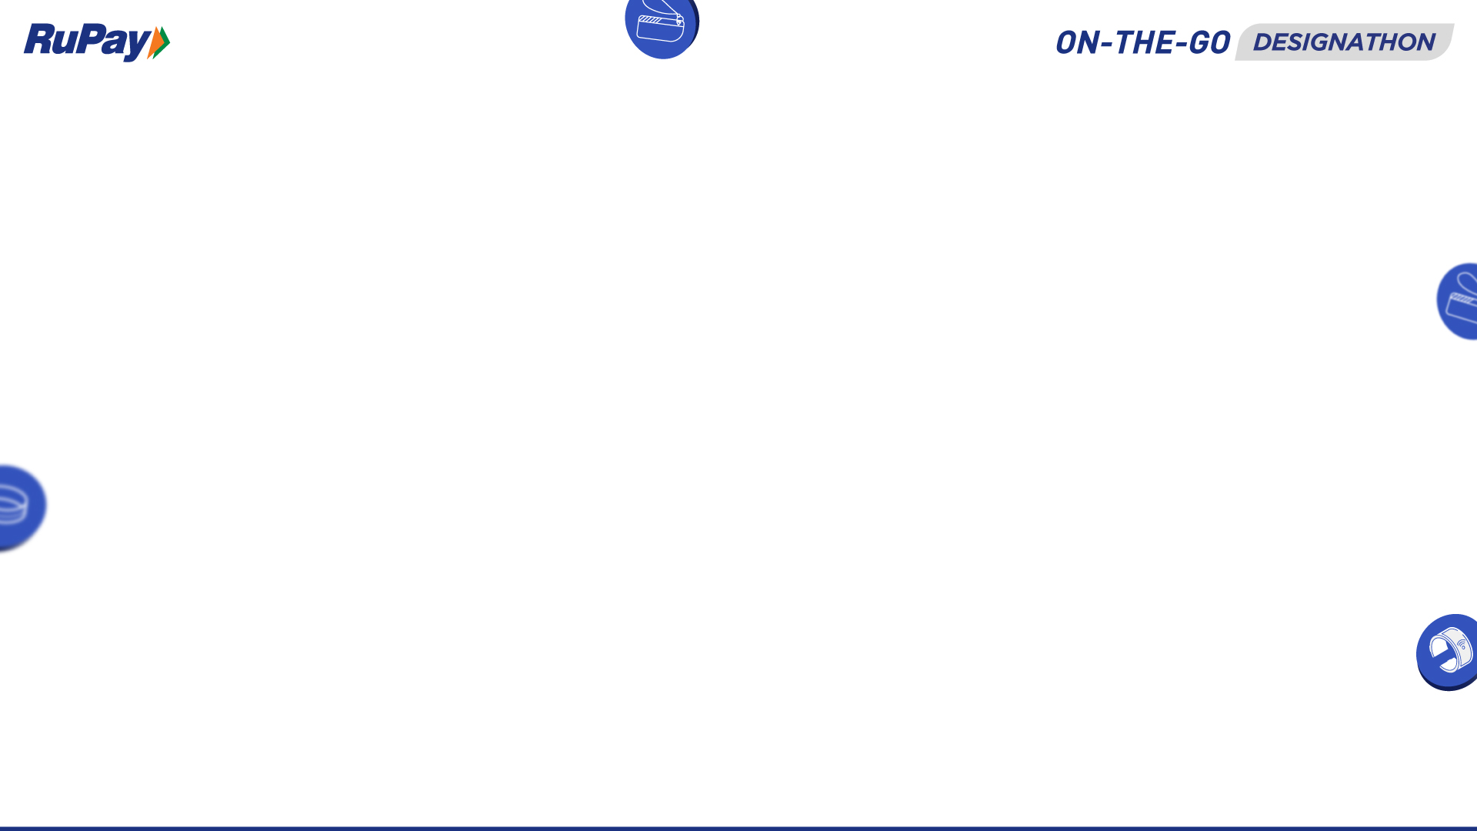
Contents
Introduction
Motivation
Modern Solution
Design
Why this solution?
Conclusion

Slide 3
Introduction
The earliest payment instruments known to have been used in India were coins, which were either punchmarked or cast in silver and copper. While coins represented a physical equivalent, credit systems involving bills of exchange facilitated inter-spatial transfers.
Paper money, in the modern sense, has its origin in the late 18th century with the note issues of private banks as well as semi-government banks. This form became quite popular as people started making transactions efficiently without much problem. However this could not solve all the problems.
Then came digital money system which entirely revolutionized the world. The transactions became quick, hassle-free and efficient. Yet still we face some problems with these solutions.

Slide 4
Motivation
Consumers value quick, convenient options when it comes to services. Hence we always need to look forward for better and efficient solutions to existing problems. The following problems are in accordance with card transactions:
Online transaction cards (credit/debit) take up space inside your wallet or pocket which might not be suitable for some users.
These cards constantly face the threat of being stolen or lost, since you can’t keep a strong watch on them everytime.

Slide 5
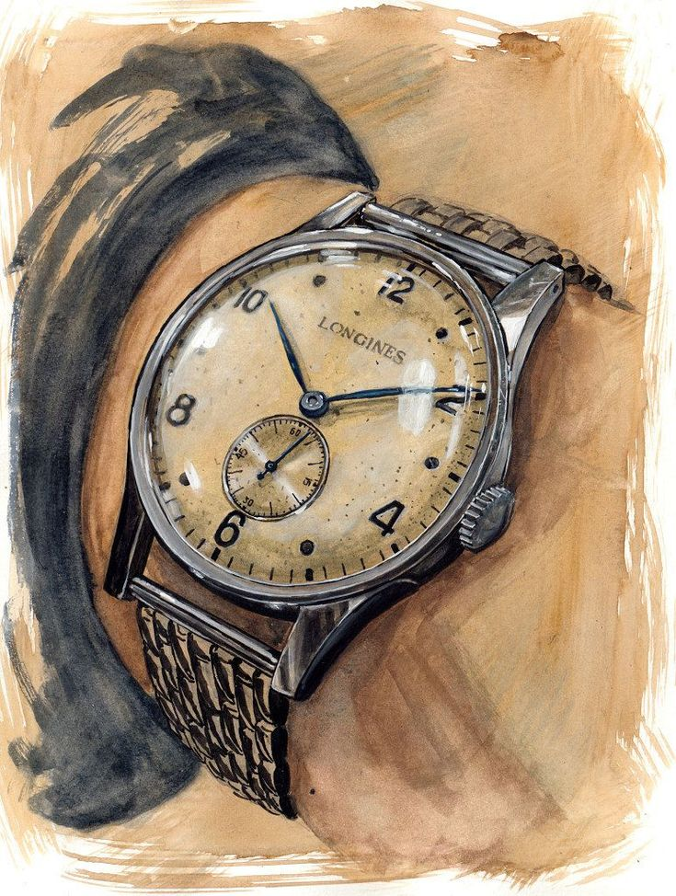
Instead of using online transaction cards, we can switch to some other payment instrument which could provide better reliability, security strength and easy transportation.
Thing about solutions, how about we devise a payment chip in the form of a unique barcode or electronic magnet tape which can be then installed in equipments that people carry when they go out?
Sound interesting right? How about we select the form factor as a analog watch? People generally wear fashionable watches when they go out. So we can have it integrated with our payment chip.
Let’s look at how our watch might look!
Modern Solution

Slide 6
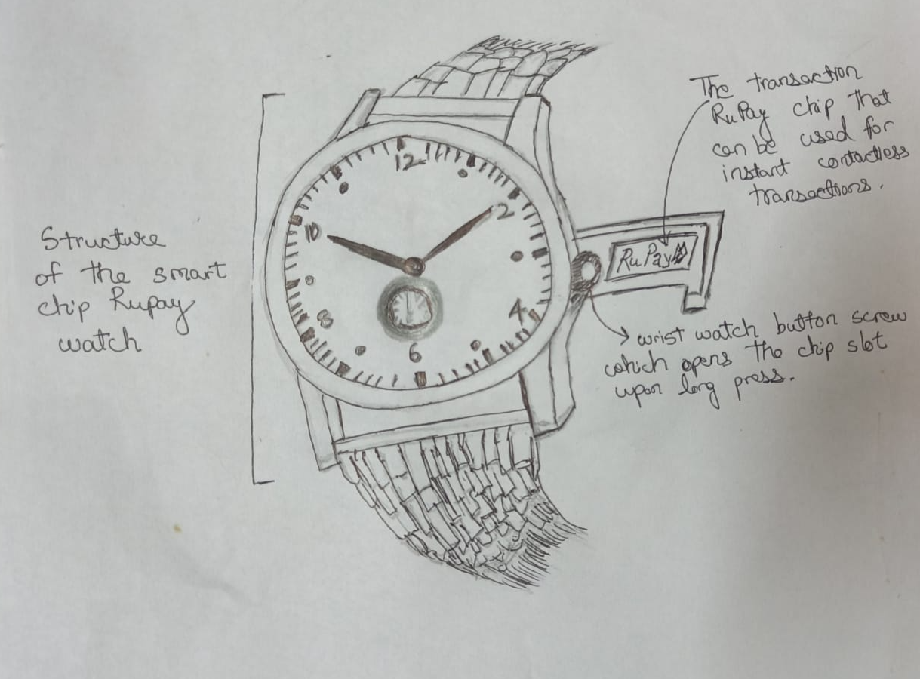
Design

Slide 7
Why this solution?
The advantages for selecting a watch as the form factor are :
It provides security, since no one will take out their watch incautiously knowing that it is their payment equipment. Also is less likely to be stolen compared to a chain, card, etc.
It is a wearable which people generally wear when they move out. Hence it is convenient for people to carry along.
The solution can also be integrated with digital watches which can provide even further security with password based authentication to open the chip.

Slide 8
Conclusion
There may be many more types of form factors to choose from but none of them can provide the security, efficiency, convenience and integrability as a watch. Therefore I conclude that ‘watch’ should be selected as the most effective form factor.
Thank You!

