Slide 1
ADVANCED DATA ANALYTICS ASSIGNMENT

Slide 2
TABLE OF CONTENTS
01
03
Overview
Methodology and Applications
02
04
Technologies and datasets used
Results and Conclusion

Slide 3

INTRODUCTION
Design a CEP System for smart building for aggregating events from diffrent sources and monitor the events with real time implementation.

Slide 4
01
OVERVIEW

Slide 5
ABOUT THIS TOPIC
We are asked to design a CEP System for smart building for aggregating events from different sources and monitor the events with real time implementation.
This system will take data from different sources and process the data in real time and then it will be monitored.

Slide 6
What is a CEP system
CEP or Complex Event Processing is a method of tracking and analyzing (processing) streams of information (data) about things that happen (events) and deriving a conclusion from them. Complex event processing, or CEP, consists of a set of concepts and techniques developed in the early 1990s for processing real-time events and extracting information from event streams as they arrive. The goal of complex event processing is to identify meaningful events (such as opportunities or threats) in real-time situations and respond to them as quickly as possible.

Slide 7
02
METHODOLOGY

Slide 8
PROCESS
Step 1
Step 2
Step 3
Firstly we take the data from the dataset provided
Using Kafka we stream that data to another server
Preprocess the data so that irregularities are minimised
Step 4
Step 5
Step 6
Now connect flink to Kafka and stream data to flink using kafka
Implement properly and check for bugs and errors
Finally make a GUI which displays the different types of data

Slide 9
Methodology
We first download the required softwares (kafka, flink, docker etc).
Then we start the docker and compose it.
We have also preprocessed the dataset to fill missing values and remove duplicates. The code used is here
After that for kafka we need a producer method and a consumer method. This is the producer and consumer code.
The producer method will read the data from the dataset and one by one or line by line and convert it into a key-pair json file and then stream the data to the consumer method.

Slide 10
Methodology
The consumer method will receive the data from the producer method and it will print or display the data on the terminal.
Once we have written the codes for these two methods we need to start the kafka zookeeper server and create a topic and then start the kafka server itself and connect to the said topic.
Now we stream that data to apache flink for further preprocessing.
We also made a GUI which will display the average temperature and humidity for each hour so that it can be monitored.

Slide 11
03
TECHNOLOGIES AND DATASETS USED

Slide 12
Datasets Used
The dataset is extracted from kaggle and can be found here. The Dataset contains the various occupancy based environmental data collected through various sensors.
The attributes of the sensor data along with their format are:
"Date": time year-month-day hour:minute:second
"Temperature": in Celsius
"Humidity": Relative Humidity in %
"Light": in Lux
"CO2": in particles per million (ppm)
"HumidityRatio": Derived quantity from temperature and relative humidity, in kg water-vapor/kg-air
"Occupancy": 0 or 1, 0 for not occupied, 1 for occupied status
These datasets have been collected by deploying various types of sensors inside physical locations for buildings.
The sensors gather data and store it minute by minute with the timestamp.
This is an experimental data used for binary classification (room occupancy) from Temperature,Humidity,Light and CO2. Ground-truth occupancy was obtained from time stamped pictures that were taken every minute.

Slide 13
Datasets Used
These datasets have been collected by deploying various types of sensors inside physical locations for buildings.
The sensors gather data and store it minute by minute with the timestamp.
This is an experimental data used for binary classification (room occupancy) from Temperature,Humidity,Light and CO2. Ground-truth occupancy was obtained from time stamped pictures that were taken every minute.
These datasets have been collected by deploying various types of sensors inside physical locations for buildings.
The sensors gather data and store it minute by minute with the timestamp.
This is an experimental data used for binary classification (room occupancy) from Temperature,Humidity,Light and CO2. Ground-truth occupancy was obtained from time stamped pictures that were taken every minute.

Slide 14






Software Requirements
Ubuntu OS
Kafka
Flink
Docker
Python
Java Jdk

Slide 15
04
RESULTS AND CONCLUSION

Slide 16
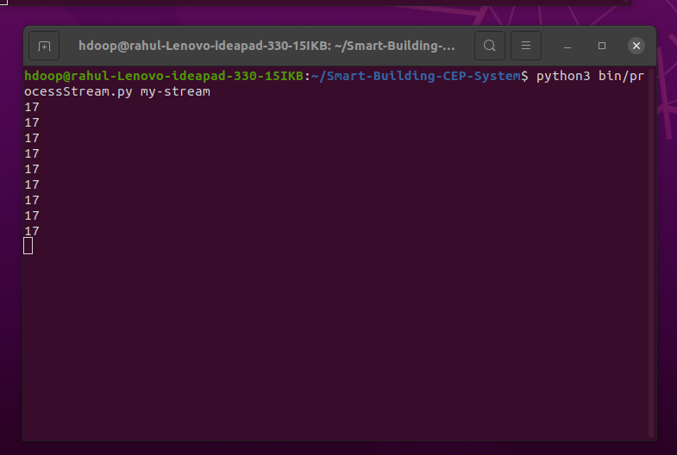
Results and screenshots
ProcesssStream

Slide 17
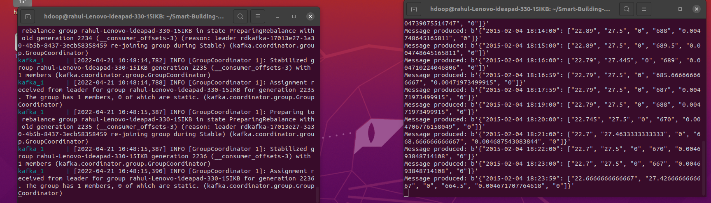
Results and screenshots
Producer Process

Slide 18
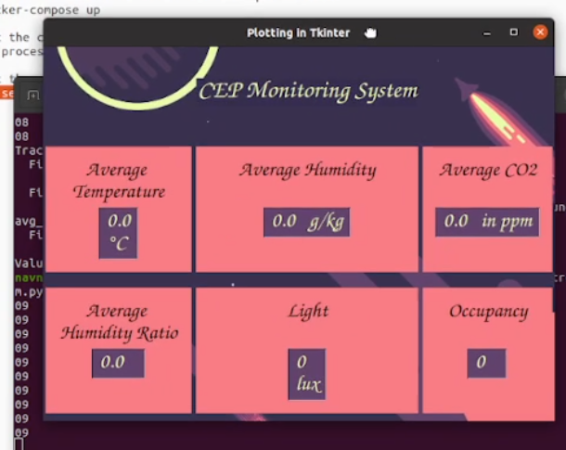
Results and screenshots
GUI

Slide 19
Conclusion
The analytics on real-time events enable us to monitor the changes within a system and provide adequate support or solutions for probable hazards. Our project has important aspects related to a smart building. We monitor the occupancy and light on regular intervals so as to ensure that when there is no occupancy in the building, the lights are always turned off. We also aggregate the temperature, humidity and CO2 levels inside the building for every hour and give suitable recommendations based on the analytical values. Thus our project provides a base for the internal working of the technical system inside a smart building.

Slide 20
THANK YOU

