Slide 1
Employee Data Analysis using Excel
STUDENT NAME: RAHUL.N
REGISTER NO: 312219336 (asunm1711312219336)
DEPARTMENT: Bachelor of Commerce (Accounting & Finance)
COLLEGE: S.A. COLLEGE OF ARTS AND SCIENCE

Slide 2
PROJECT TITLE
Employee Performance Analysis using Excel

Slide 3

AGENDA
Problem Statement
Project Overview
End Users
Our Solution and Proposition
Dataset Description
Modelling Approach
Results and Discussion
Conclusion
3/21/2024 Annual Review

Slide 4

PROBLEM STATEMENT
Measuring employee performance helps to calibrate those goals by providing insight into where someone is doing well and could be stretched and areas that are not a strength yet
It provides a clear picture of the current state of performance and highlight areas that need attention.

Slide 5

PROJECT OVERVIEW
Performance analysis is the process of studying or evaluating the performance of a particular scenario in comparison of the objective which was to be achieved.
In this presentation, I have made comparison of different persons from various business units.

Slide 6
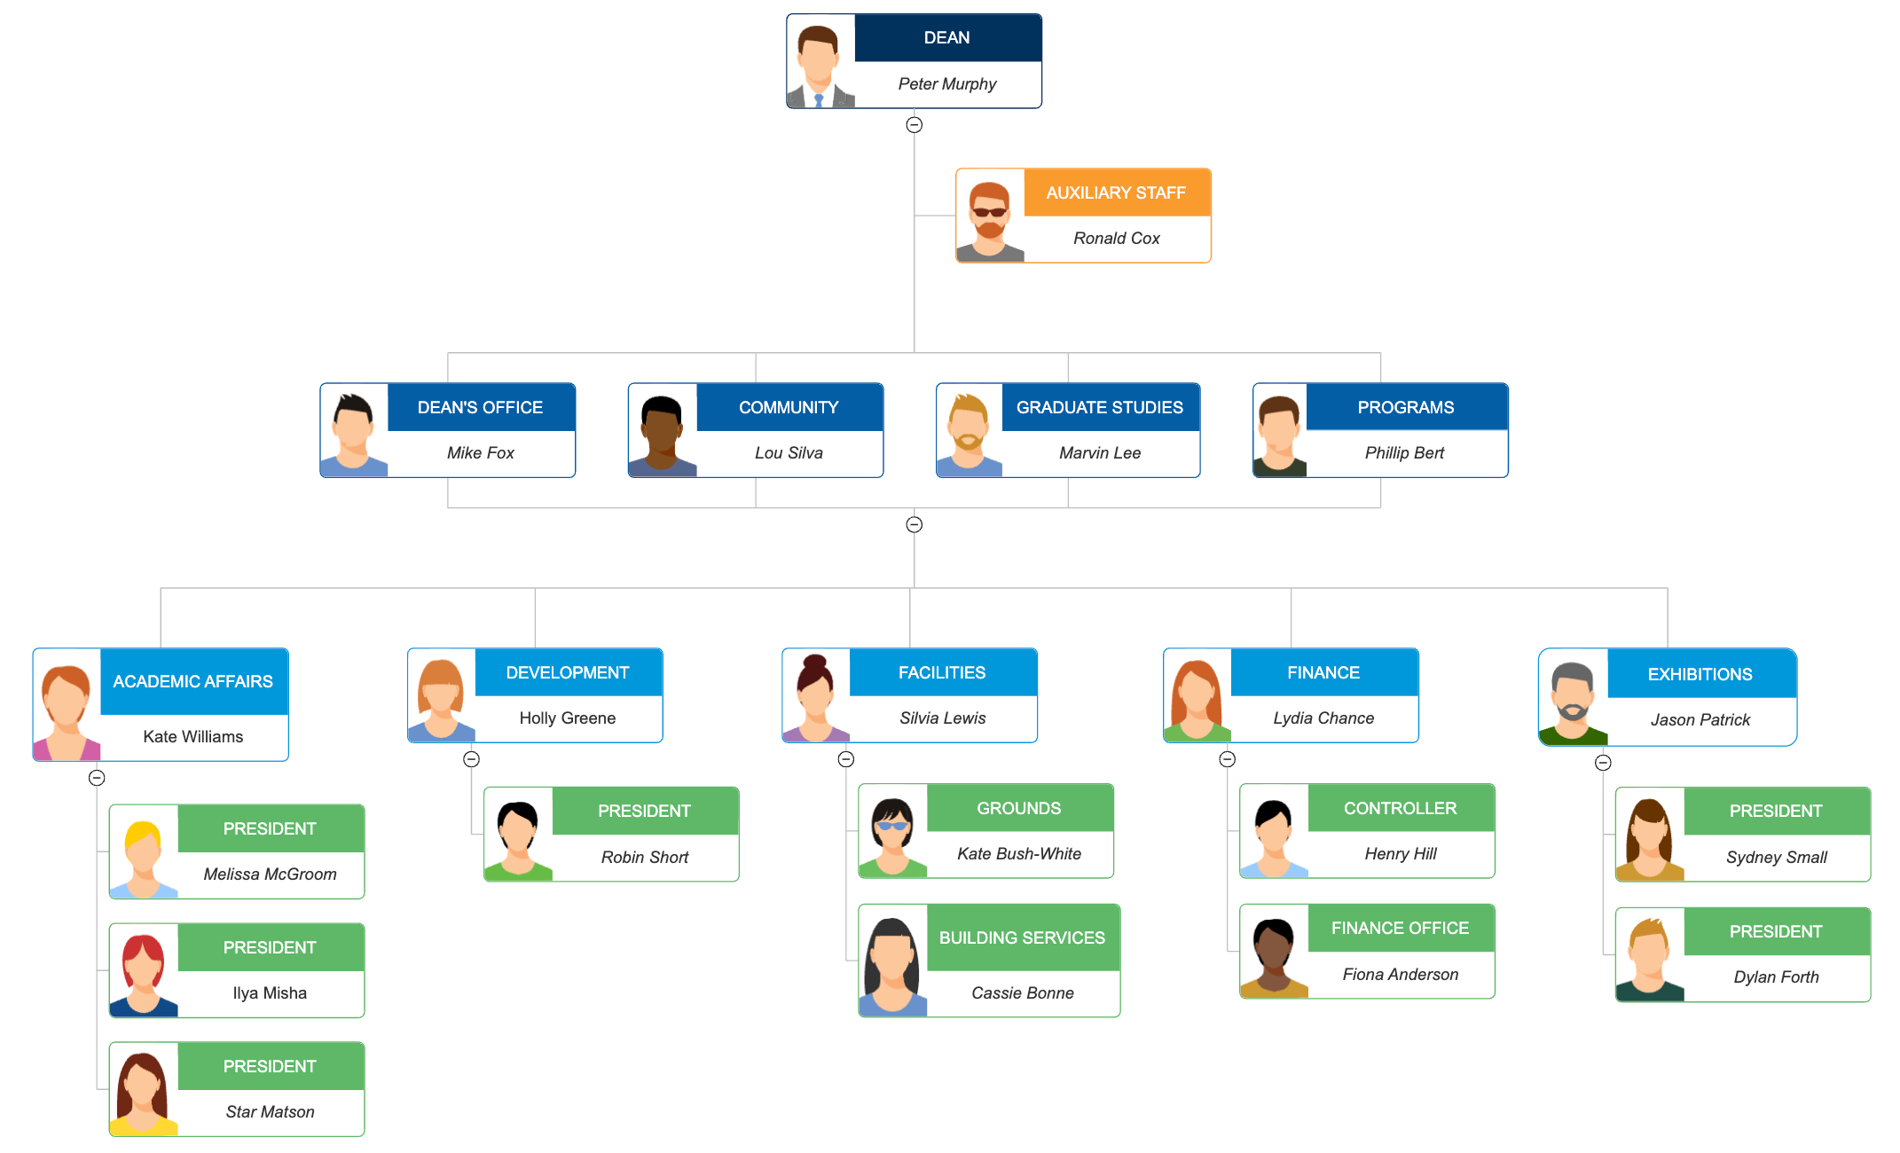

WHO ARE THE END USERS?

Slide 7

OUR SOLUTION AND ITS VALUE PROPOSITION
Conditional formatting: It helps to ascertain the missing values presented in the data sheet
Filter: By using this, I have removed the blank cells through certain conditions.
Formula: I have ascertained the performance level of employees by application of formula
Pivot table: It will summarizes the large volume of data easily
Slicer: It will showcase particular item on both graph as well as pivot table
Graph: It visualizes the data. So the users of data can easily understand the information.

Slide 8
Dataset Description
Data are taken from Kaggle website.
There are 26 features presented in the entire dataset of employees. But I have listed only 9 features of the data.
Employment ID: Numerical value
Name: Text
Employment type: Text
Gender: Male/Female
Performance level: Text
Employee rating: Numerical value

Slide 9

THE "WOW" IN OUR SOLUTION
Application of formula is the major solution in this presentation. Through this only I have determined the performance levels of all the employees listed under the data set.
And then I am really surprised with the pivot charts and the graphs, which summarizes the entire data with the ease manner.
Filters and slicers are the tools which showcases the data of particular item or particular employee.
3/21/2024 Annual Review
9

Slide 10
MODELLING
Data collection: Firstly, the data have to be collected from sources like websites, magazines, articles. For this presentation, I have taken the employment data of different business units from Kaggle website.
Feature collection: If you decide to collect any specific data. There are many features or sub-data are presented in the particular data. So we have to collect appropriate data which supports the primary data.
Data cleaning: If the organisation collects the vast amount of data to make decisions. But in reality, the entire data will not be useful to the management. So they clean the data collected. For this purpose, they are the using the filter and sort options.
10

Slide 11
MODELLING
Performance level: Next, the important task of management to make comparative analysis of employees. In this case, the management determines the performance of the employees to ascertain that they can accomplish the goals or not. In this presentation, I have determined the performance level by application of formula like IFS
Summarization: Pivot tables and the charts helps to summarizes the large data into the simplest manner. I have enclosed both charts and pivot charts in this project which provides a clear picture of the data what I have taken.

Slide 12
RESULTS
12

Slide 13
RESULTS

Slide 14
CONCLUSION
From the above results, I understand that the performance of the employees from different business units are medium. So the employees should enhance their performance to accomplish the goals of both individual and organization.
Both graph and the pie chart presents the data in the understandable way. So the management and employees can get insights and make informed decisions.

