Slide 1
Speech analysis using Filter bank

Slide 2
Topics
Spectrum analysis
Auditory system – Filter bank
Analysis model (speech coding)
Types of filter banks
  Uniform
  Nonuniform (logarithmic & critical)
Implementation of filter banks
Practical examples of speech recognition filter banks

Slide 3
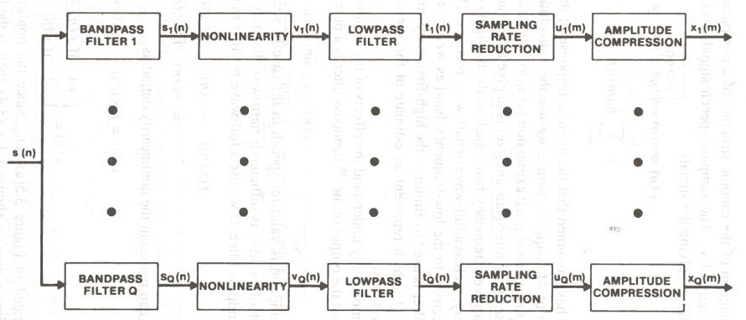
Filter Bank analysis model

Slide 4
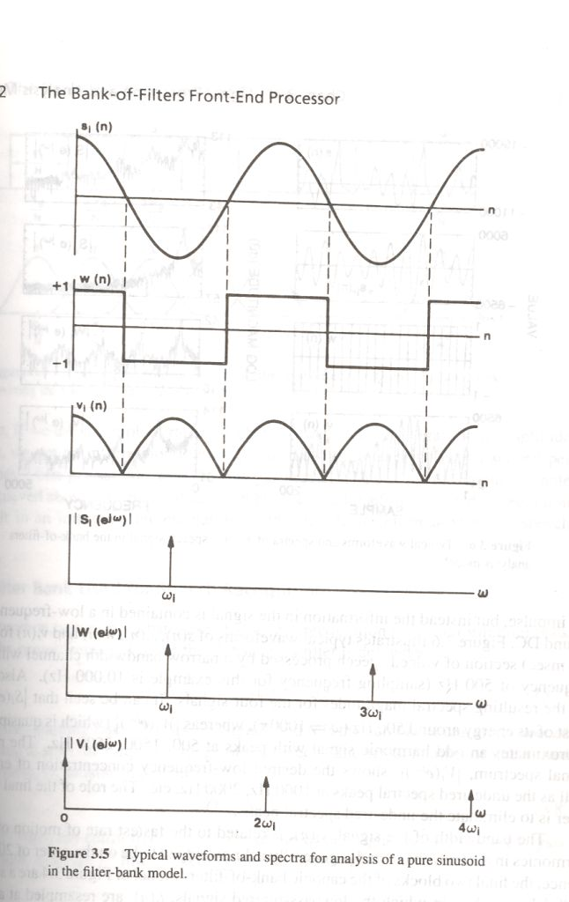
Filter Bank analysis model (cont..)

Slide 5
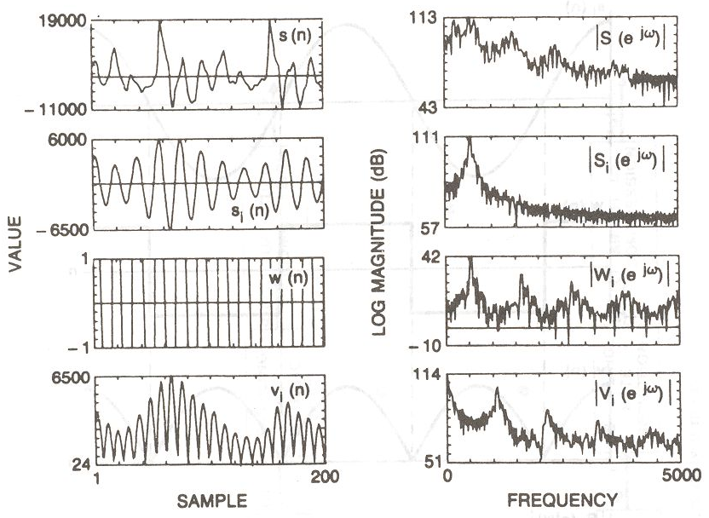
Filter Bank analysis model (cont..)

Slide 6
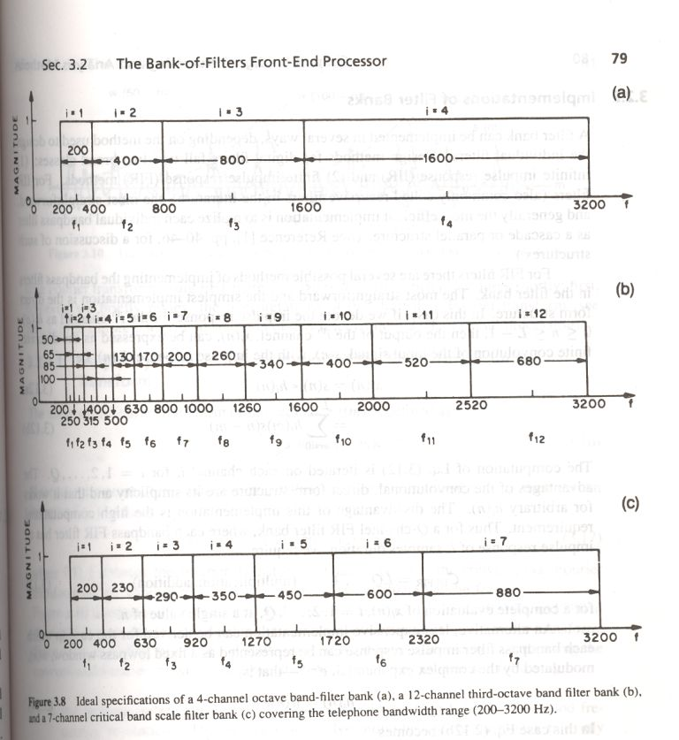
Types of filter banks

Slide 7
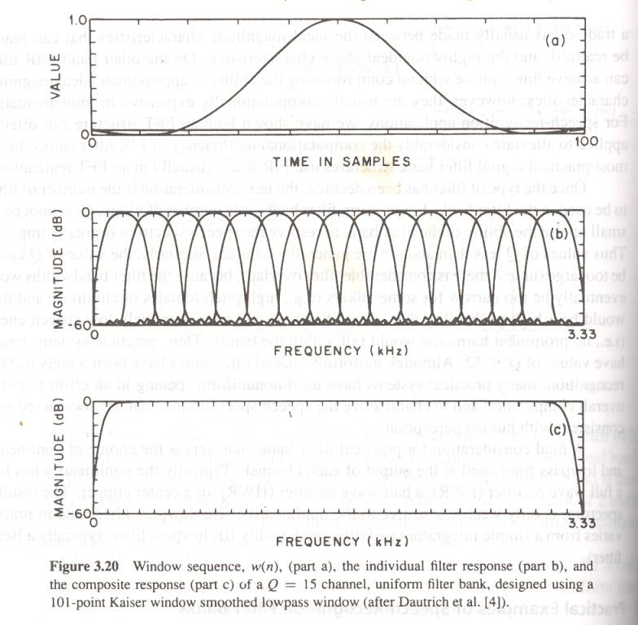
Examples of SR filter banks

Slide 8
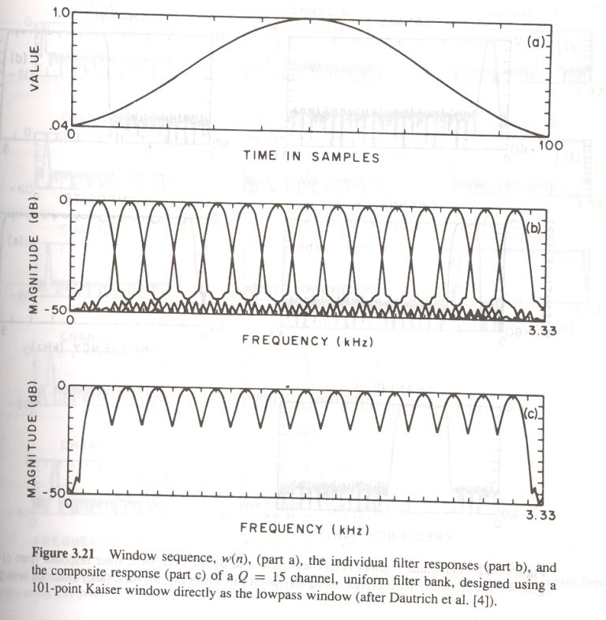
Examples of SR filter banks (Cont.)

Slide 9
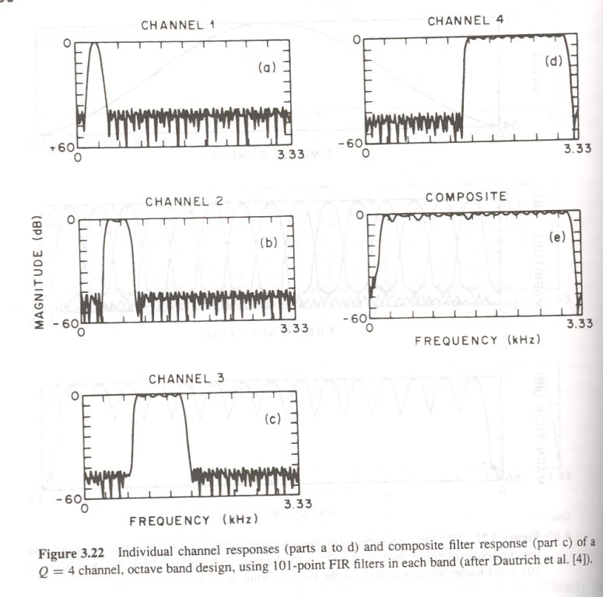
Examples of SR filter banks (Cont.)

Slide 10
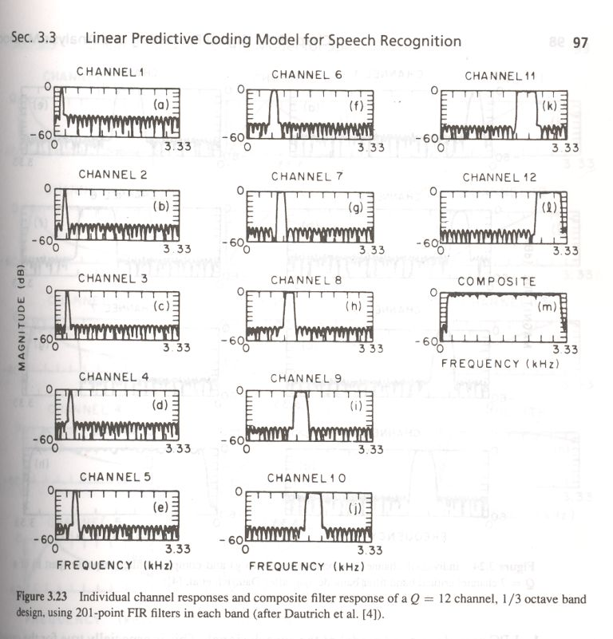
Examples of SR filter banks (Cont.)

Slide 11
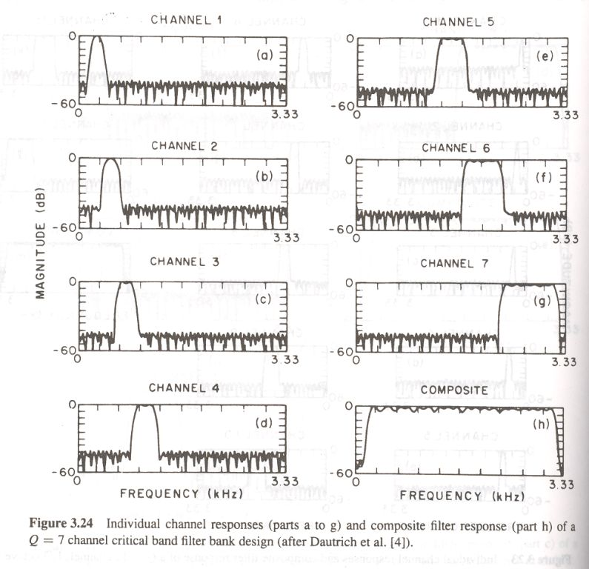
Examples of SR filter banks (Cont.)

Slide 12
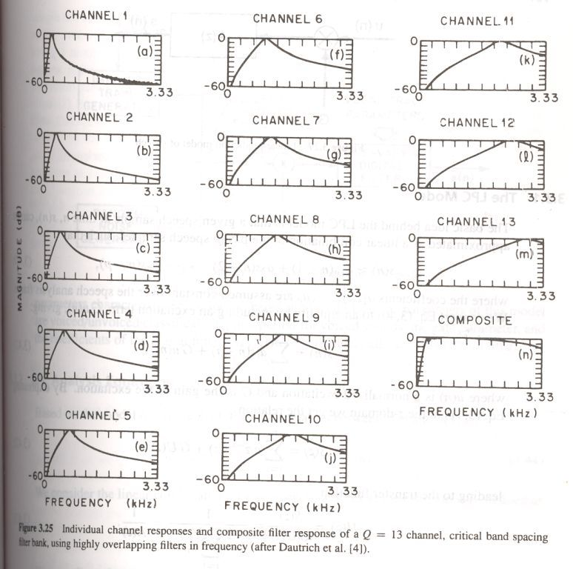
Examples of SR filter banks (Cont.)

Slide 13
Assignment-1
Implement the voiced/unvoiced speech detector using (a) short time average energy, (b) short time average zero crossing rate (ZCR), (c) short time autocorrelation function and (d) combination of the above features.
Implement the speech segmentation task (at syllable level) using short time average energy.
Implement the vowel recognition system using ZCR as the feature with 8 filters.
Implement the pitch contour estimation using (a) short time autocorrelation function and (b) short time average magnitude difference function (AMDF).

