Slide 1
Knowledge Sources in Speech

Slide 2
Knowledge Sources in Speech
Message: Thought to be conveyed
Speaker: Who the speaker is?
Language: Language in which speech is produced
Naturalness: Pleasing quality of speech
Intonation: Inreasing/decreasing pitch
Duration: Variations in the duration patterns
Stress: Uttering with special attention (words or syllables)
Accent: Dialect region of person
Emotions (mood): Status of mind
Health: Condition of speech production organs
Device and Channel: Microphone and medium in which speech is collected

Slide 3
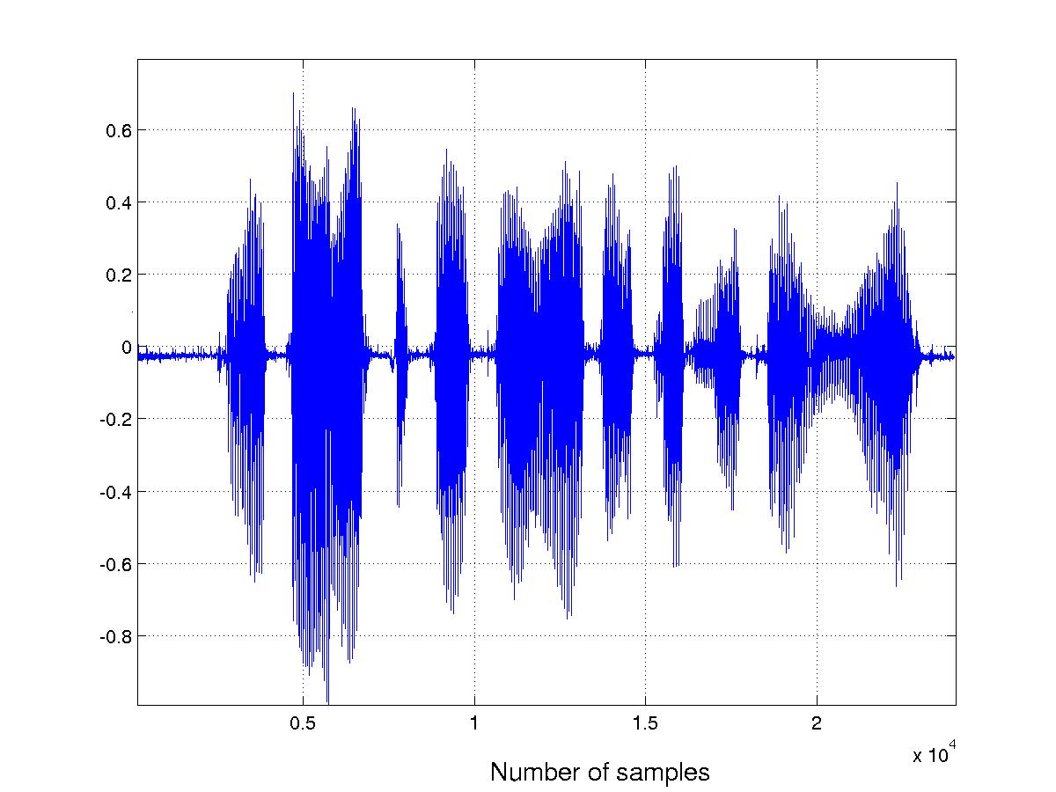
Illustration of knowledge sources in speech
Text : maataa aur pitaa kaa aadar karnaa chaahie
Speech from hypothetical units :

Slide 4
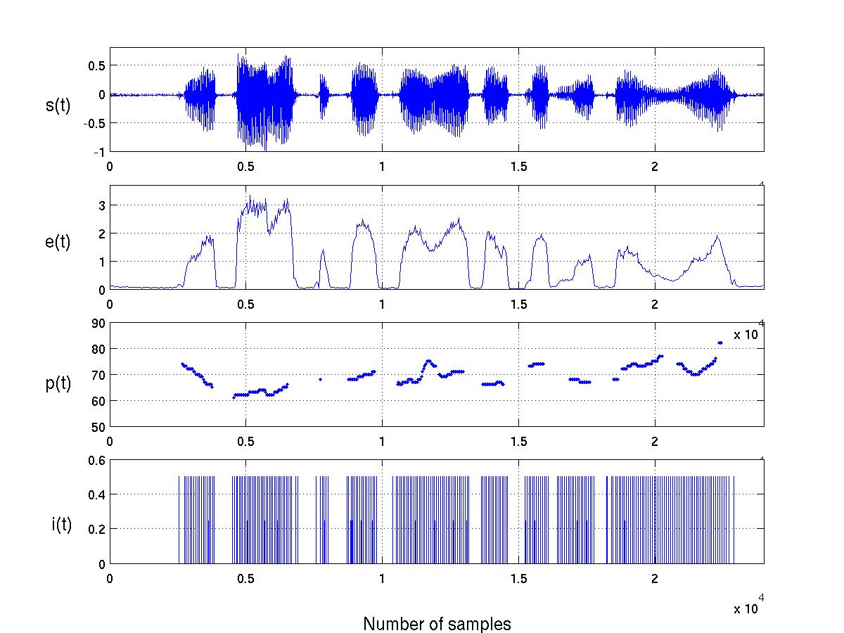
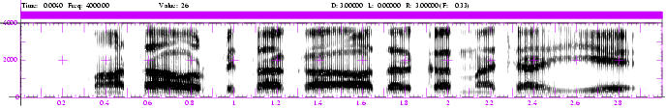
Illustration of knowledge sources in speech (Contd..)
sp(t)
maa
taa
aur
pi
taa
kaa aa
dar
kar
naa
chaa
hi
e
s(t): speech waveform, e(t): energy contour, p(t): pitch contour,
i(t): instants of significant excitation and sp(t) : spectrogram
next

Slide 5
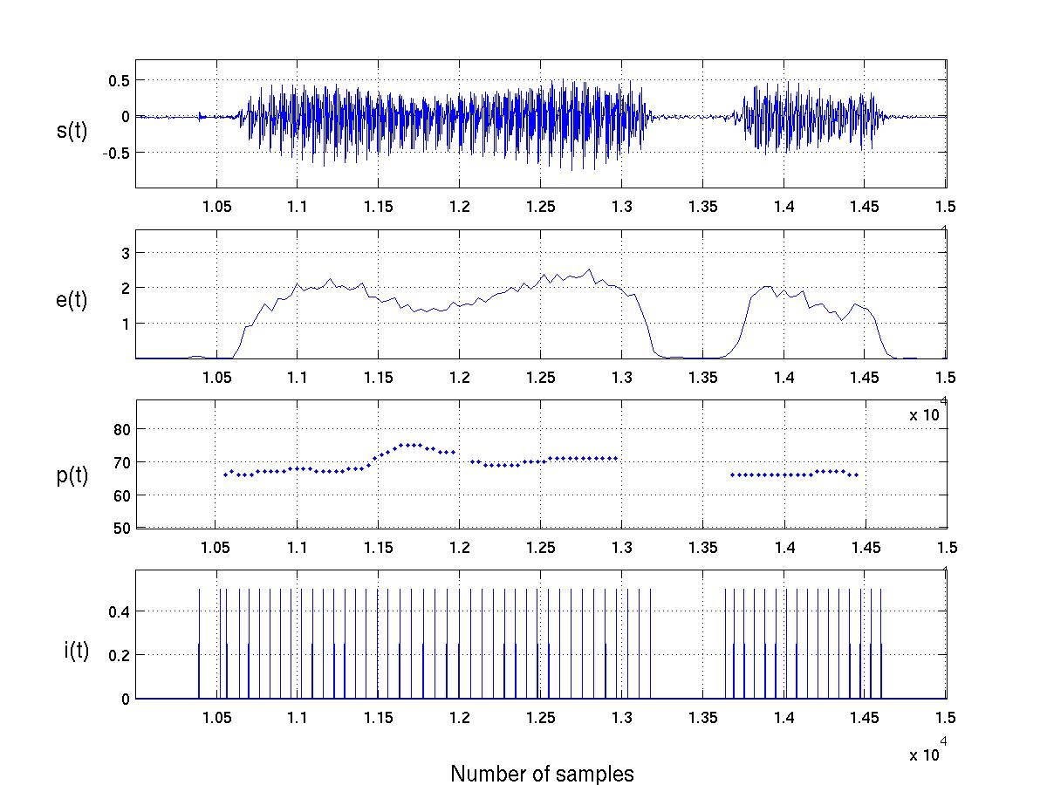
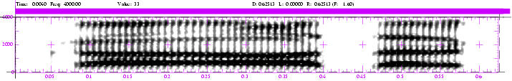
Illustration of knowledge sources in speech (Contd..)
sp(t)
kaa
aa
dar
s(t): speech waveform, e(t): energy contour, p(t): pitch contour
i(t): instants of significant excitation and sp(t) : spectrogram
Back

Slide 6
Knowledge sources in speech
(analysis point of view)
Segmental level (10-30 ms) : Positioning and movement of
articulators, shapes of cavities (oral and nasal), voiced and
unvoiced excitation, periodicity (pitch) and formant structure
Sub-segmental level (3-5 ms): Glottal pulse shape, open and closure
regions of glottis, consonant regions (burst and transition regions)
Supra-segmental level (>100 ms) : Prosody (duration and pitch),
stress, prominence, melody, syntax and semantics.
Coarticulation level : Constraints due to linguistic context: Influence
of the adjacent units in the articulation of the present unit.

