Slide 1
Speech Production and Perception

Slide 2
Fundamentals of Speech Processing
What is speech?
What is speech processing?
Speech processing for telecommunication, human-computer interaction and biomedical tasks
Why speech processing is needed?
Elements of speech communication
Steps in human speech production and perception
Speech production and perception mechanisms
Language constraints on speech processing
Acoustic phonetic characterization of speech
Knowledge sources in speech
Technological goals in speech processing
History of speech processing

Slide 3
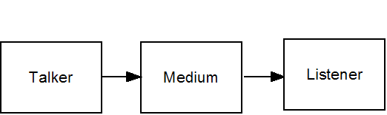
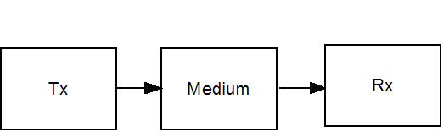
Elements of Speech Communication
Human:
Electrical:
Talker: Message formulation and conveying via speech mode.
Listener: Reception of speech and message comprehension.
Medium: Physical medium which carries speech from talker to listener.

Slide 4
Speech Chain: Steps in Human Speech Communication
Talker:
Message
Choice of
Language
Message
Coding
Speech
Speech
Production
System
Nerve Impulses:
Neuro-
Muscular
Commands
Message->Language Coding->Nerve Impulses-> Mechanical Motion-> Acoustic Pressure Variations
Listener:
Speech
Perception
System
Speech to
Nerve Impulses
Message
Comprehension
in Brain
Speech
Acoustic Pressure Variations->Mechanical Motion->Nerve Impulses->Language Decoding->Message
Dual role of a person as talker/listener

Slide 5
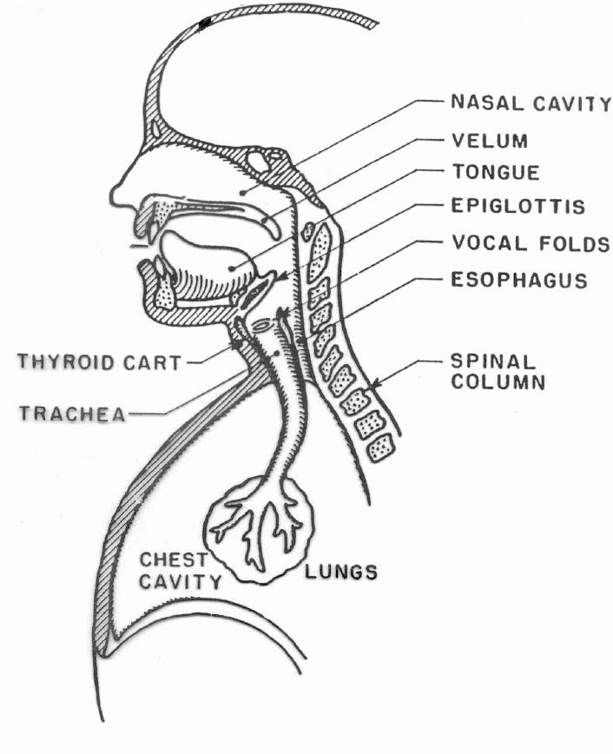
Speech Production System

Slide 6
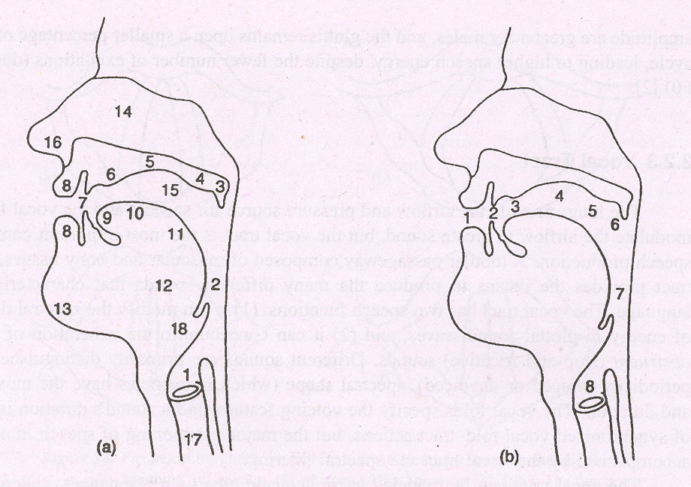
Vocal tract
Vocal folds
Pharynx
Velum
Soft palate
Hard palate
Alveolar ridge
Teeth
Lips
Tongue tip
Blade
Dorsum
Root
Mandible (jaw)
Nasal cavity
Oral cavity
Nostrils
Trachea
epiglottis
Places of articulation
Labial
Dental
Alveolar
Palatal
Velar
Uvular
Pharyngeal
glottal

Slide 7
Speech Production Mechanism
Speech is produced during exhalation of air
Lungs & associated structure provides required energy
Vocal-folds inside larynx is the main excitation source and constriction (total or partial) along vocal tract is an additional source
Supra-glottal system which includes pharynx, oral cavity and nasal cavity behave as time-varying resonator

Slide 8
Excitation Sources
Voiced Excitation
  Vibration of vocal folds
  Voiced speech
Unvoiced Excitation
  Total constriction along the vocal tract
  Partial constriction along the vocal tract
  Unvoiced speech
Mixed Excitation
  Combination of above
  Mixed speech

Slide 9
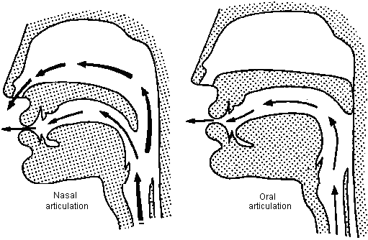
Production of Speech Sounds
Vowels - Oral cavity is wide opened, tongue hump, glottal vibration
Unvoiced Consonants - constriction (Complete closure)
Voiced Consonants - constriction & glottal vibration
Nasal Sounds - nasal cavity is coupled
Frecatives – Partial closure, Narrow opening

Slide 10
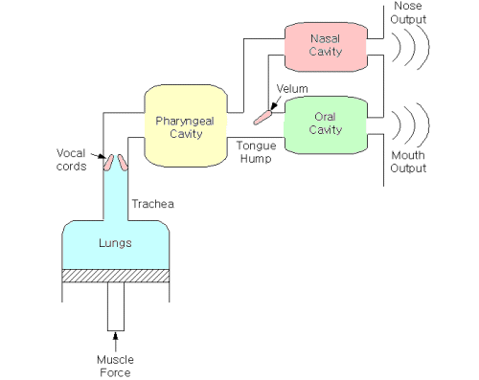
Schematic Representation of Speech Production Process

Slide 11
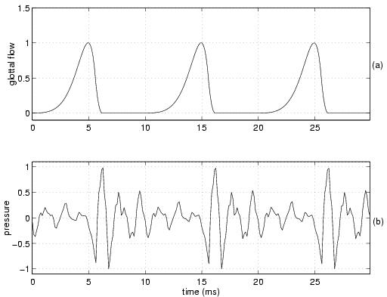
Glottal Volume Velocity and its Speech Signal

Slide 12
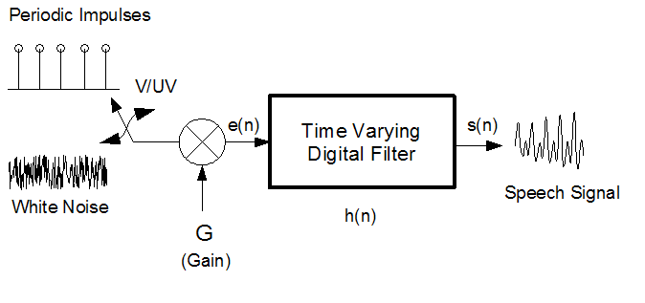
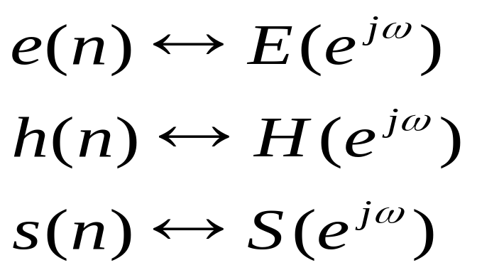
Digital Model for Speech Production

Slide 13
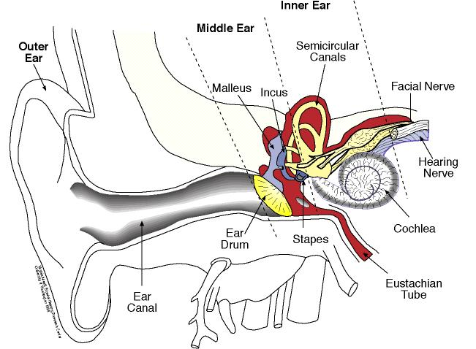
Speech Perception System

Slide 14
Speech Perception Mechanism
Mainly three regions - outer ear, middle ear & inner ear
Outer ear - directs speech pressure variations towards the middle ear
Middle ear - transforms pressure variations into mechanical motion
Inner ear - converts mechanical vibrations into electrical firings in the auditory neurons, which leads to brain
Language decoding and message understanding at the higher centers of learning which is less understood

Slide 15
Steps in Speech Reception and Message Comprehension
Acoustic pressure variations funnelled into middle ear by outer ear.
Eardrum converts acoustic pressure variations to mechanical vibrations.
Mechanical vibrations are transferred to inner ear by middle ear bones.
Standing wave patterns are generated in inner ear liquid.
Standing waves are converted into neural firings on auditory nerve.
Neural firings are decoded and message comprehension is done in brain.

Slide 16
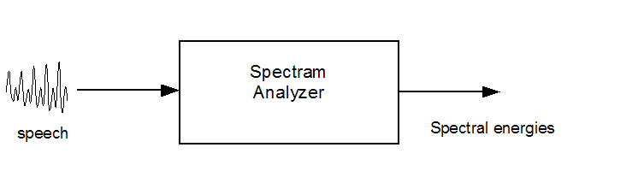
Digital Model for Speech Perception

