Slide 1
Speech Coding

Slide 2
Objective
Efficient secure storage
Efficient transmission
Applications
  Digital voice transmission over analog channels
  Wireless transmission (Mobile communications)

Slide 3
Evaluation of Coders
Bit rate
Cost of transmission and storage
Complexity and speed
Output speech quality

Slide 4
Speech quality
Broadcast, 50 – 7000 Hz, 32-64 Kbps
Toll/wireless, 200 – 3200 Hz, 8-64 Kbps, SNR > 30 dB
Communications, high intelligibility and noticeable distortion (4 Kbps)
Synthetic, substantial degradation and 90% intelligibility

Slide 5
Classes of coders
Waveform coder (sample by sample)
  PCM
Time domain waveform coder (periodicity and slowly varying intensity)
  LP coders, DPCM, DM, ADPCM
Spectral domain waveform coder (spectral properties)
Source coder / Vocoder (speech production)

Slide 6
Distortion measures
Objective measures (SNR)
Subjective measures (MOS)
  Intelligibility
  Naturalness
  Speaker characteristics

Slide 7
Speech redundancies
Speech production
  Changes in the VT shape and speech spectrum are relatively slow compared to sampling frequency
  Glottal vibration is relatively slow
  Periodicity (successive segments are nearly identical)
  Most of the speech spectral energy is at low frequencies
  Periodic vs noisy excitation
Auditory characteristics
  Phase information
  Masking (weighting to different frequencies)

Slide 8
Time domain waveform coding
Slow variation of speech energy
Periodicity
Dominant low frequency energy
Adaptive PCM
variable step size and gain
size of the window

Slide 9
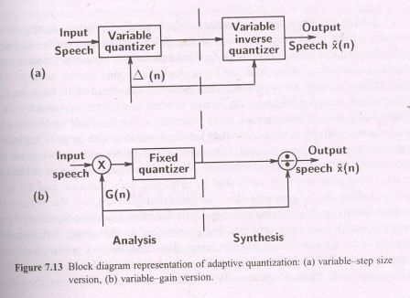
APCM

Slide 10
Exploiting properties of spectral envelope
Differential PCM
  Short term correlation (1-3 ms), spectral envelope
  Long term correlation (pitch periodicity), harmonic structure
Exploiting periodicity of voiced speech
  Pitch adaptive predictive coders
Exploiting the auditory limitation
  Noise shaping

Slide 11
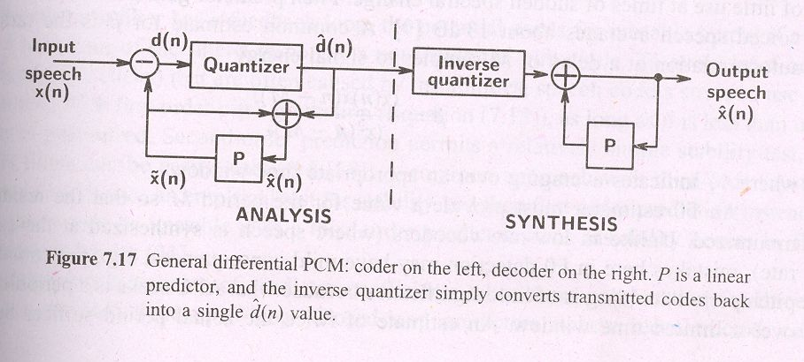
DPCM

Slide 12
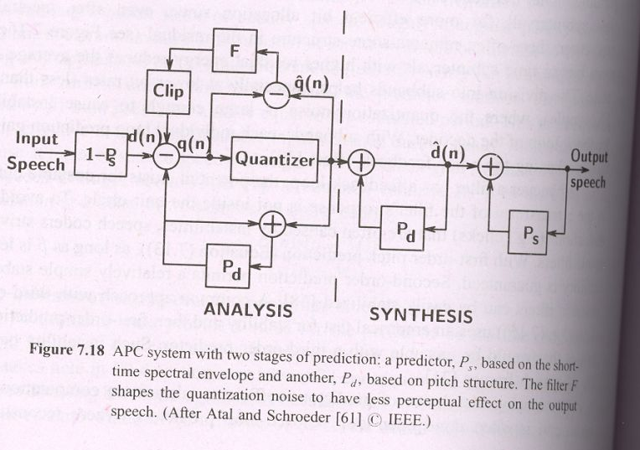
DPCM (Cont..)

Slide 13
Linear predictive coding
DPCM, LDM, ADM, ADPCM
LP coding vs LP analysis by synthesis
Different excitation models
  Simple and mixed excitation model
  Residual excited LP vocoder
  Multipulse excited LP vocoder

Slide 14
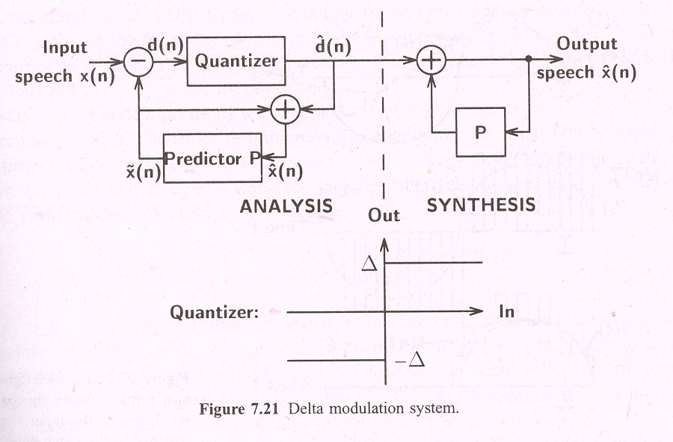
Delta Modulation

Slide 15
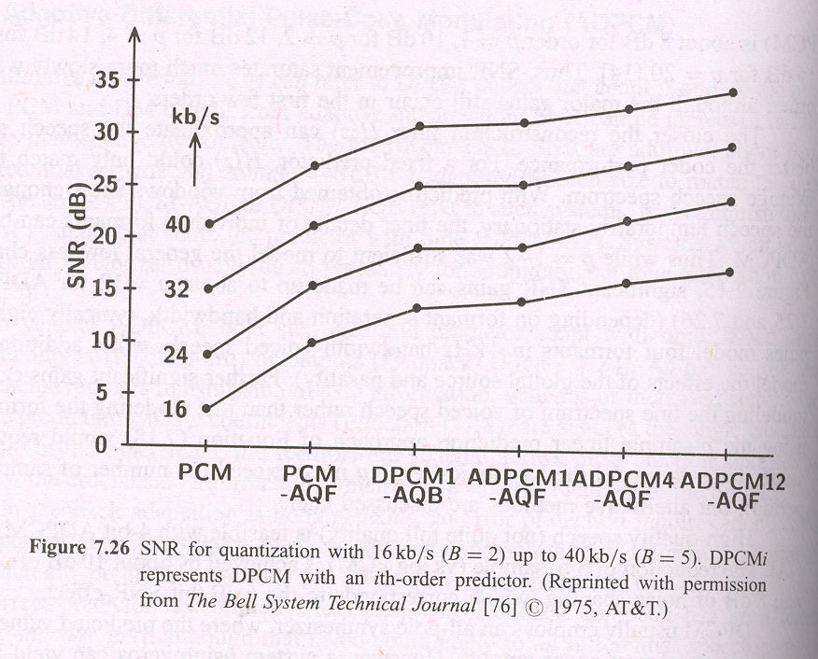
SNR for different coding schemes

Slide 16
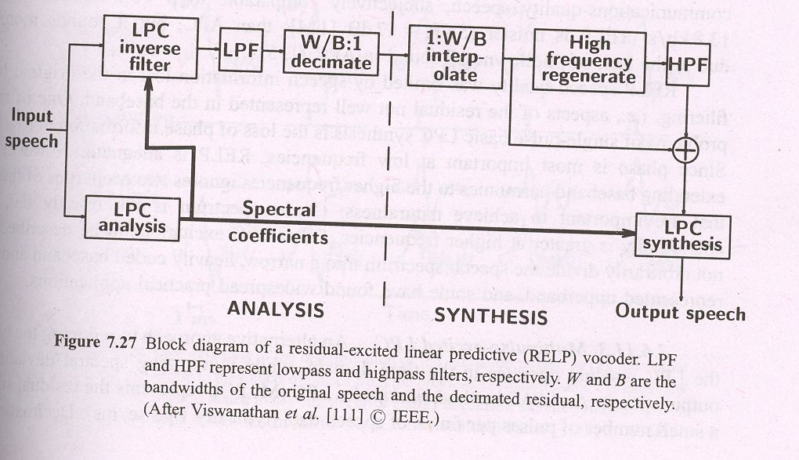
RELP vocoder

Slide 17
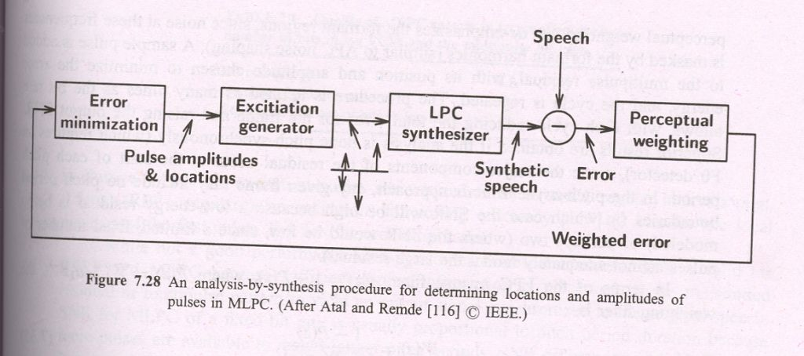
Analysis by synthesis coder

Slide 18
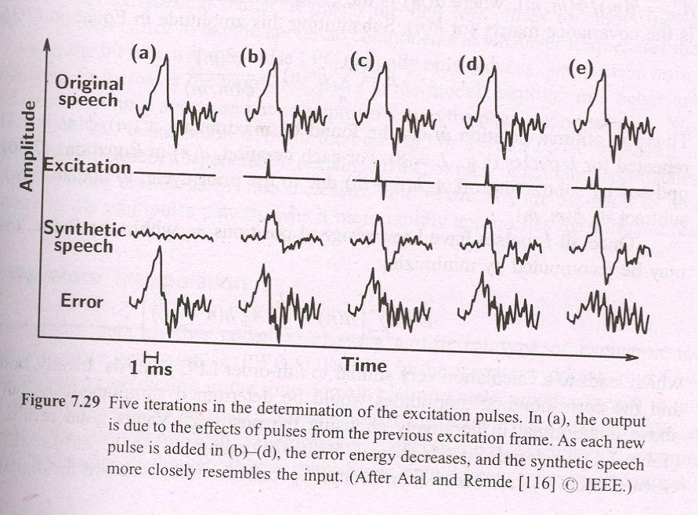

Slide 19
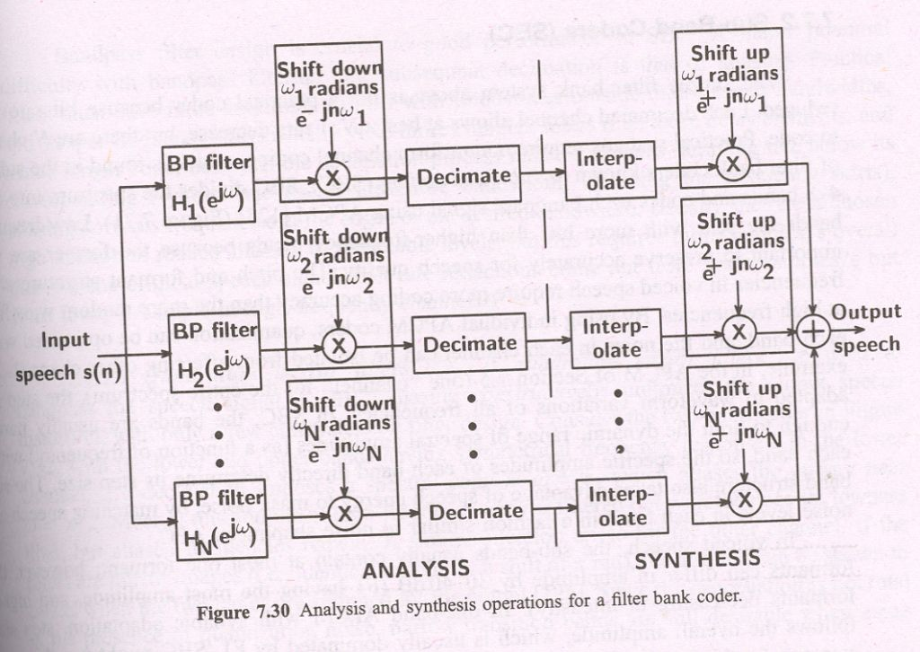
Filter bank coder

Slide 20
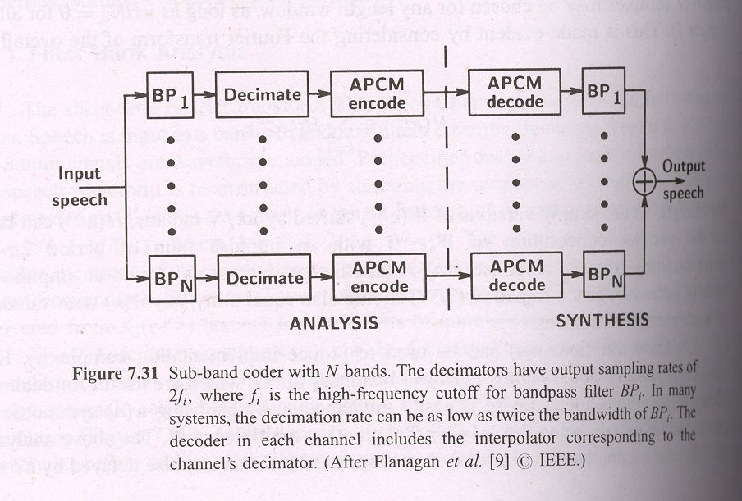
Subband coding

Slide 21
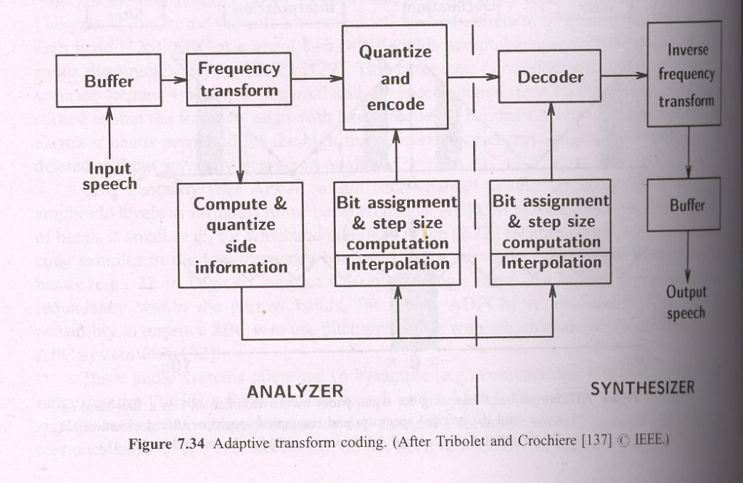
Adaptive transform coding

Slide 22
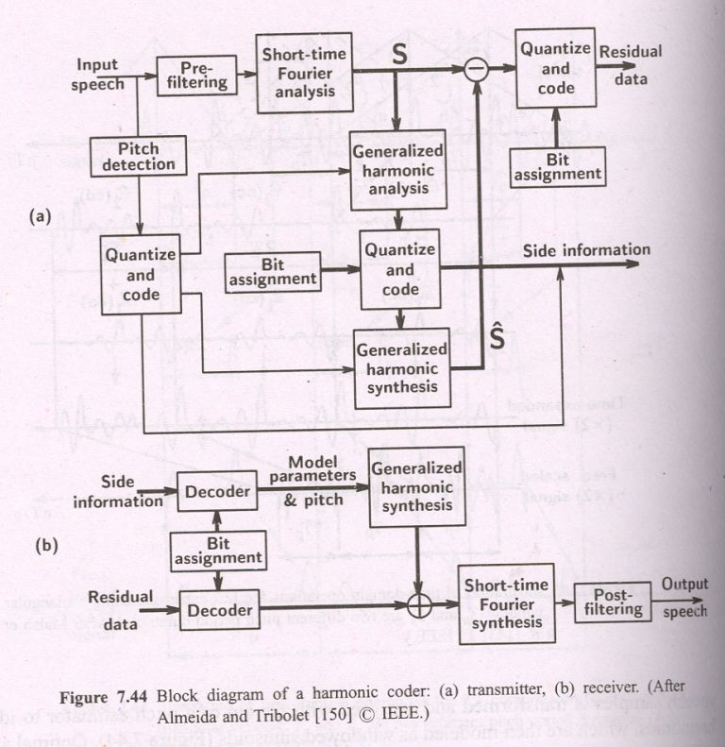
Harmonic coder

Slide 23
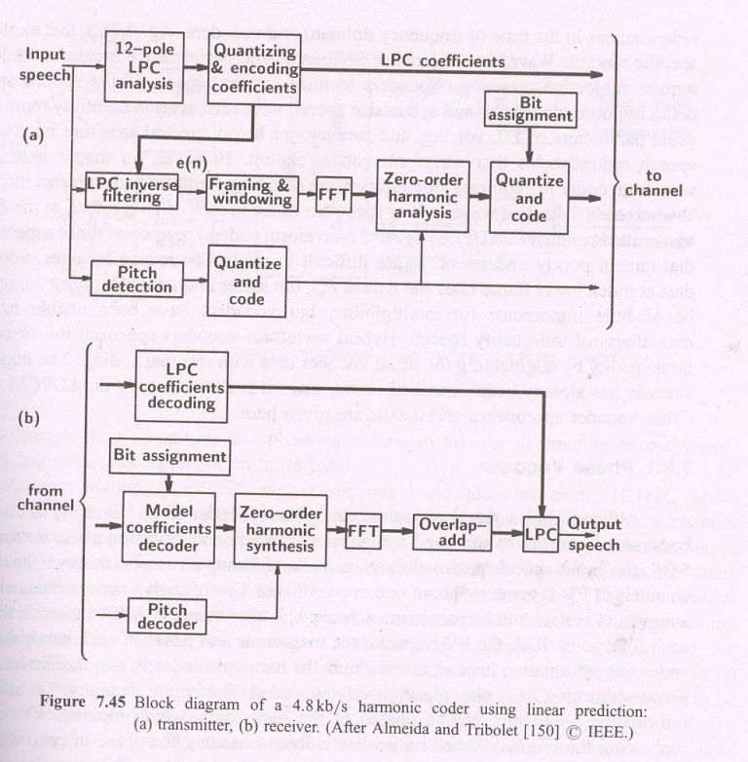
Harmonic coder using linear predictor

Slide 24
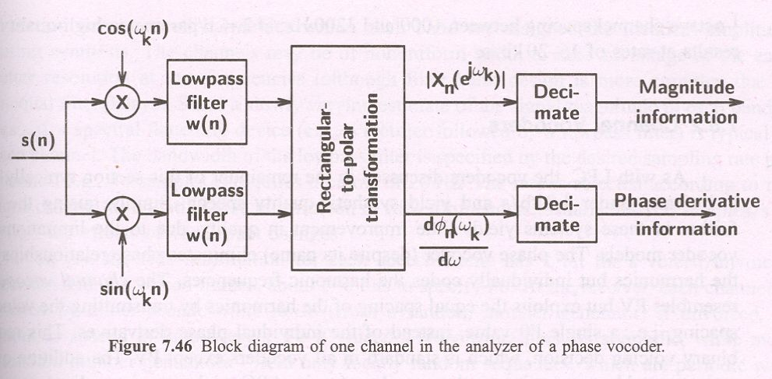
Phase vocoder

Slide 25
Speech coding
Principles of speech coding
Analysis by synthesis speech coding
Low bit rate speech coding
Perceptual audio coding of speech signals
Voice over IP speech transmission over packet networks

Slide 26
Principles of speech coding
Rate
Quality
Robustness to channel imperfections
Delay
Computational and memory requirements

Slide 27
Universal speech coder
Speech segment as a random vector
Encoding of a random speech vector
A model of quantization
Coding speech with a model family

Slide 28
Analysis by synthesis coding

Slide 29
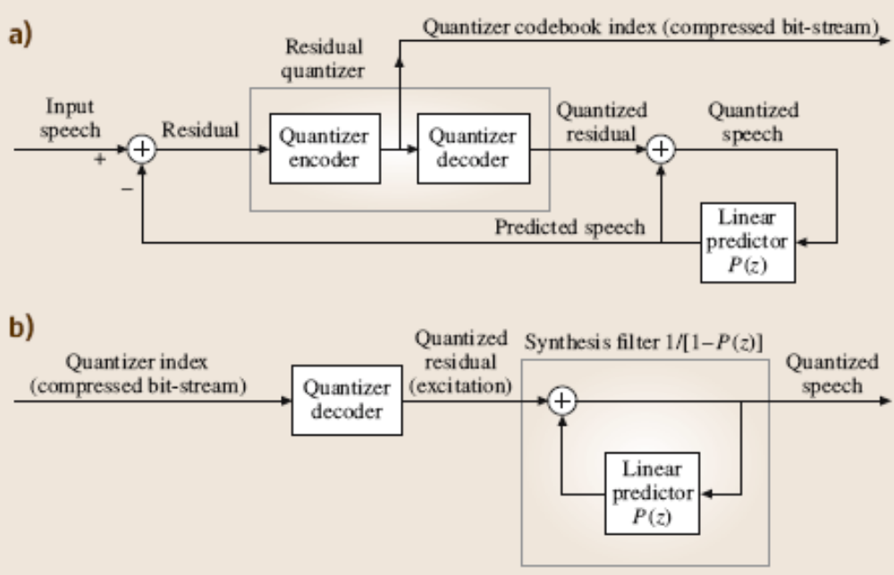
Conventional Linear prediction waveform coder

Slide 30
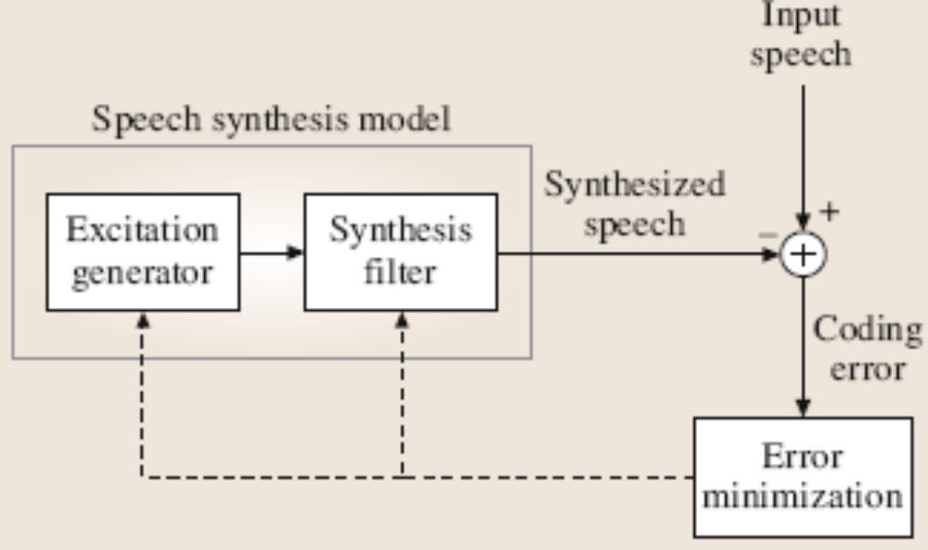
Analysis by synthesis coder

Slide 31
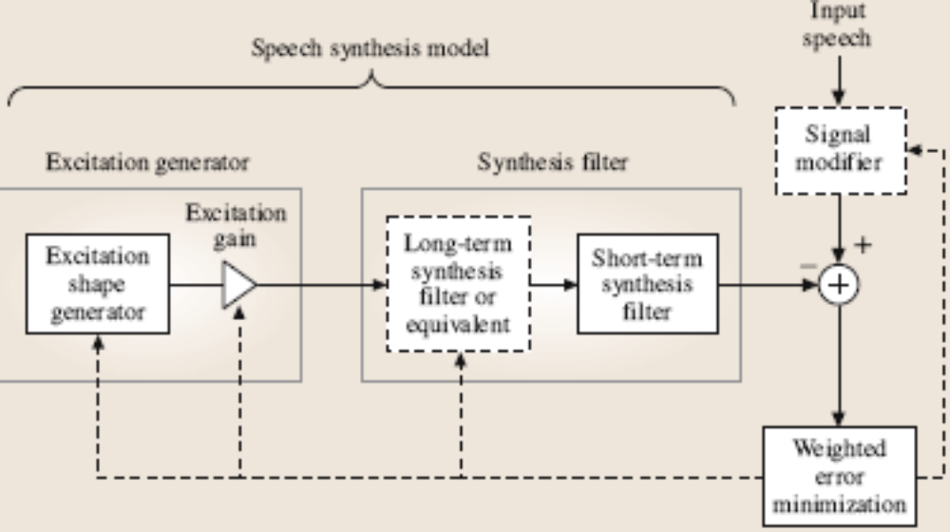
Analysis by synthesis coder (cont..)

Slide 32
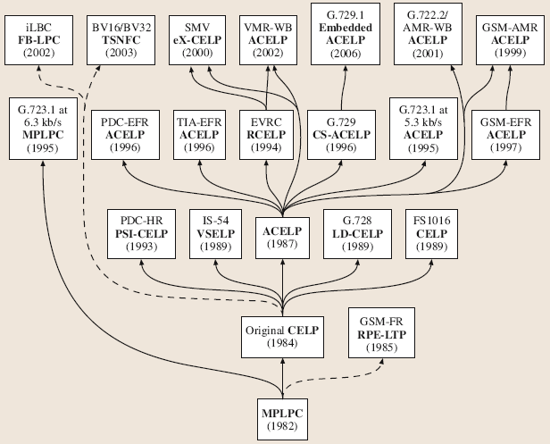
Family of the Analysis by synthesis coders

Slide 33
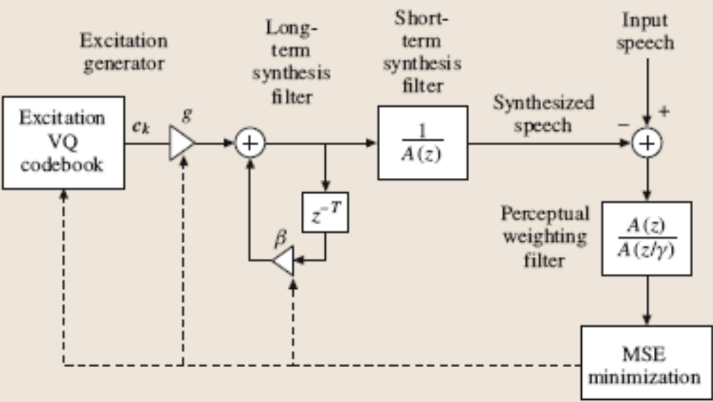
CELP coder

Slide 34
Low bit rate coders

Slide 35
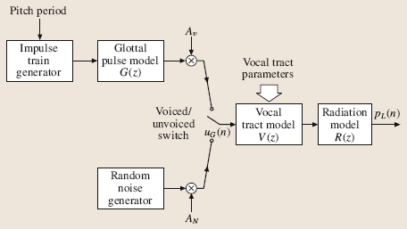
Linear model of speech production

Slide 36
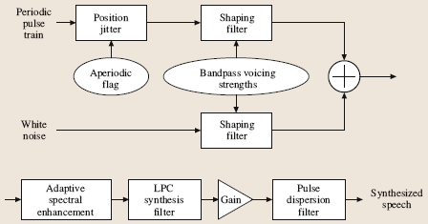
Mixed excitation linear prediction (MELP) synthesizer

Slide 37
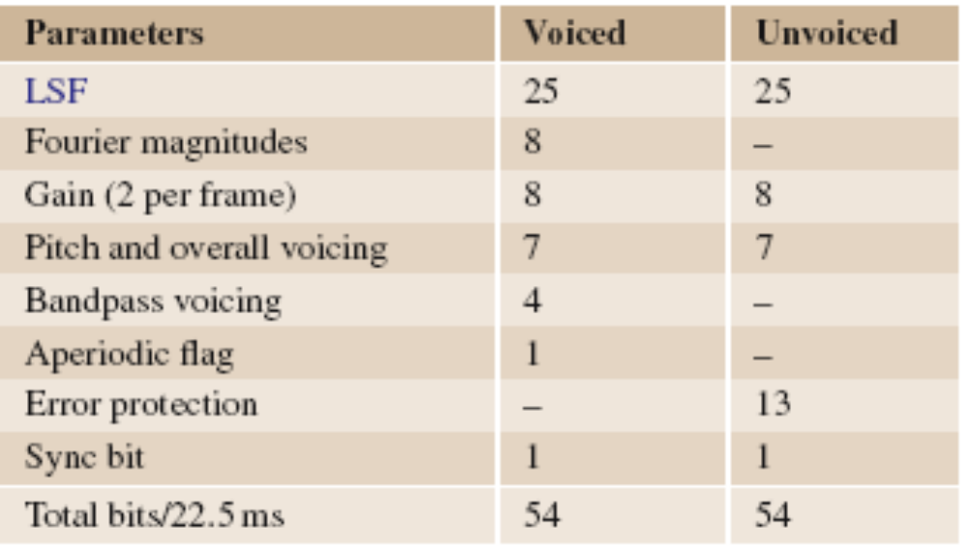
MELP coder bit allocation
(2.4 Kbps)

Slide 38
Low bit rate speech coding standards
MIL-STD 3005 (MELP 2.4 Kbps)
NATO STANAG 4591 (MELP 2.4/1.2/0.6 Kbps)

Slide 39
Perceptual audio coding

Slide 40
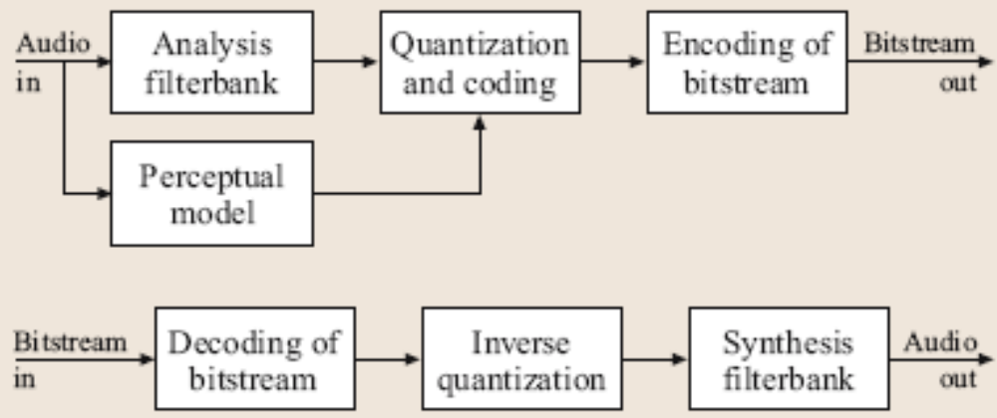
Perceptual audio coder

Slide 41
Standardized Audio Coders
MPEG-1
MPEG-2
MPEG-2 Advanced Audio Coding
MPEG-4 Advanced Audio Coding

Slide 42
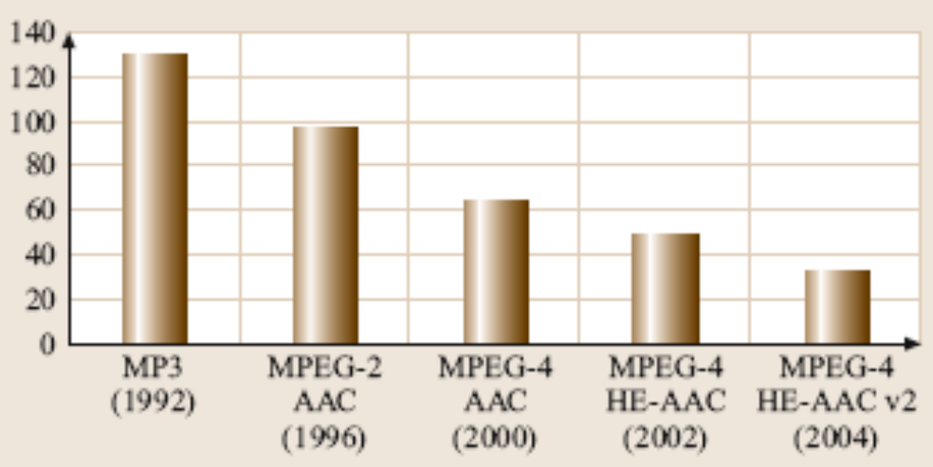
Progress in Coding Performance

Slide 43
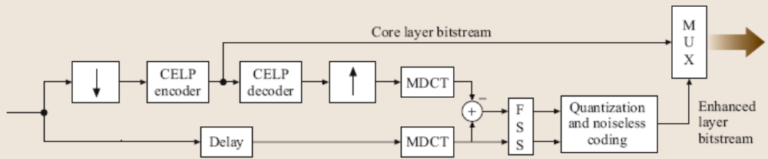
Hybrid coders

Slide 44
VoIP: speech coding for packet networks

Slide 45
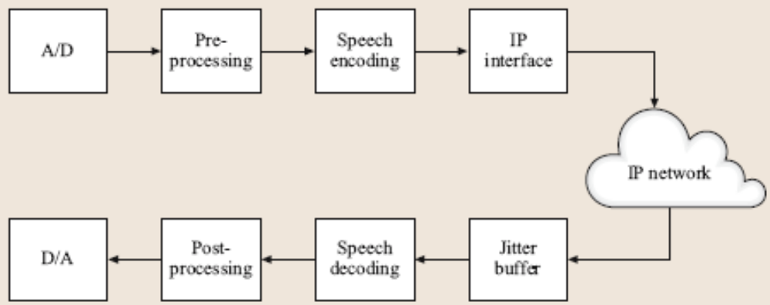
VoIP system

Slide 46
VoIP system
Echo cancellation
Speech codec
Jitter buffer
Packet loss recovery

Slide 47
Packet loss concealment
Nonparametric concealment
Parametric concealment

