Slide 1
Vector Quantization

Slide 2
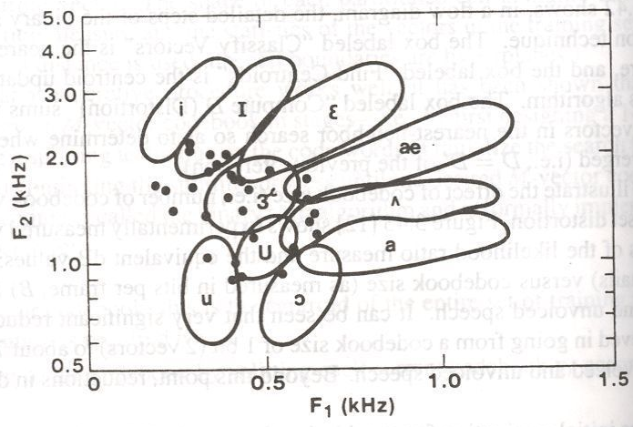
Codebook vector locations in the F1 – F2 plane

Slide 3
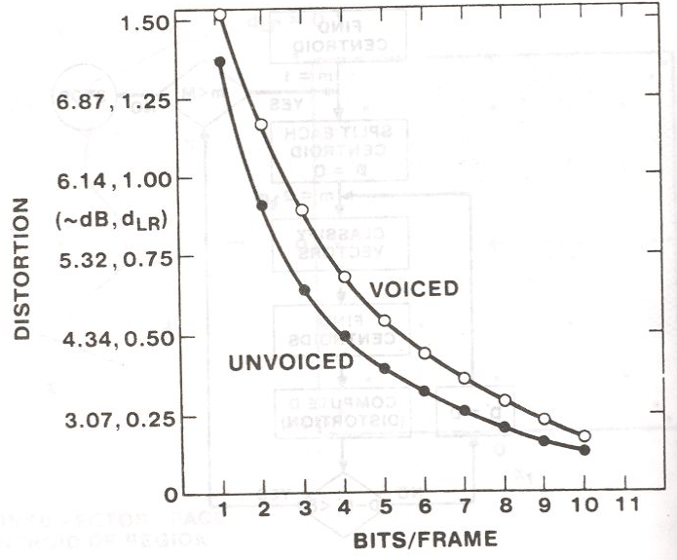
Codebook distortion vs codebook size

Slide 4
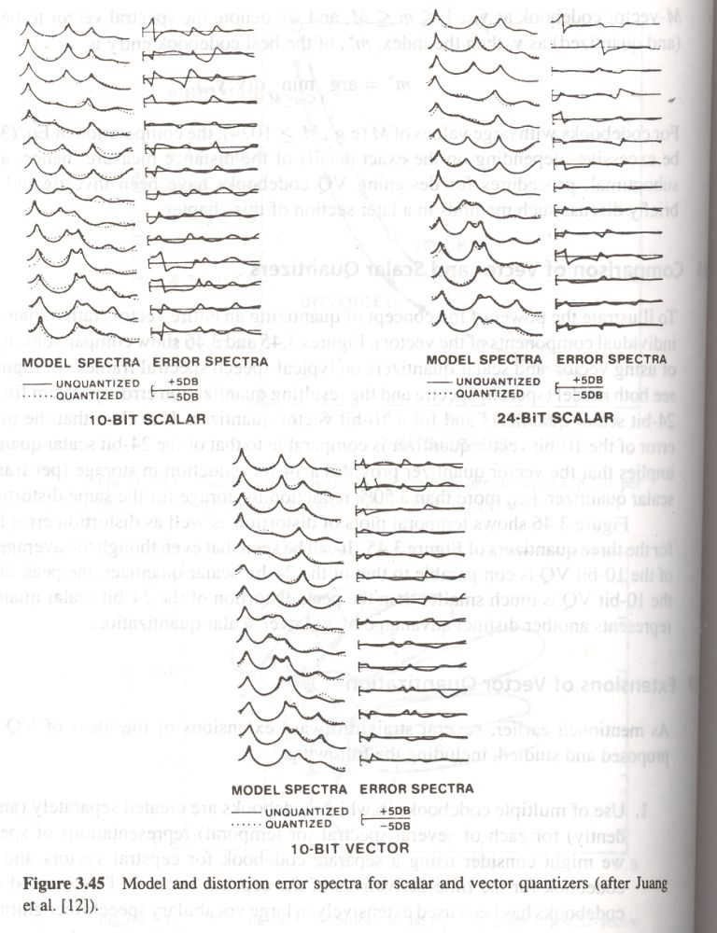
Model and distortion error spectra for scalar and vector quantizers

Slide 5
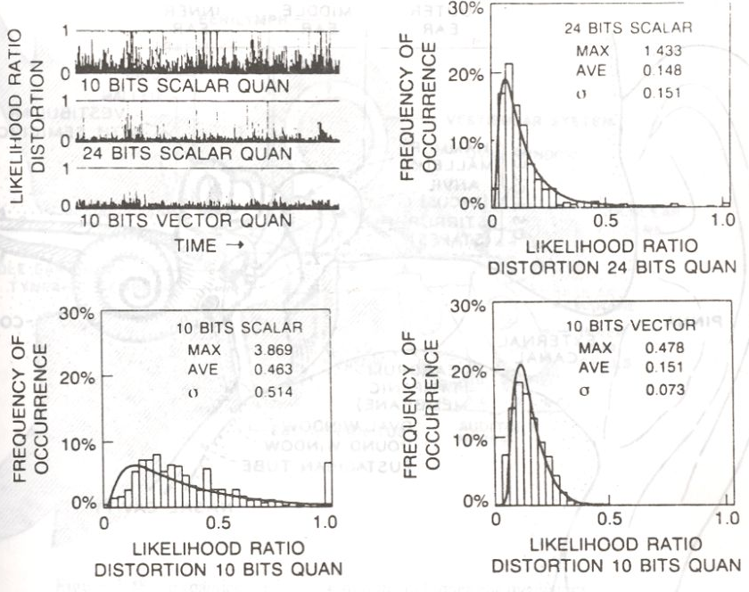
Temporal distortion for scalar and vector quantizers

Slide 6
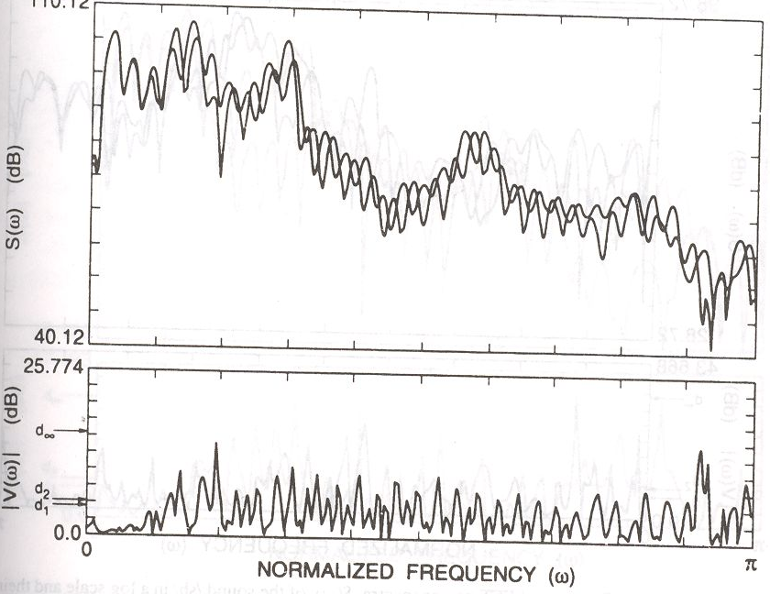
Spectral difference using FFT power spectra for the sound \e\

Slide 7
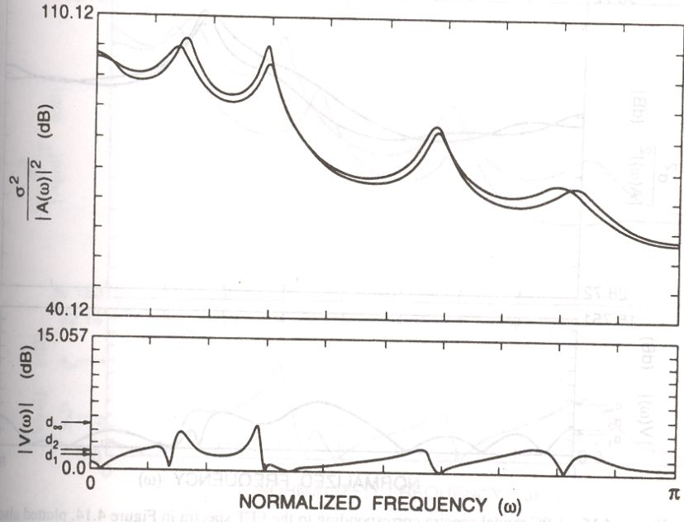
Spectral difference using LP power spectra for the sound \e\

Slide 8
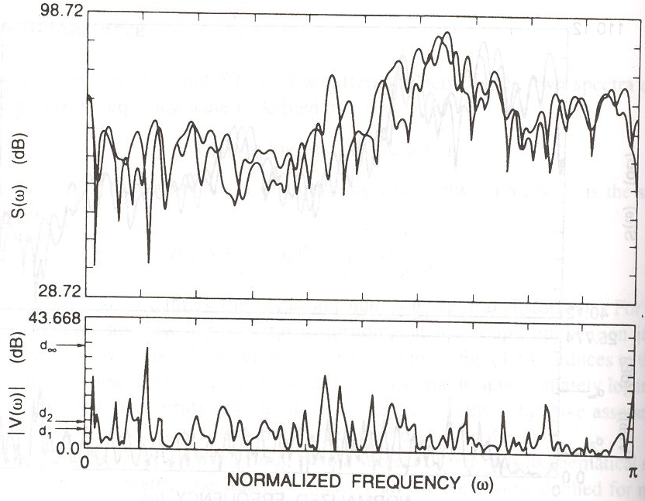
Spectral difference using FFT power spectra for the sound \sh\

Slide 9
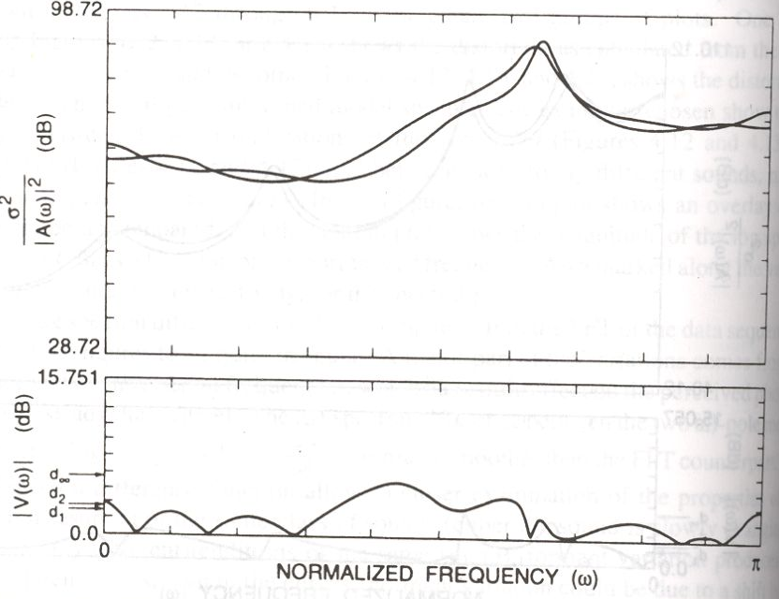
Spectral difference using LP power spectra for the sound \sh\

Slide 10
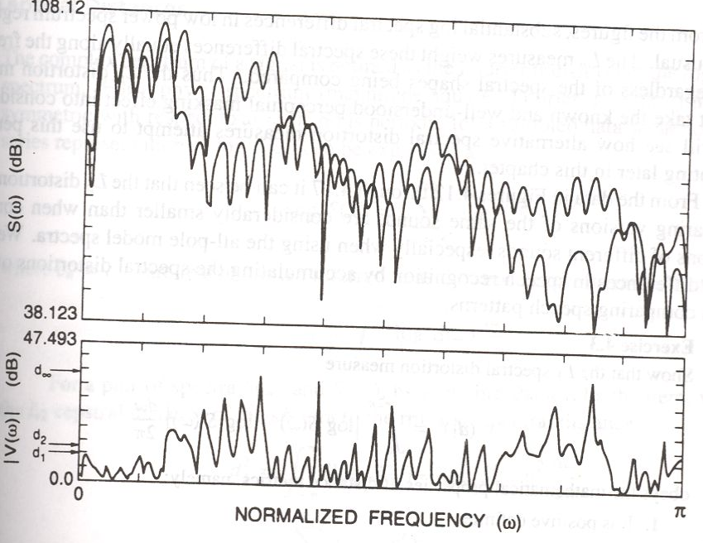
Spectral difference using FFT power spectra for the sounds \e\ and \i\

Slide 11
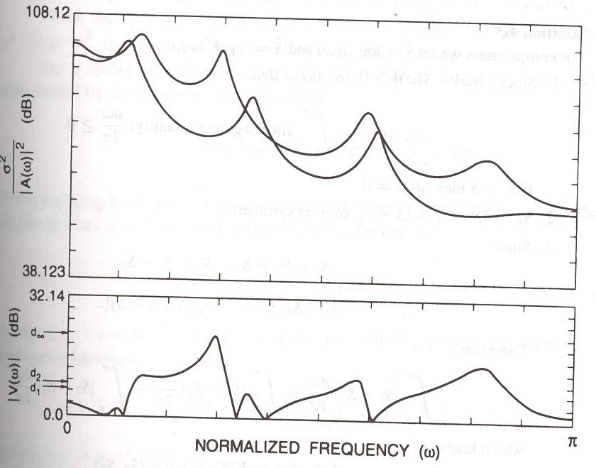
Spectral difference using LP power spectra for the sounds \e\ and \i\

Slide 12
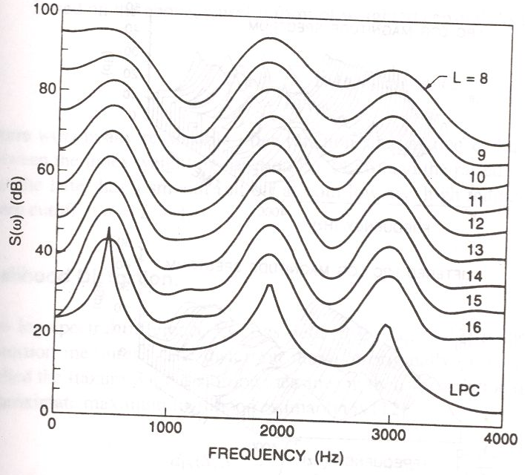
Cepstral liftering on LP spectrum

Slide 13
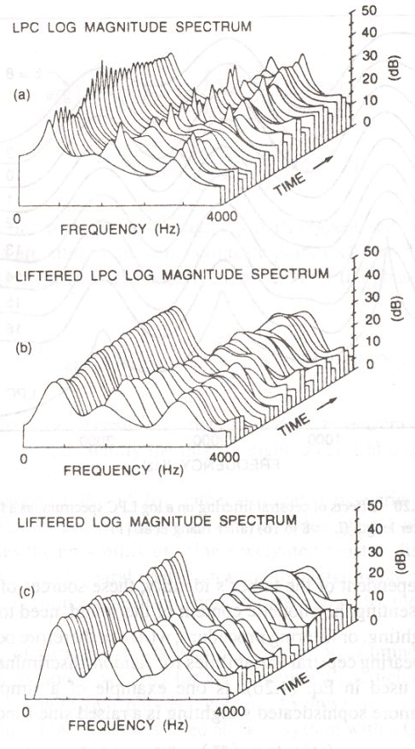
Comparison of
original and liftered
magnitude spectra

