Slide 1
Objective
Agenda
Introduction to AWS
Use case
Advantages of cloud computing
Characteristics
Domain of AWS
AWS Architecture
Demo-1 AWS Free Tier Account

Slide 2
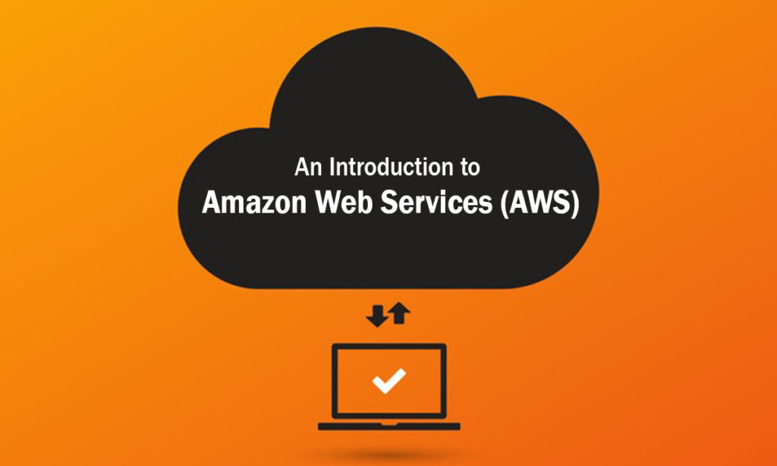
Introduction to AWS
Amazon Web Services(AWS) is a secure cloud services platform, offering
computing power, database storage, content delivery and other functionally to
help businesses scale and grow.

Slide 3
Introduction to AWS
It provides 300 plus services, as of this presentation.
Client security is a significant concern for AWS. Their infrastructure is successfully satisfying the security concerns of the military, global banks, and other high-sensitivity organizations.
It has 230 security, compliance, and governance services with 90 security standards and compliance certifications, and 117 AWS services can encrypt data.

Slide 4
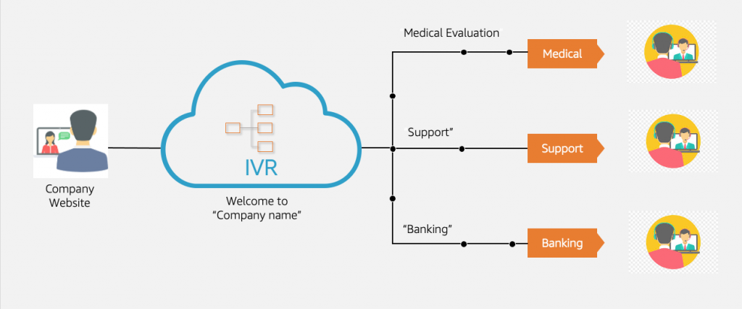
Use-Cases
Manufacturing Organization
Architecture consulting
Media company
Large enterprise

Slide 5
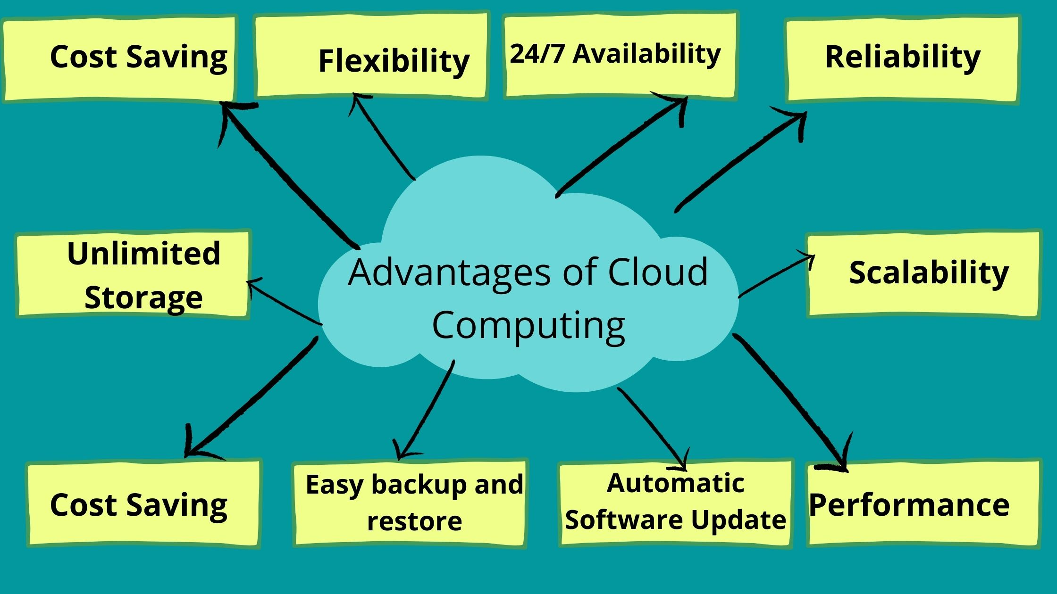
Advantages of Cloud Computing
Flexibility
Cost effective
Scalability
Security

Slide 6
Advantages of Cloud Computing
Cloud computing do not need high quality equipment for user, and it is very easy to use.
Provides dependable and secure data storage center.
Reduce run time and response time.
Cloud is a large resource pool that you can buy on-demand service.
Scale of cloud can extend dynamically providing nearly infinite possibility for users to use internet.

Slide 7
Essential Characteristics
On-demand self-service
A consumer can unilaterally provision computing capabilities, such as server time and network storage, as needed automatically without requiring human interaction with each service provider.
Broad network access
Capabilities are available over the network and accessed through standard mechanisms that promote use by heterogeneous thin or thick client platforms (e.g., mobile phones, tablets, laptops, and workstations).

Slide 8
Characteristics
Resource pooling
The provider’s computing resources are pooled to serve multiple consumers
Resources can be dynamically assigned and reassigned according to customer demand
Customer generally may not care where the resources are physically located but should be aware of risks if they are located offshore

Slide 9
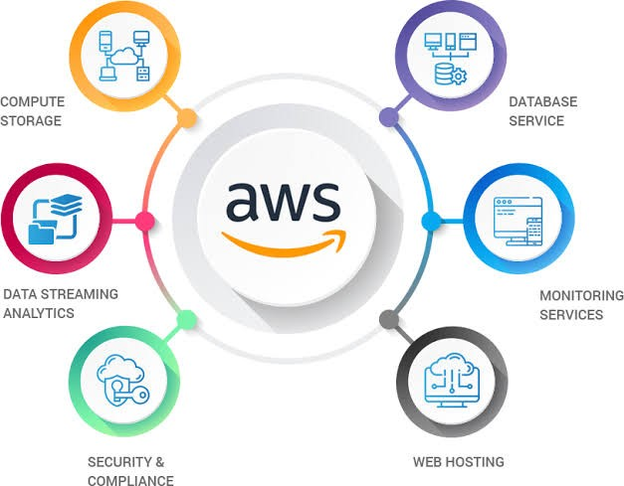
Domain of AWS
Compute
Migration
Security & compliance
Storage
Networking
Messaging
Database
Management tools

Slide 10
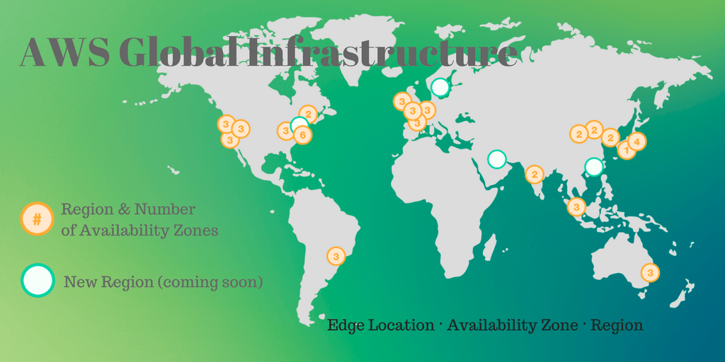
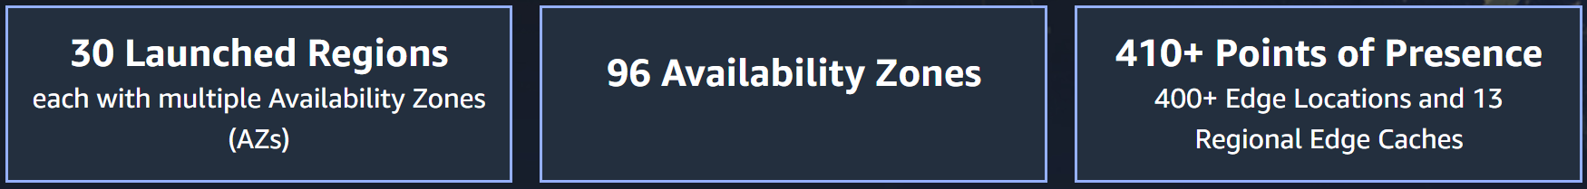
AWS Architecture
egions are geographic locations worldwide where AWS hosts its data centers.

Slide 11
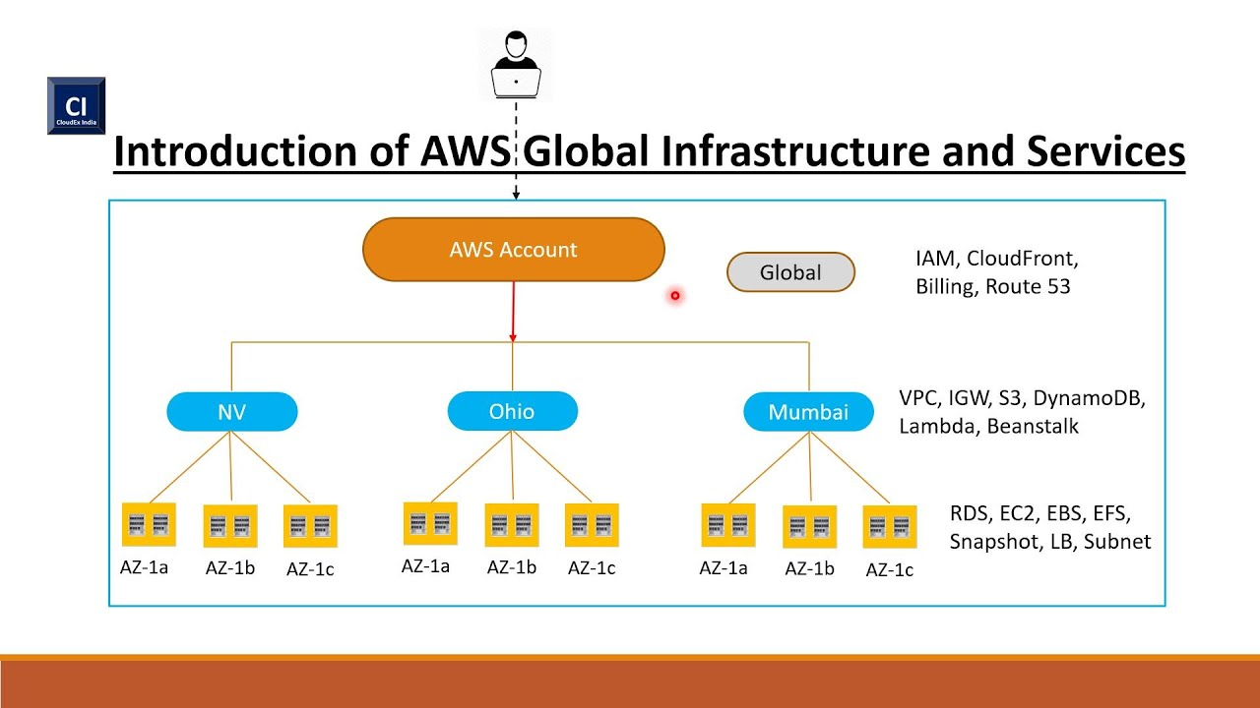
AWS Architecture

Slide 12
AWS Architecture
AWS Region
AWS Region is a separate geographic area with a set of Availability Zones
AZs are multiple isolate locations/ Data Centers within a Region
AWS Regions meet the highest level of security, compliance, and Data protection
Pricing
Security and Compliance Requirement
User / Customer Location
Service Availability
Latency

Slide 13
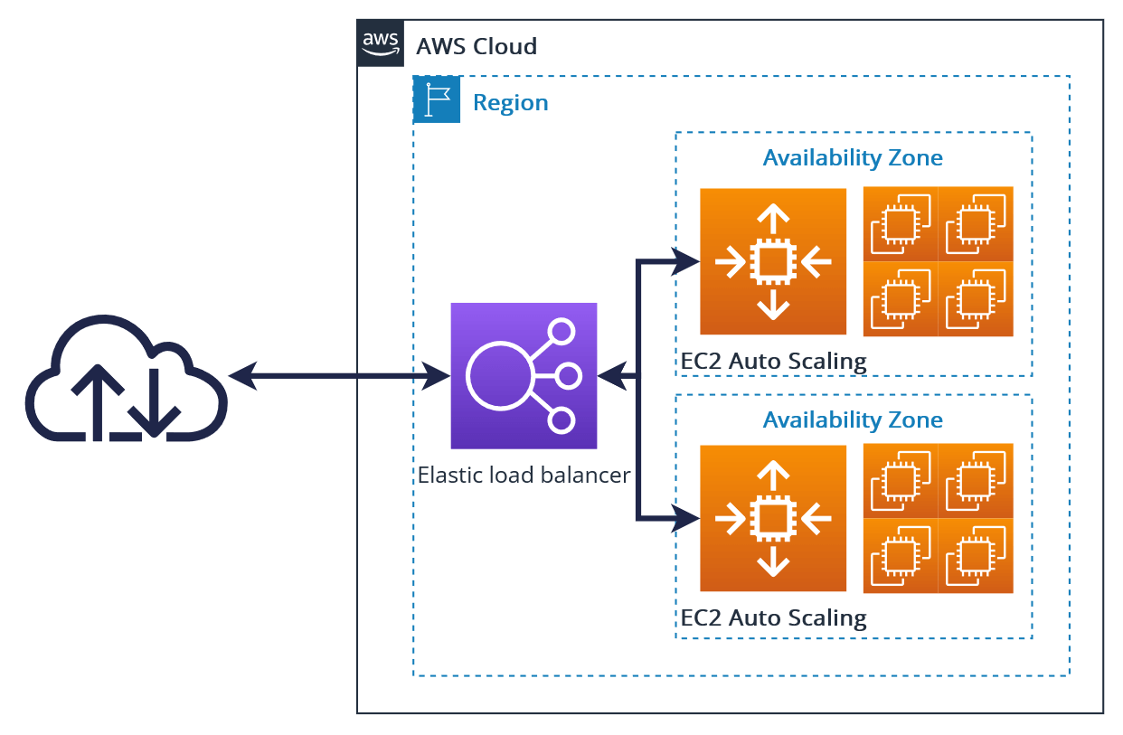
AWS Architecture
AWS Availability Zones
It ensures that data and services is available in normal and even in disaster recovery operation
It is achieved by maintaining reliable engineering, service management techniques, and redundancy to minimize system failures and time to repair
Considering all these aspects, AWS provides optimum services to its customers by maintaining High Availability of data.

Slide 14
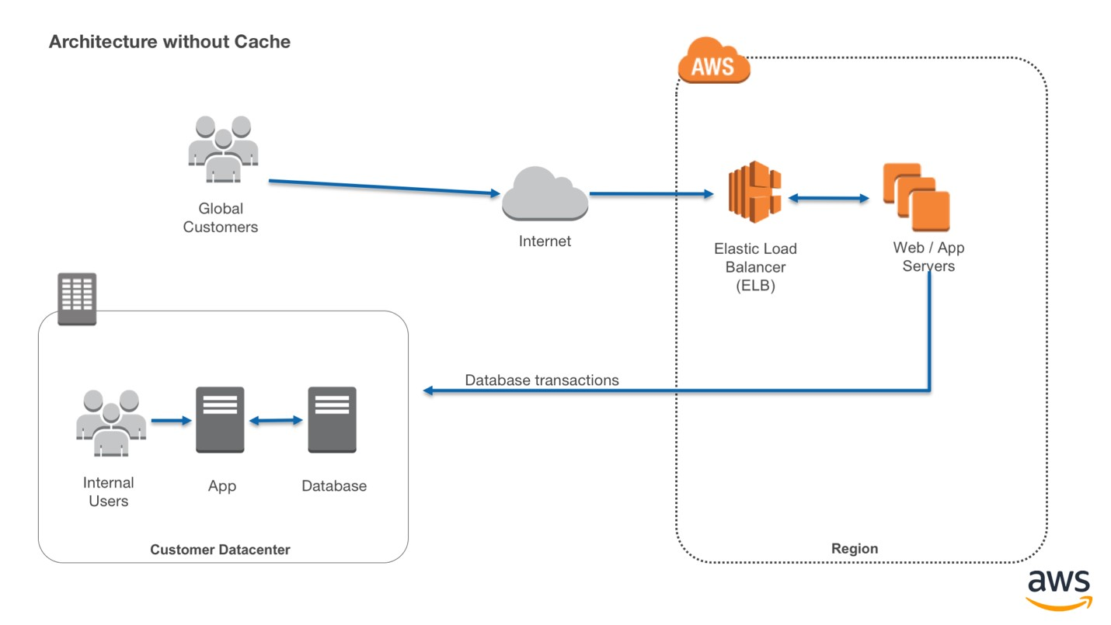
AWS Architecture
Latency
Latency is the measure of time required for transfer of data from client to server and back to the client.
More the latency, lower is the efficiency
AWS has its clients throughout the world, so to reduce latency and avoid load on servers, they use Edge Locations.

Slide 15
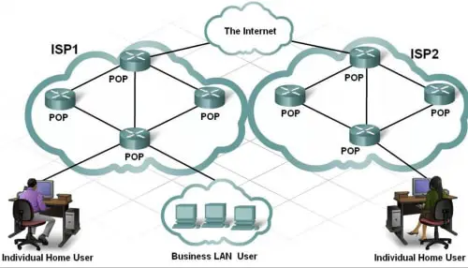
Pop (Point of Presence Locations)
AWS Architecture
Pop locations are used by AWS CloudFront service, which is a fast Content Delivery Network (CDN) service that securely delivers data, videos, applications to customers globally with low latency.

Slide 16
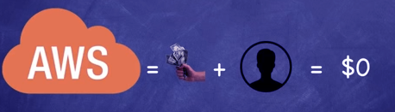
Demo-1: Signup an AWS Free Tier Account

Slide 17
Management Console
AWS Free Tier:
Amazon Free Tier offers many resources to begin your work and understand how to support ephemeral workloads while maintaining a continues infrastructure state.
AWS Free Tier provides you control for AWS resources such as EC2, S3, and AWS Identity Access Management.

Slide 18
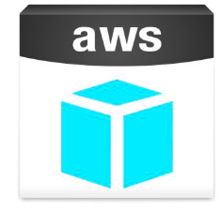
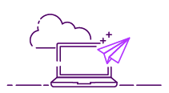
Management Console
AWS can be managed in two ways-
Through the mobile app
Through a simple and intuitive web-based user interface

Slide 19


