Slide 2
Objective
Agenda
Why cloud?
Before cloud computing
What is cloud computing?
Cloud services models
Cloud deployment models
Cloud providers

Slide 3
Why cloud?
Before cloud computing:
Suppose you want to host a website, these are the following things that you would need to do:
High traffic? More servers.
Monitoring and maintain servers.

Slide 4
Why cloud?
Before cloud computing:
If you consider costs then this setup is expensive.
Troubleshooting problems can be tedious and may conflict with your business goals.
Since the traffic is varying, your servers will be idle most of the time.

Slide 5
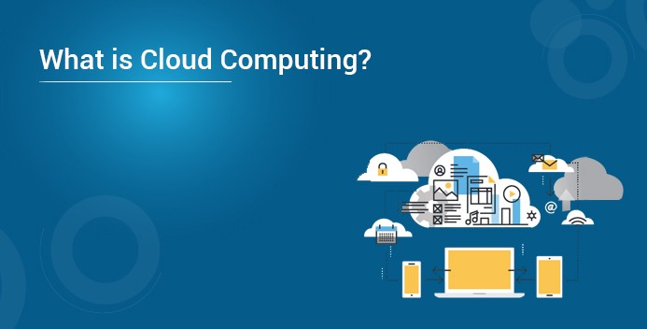
What Is Cloud Computing?
Cloud computing is:
Strong data/application on remote servers
Processing data/application from servers
Accessing data/application via internet
Uses Virtualization Concept
Enables Access to Cloud services
Provides the option “pay as you go”

Slide 6
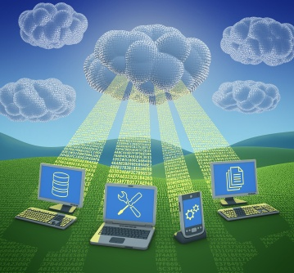
What Is Cloud Computing?
Generally speaking, cloud computing can be thought of as anything that involves delivering hosted services over the Internet.
According to NIST Cloud computing is a model for enabling ubiquitous, convenient, on-demand network access to a shared pool of configurable computing resources (e.g., networks, servers, storage, applications, and services) that can be rapidly provisioned and released with minimal management effort or service provider interaction. (Special Publication 800-145)

Slide 7
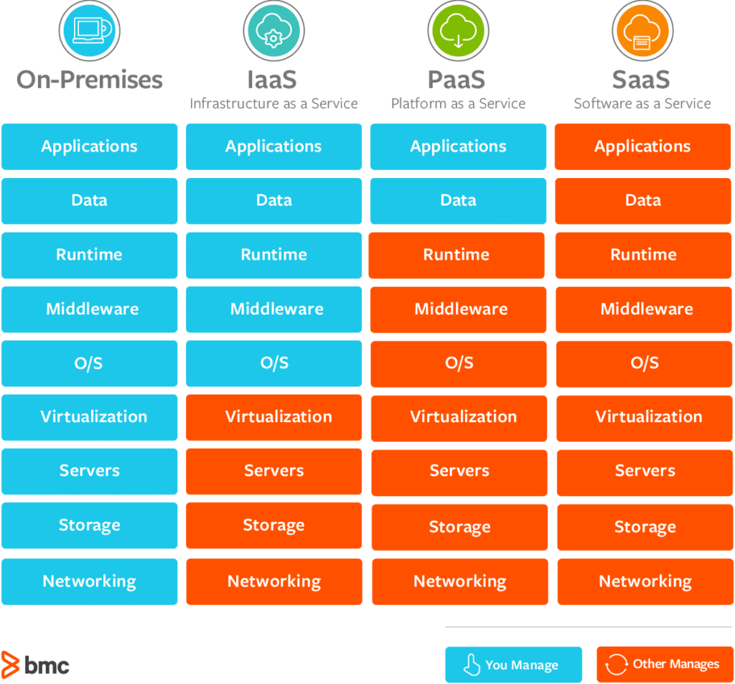
Different Cloud Computing Service models

Slide 8
Different Cloud Computing Service models

Slide 9
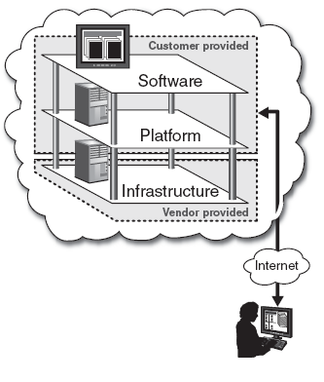
Service Models
Software-as-a-Service (SaaS)
Also referred to as “software on demand,” this service model involves outsourcing the infrastructure, platform, and software/applications.
Typically, these services are available to the customer for a fee, pay-as-you-go, or a no charge model.
The customer accesses the applications over the internet.

Slide 10
Service Models
Platform-as-a-Service (PaaS)
A service model that involves outsourcing the basic infrastructure and platform (Windows, Unix)
PaaS facilitates deploying applications without the cost and complexity of buying and managing the underlying hardware and software where the applications are hosted.
The customer uses their own applications

Slide 11
Service Models
Infrastructure-as-a-Service (IaaS)
A service model that involves outsourcing the basic infrastructure used to support operations--including storage, hardware, servers, and networking components.
The service provider owns the infrastructure equipment and is responsible for housing, running, and maintaining it. The customer typically pays on a per-use basis.
The customer uses their own platform (Windows, Unix), and applications

Slide 12
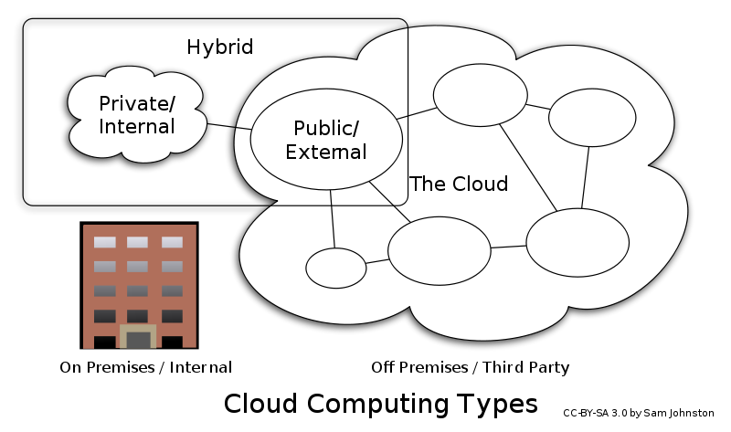
Deployment Models

Slide 13
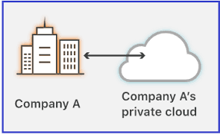
Deployment Models
Private Cloud:
The cloud is operated solely for an organization. It may be managed by the organization or a third party and may exist on premise or off premise.

Slide 14
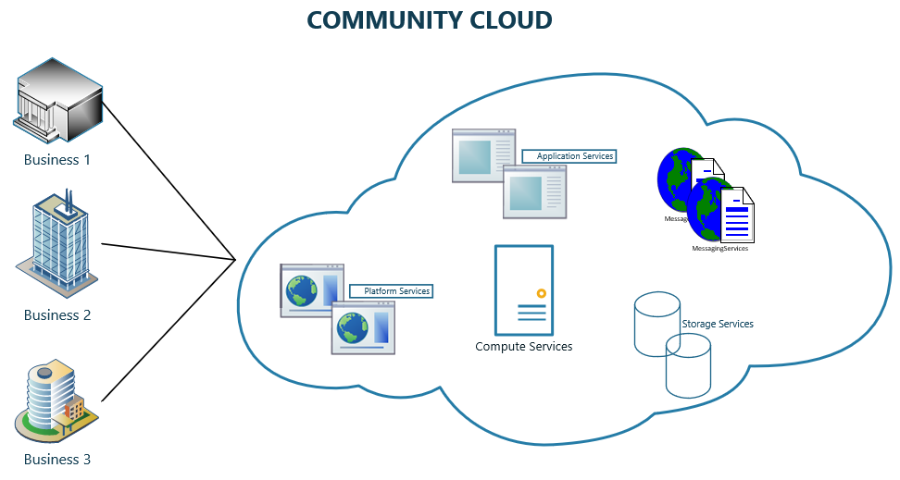
Deployment Models
Community Cloud:
The cloud infrastructure is shared by several organizations and supports a specific community that has shared concerns.
It may be managed by the organizations or a third party and may exist on premise or off premise

Slide 15
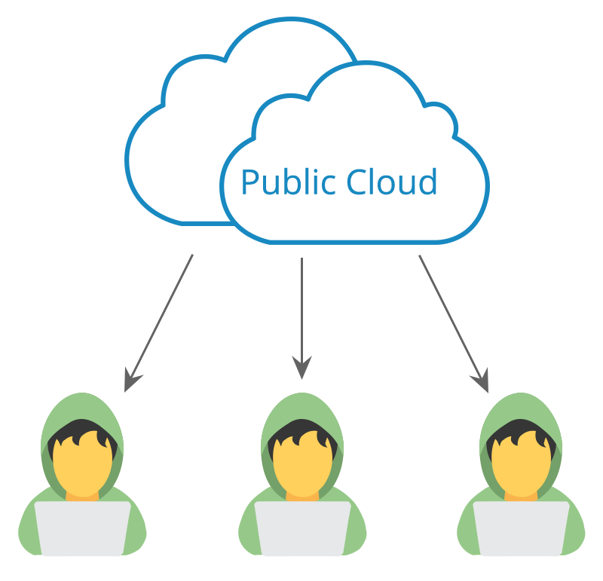
Deployment Models
Public Cloud:
The cloud infrastructure is made available to the general public or a large industry group and it is owned by an organization selling cloud services.

Slide 16
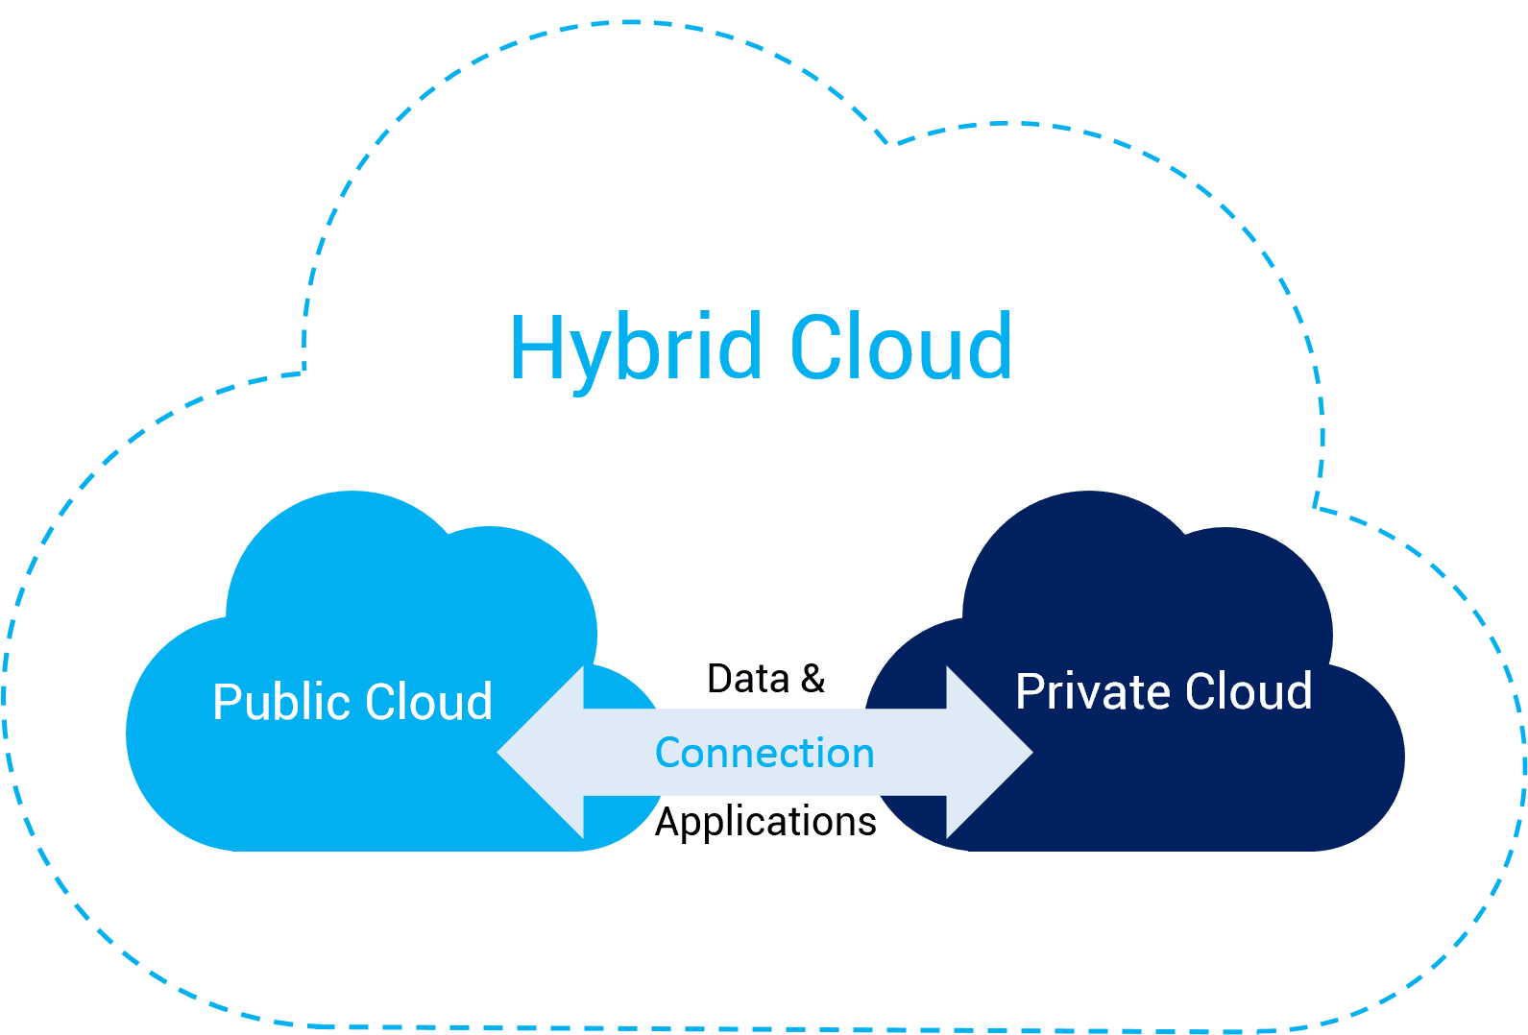
Deployment Models
Hybrid cloud:
The cloud infrastructure is a composition of two or more clouds (private, community, or public).

Slide 17
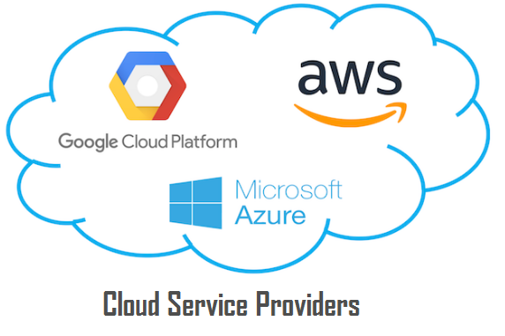
Cloud Services Providers
AWS (Amazon web services)
GCP (Google cloud)
Azure (Microsoft)

Slide 18
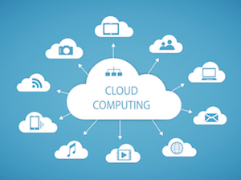
Cloud Services Providers

Slide 19
What It Provides
Cloud computing provides shared services as opposed to local servers or storage resources
Enables access to information from most web-enabled hardware
Allows for cost savings – reduced facility, hardware/software investments, support

Slide 20
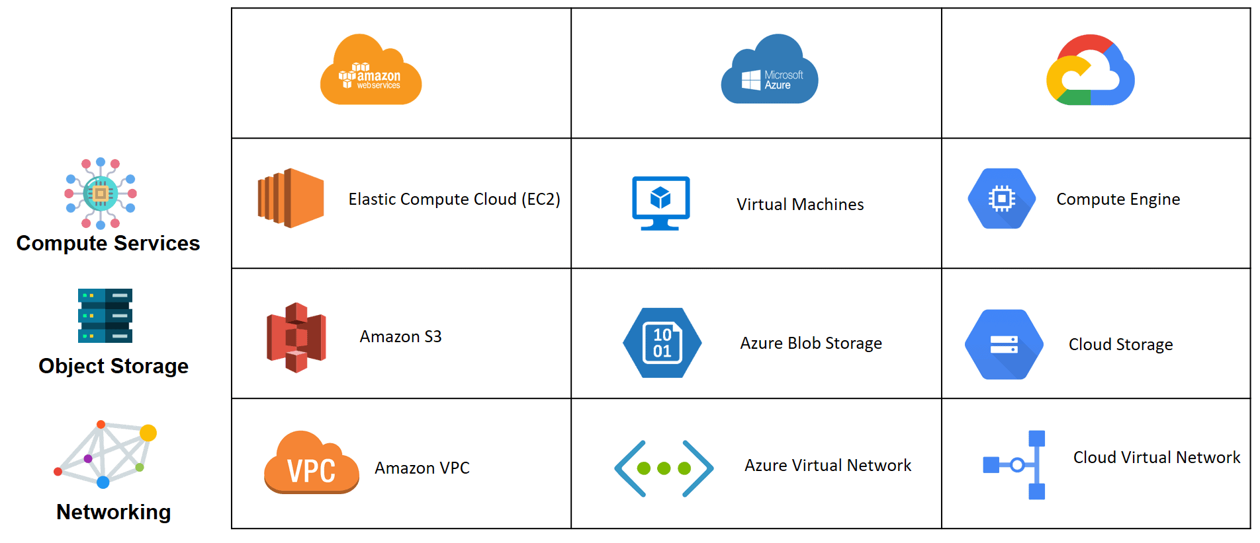
Service Comparison of AWS, Azure and GCP:

Slide 21
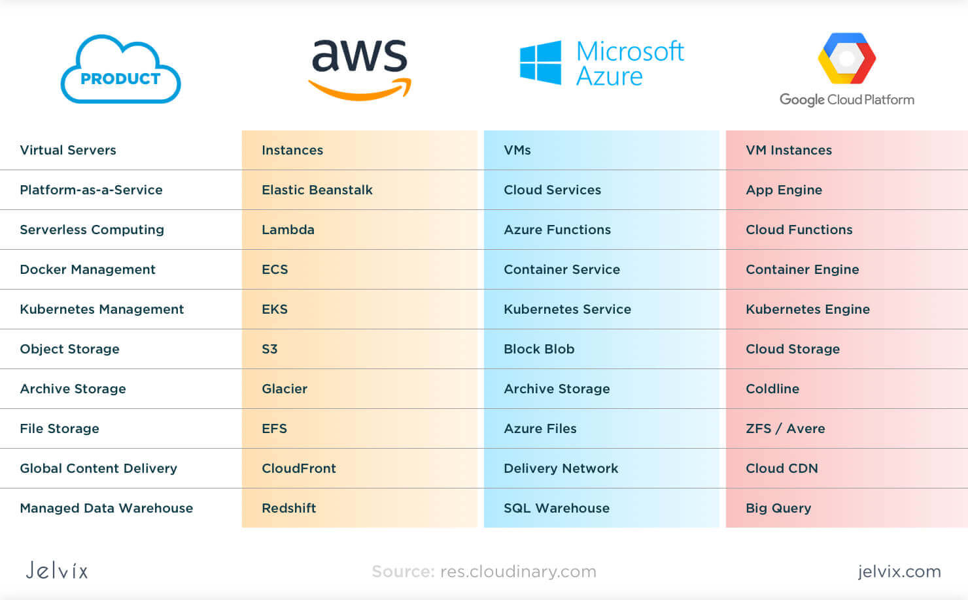
Service Comparison of AWS, Azure and GCP:

Slide 22


