Slide 1
Lead Scoring Case Study
Submitted by
Chetan kabburi
Rahul Shetty
Rahul Singh

Slide 2
Business Objective
Assist X Education in identifying high-potential leads that have the greatest likelihood of converting into paying customers.
Develop a logistic regression model that assigns a lead score ranging from 0 to 100, helping the company efficiently target prospective leads.

Slide 3
Problem Statement
Company Overview:
X Education is an e-learning company offering online courses for industry professionals.
Context:
The company promotes its courses via online platforms such as search engines and websites.
Visitors explore different courses, watch videos, or complete inquiry forms on the website.
Those who submit their details via forms are classified as leads.
Challenges:
The company receives a large volume of leads, but only 38% convert into customers.
To improve efficiency, X Education seeks to develop a system that assigns a lead score to determine the likelihood of conversion.
A higher lead score indicates a greater probability of conversion, while a lower lead score suggests a weaker potential.

Slide 4
Data Cleaning
Handling Missing Data:
Removed columns with more than 40% missing values, including:
How did you hear about X Education? (78.46% missing)
Lead Profile (74.18% missing)
Lead Quality (51.60% missing)
Asymmetrique Profile Score, Activity Score, Activity Index, Profile Index (45% missing)
Eliminating Redundant Columns:
Dropped unnecessary variables:
Updates
Last Activity
Prospect ID
Filling Missing Values:
Numerical data filled using median values.
Categorical data filled using mode values.

Slide 5
Exploratory Data Analysis (EDA)
Insights from Univariate Analysis:
Leads from Google and Direct Traffic exhibit higher conversion rates.
Prospective students specializing in Finance Management have the highest conversion probability.
Working professionals show greater likelihood of converting.
Most leads originate from Mumbai, with a conversion rate exceeding 50%.

Slide 6
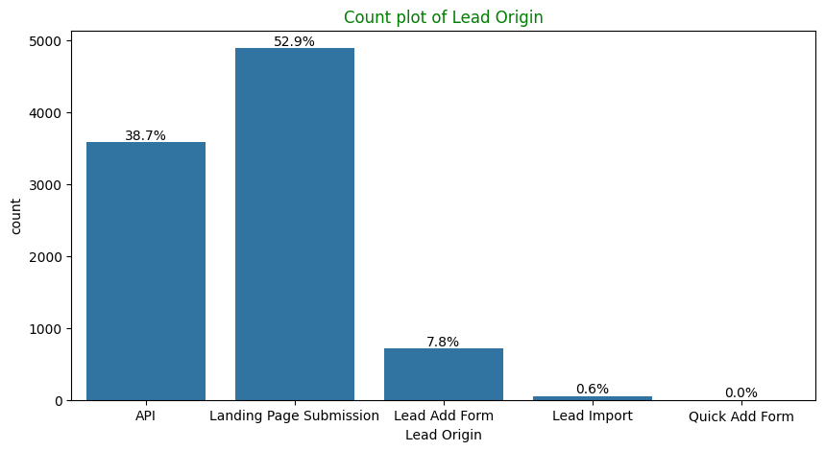
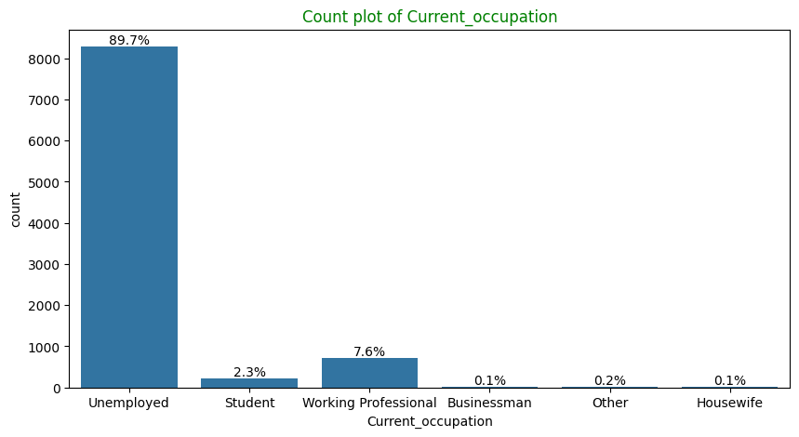
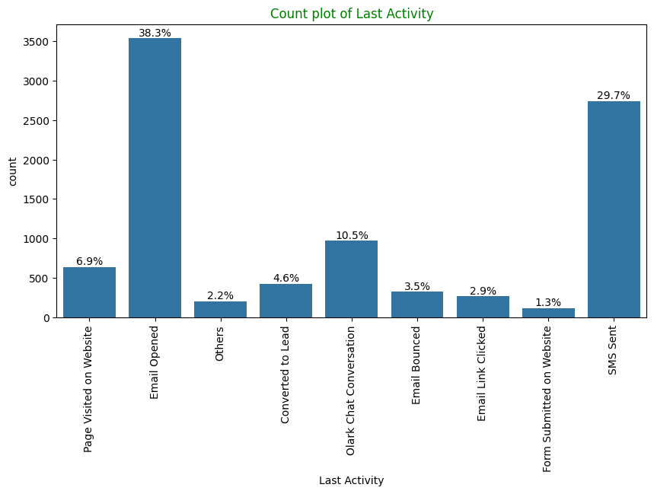
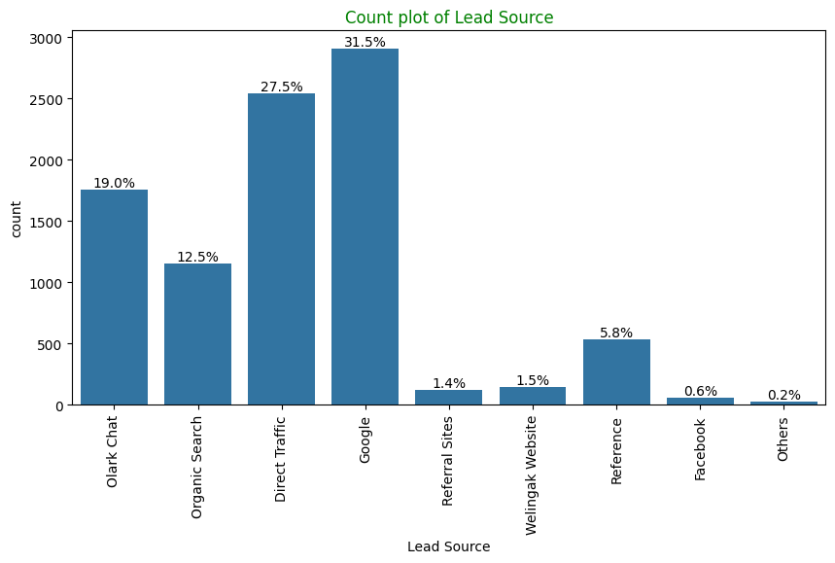
Univariate Analysis

Slide 7
Univariate Analysis - Key Observations
Here is the list of features from variables which are present in majority (Converted and Not Converted included)
Lead Origin: "Landing Page Submission" identified 53% customers, "API" identified 39%.
Current_occupation: It has 90% of the customers as Unemployed
Do Not Email: 92% of the people has opted that they dont want to be emailed about the course.
Lead Source: 59% Lead source is from Google & Direct Traffic combined
Last Activity: 68% of customers contribution in SMS Sent & Email Opened activities

Slide 8
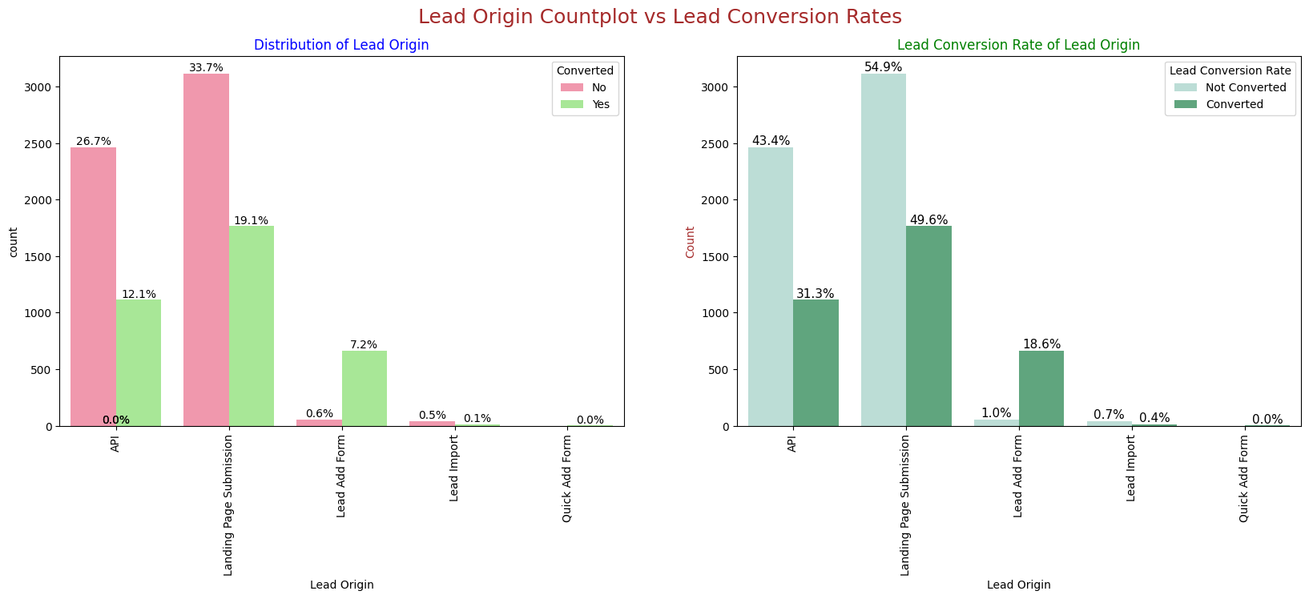
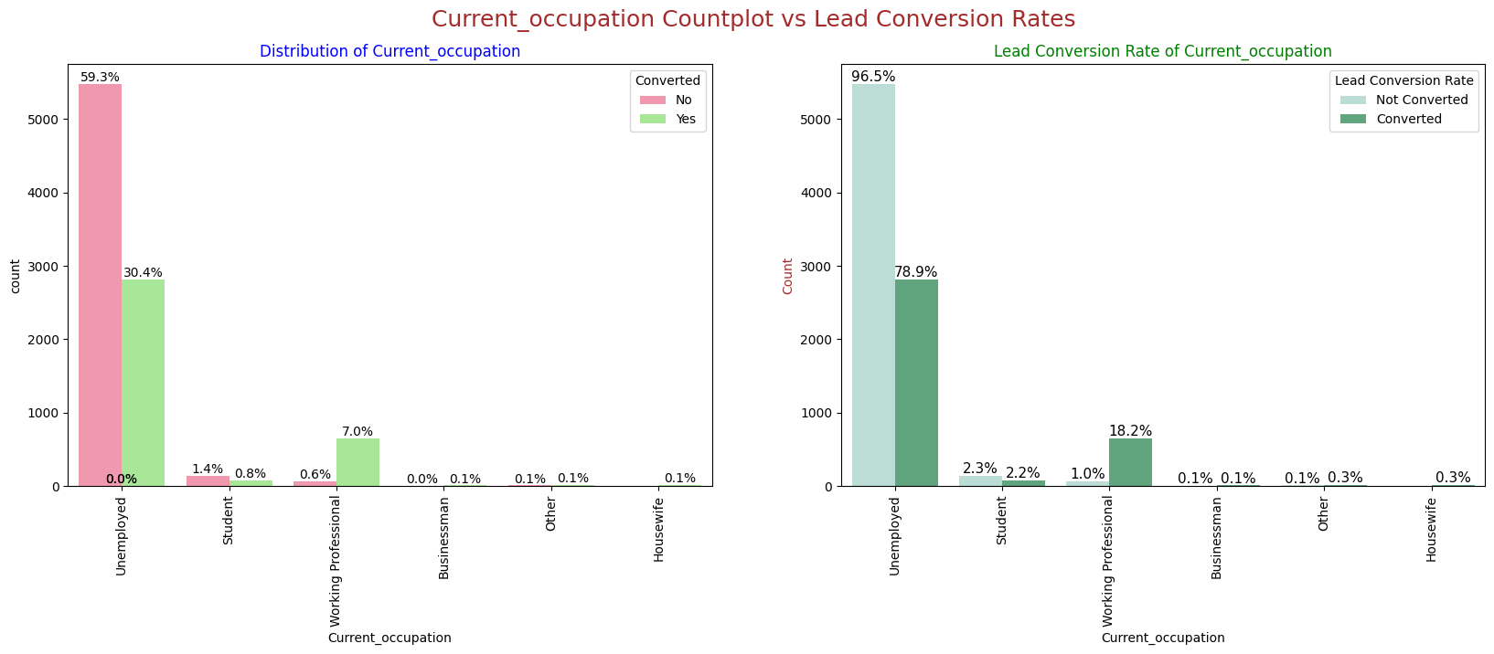
Bi-variate Analysis (1/4)

Slide 9
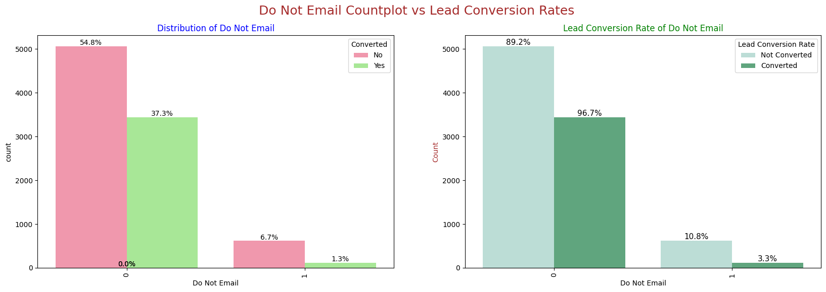
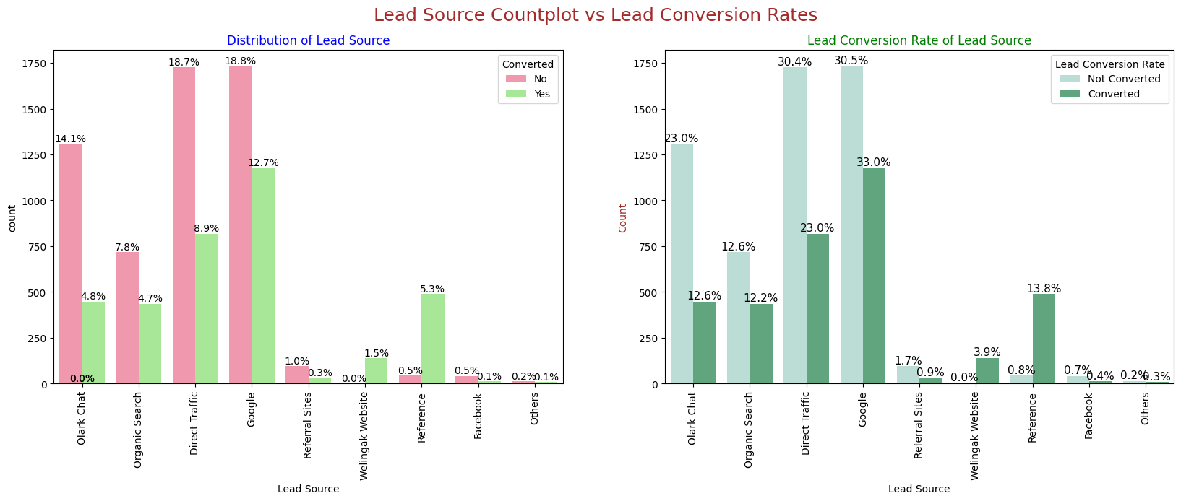
Bi-variate Analysis (2/4)

Slide 10
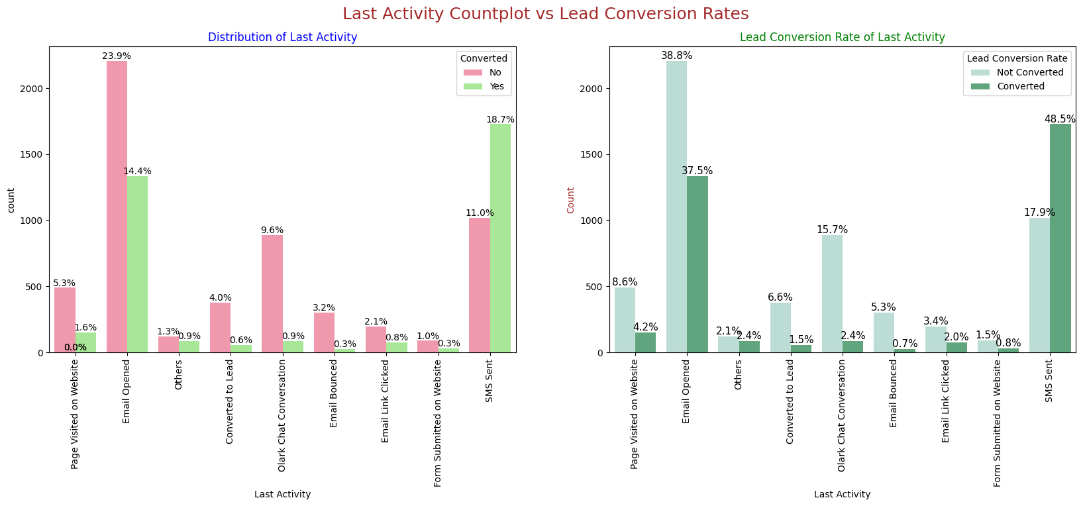
Bi-variate Analysis (3/4)

Slide 11
Bi-variate Analysis (4/4)
Correlation Analysis:
Total Visits and Pages Viewed per Visit exhibit a strong positive correlation.
Time Spent on Website correlates positively with:
Lead Conversion
Page Views
Total Visits
Page Views and Lead Conversion show a negative correlation.
Bi-variate Analysis - Key Takeaways
Numerical Variables Relationship:
A linear correlation exists between Total Visits and Pages Viewed per Visit.
Categorical & Numerical Relationships:
Leads sourced from Organic Search have higher page views per visit and better conversion rates.
Those spending more time on the website exhibit higher conversion probabilities.
Visitors with multiple site visits are more likely to convert.
Individuals enrolling for career growth display a higher likelihood of conversion.

Slide 12
Model Building
Model Overview
A logistic regression model was developed to predict the likelihood of lead conversion.
The model assigns lead scores, allowing the sales team to prioritize high-potential leads.
The final model includes 12 features, with the top three influential variables being:
Lead Source – Welingak Website
Lead Source – Reference
Current Occupation – Working Professional

Slide 13
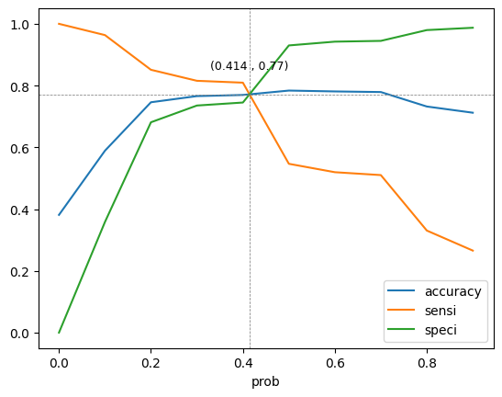
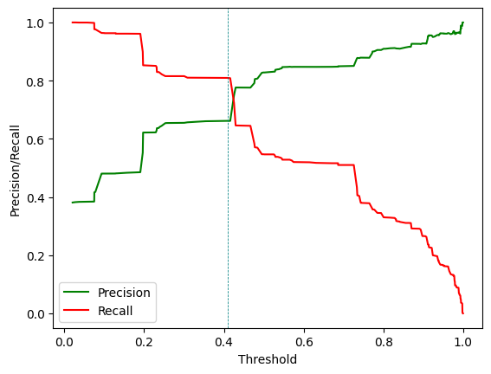
Model Evaluation
The intersection point of the curve is the threshold value where the model achieves a balance between precision and recall. It can be used to optimize the performance of the model based on business requirement, Here our probability threshold is 0.41 approx. from above curve.

Slide 14
Model Evaluation
Training Data
Optimal Cut-off Probability: 0.345
Accuracy: 80.51%
Sensitivity (Recall): 65.69%
Specificity: 89.65%
Positive Predictive Value (Precision): 79.64%
Negative Predictive Value: 80.92%
Model Performance - Test Data
Accuracy: 80.34%
Sensitivity (Recall): 79.82%
Specificity: 80.68%
Precision: 72.95%
True Positive Rate (TPR): 79.82%
False Positive Rate (FPR): 19.32%
The evaluation metrics remain consistent across training and test datasets, confirming the model's reliability and effectiveness
Confusion Matrix (Test Data)
True Negatives (TN): 1,353
False Positives (FP): 324
False Negatives (FN): 221
True Positives (TP): 874

Slide 15
Key Recommendations & Conclusion
Prioritize High-Scoring Leads:
Leads with higher lead scores should be given more attention for enhanced conversion rates.
Strengthen Google Marketing Efforts:
Since Google-driven traffic has a strong conversion performance, additional marketing efforts should be made here.
Encourage Referrals:
Offer incentives for existing customers to refer new prospects.
Expand Geographic Reach:
Since most leads come from Mumbai, marketing strategies should be expanded to other major cities.
Target Unemployed Individuals & Finance Professionals:
Since unemployed individuals and those with a Finance Management specialization have higher conversion rates, targeted engagement is recommended.
Reduce Focus on Students:
Conversion rates among students are significantly lower, so sales efforts in this segment should be minimized.

