Slide 1


Team Details
  Team name: [Owner to fill]
  Team leader name: [Owner to fill]
  Problem Statement: [Owner to fill]
Notes:
Team details remain placeholders at the owner's explicit request. Product: LeadNet. Proposed challenge: Sustainability & Social Impact. Confirm registered team roster before submission.
Source: explicit owner approval in the recovered session, 17 October 2026.

Slide 2
Brief about the idea
LeadNet
Citizens verify the fix
A closed complaint alone does not show whether a street was repaired. LeadNet keeps the report, evidence, official claim and citizen verdict in one public record.
Photo + voice reporting Real ward assignment Public outcome ledger
Bengaluru prototype | Independent demonstration; no government endorsement
Notes:
LeadNet helps citizens report civic problems, tracks the official response, and separates a claimed fix from citizen-verified resolution. The prototype focuses on one complete report-to-verification loop in Bengaluru.
Sources: repository docs/PRD.md; docs/ARCHITECTURE.md; packages/shared/src/stateMachine.ts; priority.ts; sla.ts; verification.ts; metrics.ts. These are implemented contracts, not evidence of a deployed pilot.
Source: docs/research/wards.md; apps/api/data/validation.json. GBA December 2025 final delimitation via https://data.opencity.in/dataset/gba-wards-delimitation-2025 (metadata licence: Other (Public Domain)), official GBA GeoServer Kannada cross-check. 369 cleaned polygons, 5 corporations; source differences documented.

Slide 3
Opportunities
Different by design
How it helps
Proposed USP
Independent evidence review
One issue, one public history
Bounded AI, auditable rules
Officials claim completion. Eligible citizens confirm or dispute it. The ledger preserves the gap.
Nearby reports join one canonical issue without deleting original reports. A ward queue makes responsibility visible.
Gemini observes and drafts. Code owns routing, priority, deadlines, transitions, quorum and every published metric.
Notes:
Differentiation is the combined evidence, citizen quorum and published metric definitions. This is a proposed product distinction, not a claim that no competitor offers citizen confirmation. No unverified market statistics are used.
Sources: repository docs/PRD.md; docs/ARCHITECTURE.md; packages/shared/src/stateMachine.ts; priority.ts; sla.ts; verification.ts; metrics.ts. These are implemented contracts, not evidence of a deployed pilot.

Slide 4
List of features offered by the solution
Report copilot
Ward routing + duplicate review
Photo, voice or text; citizen confirms the draft.
Real polygons and distance checks before AI comparison.
Live civic record
Officer workflow
Map, timeline, evidence, support, follow and Issue Pass.
Acknowledge, start work, upload resolution evidence.
Citizen verification
Outcome ledger
Eligible votes confirm the fix or reopen the issue.
Claimed versus verified, SLA and reopen metrics with definitions.
Local source implemented and checked; cloud work deferred by owner. Browser review pending.
Notes:
Local source implemented and checked; cloud work deferred by owner. Browser review pending.
Feature architecture and source are implemented. A rendered UI review and live cloud/AI verification remain separate checks. Fictional leaders and projects are labelled demonstration records.
Sources: repository docs/PRD.md; docs/ARCHITECTURE.md; packages/shared/src/stateMachine.ts; priority.ts; sla.ts; verification.ts; metrics.ts. These are implemented contracts, not evidence of a deployed pilot.

Slide 5
Process flow diagram or Use-case diagram
Report
Route
Act
Verify
Measure
Photo, voice, text
Citizen confirms
Ward polygon
Nearby duplicates
Officer response
Repair evidence
Evidence gate
Citizen quorum
Computed ledger
Published rules
Wrong-location evidence is held for review
Only eligible citizens can verify or reopen. A written officer override stays visible. Silence never closes an issue.
Notes:
A deterministic state machine governs every transition. Evidence observations are checked before an official claim advances. Citizen quorum is min(2, eligible), with at least one required vote. Silence never counts as confirmation.
Sources: repository docs/PRD.md; docs/ARCHITECTURE.md; packages/shared/src/stateMachine.ts; priority.ts; sla.ts; verification.ts; metrics.ts. These are implemented contracts, not evidence of a deployed pilot.

Slide 6
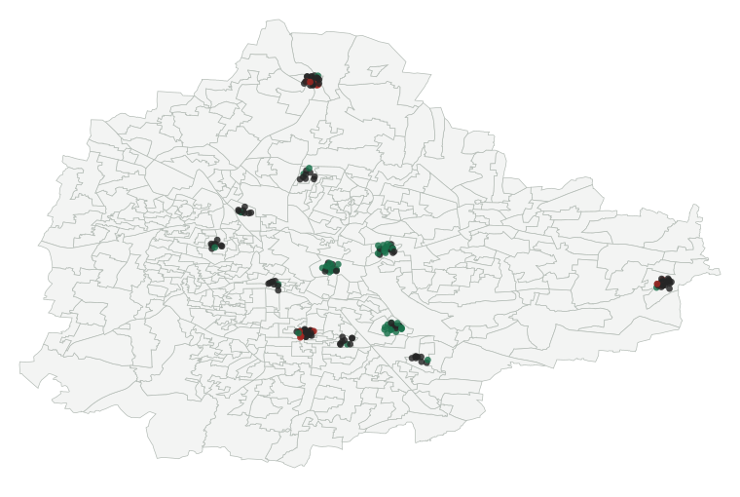
Wireframes/Mock diagrams of the proposed solution (optional)
Illustrative ledger
100
50
Fixes claimed
Citizen verified
Scripted demo records
Not measured city performance
Not a product screenshot
Map diagram from actual geometry
Notes:
The graphic uses the shipped ward geometry and actual deterministic demo positions. The adjacent ledger is a native editable diagram of computed seed values. This slide is a mock diagram, not a screenshot and not measured municipal performance.
Source: docs/research/wards.md; apps/api/data/validation.json. GBA December 2025 final delimitation via https://data.opencity.in/dataset/gba-wards-delimitation-2025 (metadata licence: Other (Public Domain)), official GBA GeoServer Kannada cross-check. 369 cleaned polygons, 5 corporations; source differences documented.
Source: apps/api/data/demo-seed-summary.json and apps/web/public/data/demo-city.json, generated by a deterministic dry run at 2026-10-17T08:00Z. Every issue, person, vote, budget and outcome is fictional demo data. No civic performance claim is made.

Slide 7
Architecture diagram of the proposed solution
Citizen / officer web
Cloud Run API
Firestore + Storage
React + Firebase Hosting
Hono + firebase-admin
Records, photos, AI audit
Firebase Auth
Gemini on Vertex AI
Deterministic core
Identity and demo roles
Draft, select, observe
In-process rules + verifiers
API owns all writes. Browser reads are read-only. Schema checks, one repair retry, then a safe fallback.
Notes:
This is the implemented target architecture. Firebase Hosting would serve the SPA; /api would route to Cloud Run. Admin SDK owns mutations. Vertex uses a service account, not browser API keys. Cloud deployment and live model evaluation are deferred by owner; the current review continues locally.
For Ask LeadNet, Gemini selects closed fact keys; code renders complete labelled bilingual values, units and sample sizes. Public AI projections exclude citizen transcripts and unapproved pre-edit prose. The deterministic core is inside the API, not another cloud service.
Sources: repository docs/PRD.md; docs/ARCHITECTURE.md; packages/shared/src/stateMachine.ts; priority.ts; sla.ts; verification.ts; metrics.ts. These are implemented contracts, not evidence of a deployed pilot.

Slide 8
Technologies to be used in the solution
Interface
React 19, TypeScript, Vite, Tailwind, Motion, MapLibre
Google services
Firebase Hosting / Auth / Storage; Firestore; Cloud Run
AI integration
Gemini on Vertex AI; schema and task verifiers
API and domain
Node.js, Hono, firebase-admin, shared deterministic rules
Privacy
API-only writes, EXIF removal, PII scrub, private citizen audio
Evidence
Original reports, append-only events, source attribution, demo labels
Notes:
The stack is present in the codebase. Service integration code is distinct from successful cloud deployment or a measured live model evaluation.
Sources: repository docs/PRD.md; docs/ARCHITECTURE.md; packages/shared/src/stateMachine.ts; priority.ts; sla.ts; verification.ts; metrics.ts. These are implemented contracts, not evidence of a deployed pilot.

Slide 9
Estimated implementation cost (optional)
Cloud cost has not been measured
Cloud Run
CPU, memory, requests and warm-instance time
Vertex Gemini
Input/output tokens and media processing
Firestore
Reads, writes, indexes and retention
Storage
Evidence size, downloads and retention
Cloud spending and alert setup are deferred. A $25 alert is planned; it is not a spending cap. No measured monthly cost is claimed.
Notes:
No cloud invoice, capacity benchmark or pricing estimate is claimed. The owner chose to continue locally, deferring cloud spending and alert configuration. Cost drivers are architecture facts, not quoted prices.
Sources: repository docs/PRD.md; docs/ARCHITECTURE.md; packages/shared/src/stateMachine.ts; priority.ts; sla.ts; verification.ts; metrics.ts. These are implemented contracts, not evidence of a deployed pilot.

Slide 10
Snapshots of the prototype
Actual browser capture pending
No illustration is presented as a product screenshot. The local interface needs a rendered review before these two captures can be added.
Required capture 1
Required capture 2
Homepage and ward map
Include the visible demo-data label
Issue evidence and officer workflow
Use the verified deployed build
Notes:
This template section remains an explicit readiness gap. Managed browser access was blocked in the current authoring environment. No fake screenshot was substituted. Add genuine product captures and rerender this deck before submitting.
Source: docs/research/media.md and apps/web/public/samples/CREDITS.md. Licensed photographs are illustrations; synthetic audio is labelled. No generated screenshot is presented as the product.

Slide 11
Prototype Performance report/Benchmarking
Ward dataset
369 wards; 5 corporations; all representative points inside polygons
Seed integrity
200 demo histories replay; 1498 events; deterministic output hash
Media integrity
14 JPEGs without EXIF/XMP/IPTC; 17 sample fingerprints match
Code checks
Automated contract tests pass; all-workspace typecheck and web/API builds pass; 11 offline AI safety checks pass
Cloud deployment and live model evaluation deferred by owner
No live quality or latency results
Notes:
The figures on this slide are local integrity checks, not live model benchmarks. Cloud deployment and live model evaluation are deferred by owner. No Gemini category accuracy, duplicate precision/recall, evidence detection rate or latency is fabricated. A future live evaluation requires owner-directed resumption.
Source: apps/api/data/demo-seed-summary.json and apps/web/public/data/demo-city.json, generated by a deterministic dry run at 2026-10-17T08:00Z. Every issue, person, vote, budget and outcome is fictional demo data. No civic performance claim is made.
Source: docs/research/wards.md; apps/api/data/validation.json. GBA December 2025 final delimitation via https://data.opencity.in/dataset/gba-wards-delimitation-2025 (metadata licence: Other (Public Domain)), official GBA GeoServer Kannada cross-check. 369 cleaned polygons, 5 corporations; source differences documented.
Source: docs/research/media.md and apps/web/public/samples/CREDITS.md. Licensed photographs are illustrations; synthetic audio is labelled. No generated screenshot is presented as the product.
Status: submission/status.json

Slide 12
Additional Details/Future Development (if any)
Deferred cloud work
Owner chose to continue locally. Deployment, live model evaluation and public-link checks resume only when requested.
First pilot
Work with one ward or resident group; obtain consent, define moderation and review disputed closures with humans.
Later development
Complaint-system integrations, notifications, privacy blurring, real official identity checks and larger-scale analytics.
Notes:
Government integrations and real official verification are roadmap items. LeadNet is an independent prototype; seeded fictional leaders and budgets must not be mistaken for actual officials or public spending.
Sources: repository docs/PRD.md; docs/ARCHITECTURE.md; packages/shared/src/stateMachine.ts; priority.ts; sla.ts; verification.ts; metrics.ts. These are implemented contracts, not evidence of a deployed pilot.

Slide 13
Provide links to your:
GitHub public repository
[Owner: publish approved repository and paste URL]
Demo video (under 3 minutes)
[Owner: record, upload and paste public video URL]
Final product
[Cloud deployment deferred by owner; public URL pending]
All three links must open without account access during evaluation.
Notes:
Links remain explicit placeholders until published and checked. No repository push/publication, video upload, contest submission or live deployment is implied by this deck.
Source: prescribed template; current status in submission/status.json.

Slide 14

Notes:
Original closing artwork retained unchanged.
Source: prescribed AI Builder Cup submission template.

