Slide 1

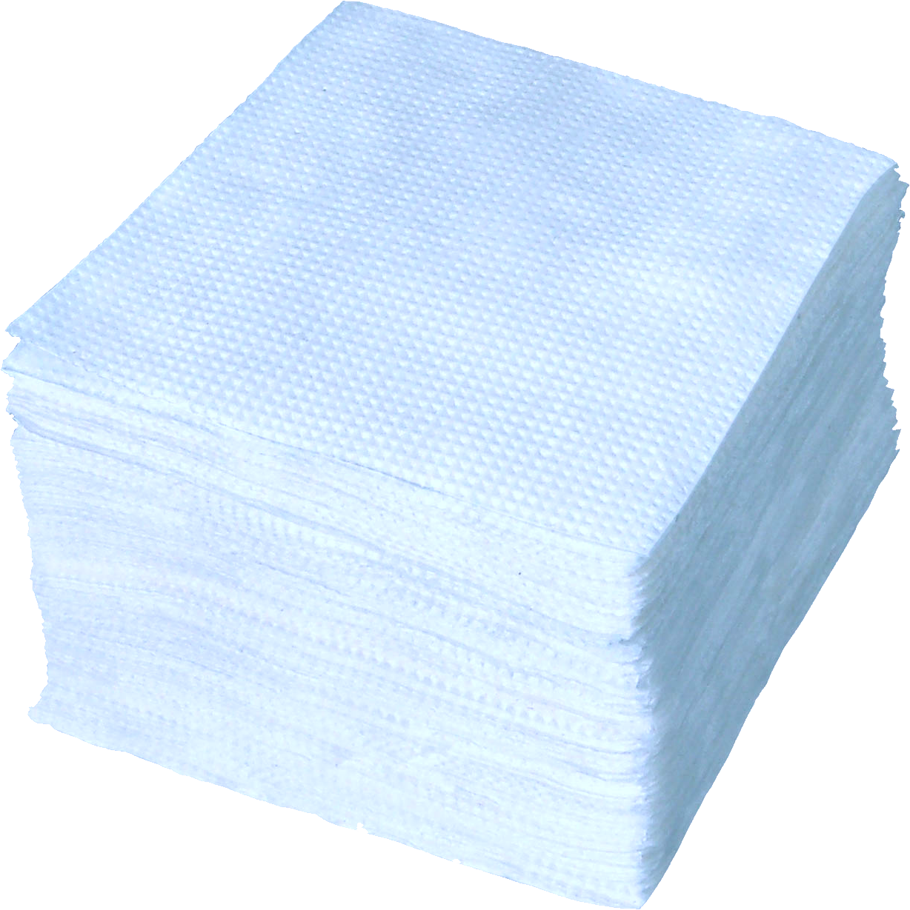


SELL Paper
If you are a customer having lots of papers and want to recycle them, then register with us and we will collect the paper and earn credits.
Customer Registration
BUY Paper
If you are a paper recycling company looking for paper raw materials, then register with us and provide us your requirement.
Consumer Registration

Slide 2
Buy and Recycle Paper
*
Consumer Firm Name:
*
Email ID:
*
Password:
Confirm Password:
*
Notes:
Customer registration page

Slide 3
*
Line 1
Firm Address:
Line 2
Landmark
City
State
Pin code
*
Phone number:
GSTIN:
Register
Notes:
Customer registration page cont1

Slide 4
Buy and Recycle Paper
Consumer ID:
Password:
Login
New user? Register now
Notes:
Customer login page

Slide 5
Recycle paper for credits
Welcome John!
Enter Paper details:
Buy Paper
Choose the paper type:
Select
>
Reward Points
Newspaper
Notebooks
Dashboard
Cardboard
Magazines
Feedback
shredded
Other
Referrals
Paper quality:
Low
Medium
High
Paper unit price/Kg is 6 Kg (Auto generated)
Paper Quantity in Kgs:
10
Add To List

Slide 6


Recycle paper for credits
Welcome John!
Buy Paper
Buy paper details:
Reward Points
Paper No
Type
Quality
Quantity in Kgs
Edit
Dashboard
1
Newspaper
Medium
10
Feedback
Referrals
Back
Add New Item
Check Availability

Slide 7
Recycle paper for credits
Welcome John!
Buy Paper
Buy paper details:
Reward Points
Sl No.
Type
Quality
Quantity in Kgs
Availability
Select
Dashboard
1
Newspaper
10
Medium
Yes
Feedback
2
Newspaper
No
Check paper lot
Low
15
3
Cardboard
High
20
Referrals
Yes
4
Cardboard
Check paper lot
Low
50
No
5
Magazines
High
5
Yes
Cancel
Check Paper Lot
Buy Paper

Slide 8


Recycle paper for credits
Welcome John!
Buy Paper
Paper lot details:
Reward Points
Available
Quantity
Required Quantity
Sl No.
Type
Quality
Select
Dashboard
1
Newspaper
Medium
50
10
15
Feedback
2
Newspaper
10
Low
20
3
Cardboard
45
Referrals
High
50
4
Cardboard
35
Low
5
5
Magazines
25
High
Back
Buy Paper

Slide 9
Recycle paper for credits
Welcome John!
Buy Paper
Order Summary:
Sl. No
Type
Quality
Quantity (in Kgs)
Price per Kg
Paper Price
Edit
Reward Points
1
Newspaper
6
66
Medium
10
Dashboard
2
Newspaper
5
3
15
Low
Feedback
3
Cardboard
20
15
300
High
Referrals
35
8
280
4
Cardboard
Low
5
Magazines
5
10
50
High
Total amount to be Paid: Rs 771.00
Back
Place Order

Slide 10
Recycle paper for credits
Buy Paper
Payment Details:
Total amount to be Paid: Rs 771.00
Reward Points
Credit/Debit card
Net banking
UPI
Dashboard
Please enter your UPI ID
Feedback
Samplenumber@upi
Verify
Referrals

Slide 11
Recycle paper for credits
Buy Paper
Payment Details:
Total amount to be Paid: Rs 771.00
Reward Points
Credit/Debit card
Net banking
UPI
Dashboard
Please enter your UPI ID
Feedback
Samplenumber@upi
Verified
Referrals
Pay Now

Slide 12
Buy Paper
Your order is complete!!!
Reward Points
Your order will be delivered to your firm address in 2 Working days.
Dashboard
Feedback
Thank you for participating towards our paper recycling initiative ☺
Referrals

