Slide 1



Web Application High Level Design
2
1
Customer
Web Application Hosted on Cloud
Consumer
3

Slide 2
Module Details
1. Customer Module :
1. Customer Registration
2. Edit Customer Details
3. Customer Login
4. List Services Available
* Sell Used Paper
* Referral
5. Reward Points
* View Reward Points
* Redeem Reward Points
6. Customer Dashboard (History of Paper Sold for Recycling)
7. Customer Feedback
2. Consumer Module :
1. Consumer Registration
2. Edit Consumer Details
3. Consumer Login
4. List Services Available
* Buy Used Paper
* List Paper Requirements (Create Demand)
* Payment Details --> External Payment Gateway (UPI)
5. Consumer Dashboard (Recycled Paper Details)
6. Consumer Feedback
3. Application Module(Backend) :
1. Payment Gateway (External)
2. OTP Service (External)
3. Mail Verification
4. Customer Service
5. Consumer Service
6. Used Paper Service
* Customer
* Consumer
7. Send Paper Collection Detail to Consumer
8. Manage Reward Points

Slide 3
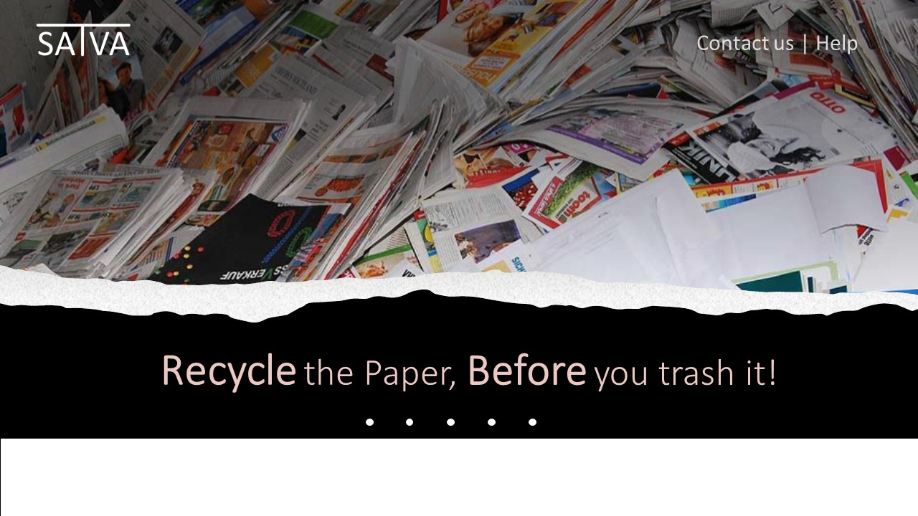
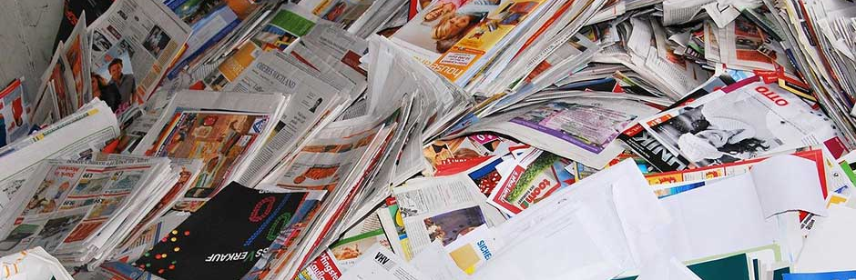

Contact us | Sign in |Help
Recycle the Paper,
Before you trash it!
This Photo by Unknown Author is licensed under CC BY

Slide 4

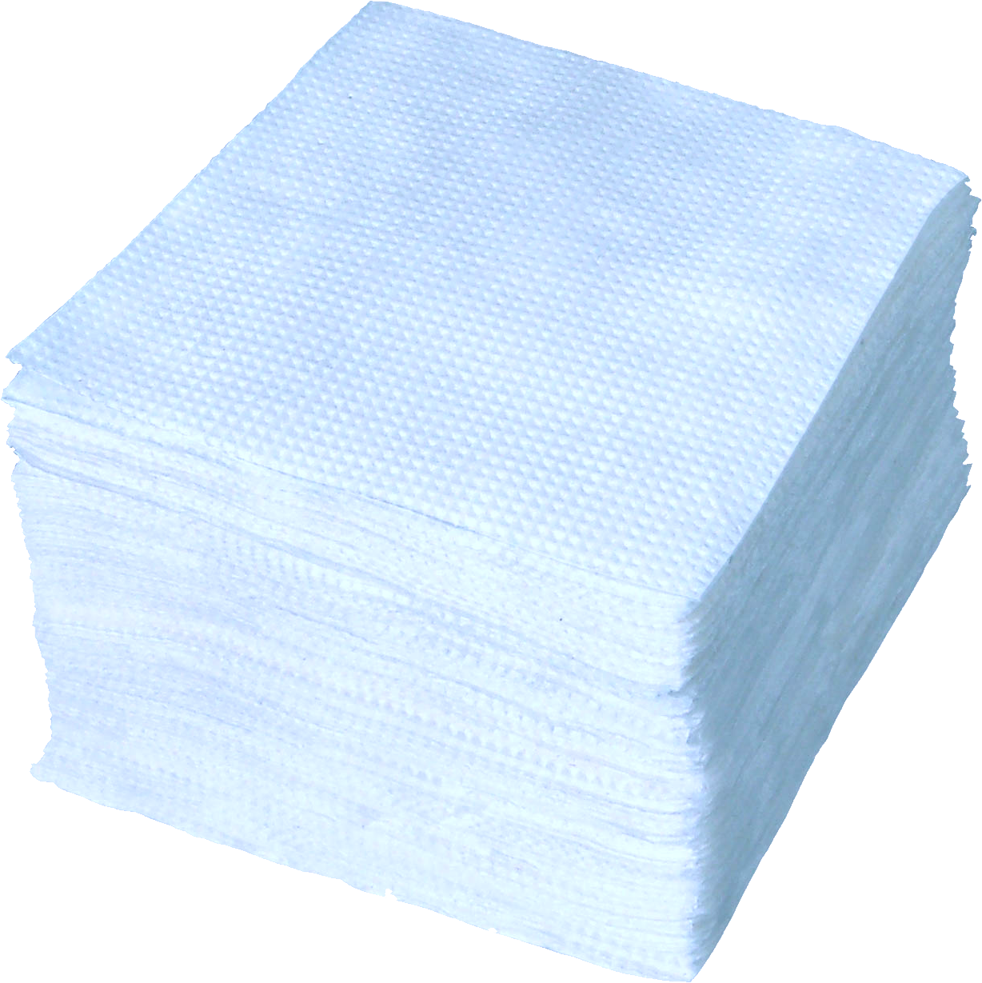


SELL Paper
If you are a customer having lots of papers and want to recycle them, then register with us and we will collect the paper and earn credits.
Customer SignIn
BUY Paper
If you are a paper recycling company looking for paper raw materials, then register with us and provide us your requirement.
Consumer SignIn

Slide 5

Recycle paper for credits
*
First Name:
Last Name:
*
Email ID:
*
Password:
/*Add password rules
Confirm Password:
*
Notes:
Customer registration page

Slide 6
*
Line 1
Address:
Line 2
Landmark
City
State
Pin code
*
Phone number:
Register
Notes:
Customer registration page cont1

Slide 7
Recycle paper for credits
Customer ID:
Password:
Login
New user? Register now
Notes:
Customer login page

Slide 8
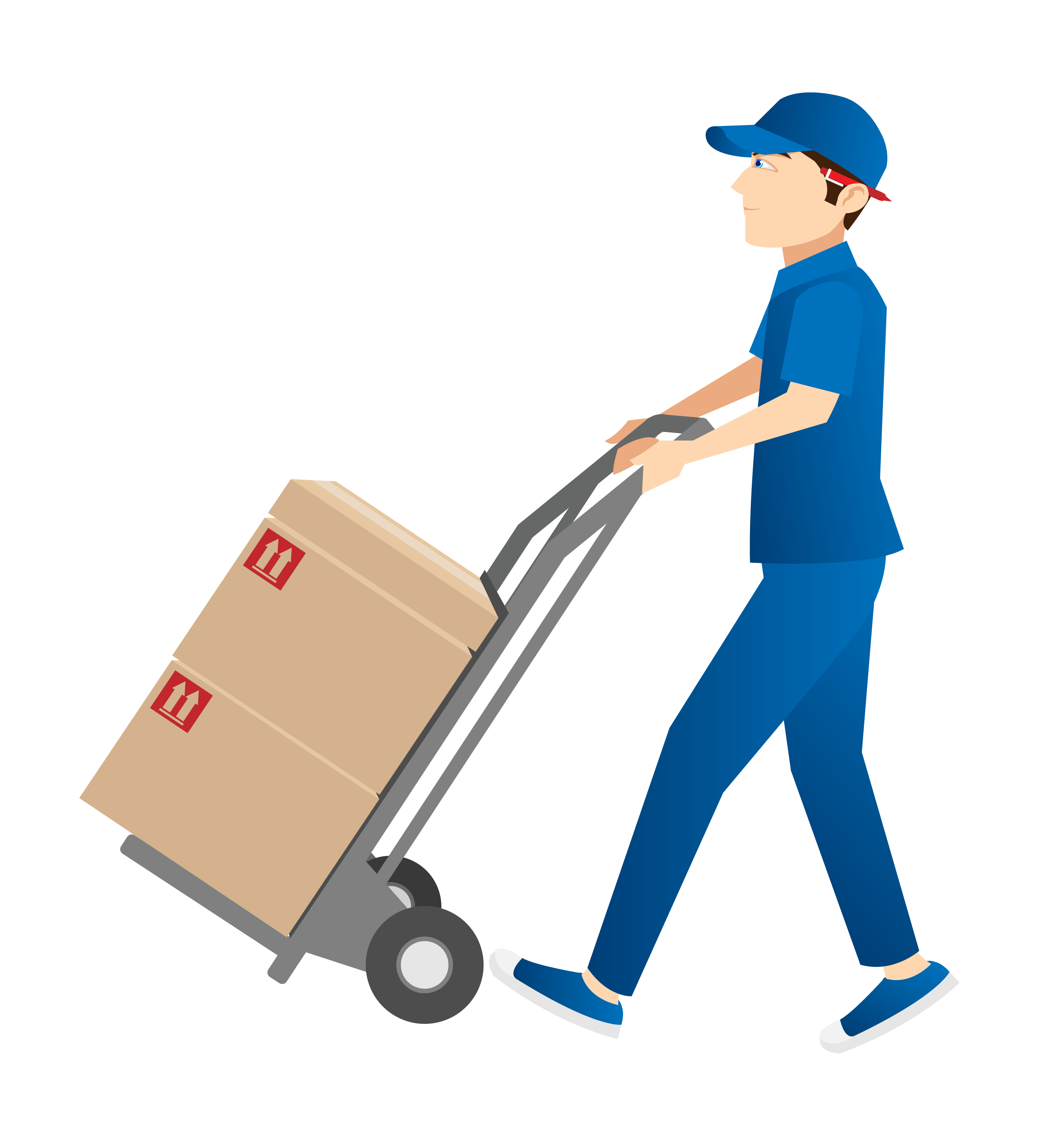
User
photo
Welcome <Username>, Hope you are having a good day!!
Sell Paper
Choose a paper collecting service
Reward Points
Dashboard
Feedback
Dropbox
Pick up
Referrals
You can locate the nearby Paper drop box and drop the papers.
You can schedule an appointment and our pickup agent will pick the papers from your address.
Locate Nearby Drop Box
Make An Appointment

Slide 9
If customer clicks on locate nearby drop box
Drop box locate UI

Slide 10
USER
Welcome User, Hope you are having a good day !!
Sell Paper
Choose a Paper collecting service
Drop box
Reward Points
Enter Your Pin code:
Dashboard
Locate Dropbox
Feedback
Below are the Paper Drop box, in/near your area:
Sample Address 1
Sample Address 2
Sample Address 3
Sample Address 4
Sample Address 5
Sample Address 6
Sample Address 7
Referrals
Sample Address 8
Sample Address 9
Sample Address 10
Sample Address 11
Sample Address 12
Sample Address 13
Sample Address 14

Slide 11
Customer goes to the nearby drop box and enters the paper details by logging in the drop box
Drop box’s software UI

Slide 12
Recycle paper for credits
Customer ID:
Password:
Login
New user? Register now
Notes:
Customer login page

Slide 13
Recycle paper for credits
Welcome <Username>
Enter Paper details:
Choose the paper type:
Select
>
Newspaper
Notebooks
cardboard
Magazines
shredded
Other
Paper quality:
Low
Medium
High
Paper Quantity in Kgs:
6
/*Add rule-> minimum Quantity – 5Kgs
Add to list

Slide 14


Drop paper details:
Paper No
Type
Quality
Quantity in Kgs
Edit
1
Cardboard
Medium
6
Back
Add new item
Drop Paper

Slide 15
Dear user,
Please drop papers in the box below.

Slide 16

Please wait,
We are processing paper details…

Slide 17
If Customer details match with device calculated details, show success message
Success Message UI

Slide 18
Congratulations <Username>!!
You have earned 200 reward points
Thank you for contributing towards our paper recycling initiative.

Slide 19
If Customer details do not match with device calculated details, show failure message
Failure message and details comparison UI

Slide 20


Oops… Paper details do not match
Paper Details provided by you
Paper details calculated by drop box
Paper No
Type
Quality
Quantity
(in Kgs)
Paper No
Type
Quality
Quantity
(in Kgs)
1
Cardboard
Medium
6
1
Cardboard
Medium
6
2
Notebooks
Low
8
2
Notebooks
Low
7.5
3
Newspaper
Medium
10
3
Newspaper
Low
10.75
Continue with device calculated details
Cancel

Slide 21
If customer clicks on continue -> show the success message
Success message UI

Slide 22
Congratulations <Username>!!
You have earned 220 reward points
Thank you for contributing towards our paper recycling initiative.

Slide 23
If customer clicks on cancel -> Show the paper back message
Paper back message UI

Slide 24
☹
Transaction is cancelled!
Please collect your paper back from the box below.

Slide 25
SELL Paper
If you are a customer having lots of papers and want to recycle them, then register with us and we will collect the paper and earn credits.
Customer Registration
BUY Paper
If you are a paper recycling company looking for paper raw materials, then register with us and provide us your requirement.
Consumer Registration

Slide 26
Consumer clicks on Consumer registration button

Slide 27
Buy and Recycle Paper
Consumer ID:
Password:
Login
New user? Register now
Notes:
Customer login page

Slide 28
Buy and Recycle Paper
*
Consumer Firm Name:
*
Email ID:
*
Password:
/*Add password rules
Confirm Password:
*
Notes:
Customer registration page

Slide 29
*
Line 1
Firm Address:
Line 2
Landmark
City
State
Pin code
*
Phone number:
GSTIN:
Register
Notes:
Customer registration page cont1

Slide 30
Buy and Recycle Paper
Consumer ID:
Password:
Login
New user? Register now
Notes:
Customer login page

Slide 31
Recycle paper for credits
Welcome <Username>
Enter Paper details:
Buy Paper
Choose the paper type:
Select
>
Dashboard
Newspaper
Notebooks
Feedback
Cardboard
Magazines
Referrals
Shredded
Others
Paper quality:
Low
Medium
High
Paper unit price/Kg is 6 Kg (Auto generated)
Paper Quantity in Kgs:
10
Add To List

Slide 32

Recycle paper for credits
Welcome <Username>
Buy Paper
Buy paper details:
Dashboard
Paper No
Type
Quality
Quantity in Kgs
Edit
Feedback
1
Newspaper
Medium
10
Referrals
Back
Add New Item
Check Availability

Slide 33
Consumer clicks on Check availability button

Slide 34
Recycle paper for credits
Welcome <Username>
Buy Paper
Buy paper details:
Dashboard
Sl No.
Type
Quality
Quantity in Kgs
Availability
Select
Feedback
1
Newspaper
10
Medium
Yes
Referrals
2
Newspaper
No
Check paper lot
Low
15
3
Cardboard
High
20
Yes
4
Cardboard
Check paper lot
Low
50
No
5
Magazines
High
5
Yes
Cancel
Check Paper Lot
Buy Paper

Slide 35
Consumer clicks on Check paper lot button

Slide 36
Recycle paper for credits
Welcome <Username>
Buy Paper
Paper lot details:
Dashboard
Sl No.
Type
Quality
Available
Quantity
Required Quantity
Select
Feedback
1
Newspaper
Medium
50
10
Referrals
15
2
Newspaper
10
Low
20
3
Cardboard
45
High
50
4
Cardboard
35
Low
5
5
Magazines
25
High
Back
Buy Paper

Slide 37
Recycle paper for credits
Welcome <Username>
Buy Paper
Order Summary:
Dashboard
Sl No.
Type
Quality
Quantity (in Kgs)
Price per Kg
Paper Price
Edit
1
Newspaper
6
66
Feedback
Medium
10
2
Newspaper
5
3
15
Low
Referrals
3
Cardboard
20
15
300
High
4
Cardboard
35
8
280
low
5
Magazines
5
10
50
High
Total amount to be Paid: Rs 771.00
Back
Pay Now and Order

Slide 38
Recycle paper for credits
Buy Paper
Payment Details:
Total amount to be Paid: Rs 771.00
Dashboard
Credit/debit card
Net banking
UPI
Feedback
Please enter your UPI ID
Referrals
Samplenumber@upi
Verify

Slide 39
Consumer clicks on verify button

Slide 40
Recycle paper for credits
Buy Paper
Payment Details:
Total amount to be Paid: Rs 771.00
Dashboard
Credit/debit card
Net banking
UPI
Feedback
Please enter your UPI ID
Referrals
Samplenumber@upi
Verified
Pay Now

Slide 41
Buy Paper
Your order is complete!
Dashboard
Your order will be delivered to your firm address in 2 Working days.
Feedback
Referrals
Thank you for participating towards our paper recycling initiative.

