Slide 1
AI-Powered IT Support Agent
• Intelligent IT Helpdesk Agent built using LangGraph and Large Language Models.
• Automates issue analysis, classification, troubleshooting and ticket creation.
• Uses Knowledge Base caching to avoid solving the same issue repeatedly.
• Supports Human-in-the-Loop clarification for ambiguous requests.
• Automatically emails generated tickets to the IT Admin Team.

Slide 2
Problems Faced by Modern IT Teams
• Thousands of repetitive support tickets every month.
• Engineers repeatedly solve identical issues.
• Slow manual ticket triaging and routing.
• Knowledge spread across documents and senior engineers.
• High Mean Time To Resolution (MTTR).
• Poor user experience due to delayed responses.

Slide 3
How Our AI Agent Solves These Problems
Problem → AI Solution
• Repetitive Issues → Knowledge Base Reuse
• Manual Classification → LLM-based Intelligent Classification
• Missing Information → Human-in-the-Loop Questions
• Manual Ticket Creation → Automatic Ticket Generation
• Delayed Notifications → SMTP Email to Admin Team
• Inconsistent Troubleshooting → Structured AI Resolution Steps

Slide 4
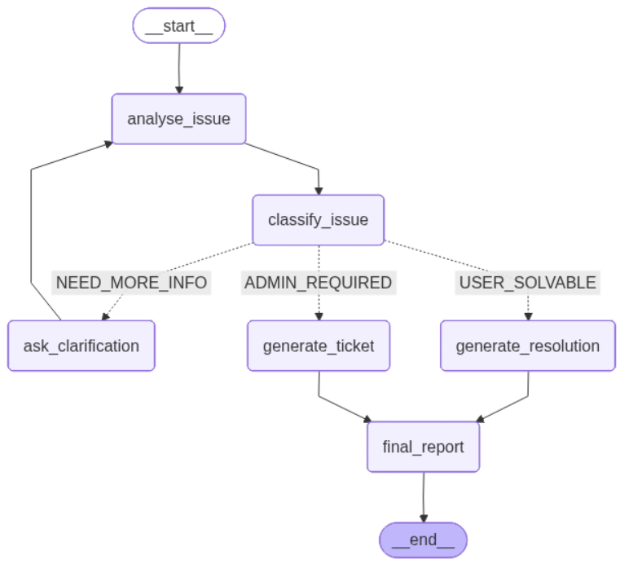
Technical Documentation - Workflow

Slide 5
State Management in LangGraph
SupportAgentState stores the complete workflow context.
Important State Fields:
• user_issue, user_name, user_email
• issue_summary, issue_category, affected_system, severity
• decision, confidence, reason
• clarification_questions, clarification_answer
• knowledge_cache_hit, solution_step
• ticket_id, ticket_priority, ticket_status

Slide 6
Conclusion
• Reduces repetitive IT support workload.
• Improves response time using AI automation.
• Reuses existing solutions through Knowledge Base caching.
• Escalates only genuine admin issues.
• Enterprise-ready architecture using LangGraph, Pydantic and LLMs.

