Slide 1
PREDICTIVE MAINTENANCE ANALYTICS
Predictive Maintenance
Analytics
Python | SQL Server | Power BI
PREPARED BY
DATASET
Rahul Santosh Mangale
AI4I 2020 Predictive Maintenance (10,000 records)

Slide 2
PREDICTIVE MAINTENANCE ANALYTICS
PREDICTIVE MAINTENANCE ANALYTICS
1. Introduction
Unplanned machine breakdowns cause production delays, repair costs and safety risks. Predictive maintenance uses operating data to find the conditions under which machines fail, so that maintenance can be planned before a breakdown happens.
This project is an end-to-end data analytics solution on a machine failure dataset. It covers data cleaning and exploration in Python, business analysis in SQL Server, an interactive Power BI dashboard, and machine learning models that predict failures.
2. Problem Statement and Objectives
Problem: Machine failures are rare but costly, and it is not clear which operating conditions lead to them.
Understand the dataset and check its quality.
Measure the overall failure rate and compare it across machine types.
Identify which failure modes are most common.
Study how tool wear, rotational speed, torque, temperature and power affect failures.
Build an interactive dashboard that gives a quick view of machine health.
Build and compare machine learning models that predict whether a machine will fail.
2

Slide 3
PREDICTIVE MAINTENANCE ANALYTICS
PREDICTIVE MAINTENANCE ANALYTICS
3. Dataset Description
The dataset is the AI4I 2020 Predictive Maintenance dataset (ai4i2020.csv). It has 10,000 records and 14 columns, with no missing values and no duplicate rows.
UDI: Unique record number (1 to 10,000)
Product ID: Product identifier
Type: Product quality type: L (Low), M (Medium), H (High)
Air temperature [K]: Surrounding air temperature in Kelvin
Process temperature [K]: Process temperature in Kelvin
Rotational speed [rpm]: Rotational speed of the machine
Torque [Nm]: Torque applied, in Newton-metres
Tool wear [min]: Minutes of tool use
Machine failure: Target: 1 = failure, 0 = no failure
TWF, HDF, PWF, OSF, RNF: Failure modes: tool wear, heat dissipation, power, overstrain and random failure
3

Slide 4
PREDICTIVE MAINTENANCE ANALYTICS
PREDICTIVE MAINTENANCE ANALYTICS
4. Tools and Technologies
Python (pandas, NumPy, Matplotlib, Seaborn, scikit-learn) in Jupyter Notebook: Data cleaning, exploration, feature engineering and machine learning
SQL Server (T-SQL): Database storage, views and business analysis queries
Power BI: Interactive dashboard and KPI reporting
5. Project Workflow
Load the data and understand its structure (Python).
Run data quality checks (Python).
Explore the data with statistics and charts (Python).
Create new features (Python and SQL).
Load the data into SQL Server and create analysis views.
Answer business questions with SQL queries.
Connect Power BI to the SQL view and build the dashboard.
Train and compare machine learning models.
Document findings and recommendations (this report).
4

Slide 5
PREDICTIVE MAINTENANCE ANALYTICS
PREDICTIVE MAINTENANCE ANALYTICS
6. Data Understanding and Cleaning (Python)
The dataset was loaded into a pandas DataFrame and checked with shape, info(), describe() and dtypes.
Shape: 10,000 rows and 14 columns.
Missing values: none in any column.
Duplicate rows: none.
Data types: all correct (integers, floats and two text columns).
Categorical values: Type has three values (L, M, H); Machine failure has two (0, 1).
Key statistics
Air temperature [K]: mean 300.00; min 295.3; max 304.5
Process temperature [K]: mean 310.01; min 305.7; max 313.8
Rotational speed [rpm]: mean 1,538.8; min 1,168; max 2,886
Torque [Nm]: mean 39.99; min 3.8; max 76.6
Tool wear [min]: mean 107.95; min 0; max 253
Because the data was already clean, no rows needed to be removed or imputed.
5

Slide 6
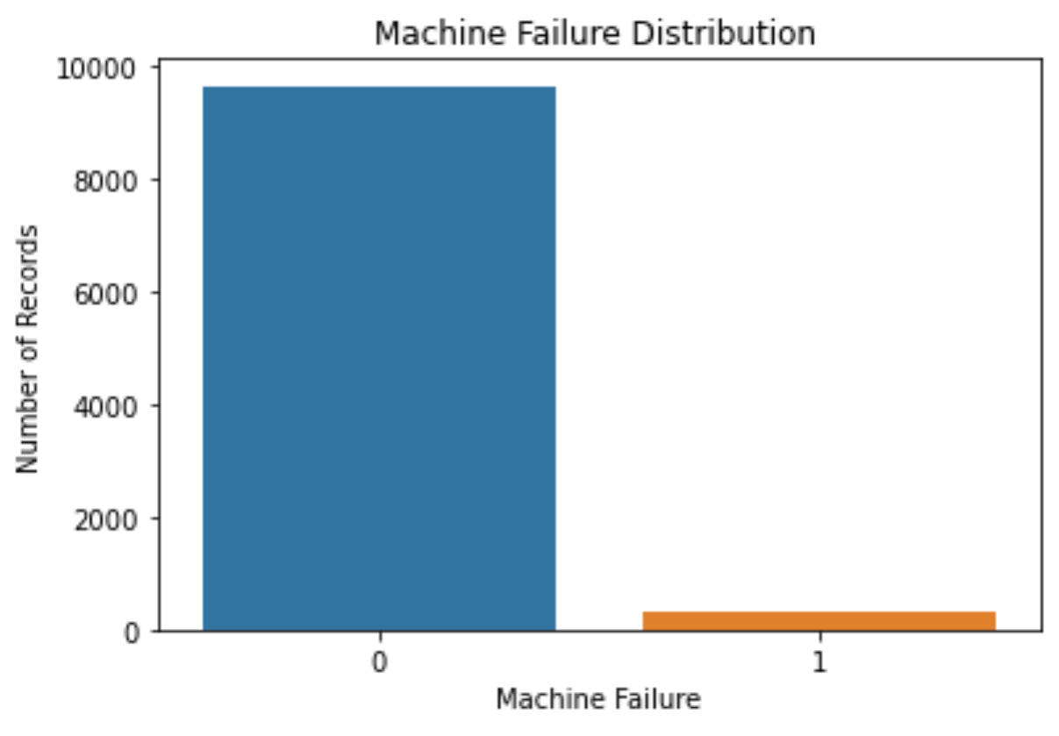
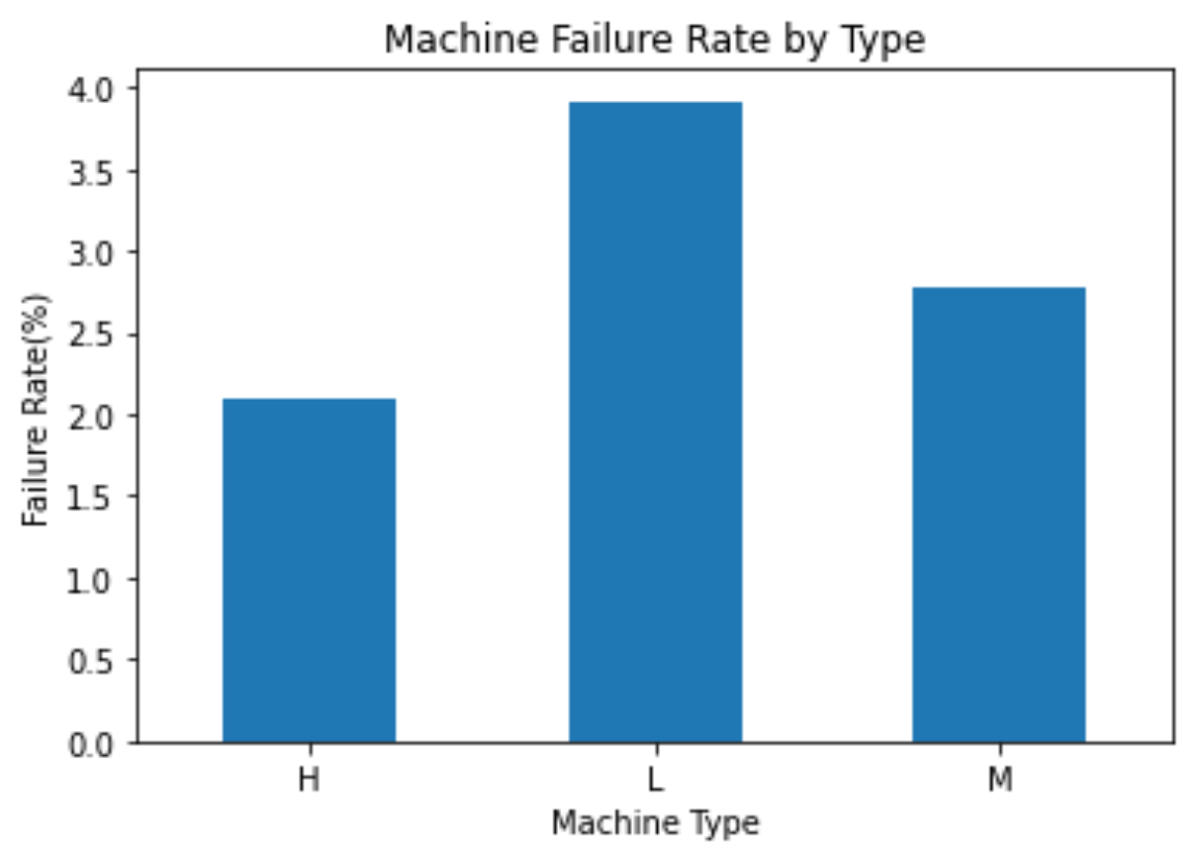
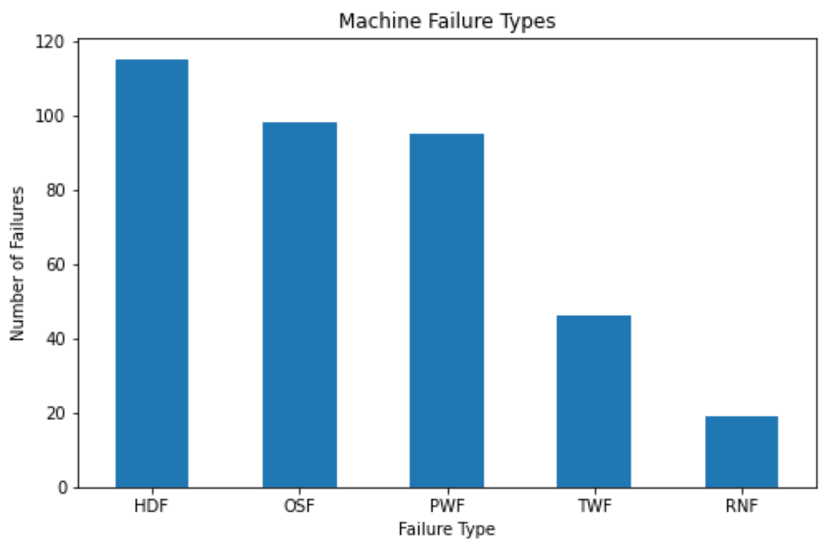
PREDICTIVE MAINTENANCE ANALYTICS
PREDICTIVE MAINTENANCE ANALYTICS
7. Exploratory Data Analysis
7.1 Failure distribution
Out of 10,000 machines, 339 failed (3.39%) and 9,661 did not fail (96.61%). The data is highly imbalanced, which matters when evaluating models (see Section 11).
7.2 Machine type
The dataset has 6,000 Low (L), 2,997 Medium (M) and 1,003 High (H) quality machines. Lower-quality machines fail more often, and the failure rate falls steadily as quality improves.
L (Low): 6,000 machines; 3.92% failure rate
M (Medium): 2,997 machines; 2.77% failure rate
H (High): 1,003 machines; 2.09% failure rate
7.3 Failure modes
Failure modes are the different reasons a machine can fail. Each machine has five flags (TWF, HDF, PWF, OSF, RNF), set to 1 when that cause occurred.
HDF: Heat Dissipation Failure — 115
OSF: Overstrain Failure — 98
PWF: Power Failure — 95
TWF: Tool Wear Failure — 46
RNF: Random Failure — 19
Heat dissipation, overstrain and power failures together account for most breakdowns. The mode counts add up to more than 339 because some machines fail in more than one way.
6

Slide 7
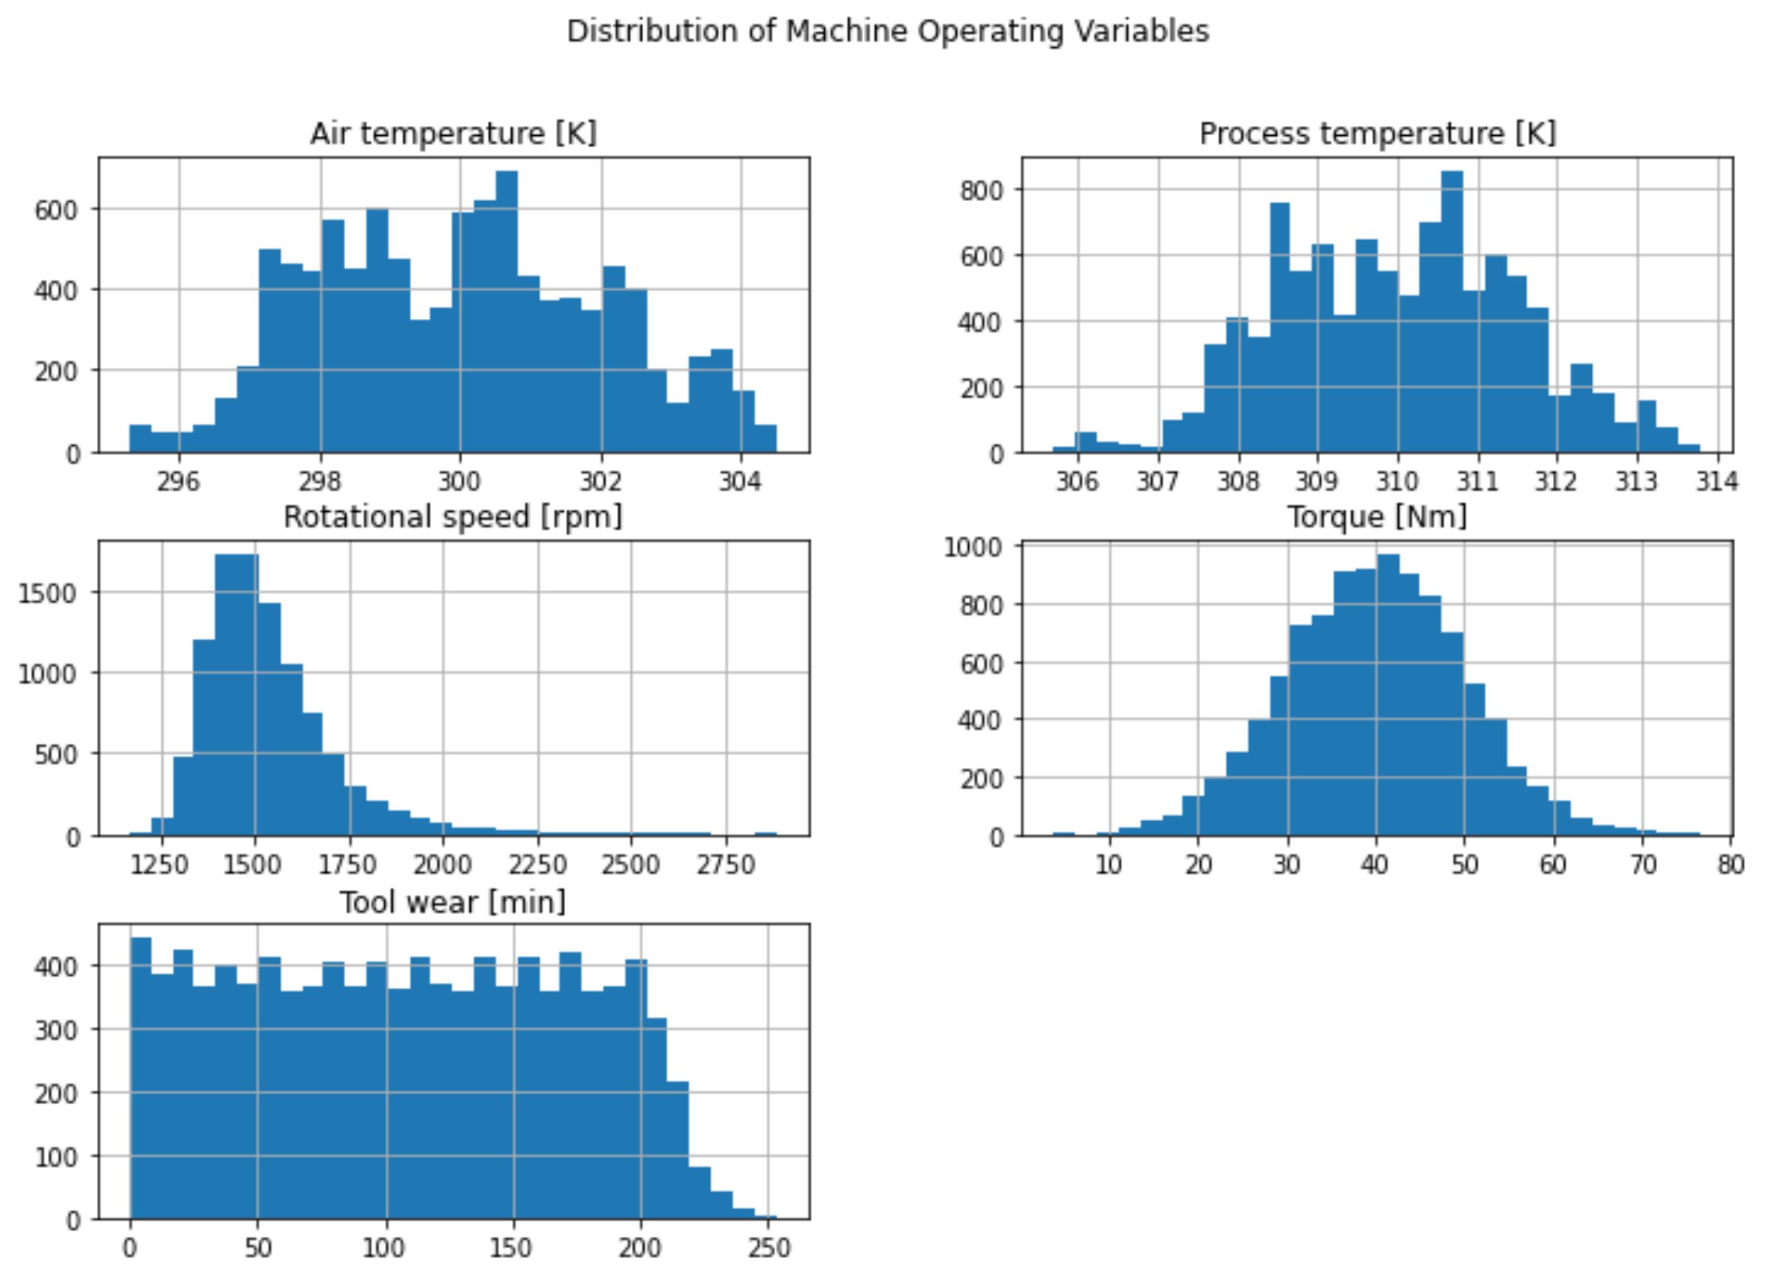
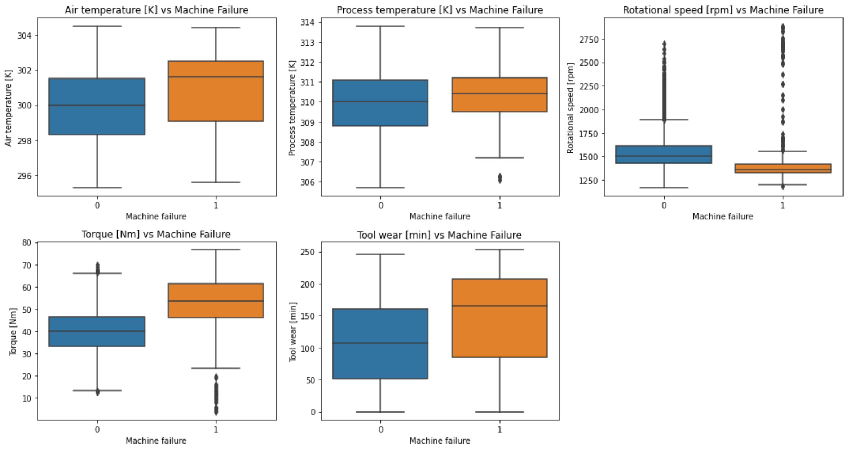
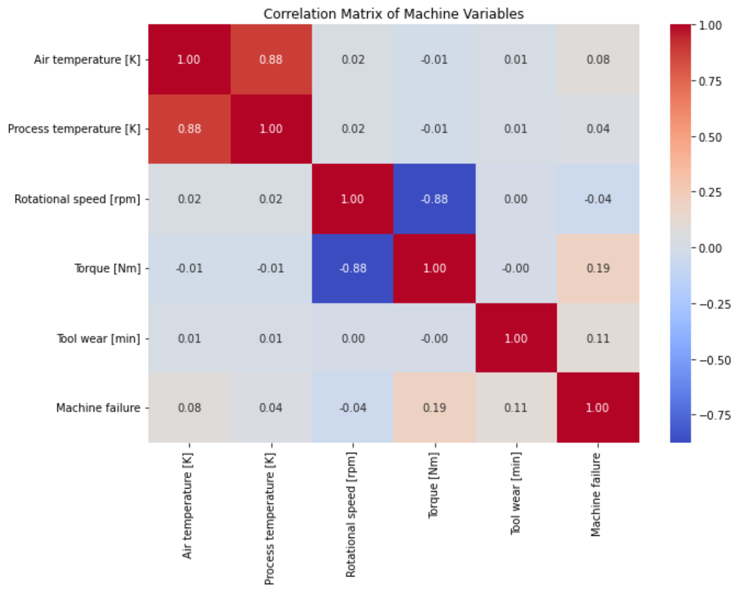
PREDICTIVE MAINTENANCE ANALYTICS
PREDICTIVE MAINTENANCE ANALYTICS
7.4 Operating Variables and Correlations
The report examines distributions of machine operating variables, box plots comparing failed and non-failed machines, and a correlation heatmap showing how strongly variables move together from -1 to +1.
7

Slide 8
PREDICTIVE MAINTENANCE ANALYTICS
PREDICTIVE MAINTENANCE ANALYTICS
8. Feature Engineering
Temperature Difference [K]: Process temperature minus Air temperature. It shows how much heat the process adds above the surroundings.
Power Proxy: Rotational speed multiplied by Torque. It is a relative measure of mechanical load, not actual electrical power in watts.
Tool Wear Category: Low (0 to 100 min), Medium (101 to 200 min) and High (above 200 min), with 4,667, 4,571 and 762 machines.
Temperature Difference and Power Proxy were also created in SQL so that Power BI could use them.
8

Slide 9
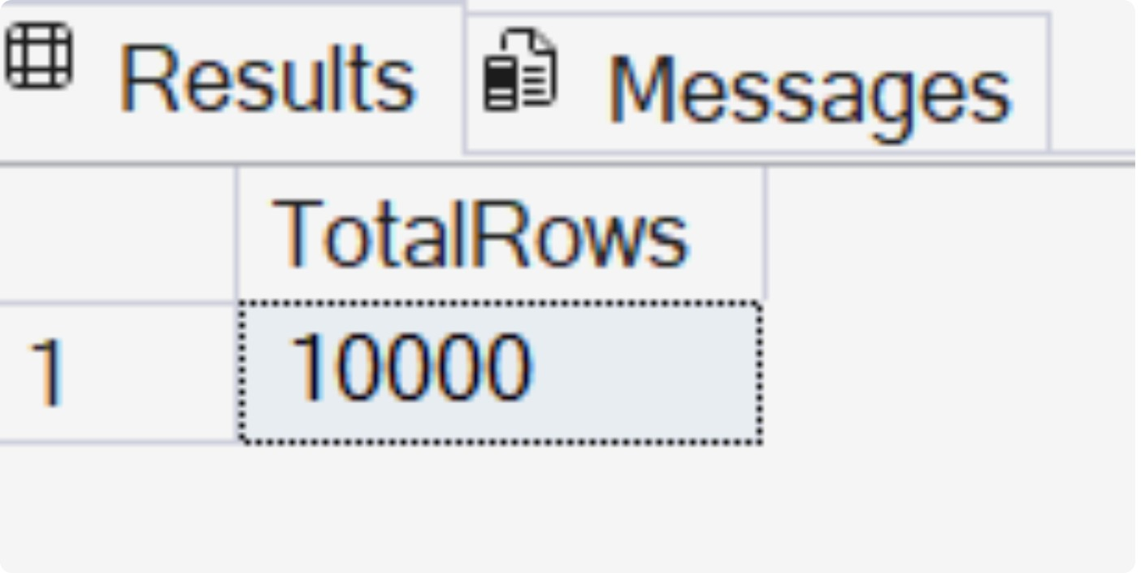
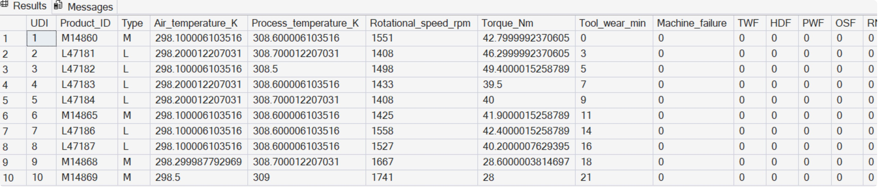
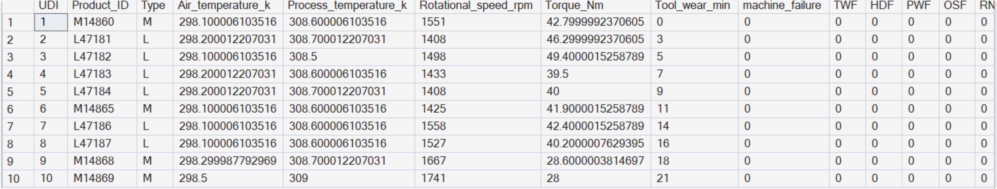
PREDICTIVE MAINTENANCE ANALYTICS
PREDICTIVE MAINTENANCE ANALYTICS
9. SQL Server Analysis
The data was loaded into PredictiveMaintenanceDB as the table dbo.ai4i2020. Two views were then created.
vw_MachineAnalysis: adds Temperature_Difference_K, Power_Proxy and a Failure_Status label (Failure or No Failure).
vw_PowerBI_MachineAnalysis: the final view for Power BI. It adds Tool_Wear_Band (0-50, 51-100, 101-150, 151-200, 201+), Power_Band (Low below 50,000; Medium below 100,000; High above) and Failure_Type (the first matching failure mode, or No Failure).
Business questions answered
Checking the imported data
Creating the analysis views
Overall failure KPIs
Failure by machine type
Failure type analysis
Tool wear analysis
Rotational speed, torque and temperature
Power proxy analysis
Final view for Power BI
9

Slide 10
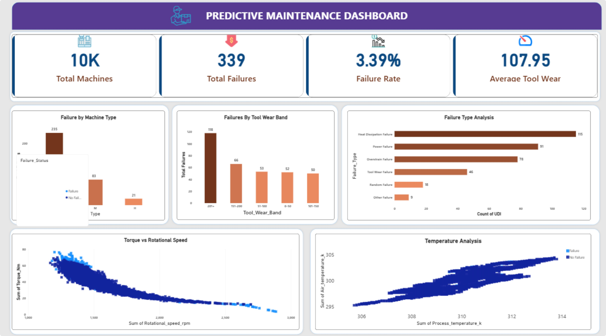
10. Power BI Dashboard
Power BI was connected to SQL Server and loaded vw_PowerBI_MachineAnalysis. The dashboard, titled Predictive Maintenance Dashboard, has these parts:
KPI cards: Total Machines, Total Failures, Failure Rate and Average Tool Wear
Donut chart: Share of Failure vs No Failure
Column chart: Failure by Machine Type: Which machine types fail most
Column chart: Failures by Tool Wear Band: How failures change as tools wear
Bar chart: Failure Type Analysis: Which failure modes are most common
Scatter chart: Torque vs Rotational Speed: Operating conditions of failed and non-failed machines
Scatter chart: Temperature Analysis: Air and process temperature, coloured by failure status
The dashboard lets a maintenance manager see overall machine health at a glance and then look at the conditions behind failures.

