Slide 1
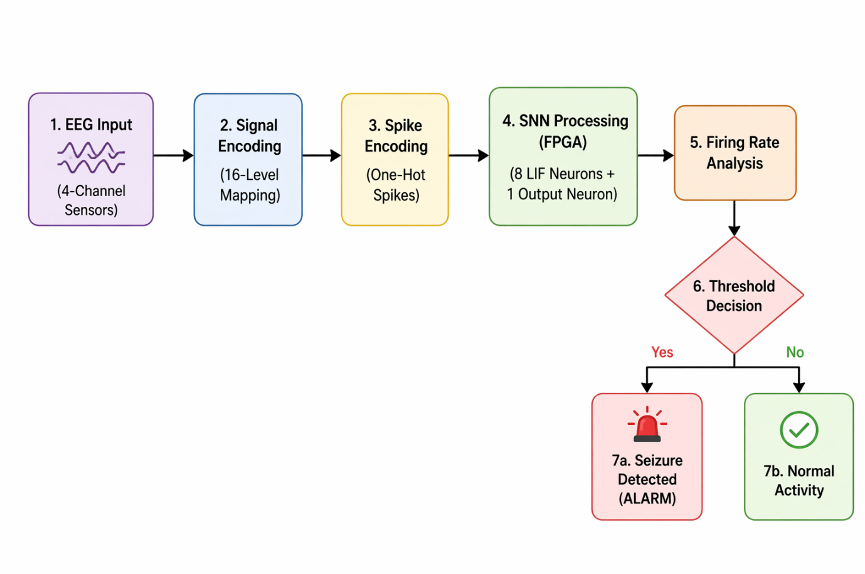
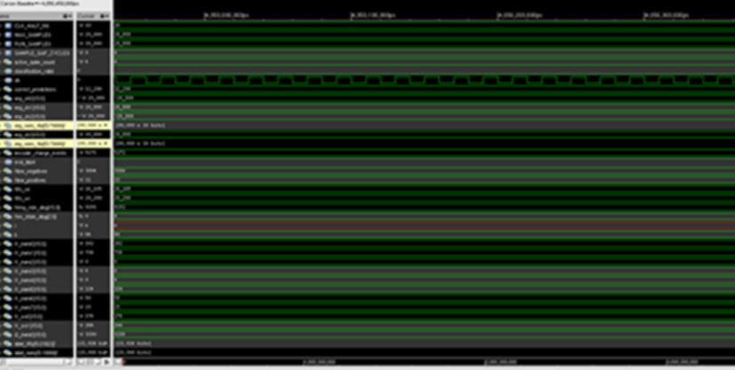
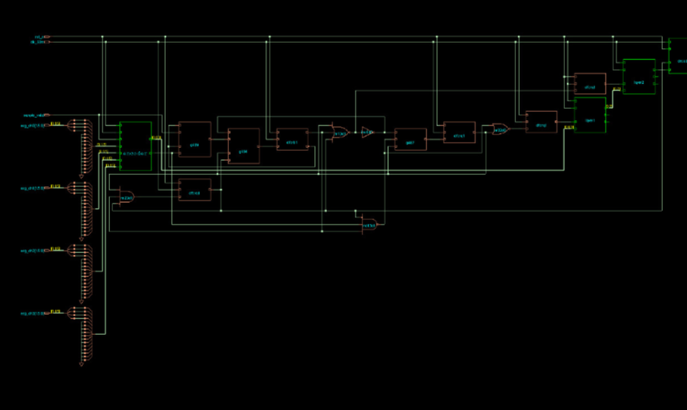
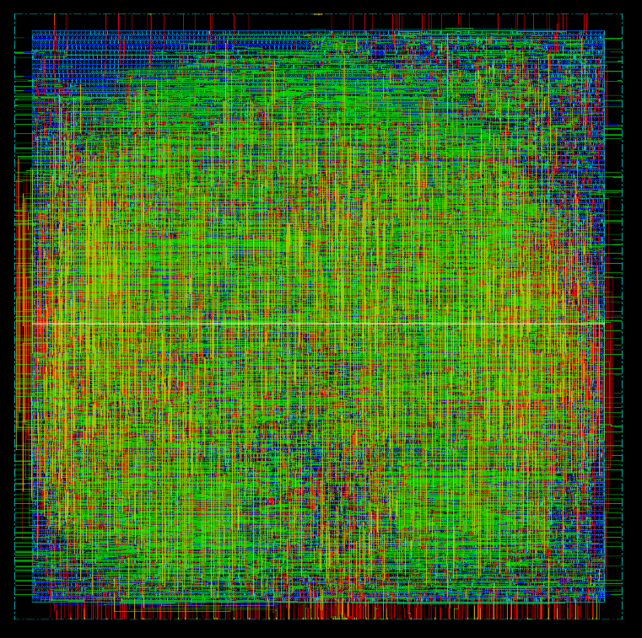
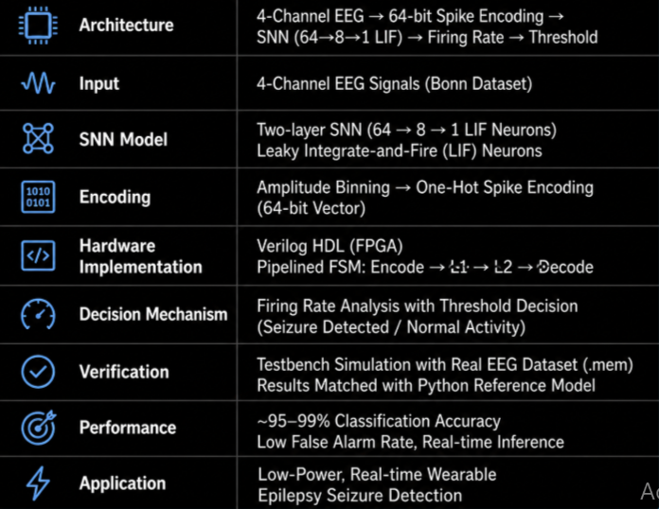
Wearable Epilepsy Seizure Detection With Spiking Neural Networks
Vootkur Rahul Reddy (24B1A7733@cvr.ac.in)
Silpa Kesav Velagaleti (shilpakesav@gmail.com)
Problem Statement/Introduction
Proposed Methodology/Advantages
Epilepsy affects approximately 50 million people worldwide, causing sudden seizures that disrupt brain activity and pose significant safety risks. While EEG remains the gold standard for diagnosis, manual analysis by experts is time-consuming. Recent advancements in AI, particularly neuromorphic computing and SNNs, offer energy-efficient alternatives for long-term monitoring. SNNs are uniquely suited for this task as they model the brain’s time-dependent evolution and replace complex multiplications with simple additions through binary encoding. This research aims to address the limitations of existing wearable solutions—specifically high channel counts (which cause social stigma) and high false alarm rates—by proposing a 4-channel, hardware-optimized SNN solution.
4-channel EEG signals are encoded into 64-bit spike vectors using amplitude binning. A two-layer SNN (64 → 8 → 1 LIF neurons) performs classification using fixed-point weights. Neurons follow Leaky Integrate-and-Fire (LIF) dynamics with threshold-based spiking. Output spikes are processed by a firing rate decoder to generate seizure alerts. Entire system is controlled by an FSM pipeline (Encode → L1 → L2 → Decode) for real-time inference. Verified using a testbench with real EEG dataset inputs (.mem files). Functional accuracy confirmed through matching predictions with ground-truth labels.
Implementation Details/Diagram
Implementation Details/Flow Chart
4-channel EEG signals are normalized and encoded into 64-bit spike vectors.
A two-layer SNN (64 → 8 → 1) using LIF neurons performs classification.
Implemented in Verilog HDL with fixed-point arithmetic for FPGA efficiency.
Controlled by an FSM-based pipeline (Encode → L1 → L2 → Decode).
Firing rate + threshold logic used for seizure detection output.
Verified using testbench simulations with real EEG dataset (.mem files).
Results Table
Conclusion
This work presents an efficient EEG-based seizure detection system using a Spiking Neural Network (SNN) optimized for hardware implementation. By employing spike-based encoding and Leaky Integrate-and-Fire (LIF) neurons, the design achieves high computational efficiency with reduced power consumption.
The proposed architecture, implemented in Verilog HDL, demonstrates reliable real-time performance through a pipelined FSM-based design and firing rate–based decision mechanism. Functional verification confirms that the hardware results closely match the software reference model, ensuring correctness.
Overall, the system achieves high detection accuracy with low false alarm rates, making it suitable for low-power wearable healthcare applications. The design highlights the potential of SNNs for neuromorphic and edge AI systems.
RTL Simulation Waveform
RTL Schematic
RTL Simulation Waveform
Final GDS Layout
PPA Table
References;-
[1] S. M. Bohte, J. N. Kok, and H. La Poutré,
[2] A. Rahimi, A. Tchouprina, P. Whatmough et al.,
REFERENCES
© Accellera Systems Initiative

