Slide 1
Analyzing
IMDB Data of 5000
movies

Slide 2
Tableau Worksheets

Slide 3
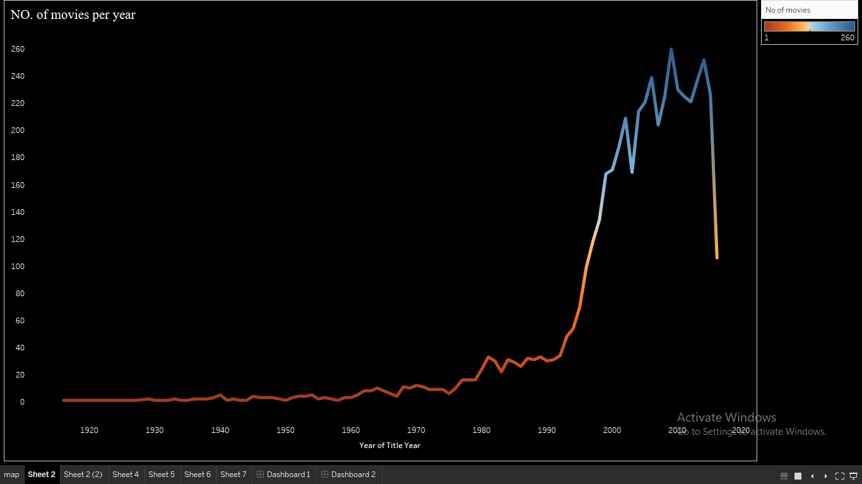

Slide 4
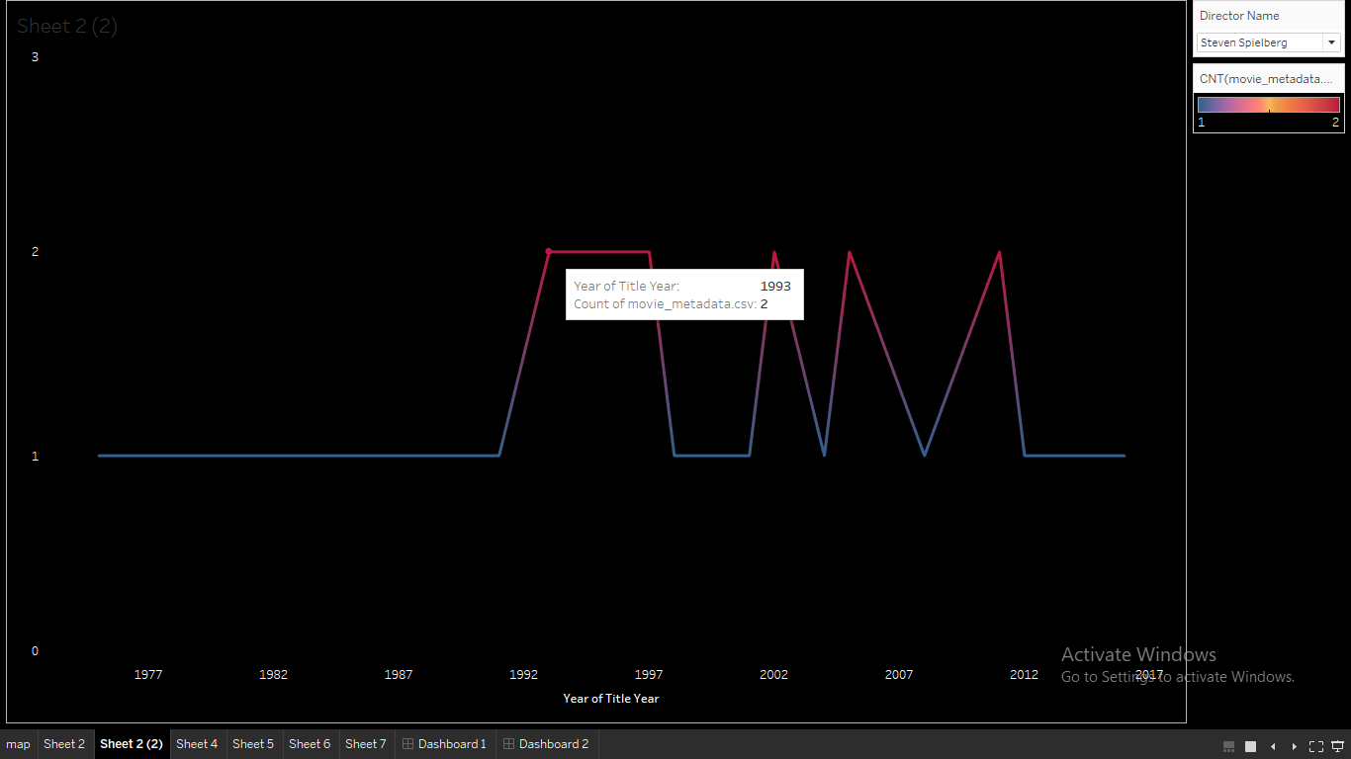

Slide 5
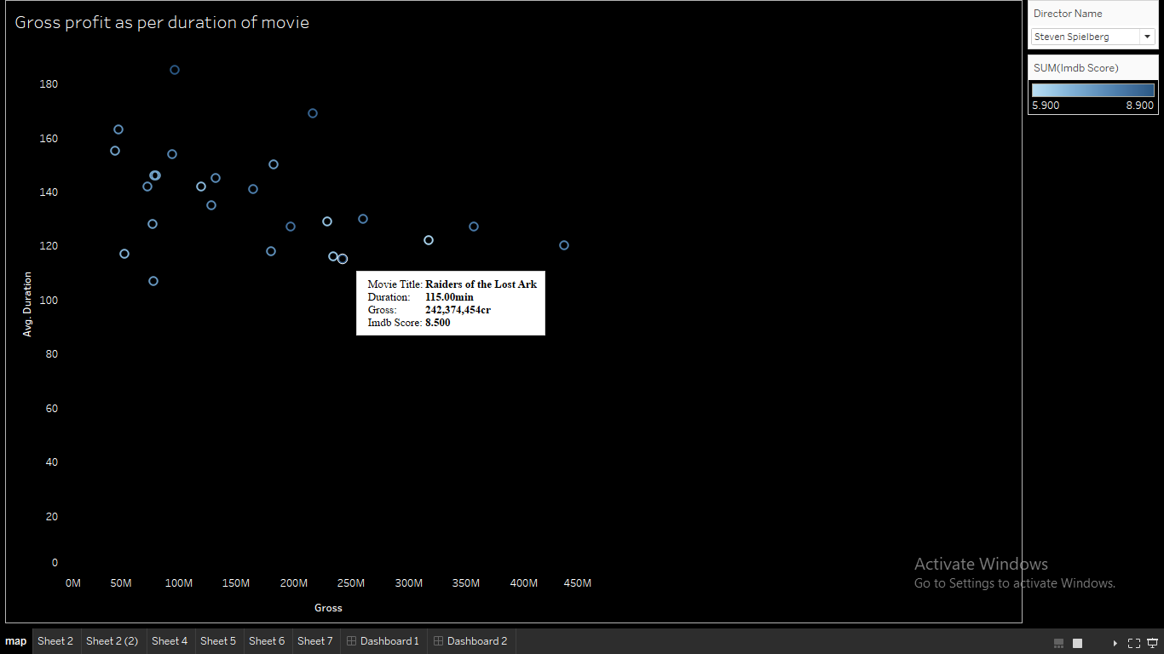

Slide 6
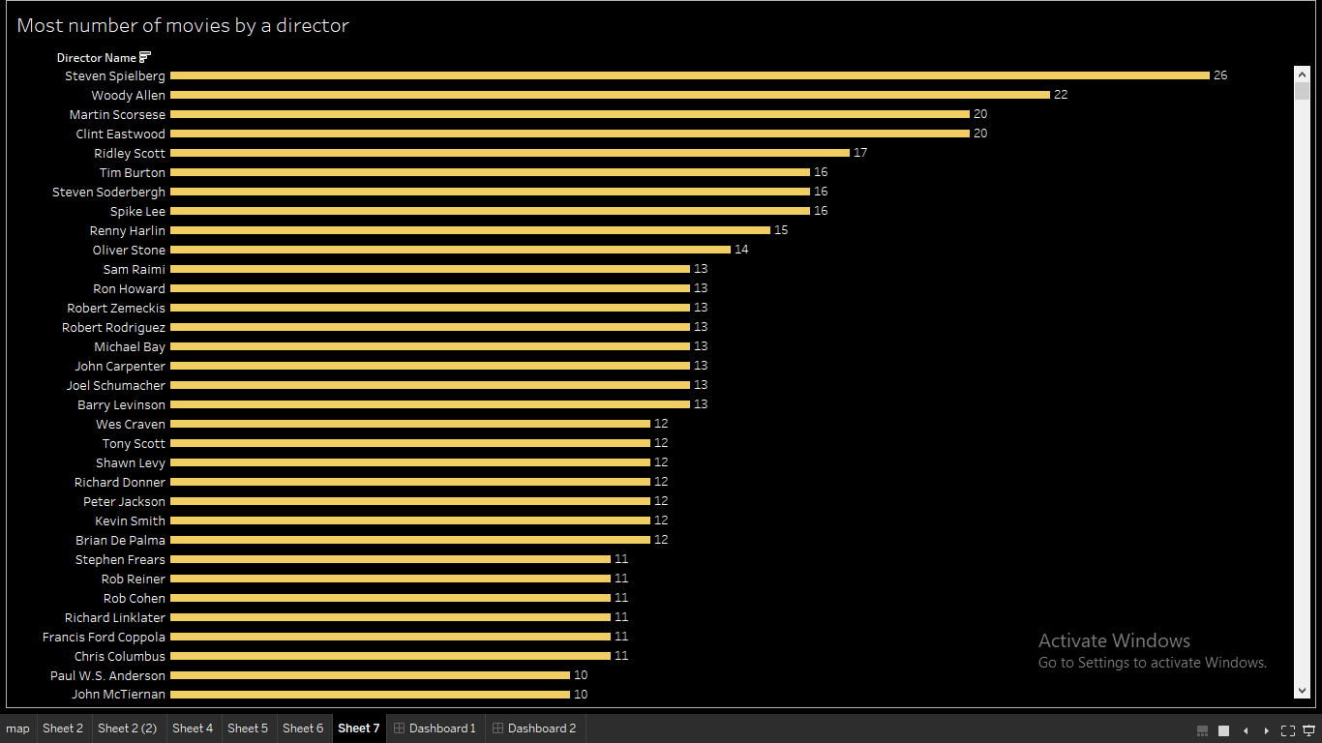

Slide 7
Dynamic Dashboards
Click here

Slide 8
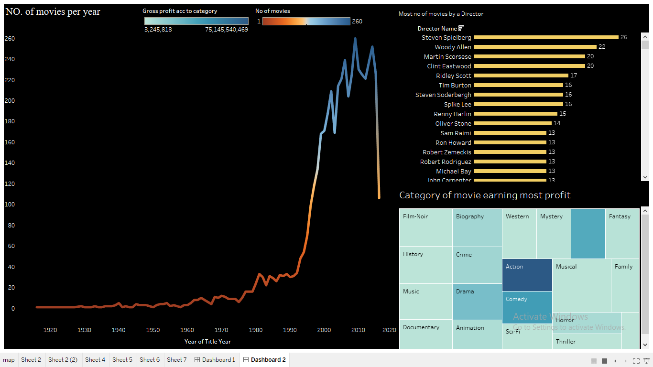

Slide 9
