Slide 1
ANALYSING
COVID-19 Cases & Deaths
Across The World

Slide 2
Tableau Worksheets

Slide 3
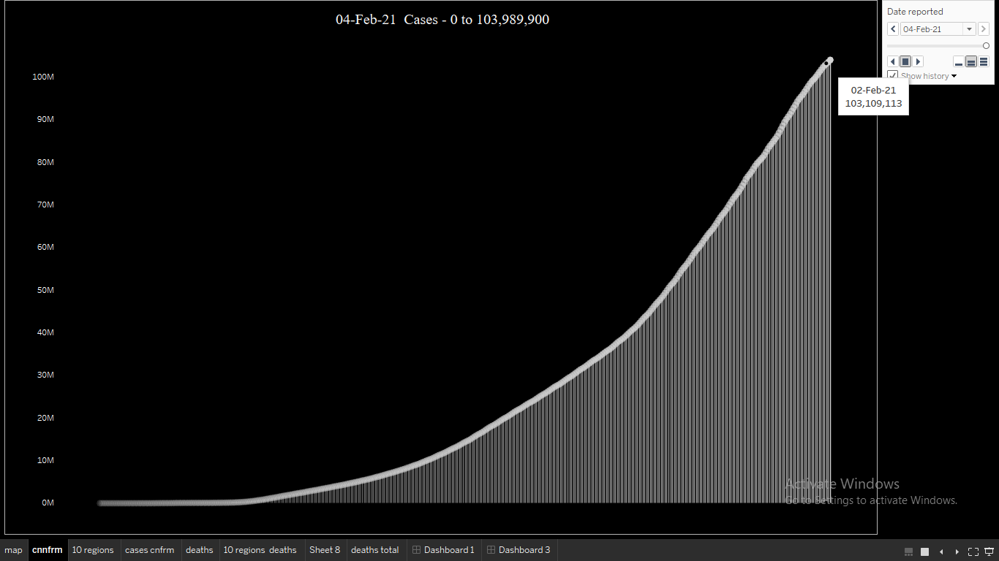

Slide 4
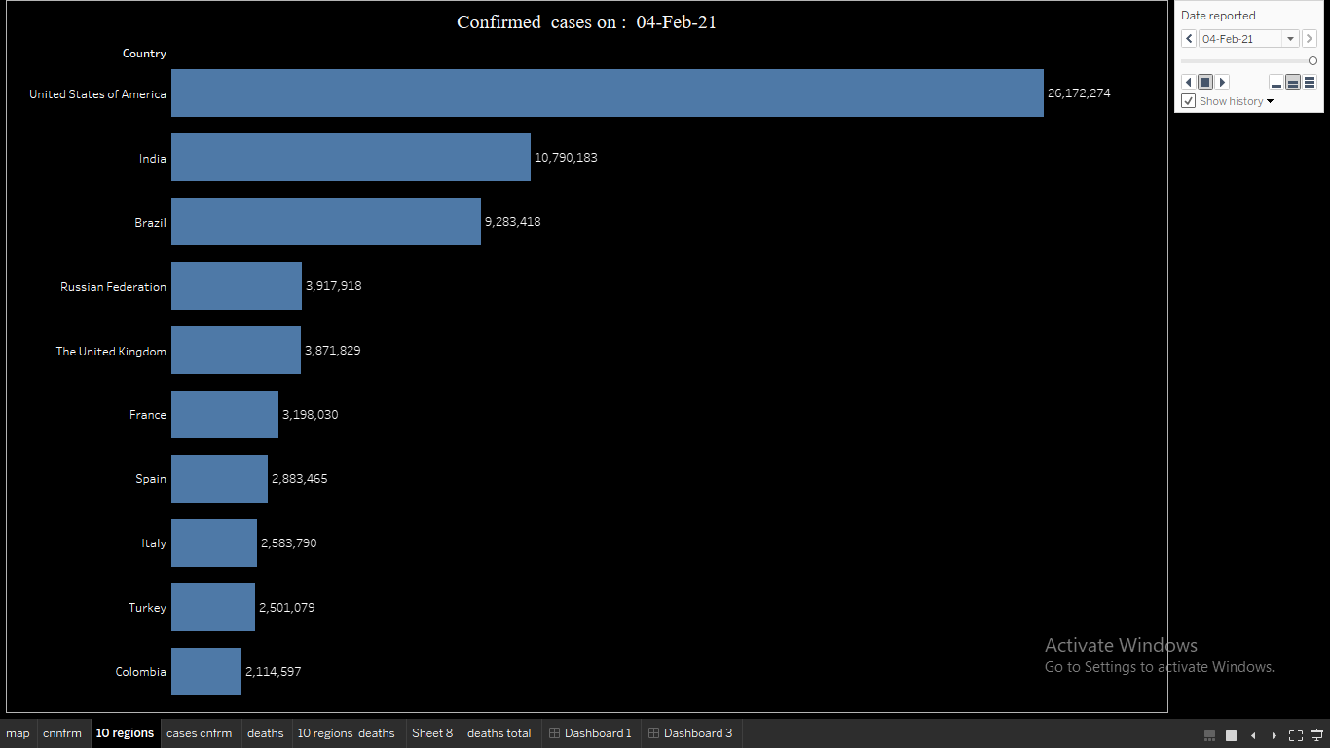
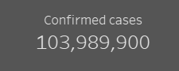

Slide 5
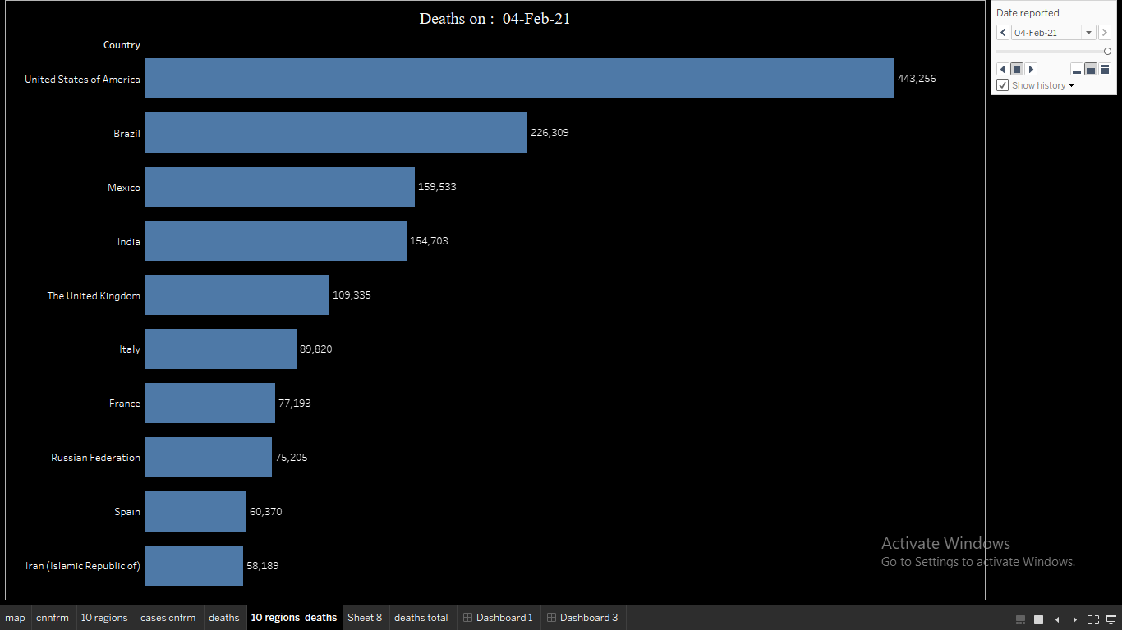
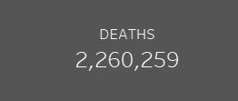

Slide 6
Dynamic Dashboards
Click here

Slide 7
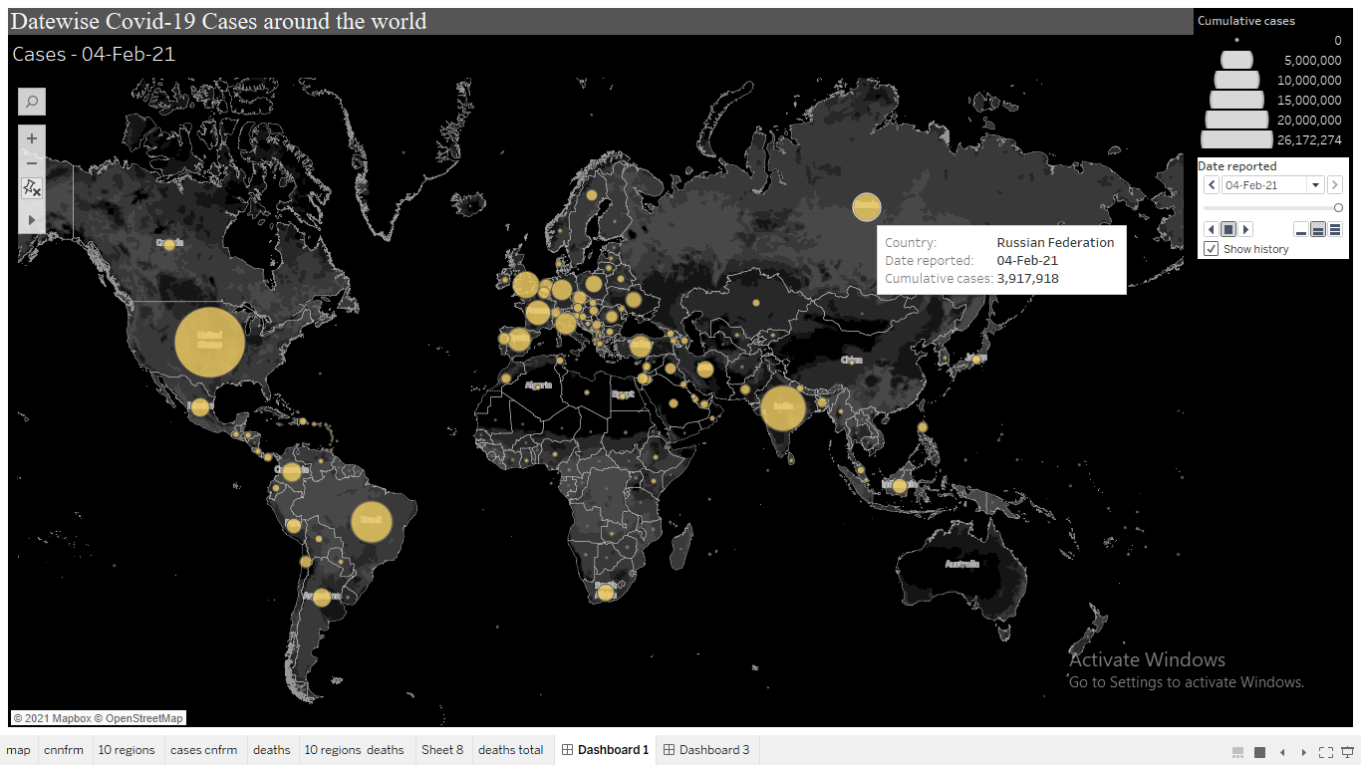

Slide 8
