Slide 1

Project Presentation of Industry Oriented Hands on Experience (22CS422)
On
Quick-Kart ( A Online Shopping App)
Presented By:
1. Rahul Das (2211985038)
2. Souvik Manna (2211985048)
Supervised By:
Dr. Rajat Takkar (9467026112)
Assistant Professor
Chitkara University, Rajpura
Department of Computer Science and Engineering,
Chitkara University, Punjab
1

Slide 2
Introduction
Quick-Kart is an online shopping and delivery platform designed to make purchasing products fast and convenient.
Customers often face difficulties in finding products quickly and managing orders efficiently.
Traditional shopping methods can be time-consuming and less organized.
Users need a simple platform to browse products, add items to cart, and place orders easily.
Managing payments and product availability can also be challenging.
Quick-Kart provides product browsing, cart management, and secure payment in one platform for a smooth shopping experience.
2

Slide 3
Technology Stack
Frontend: React.js (for building user interface)
Backend: Node.js and Express.js (for server and APIs)
Database: MongoDB (for storing user and project data)
Authentication: JWT (JSON Web Token for secure login)
UI Design: Tailwind CSS (for responsive and modern design)
Development Tool: Visual Studio Code
3

Slide 4
Project Abstract
Quick-Kart is an Online Shopping Platform where customers can order items to their requirments.
User Authentication Module.
Product Management Module.
Cart Management Module.
Payment Module.
Admin Management Module.
User and Order Management Module.
Quick Kart provides a modern and user-friendly approach to e-commerce, making online shopping more convenient, secure, and efficient for users while improving business management and customer satisfaction.
4

Slide 5
Objectives
To develop an online shopping platform that helps users purchase products easily and efficiently.
To provide a simple product browsing system for quick access to different categories and items.
To enable secure user registration and login for personalized shopping experiences.
To provide cart management features for adding and removing products conveniently.
To support secure online payment methods for safe and smooth transactions.
To manage products, orders, and customer details through an admin dashboard.
To integrate all shopping features into a single platform for better user convenience and organization.
5

Slide 6
Key Features
User Authentication: Secure login and signup using JWT.
Product Management: Add, update, and manage products easily.
Product Browsing: Search an explore products by catagories.
Shopping Cart: Add and remove products conveniently.
Secure Payment: Enable safe and smooth online transactions.
Order Management: Manage customer order efficiently.
Admin Dashboard: Monitor products, users, and sales details.
ResponsiveUI: Works smoothly on desktop .
Fast Checkout: Simplifield checkout process for better user experience
6

Slide 7
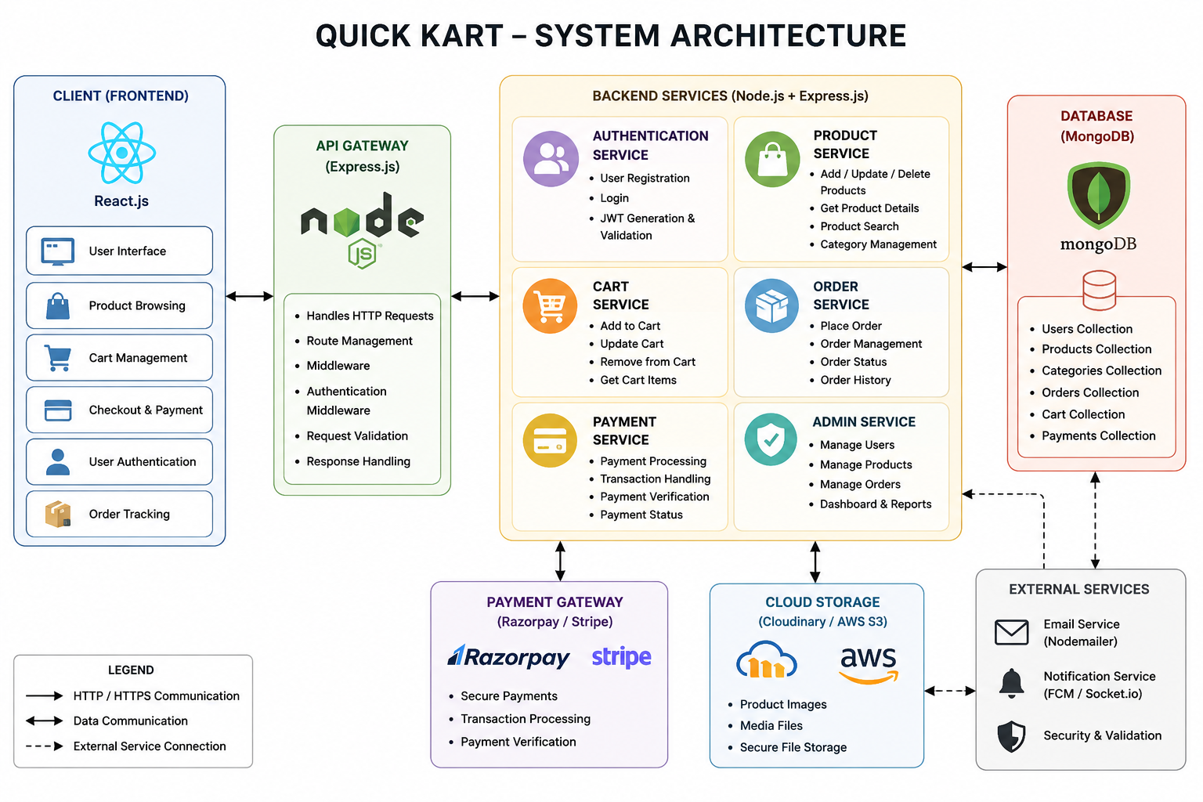
High-Level Design
7

Slide 8
System Architecture
The system follows a 3-tier architecture: Frontend, Backend, and Database
Frontend (React.js + Tailwind CSS) handles user interface and interactions
Backend (Node.js + Express.js) processes requests and manages application logic
Implements JWT authentication for secure login and access control
Database (MongoDB) stores users, documents, flashcards, quizzes, and results
Data flows from User → Frontend → Backend → Database → Frontend
8

Slide 9
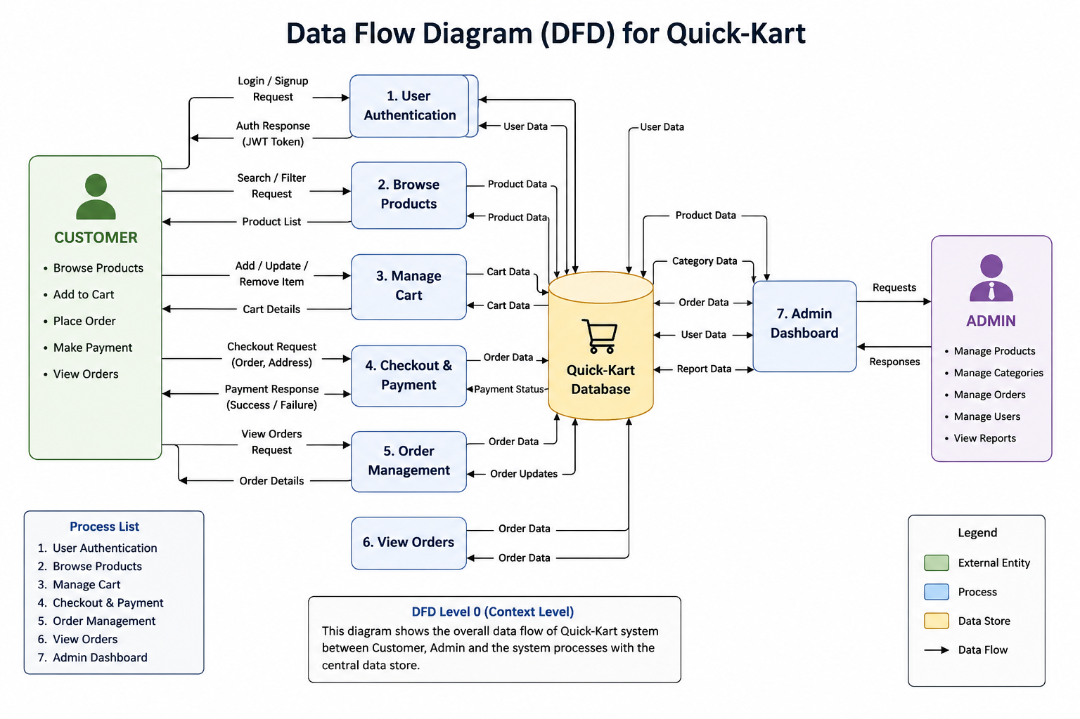
Data Flow Diagram
9

Slide 10
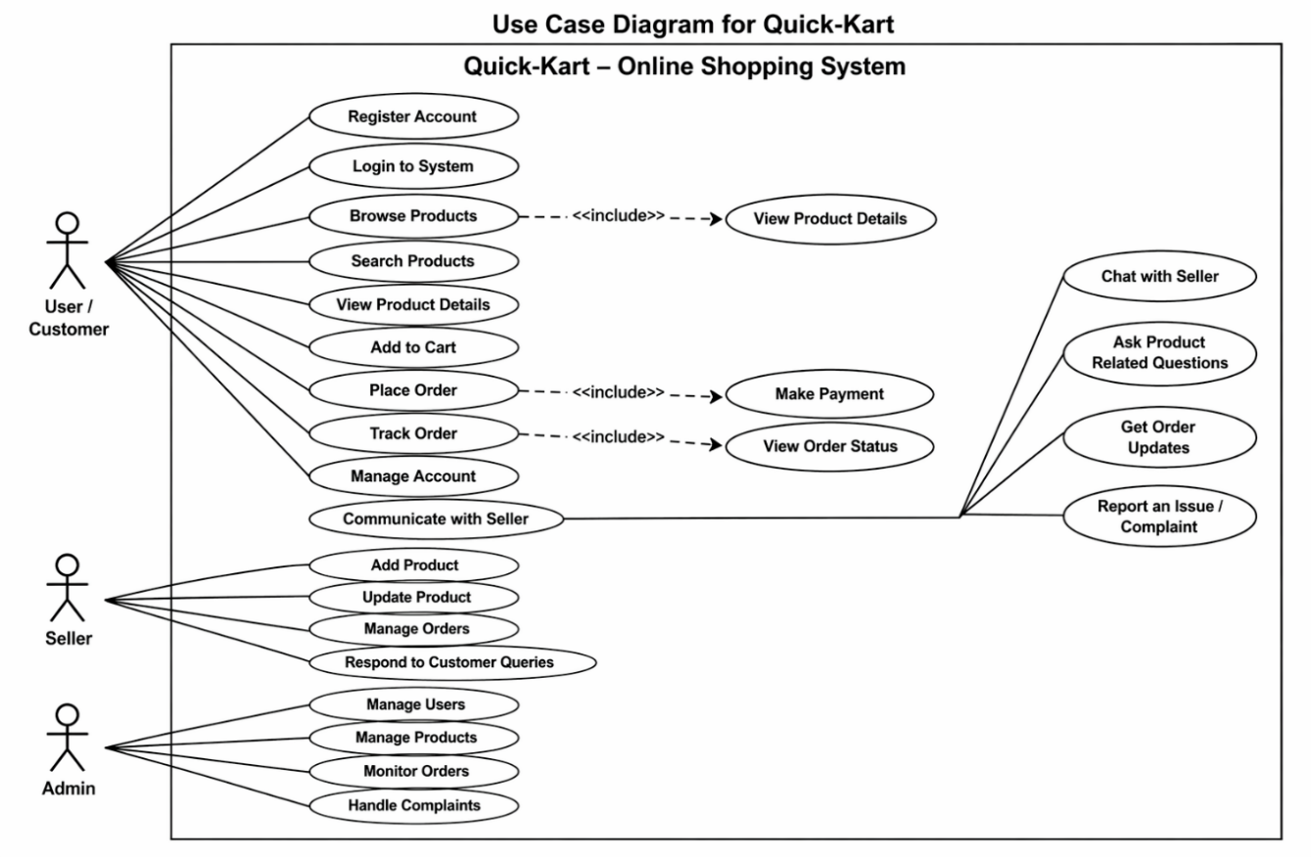
Use Case Diagram
10

Slide 11
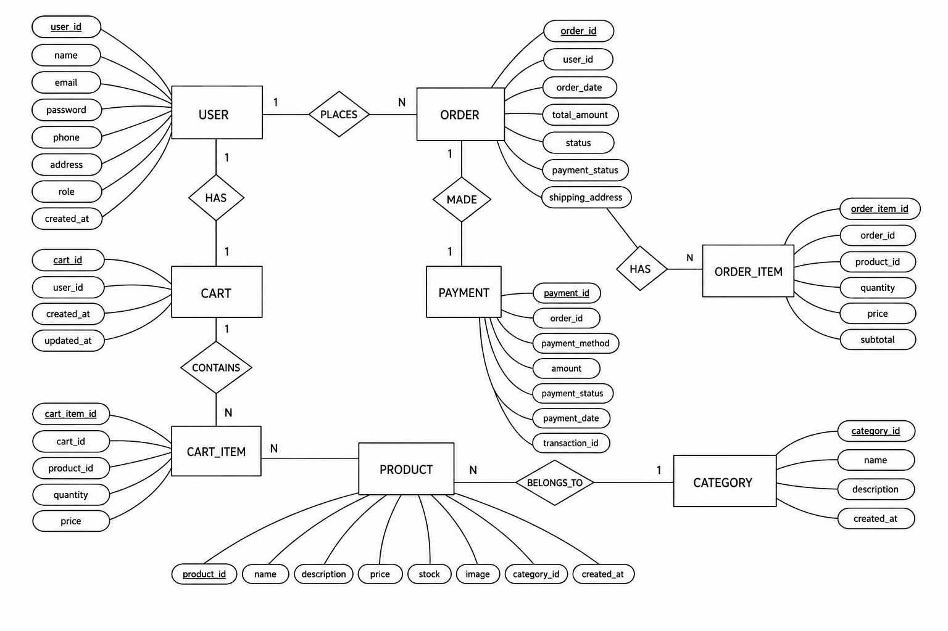
ER Diagram
11

Slide 12
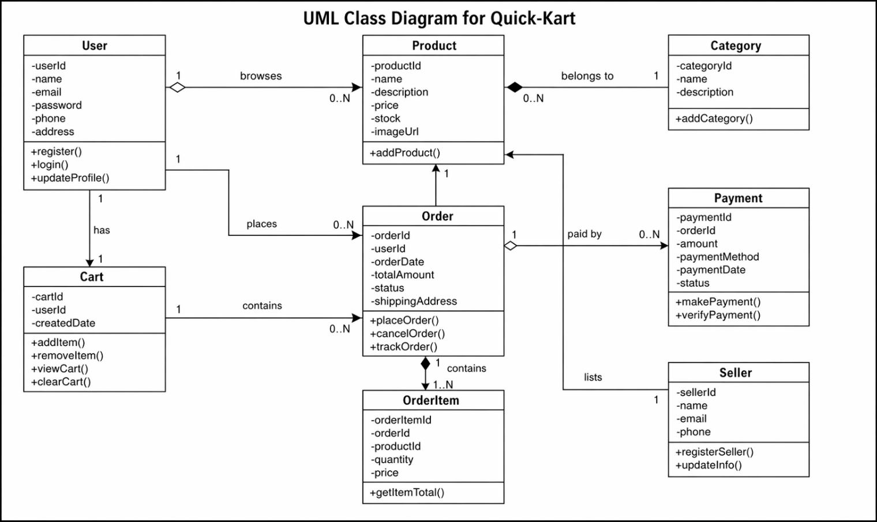
Class Diagram
12

Slide 13
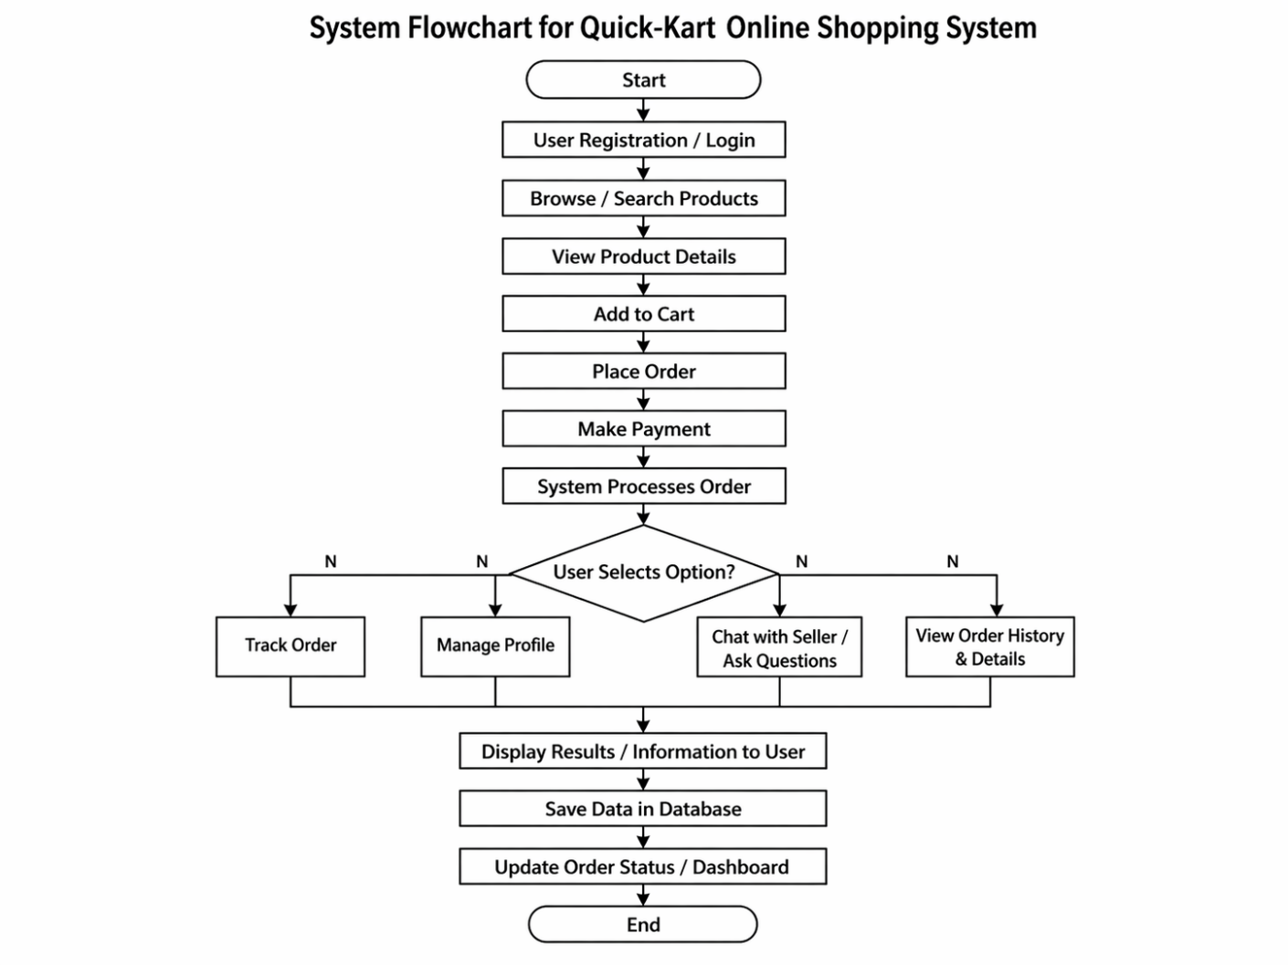
Flow Chart
13

Slide 14
Testing & Results
📌 Testing:
Performed Unit Testing for each module (authentication, product management, cart, and payment).
Conducted Integration Testing to check frontend-backend communication.
Verified all features through Functional Testing.
Tested UI for responsiveness and smooth navigation across devices.
Checked system performance with multiple product listings and user requests.
📌 Results:
User registration and login worked successfully.
Product browsing, cart management, and checkout functioned properly
Payment system processed transactions securely and accurately.
Admin dashboard managed products, users, and orders effectively.
Overall system provided a smooth, fast, and user-friendly shopping experience.
14

Slide 15
Limitations
The system depends on internet connectivity for browsing products and processing payments.
Processing a large number of users and products at the same time may affect performance.
Limited support for offline shopping features.
Payment gateway issues may sometimes interrupt transactions.
The system currently supports basic shopping features and lacks advanced recommendation systems.
Admin management is limited to basic product, user, and order handling features.
15

Slide 16
Future Scope
Implement same-day and urgent product delivery services similar to quick-commerce platforms like Blinkit.
Add real-time order tracking and delivery status updates for customers.
Develop a mobile application for faster and easier shopping access.
Add multiple payment options including wallets, UPI, and cash on delivery.
Improve system performance to handle a large number of users and products efficiently.
Enhance the admin dashboard with advanced sales analytics and reporting features.
Add customer review and rating systems for better product feedback.
16

Slide 17
Thank You
17

