Slide 1
HEALTHCARE TRANSFORMATION • ENTERPRISE CASE STUDY
Doctors AI Assistant Service
Clinical Telemedicine, Pre-Hospital Care & Mobile Health Network
Transforming regional healthcare delivery across North & Central India through AI clinical decision support, connected mobile health vans, real-time vital streams, and centralized MIS health records.
500,000+
Community Members Served
Across UP, Bihar & Jharkhand
< 8 Min
Tele-Triage Response
Down from 45 min previously
+60%
Doctor Capacity Uplift
Automated clinical transcription

Slide 2
OPERATIONAL CONTEXT
Regional Healthcare Ecosystem & Reach
Deploying specialist-level clinical guidance directly to rural and semi-urban communities.
🏥 Comprehensive Service Delivery
Delivering primary healthcare camps, maternal & child health checkups, preventive screenings, mobile medical vans, and emergency tele-triage across underserved districts.
⚠️ The Clinical Access Deficit
In target operating districts, the patient-to-doctor ratio exceeds 1:5,000 (far above the WHO recommended 1:1,000 threshold).
Specialists are clustered in metropolitan tertiary hospitals, forcing patients to travel 50-100 km for basic second opinions or delay treatment until conditions become critical emergencies.
🌍 Geographic Footprint
Active clinical outreach across Uttar Pradesh (central operating hub in Lucknow), Bihar, and Jharkhand, connecting primary clinics with tertiary referral hospitals.
🎯 The Strategic Mission
Deploy the Doctors AI Assistant Service to provide frontline health workers with instant clinical decision support, automate physician documentation, and stream real-time vitals during pre-hospital transit.
💻 Connected Digital Infrastructure
Unified health portal ecosystem:
• Tele-Consultation Gateway: Real-time video & vitals link
• Enterprise MIS: Centralized longitudinal patient EHR & reports
• Clinical LMS: Paramedic training and triage certification

Slide 3
CLINICAL BOTTLENECKS
6 Core Challenges in Regional Healthcare Delivery
Frontline barriers delaying emergency stabilization and creating doctor burnout.
👨‍⚕️ 1. Acute Specialist Deficit
Specialist doctors concentrated in distant cities; village clinics and camps have zero on-site access to cardiology or pediatric expertise.
🚑 2. Pre-Hospital Triage Delays
Ambulances and mobile vans lacked real-time doctor connectivity, leading to lost critical interventions during the 'golden hour'.
📋 3. Fragmented Paper Registers
Disconnected paper slips at mobile camps with zero patient history, causing dangerous drug interactions and lost follow-up care.
⏳ 4. Physician Cognitive Burnout
Doctors spent over 50% of consultation time typing notes and recording vitals, resulting in rushed 2-minute clinical exams.
🧪 5. Diagnostic & Lab Latency
Basic pathology tests took 3–5 days to process through distant centralized labs; patients often never returned for results.
📚 6. Frontline Protocol Gaps
Paramedics and health workers had inconsistent triage training, causing unnecessary hospital transfers or missed high-risk cases.

Slide 4
IMPLEMENTED SOLUTION
Doctors AI Assistant: Comprehensive Clinical Ecosystem
An integrated telehealth architecture bridging frontline field teams and consulting doctors.
🤖 AI Clinical Decision Support
• Symptom triage & differential diagnosis
• Green / Yellow / Red risk stratification
• Automated red-flag emergency detection
• Hands-free speech-to-text dictation
• Multi-dialect Indian medical models
• Auto-formatted standardized SOAP notes
🩺 Connected Point-of-Care Vitals
• Bluetooth/USB vital collection kits
• Live streaming 6-lead ECG & SpO2
• Digital stethoscope audio transmission
• Blood pressure & glucose monitoring
• Consulting doctor sees live waveforms
• Test turnaround reduced to <15 min
🚐 Connected Mobile Health Vans
• GPS-tracked mobile clinic deployment
• Onboard diagnostic screening units
• Low-bandwidth cloud sync to central MIS
• 1-click tertiary hospital referral dispatch
• Pre-arrival hospital emergency alerts
• Centralized staff LMS training portal
🏗️ Enterprise Healthcare Infrastructure
Telemedicine WebRTC Gateway • Enterprise Patient MIS (EHR) • Staff LMS Training Portal • Point-of-Care Diagnostic API Ingestion • Encrypted HIPAA/ABHA Compliant Cloud

Slide 5
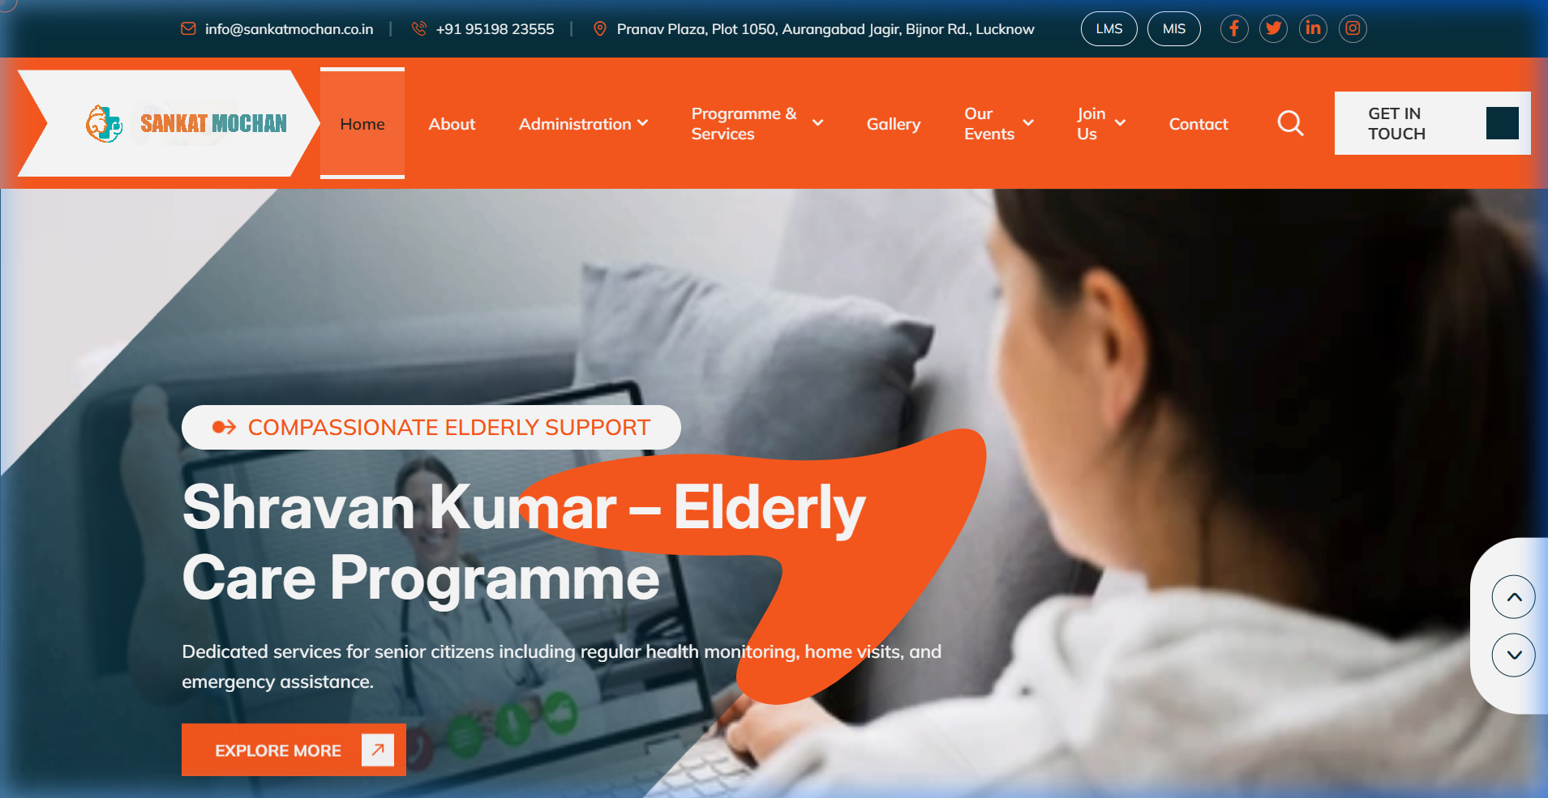
PLATFORM SCREEN 01
Healthcare Gateway & Service Architecture
Central portal providing emergency response, telemedicine triggers, and portal navigation.
🚑 24/7 Pre-Hospital Emergency Response
Immediate callout for emergency ambulance dispatch, medical assistance, and pre-hospital tele-consultation.
https://sankatmochan.co.in/
🔗 Integrated Healthcare Administration
Direct navigation into the Enterprise MIS (patient EHR records) and Clinical LMS (medical training certification).
🌐 Community Health Access
Centralized digital access connecting rural clinics, community health camps, and district medical centers.

Slide 6
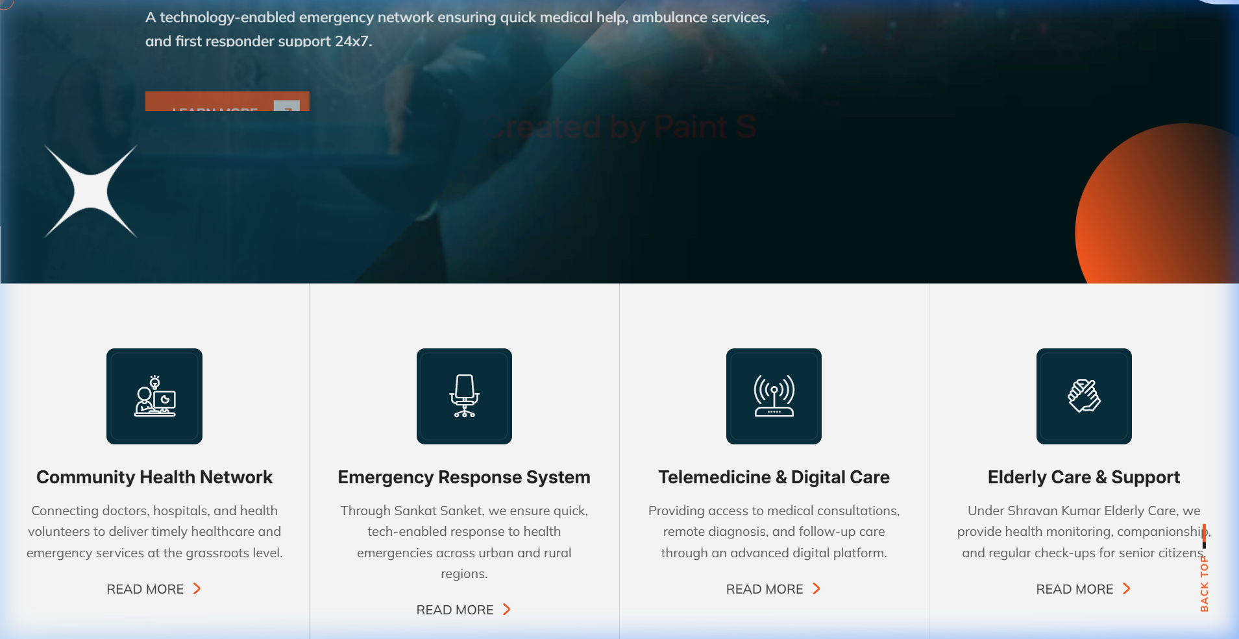
PLATFORM SCREEN 02
Healthcare Programmes & Services Matrix
Modular continuum of care spanning preventive screenings, maternal health, and mobile clinics.
📋 Comprehensive Care Catalog
Covers Pre-Hospital Care, Primary Health Camps, Maternal & Child Health, Preventive Screenings, and Mobile Vans.
https://sankatmochan.co.in/#services
💊 Pharmacy & Diagnostics Integration
Centralized coordination for essential medication dispensing and rapid point-of-care laboratory diagnostics.
🧠 Mental Health & Wellness
Integrated tele-counselling workflows addressing mental health awareness and psychosocial community support.

Slide 7
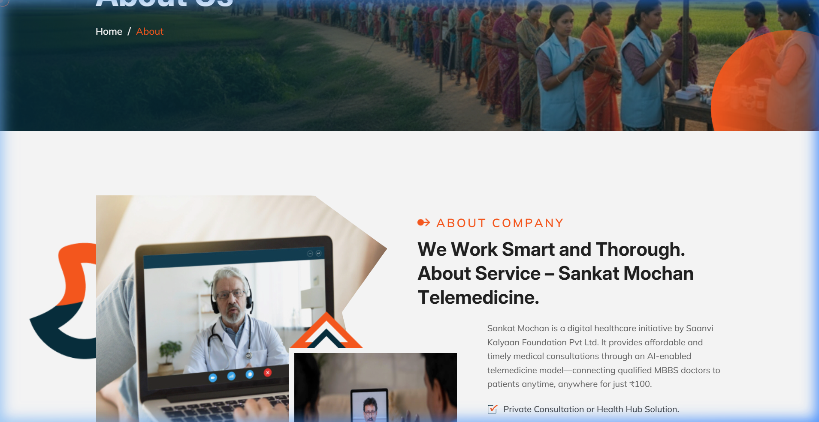
PLATFORM SCREEN 03
Institutional Mission & Community Healthcare Governance
Democratizing healthcare access across underserved districts in UP, Bihar, and Jharkhand.
🎯 Healthcare Equity Mission
Delivering high-quality, doctor-guided medical consultations to rural families, elderly patients, and vulnerable communities.
https://sankatmochan.co.in/about.php
🏥 Clinical Governance Framework
Structured administrative oversight spanning finance, monitoring & evaluation (M&E), legal compliance, and training.
🤝 Hospital Referral Network
Established referral tie-ups with district hospitals and tertiary care trauma centers for seamless emergency transfer.

Slide 8
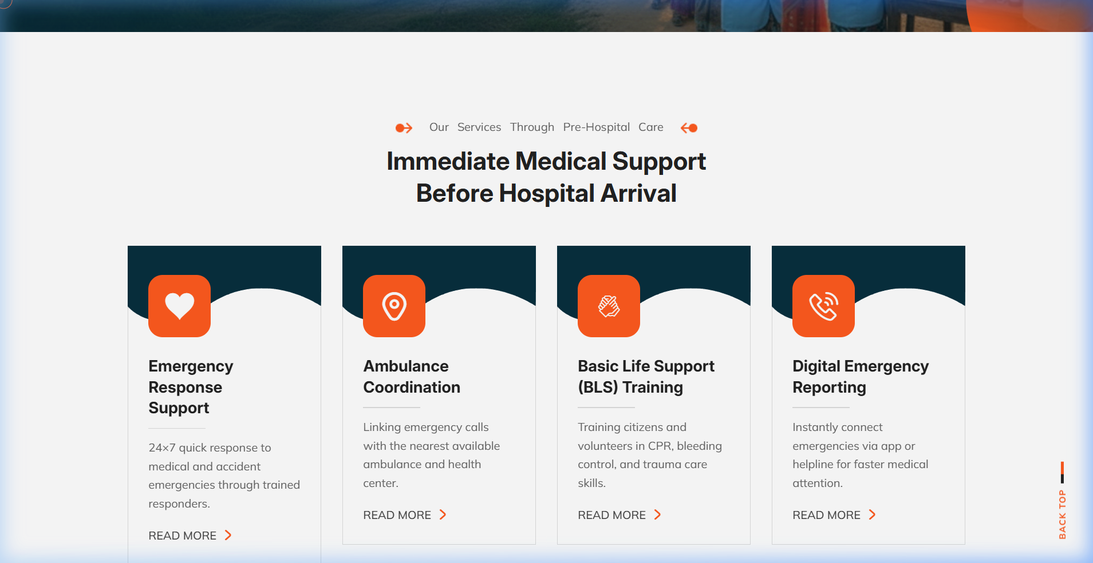
PLATFORM SCREEN 04
Pre-Hospital Care & Telemedicine Consultation
Immediate clinical tele-triage during transit and emergency patient stabilization.
⚡ 24/7 Tele-Triage Connectivity
Field paramedics connect via low-bandwidth video/audio to consulting specialists within <8 minutes of dispatch.
https://sankatmochan.co.in/Pre-Hospital-Care.php
📊 Live Vital Signs Telemetry
Streams ECG waveforms, oxygen saturation, blood pressure, and glucose levels in real time to the doctor's screen.
🚨 Golden Hour Management
Enables physician-guided stabilization protocols for acute cardiac arrest, stroke, and trauma before hospital arrival.

Slide 9
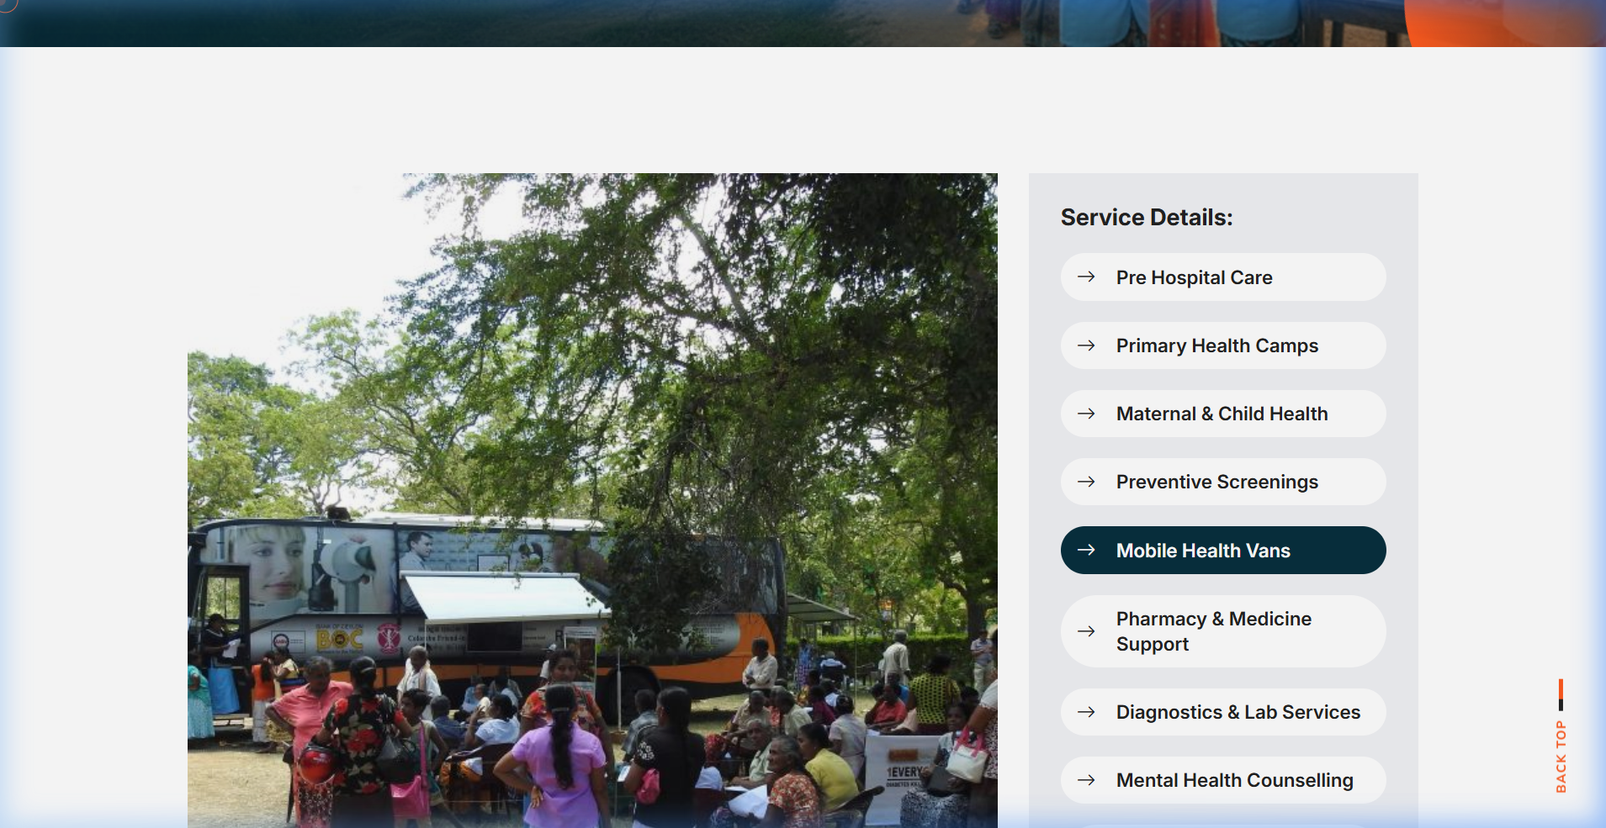
PLATFORM SCREEN 05
Mobile Health Vans & Primary Camp Operations
Taking multi-diagnostic screening and clinical consultations directly into villages.
🚐 Connected Mobile Medical Vans
Fully outfitted medical units operating across rural routes, carrying diagnostic kits, vital monitors, and satellite links.
https://sankatmochan.co.in/Mobile-Health-Vans.php
⛺ On-Ground Camp Management
Streamlined registration and triage for primary health camps, ingesting patient records directly into the central cloud MIS.
⚡ Instant Point-of-Care Lab
Diagnostic screening for diabetes, hypertension, and anemia delivering results on-site in <15 minutes.

Slide 10
FUNCTIONAL CAPABILITIES
6 Core Healthcare Modules Deployed
End-to-end clinical capability from emergency tele-triage to centralized EHR.
01. AI Clinical Decision Support
Symptom parser & triage rules flagging emergency red flags.
02. Point-of-Care Vitals Streaming
Live 6-lead ECG, SpO2, NIBP & glucose telemetry to doctor cockpit.
03. Speech-to-Text Clinical Notes
Hands-free dictation auto-formatting standardized SOAP consultation notes.
04. Centralized Patient MIS (EHR)
Cloud portal managing longitudinal medical history, lab reports & prescriptions.
05. Staff Clinical LMS Portal
Standardized training, triage guidelines & certification for field nurses.
06. Hospital Referral Dispatch
Pre-arrival alerts and digital transfer summaries for tertiary trauma centers.

Slide 11
TECHNICAL ARCHITECTURE
Secure, Low-Bandwidth Telehealth Infrastructure
Engineered for reliable clinical consultations even in low-connectivity rural zones.
⚡ Low-Bandwidth WebRTC Video & Audio
• Adaptive bitrate WebRTC streaming optimized for 2G/3G/4G connectivity.
• Sub-second synchronization of digital stethoscope audio and live ECG waveforms.
• Local offline caching on mobile vans ensuring patient records are never lost during signal drops.
🧠 AI Reasoning & Clinical Parser Pipeline
• Domain-trained clinical LLM recognizing regional Indian medical terminology and brand names.
• Real-time drug-drug interaction checker preventing adverse prescription errors.
• Automated plain-language patient summary generation in regional languages.
🗄️ Enterprise MIS Database & Security
• Relational PostgreSQL database with strict role-based access control (RBAC).
• Encrypted patient health identifiers ensuring patient data privacy.
• Continuous audit logging for all tele-consultations, prescription edits, and lab results.
🎓 Centralized LMS Training Architecture
• Cloud-hosted Learning Management System for paramedic and health worker upskilling.
• Interactive emergency response drills and automated clinical competency testing.
• Ensures uniform medical protocol adherence across all rural operating territories.

Slide 12
MEASURED CLINICAL IMPACT & OPERATIONAL GAINS
Delivering Timely, Accessible Healthcare to Every Citizen
Deploying the Doctors AI Assistant Service transformed frontline healthcare from disconnected, manual visits into an intelligent, data-driven clinical network.
< 8 Min
Tele-Triage Response
Reduced from 45 min previously
+60%
Consultation Capacity
Physicians see more patients with AI notes
< 15 Min
Point-of-Care Testing
Down from 3–5 days lab latency
+44%
Golden Hour Capture
Timely emergency hospital transfers
100%
Digital Health Records
Longitudinal EHR replacing paper registers
500k+
Citizens Reached
Across UP, Bihar & Jharkhand communities
Doctors AI Assistant Service • Healthcare Transformation Case Study

