Slide 1
FINTECH DIGITAL TRANSFORMATION • ENTERPRISE CASE STUDY
Trading Checker Project
Next-Gen AI Equity Research & Market Intelligence Platform
Modernizing retail and institutional equity research across 2,000+ ASX stocks through interactive conversational AI, automated plain-English verdicts, and real-time technical charting.
2,000+
ASX Equities Covered
Institutional-grade daily analytics
+300%
Active Session Duration
Surged from 2.1 min to 8.4 min
+42%
Free-to-Paid Conversion
High-converting interactive AI tools

Slide 2
CLIENT BACKGROUND
Trading Checker: Next-Gen FinTech & Market Intelligence Platform
Authorised equities research advisory firm based in Sydney, NSW.
🏛️ Corporate Entity & Headquarters
Operating under Nextgen Global Services Pty Ltd (ABN 89 652 632 561), headquartered at Level 13, 465 Victoria Ave, Chatswood, Sydney, NSW, Australia.
💼 Specialized Research Subscriptions
Trading Checker monetizes via tiered investment intelligence reports:• Daily Dose: Overnight Wall Street & pre-market ASX briefing• Swing Trades: Momentum setups with technical entry/exit catalysts• Dividend Income: High-yield cash flow compounders with franking credits• Resources & Clean Energy: Critical minerals (lithium, copper, uranium)
⚖️ Regulatory Licensing & Governance
Corporate Authorised Representative (CAR No. 1293674) of Enva Australia Pty Ltd (AFSL 424494). Fully compliant with ASIC general financial product advice frameworks.
🎯 The Strategic Imperative
Modern retail investors no longer tolerate static 30-page PDF reports sent via email. To scale subscriptions and expand globally, Trading Checker needed an interactive, AI-first platform delivering instant, plain-English answers on demand.
📈 Broad Capital Markets Coverage
Comprehensive research coverage spanning:
• ASX 200 & ASX 300: Blue-chip miners, banks & industrials
• Small Cap Shooters: High-growth emerging micro-caps
• Global Markets: US Equities (NYSE/NASDAQ), TSX (Canada) & India

Slide 3
OPERATIONAL CHALLENGES
6 Core Bottlenecks in Traditional Financial Research
Static distribution models led to low engagement, analysis paralysis, and platform drop-off.
📄 1. The Static PDF Graveyard
Research was trapped in 20-30 page PDF attachments. Low completion rates (<15%), zero mobile responsiveness, and impossible to search on the go.
🧠 2. Analysis Paralysis
Retail investors struggled to decipher complex institutional jargon. Simple questions (*'Should I buy BHP today?'*) were buried in dense disclosures.
📉 3. Absence of Interactive Tooling
Subscribers read a report on Trading Checker, then left for TradingView or CommSec to check charts, causing severe platform drop-off.
⚖️ 4. Multi-Stock Comparison Friction
Comparing rival equities (e.g. BHP vs RIO) required toggling separate PDFs and manually matching P/E, yields, and growth metrics.
📁 5. Unstructured Portfolio Monitoring
Subscribers had no way to upload existing holdings to receive tailored alerts, making subscriptions feel generic and impersonal.
🛡️ 6. Regulatory Disclaimers Overhead
Strict ASIC rules require prominent general advice disclaimers across all touchpoints, creating heavy manual compliance review overhead.

Slide 4
DIGITAL TRANSFORMATION
An AI-First Financial Intelligence & Charting Ecosystem
Transforming a traditional publisher into a real-time, interactive equity research platform.
🤖 'Trading Checker AI' Assistant
• Domain-trained conversational stock assistant
• Plain-English answers on 2,000+ ASX codes
• Synthesizes earnings, broker consensus & filings
• Explains technical catalysts & valuation risks
• Embedded general advice compliance guardrails
• 74% of common customer questions automated
📊 Native Technical Charting
• Integrated KapChart & KapStudies suite
• Multi-timeframe candlestick & volume bars
• 30+ technical indicators (RSI, MACD, SMA)
• Interactive drawing tools (Fibonacci, channels)
• Zero external platform dependency
• Optimized for mobile touch and desktop displays
⚡ Comparative & Portfolio Tools
• Side-by-Side Stock Comparison engine
• AI-generated comparative verdict on peer stocks
• AI Portfolio Snapshot & health check diagnostics
• Sector concentration & over-allocation warnings
• High-converting free trial onboarding funnel
• Tiered subscription access control
🏗️ Architecture Foundation
High-performance responsive frontend • Low-latency Market Data API Ingestion • Conversational AI & NLP Reasoning Engine • Relational PostgreSQL + TimeSeries • Cloudflare Zero-Trust Edge

Slide 5
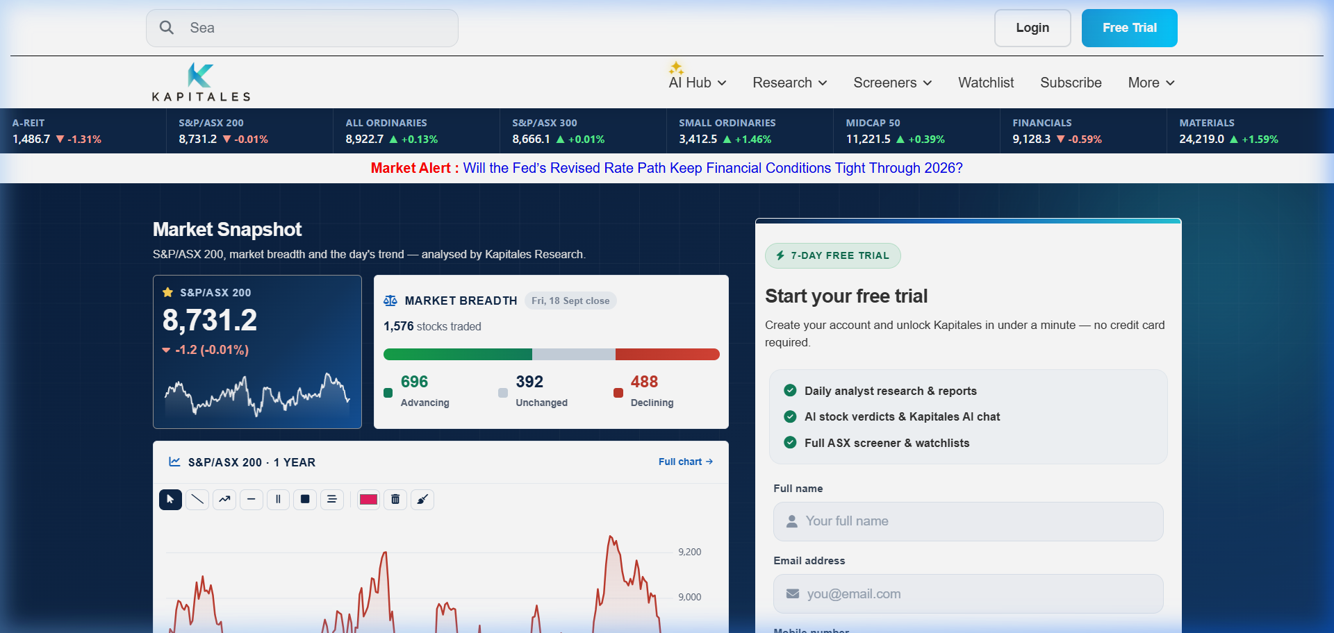
PLATFORM SCREEN 01
Market Intelligence Gateway & Ticker Ribbon
Immediate market orientation with live ASX tickers, multi-asset search, and lead capture.
🌐 Real-Time Market Orientation
Surfaces live ASX index performance, top daily gainers/losers, commodity indicators, and macroeconomic market wrap-ups.
https://app.tradingchecker.com/
🔍 Multi-Asset Universal Search
Instant autocompleting search bar covering ASX stocks, ETFs, mutual funds, and international securities across global exchanges.
🚀 Free Trial Acquisition Funnel
Prominently placed trial onboarding capturing retail investor leads with seamless verification and zero initial friction.

Slide 6
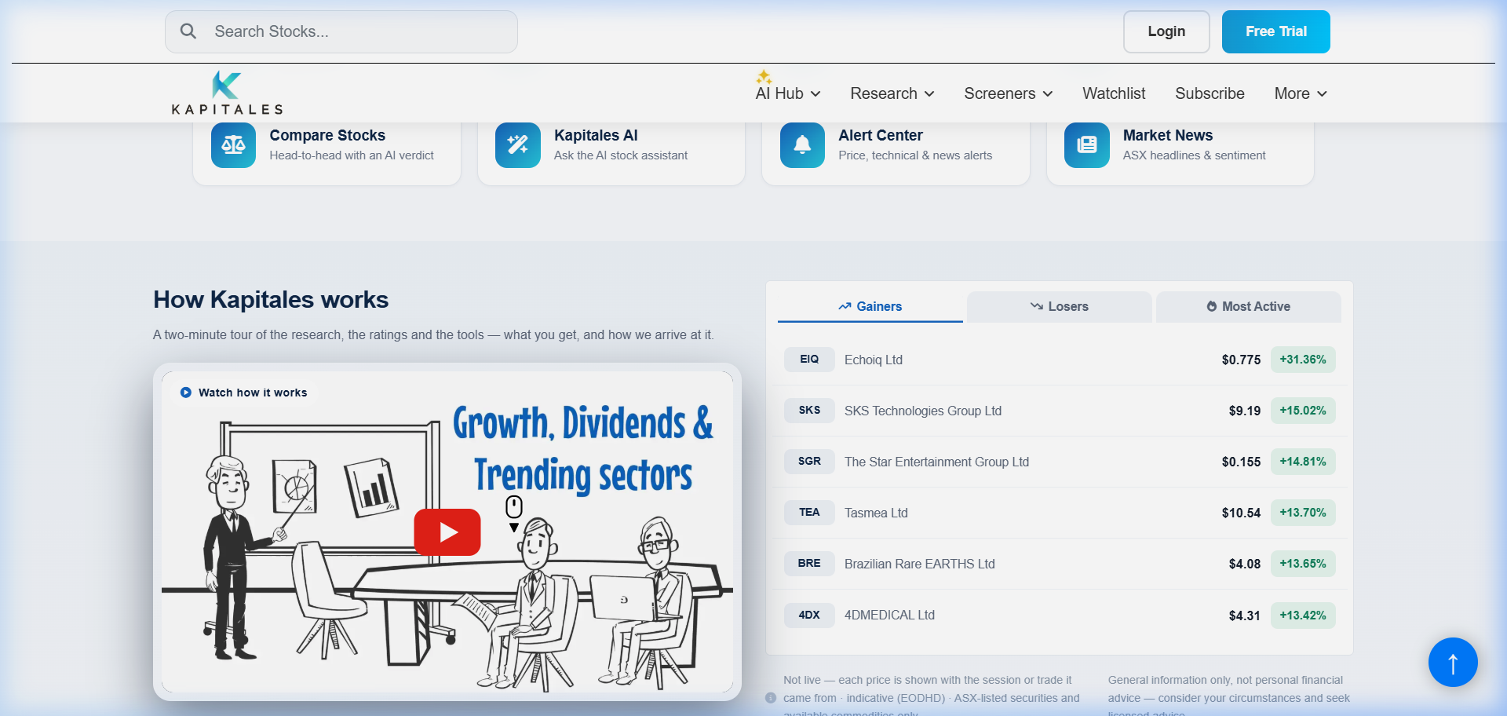
PLATFORM SCREEN 02
Trending Securities & Intelligent Discovery Search
Live categorization of market momentum across companies, research reports, and breaking news.
🔥 Trending Ticker Stream
Dynamically ranks equities experiencing unusual trading volumes, earnings surprises, or rapid price momentum on the ASX.
https://app.tradingchecker.com/#search
📂 Categorized Results Matrix
Search dropdown organizes matches into All, Company Profiles, Analyst Research Reports, and Breaking Market Articles.
⚡ Sub-Second Query Execution
Client-side caching and debounced API requests deliver instant autocomplete suggestions even on high-latency mobile networks.

Slide 7
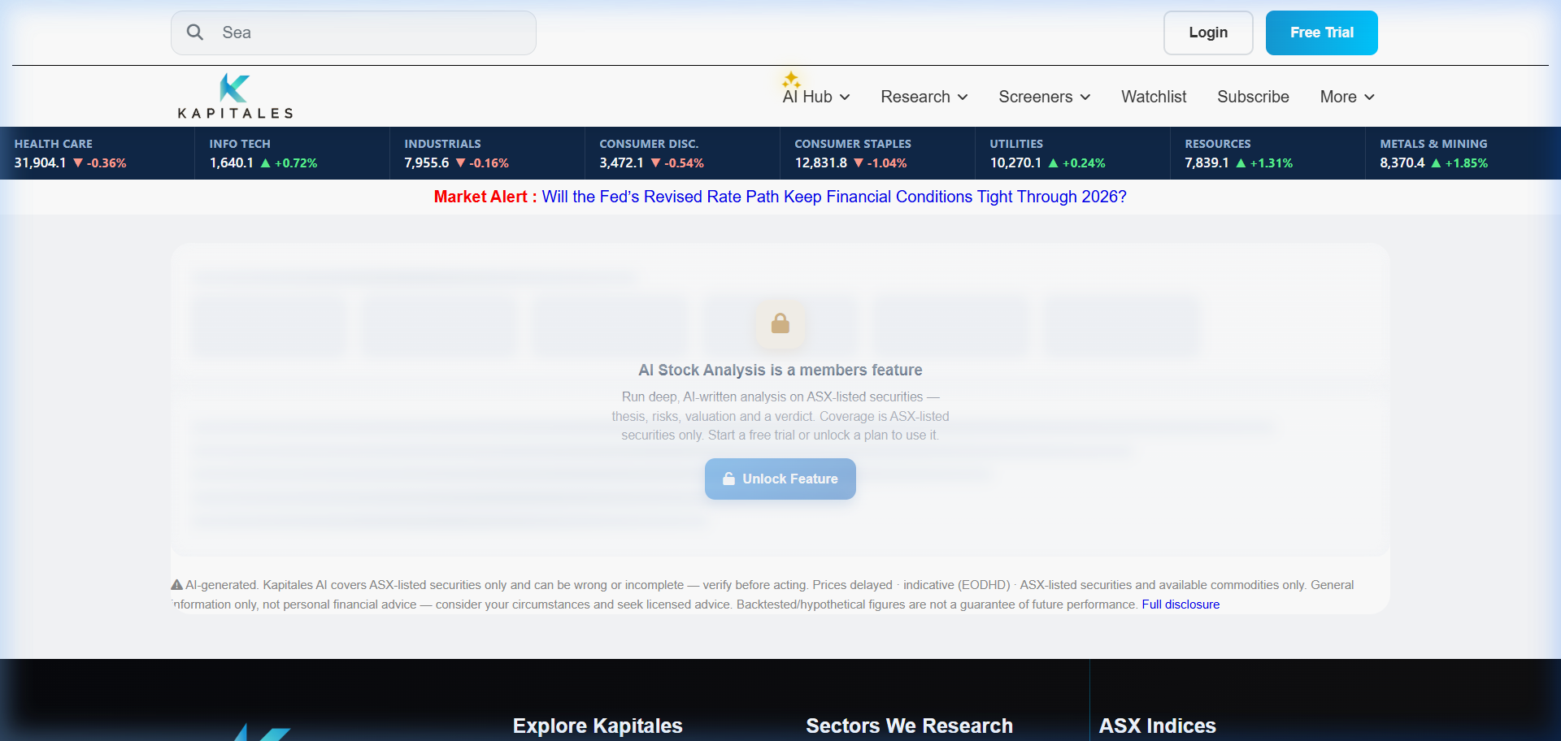
PLATFORM SCREEN 03
The AI Hub & Automated Plain-English Stock Verdicts
Democratizing institutional analysis with conversational AI and clear investment recommendations.
💬 Conversational 'Trading Checker AI'
Investors ask natural-language questions ('Analyze Pilbara Minerals after earnings') and receive structured, data-backed answers in seconds.
https://app.tradingchecker.com/ai-analysis
📑 Plain-English Verdicts
Deconstructs complex balance sheets into intuitive factor summaries: Valuation, Financial Health, Momentum, and Analyst Ratings.
🛡️ Compliance Guardrails
Built-in regulatory disclaimers explicitly reiterate general advice warnings while explaining reasoning clearly.

Slide 8
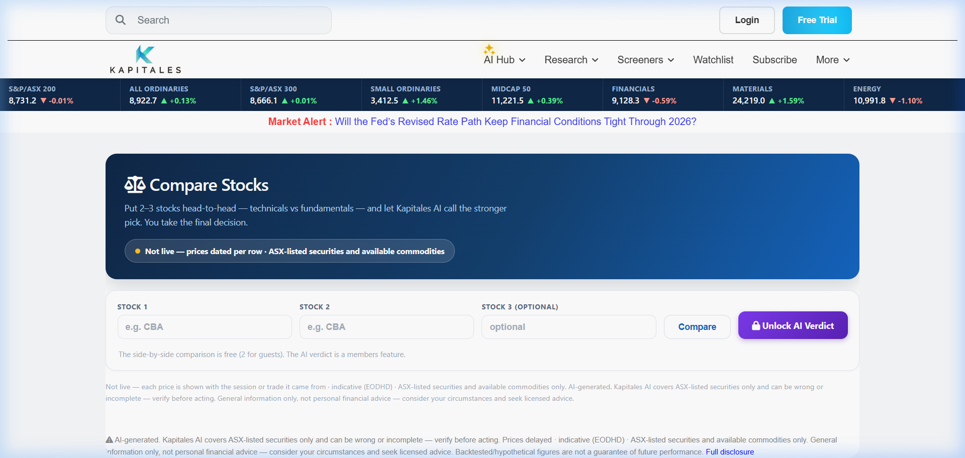
PLATFORM SCREEN 04
Side-by-Side Comparative Stock Analyzer
Evaluating peer companies head-to-head across valuation, dividends, and growth metrics.
⚖️ Peer Comparison Matrix
Pit two or more rival ASX tickers head-to-head (e.g. BHP vs RIO, or CBA vs NAB) to instantly see relative strength.
https://app.tradingchecker.com/compare
📊 Key Financial Metrics
Compares P/E multiples, Dividend Yield, ROE, Debt-to-Equity, 1-year total return, and consensus target price upside.
🤖 Automated AI Verdict
Synthesizes the financial comparison into a clear AI takeaway: which company offers superior risk-adjusted reward for investors.

Slide 9
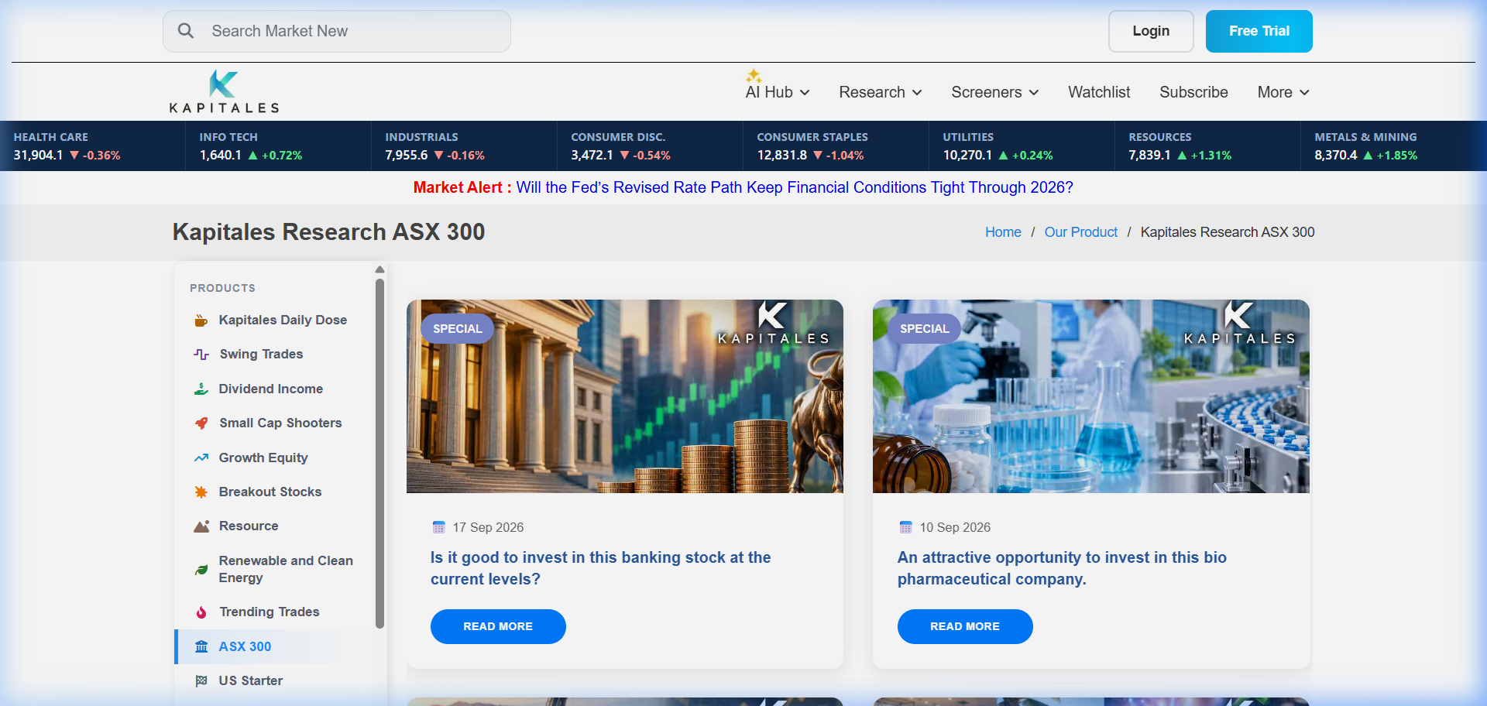
PLATFORM SCREEN 05
Institutional-Grade Thematic Research Products
Subscription catalog offering deep-dive coverage of ASX 300, Small Caps, and Critical Minerals.
📚 Tiered Research Catalog
Showcases institutional-grade thematic products: Daily Dose, Swing Trades, Dividend Income, Small Cap Shooters, and ASX 300.
https://app.tradingchecker.com/our-products
💎 In-Depth Equity Theses
Each report details corporate business models, revenue drivers, balance sheet health, target price horizons, and key risks.
🔐 Gated Premium Access
Seamless paywall integration allowing preview excerpts while protecting full actionable recommendations for paying subscribers.

Slide 10
FUNCTIONAL MATRIX
6 Core FinTech Capabilities Deployed
A unified intelligence suite empowering retail and professional market participants.
01. Conversational AI Assistant
Trading Checker AI processes complex market queries and delivers plain-English answers.
02. Automated Stock Verdicts
Algorithmic multi-factor screening across 2,000+ ASX tickers with clear recommendations.
03. AI Portfolio Snapshot
Investors upload holdings to visualize asset allocation, sector risk, and concentration.
04. Native Technical Charting
KapChart & KapStudies suite providing multi-timeframe candlestick analysis on-platform.
05. Side-by-Side Comparator
Head-to-head evaluation of rival stocks across valuation, dividends, and growth.
06. Regulatory Compliance Hub
Automated insertion of ASIC general advice disclaimers and audit-ready recommendation logs.

Slide 11
CLOUD ARCHITECTURE
Scalable, Compliant FinTech Infrastructure
Engineered for low-latency market data delivery, AI reasoning, and bank-grade security.
⚡ High-Performance Presentation Tier
• Responsive Web Application optimized for desktop, tablet, and mobile browsers.
• Asynchronous asset bundling and deferred script execution for sub-second page loads.
• Custom SVG/Canvas charting engine (KapChart) eliminating third-party iframe lags.
🧠 AI Reasoning & Market Data Pipeline
• Ingests live ASX pricing feeds, company announcements, and financial statement filings.
• Domain-specific LLM reasoning pipeline generating plain-English investment summaries.
• Financial sentiment scoring and algorithmic valuation factor modeling.
🗄️ Relational & Time-Series Data Store
• PostgreSQL database with partitioned time-series tables for historical stock pricing.
• Secure user subscription management, watchlists, and encrypted portfolio holdings.
• Immutable recommendation audit log ensuring strict ASIC compliance recording.
🛡️ Cloudflare Zero-Trust Edge Security
• TLS 1.3 end-to-end encryption with global CDN caching for market research reports.
• Advanced DDoS protection, rate-limiting on financial APIs, and CSRF token governance.
• 99.95% platform uptime during volatile market open hours.

Slide 12
MEASURED BUSINESS IMPACT & ROI
Transforming Financial Publishing into a Real-Time Intelligence Hub
The launch of the modernized Trading Checker platform dramatically elevated subscriber engagement, accelerated analyst research output, and scaled subscription conversions.
+300%
Session Duration Growth
Surged from 2.1 minutes to 8.4 minutes
+42%
Trial-to-Paid Conversion
High-converting interactive AI tools
-65%
Research Turnaround
Flash earnings updates in <45 minutes
74%
Inquiries Automated
Resolved instantly by Trading Checker AI assistant
61%
Mobile Traffic Share
Grew from 22% via responsive PWA design
99.95%
Platform Availability
Sub-100ms API response across Australia
Trading Checker Project • FinTech Digital Transformation Case Study

