Slide 1

Dr. D. Y. Patil Unitech Society
DR. D. Y. PATIL INSTITUTE OF TECHNOLOGY
(formerly Dr. D. Y. Patil Institute of Engineering and Technology)
Sant Tukaram Nagar, Pimpri, Pune.
DEPARTMENT OF ELECTRONICS & TELECOMMUNICATION
Electrical Circuit Virtual Lab
Savitribai Phule Pune University
Second Year of E &TC Engineering (2019 Course)
204187: Electrical Circuits Lab

Slide 2
EXPERIMENT 3
To study the load characterstics of DC Shunt Generator.

Slide 3
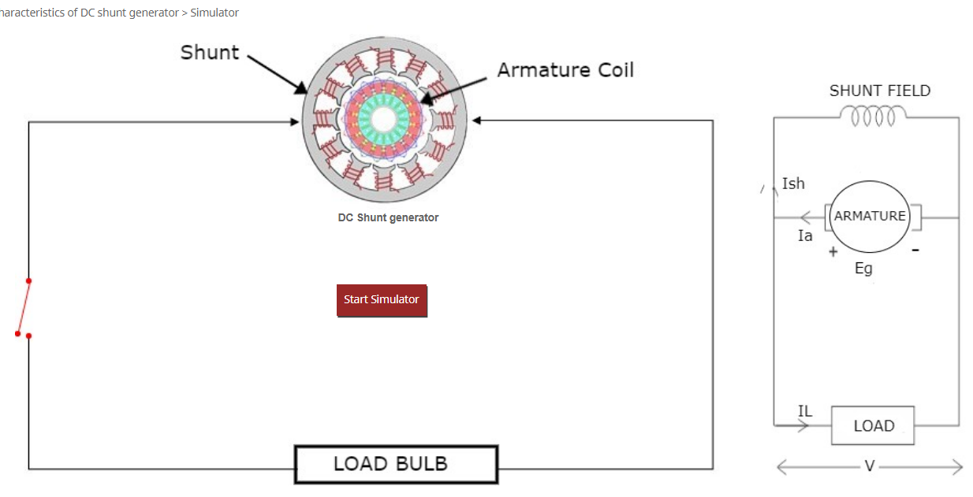
Procedure:
Go to the Simulator tab and select Start Simulator

Slide 4
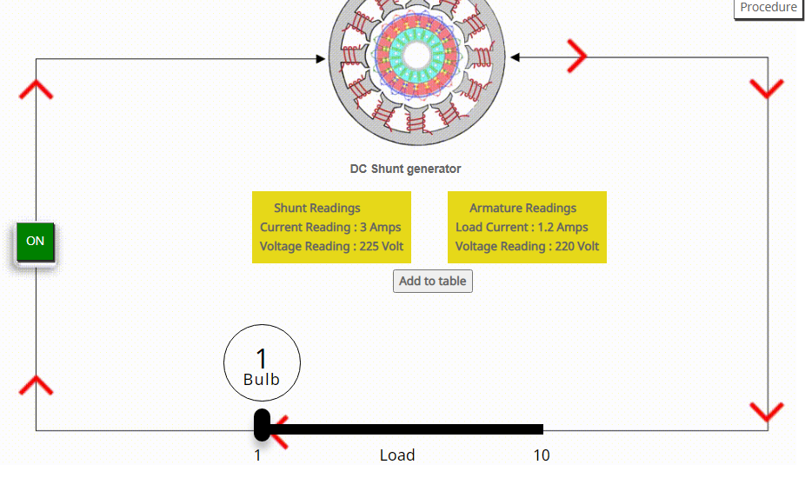
2) Set the Load Bulb and go through the Armature readings.

Slide 5

3) Click on Add to Table to add Armature Reading to Table.

Slide 6
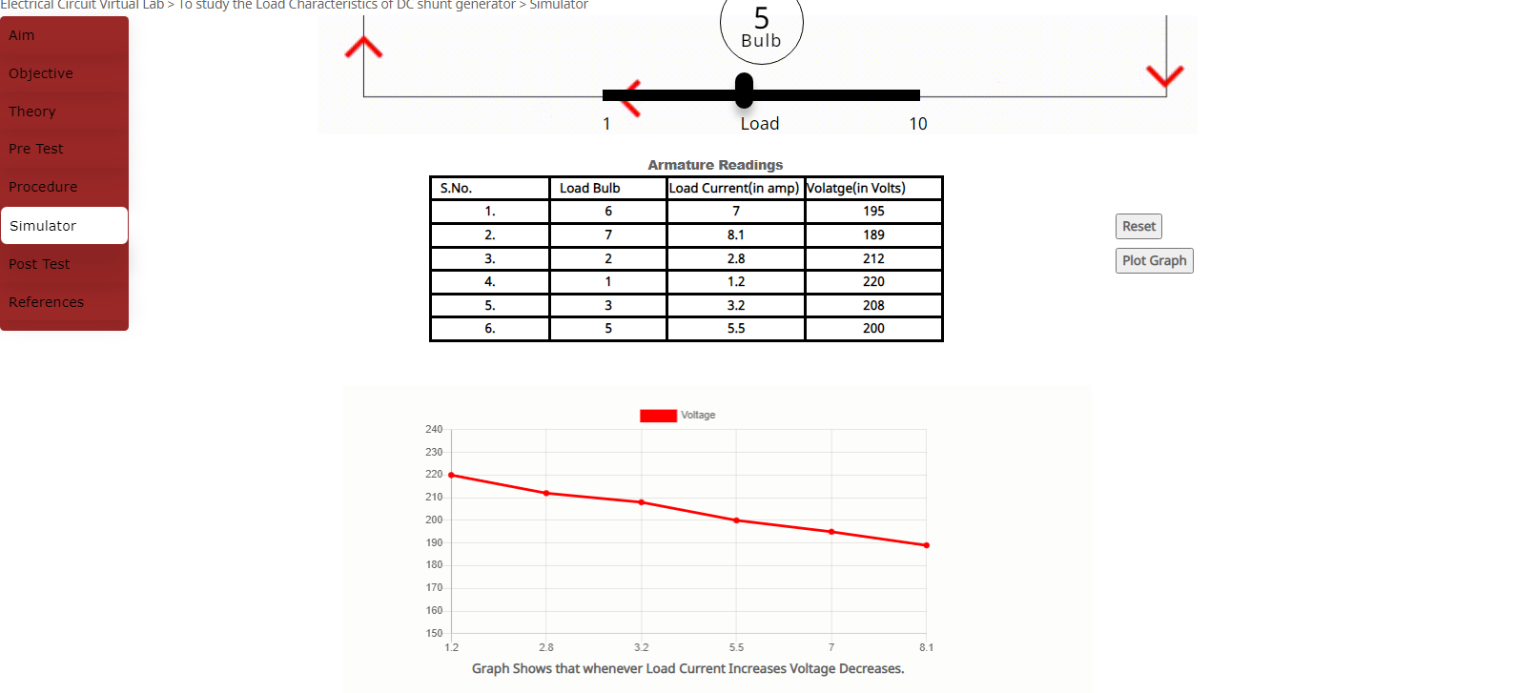
4) Complete the Armature Reading Table.

Slide 7
5) Click on Plot Graph to Plot Table

