Slide 1

Dr. D. Y. Patil Unitech Society
DR. D. Y. PATIL INSTITUTE OF TECHNOLOGY
(formerly Dr. D. Y. Patil Institute of Engineering and Technology)
Sant Tukaram Nagar, Pimpri, Pune.
DEPARTMENT OF ELECTRONICS & TELECOMMUNICATION
Electrical Circuit Virtual Lab
Savitribai Phule Pune University
Second Year of E &TC Engineering (2019 Course)
204187: Electrical Circuits Lab

Slide 2
EXPERIMENT 2
To study and verify parallel RL & RC Circuits

Slide 3
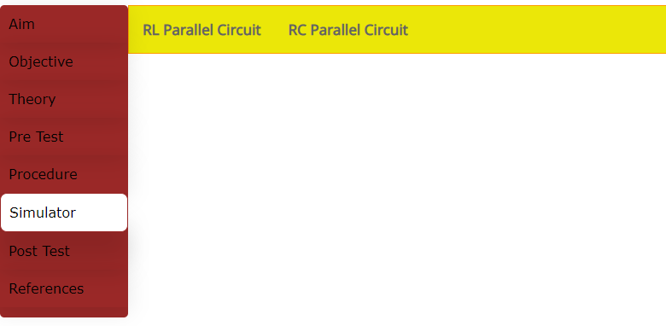
Procedure:
Go to the Simulator tab and select RL Parallel Circuit / RC Parallel Circuit.

Slide 4
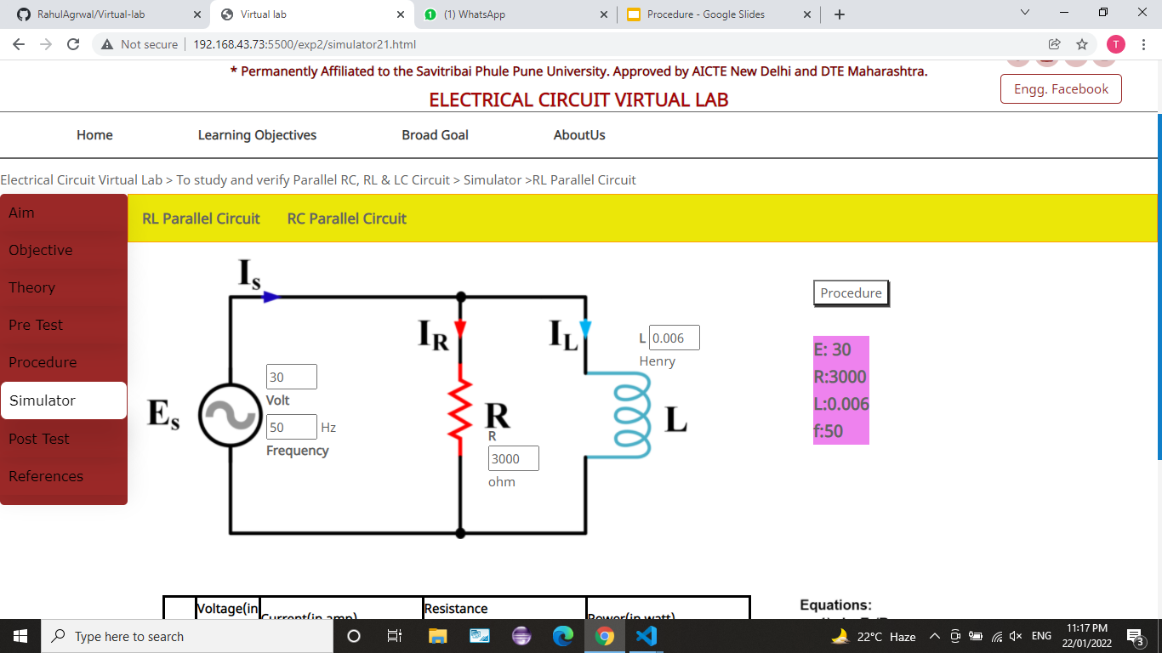
2) Set the values of voltage source(Es),frequency(f),Resistor(R) and Inductor(L).
(range: voltage:1V to 300V ,Frequency:1 Hz to 300Hz,Resistor : 1 ohm to 10k ohm ,Inductor: upto 1000 Henry)

Slide 5
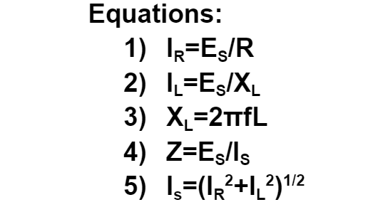
3) Put the values in equations given. Solve the equations to find current(I_{L}, I_{R},I_{S} ),reactance(X_{L}),impedance(Z),power(P)=V.I

Slide 6
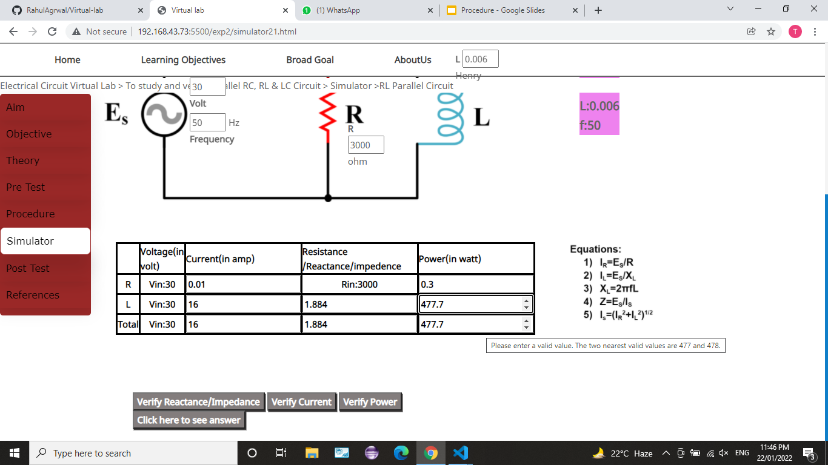
4) Put the values which you have calculated in tabular form as shown.
NOTE:i) If your answer is less than 1,then round it off upto 5 decimal places.
ii) No need to calculate voltage and resistance as it is given.

Slide 7
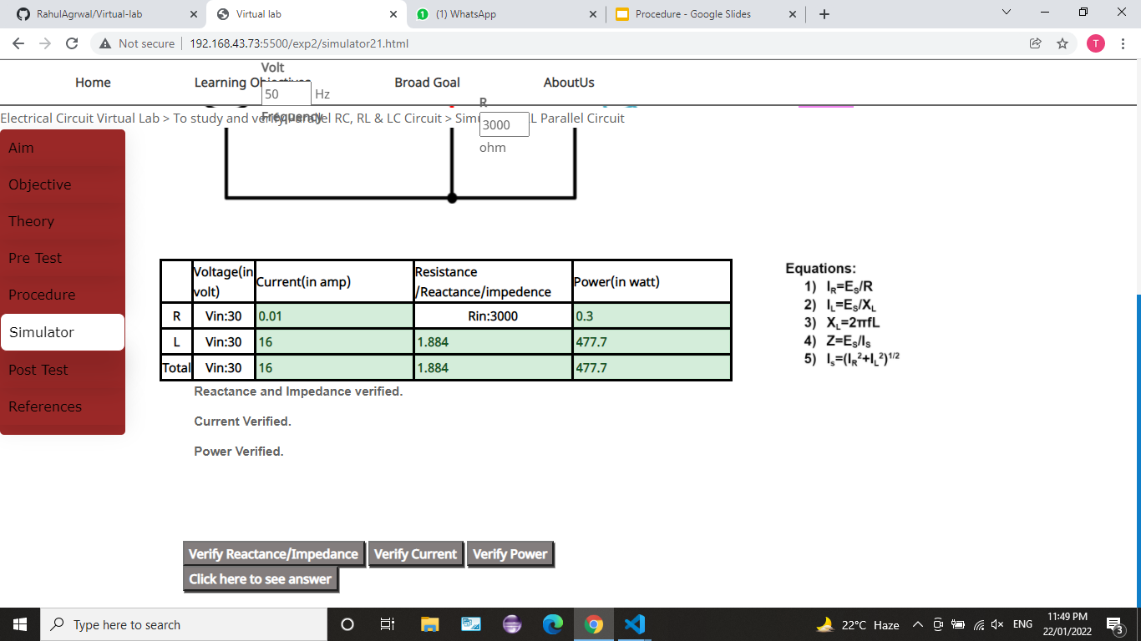
5) Click on Verify Reactance/Impedance ,Verify Current ,Verify Power buttons to verify your answers.

Slide 8
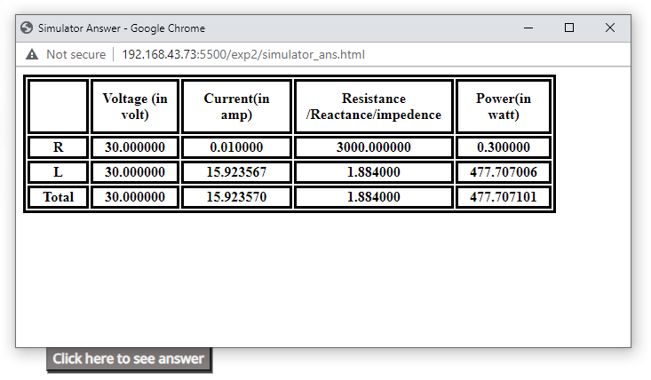
6) Click on the Click here to see answer button to see correct answers if you want. Answers will be displayed in the table.

Slide 9
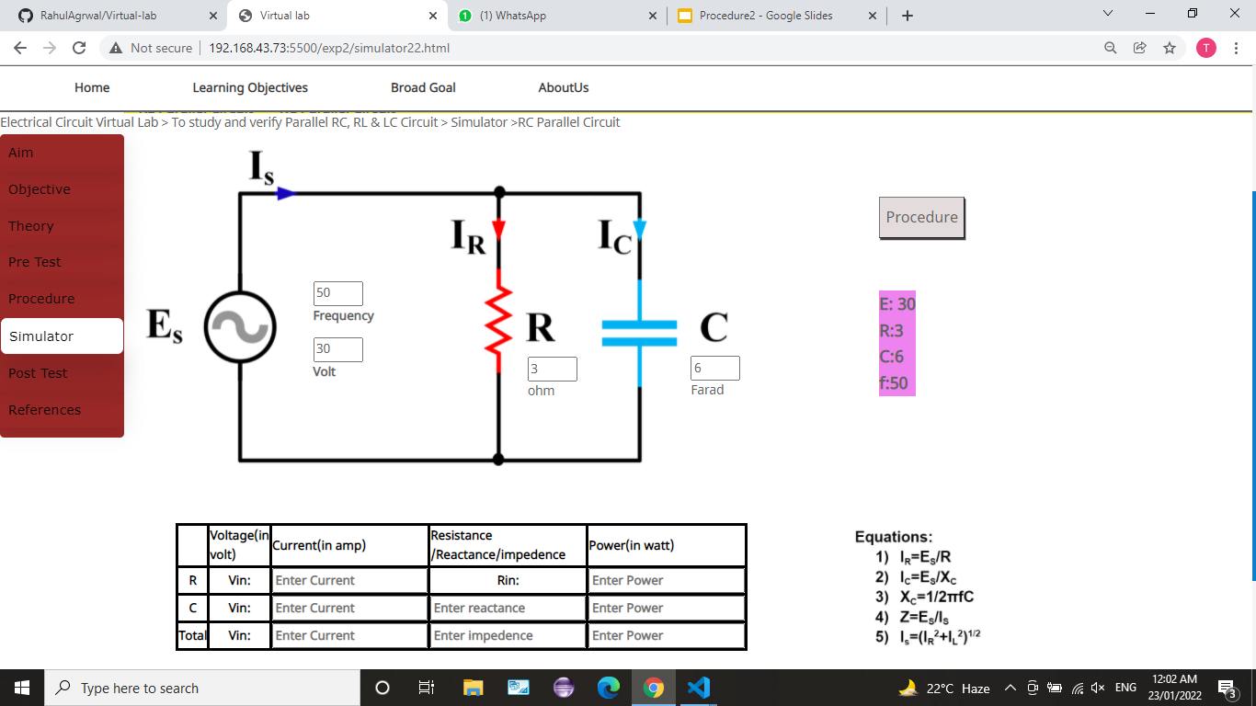
7) Repeat the same procedure for RC parallel circuit.

