Slide 1

Dr. D. Y. Patil Unitech Society
DR. D. Y. PATIL INSTITUTE OF TECHNOLOGY
(formerly Dr. D. Y. Patil Institute of Engineering and Technology)
Sant Tukaram Nagar, Pimpri, Pune.
DEPARTMENT OF ELECTRONICS & TELECOMMUNICATION
Electrical Circuit Virtual Lab
Savitribai Phule Pune University
Second Year of E &TC Engineering (2019 Course)
204187: Electrical Circuits Lab

Slide 2
EXPERIMENT 1
To verify Kirchhoff’s Laws: Kirchhoff’s Current Law, Kirchhoff’s Voltage Law

Slide 3
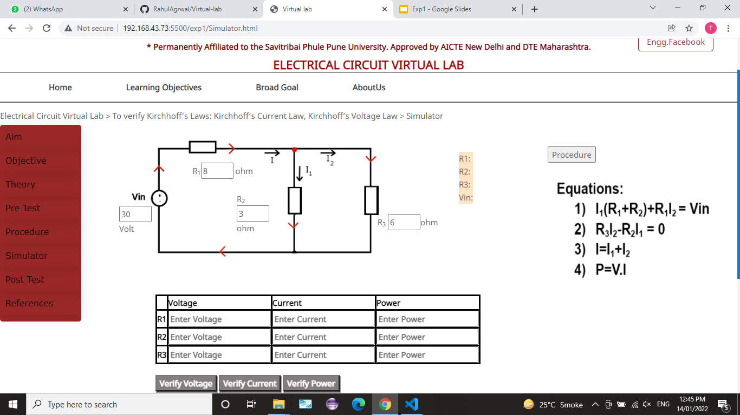
Procedure
1) Set the values of Resistors(R1,R2,R3) and battery (Vin).
(range for battery voltage is:1V to 300V and Resistors : 1 ohm to 10k ohm)

Slide 4
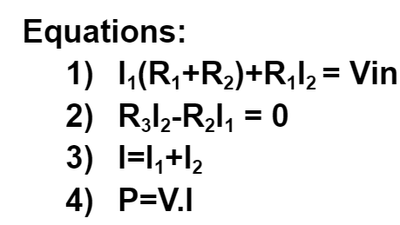
2) Put the values in Kirchhoff’s equations given. Solve the equations to find voltage ,current ,power in each resistor.

Slide 5
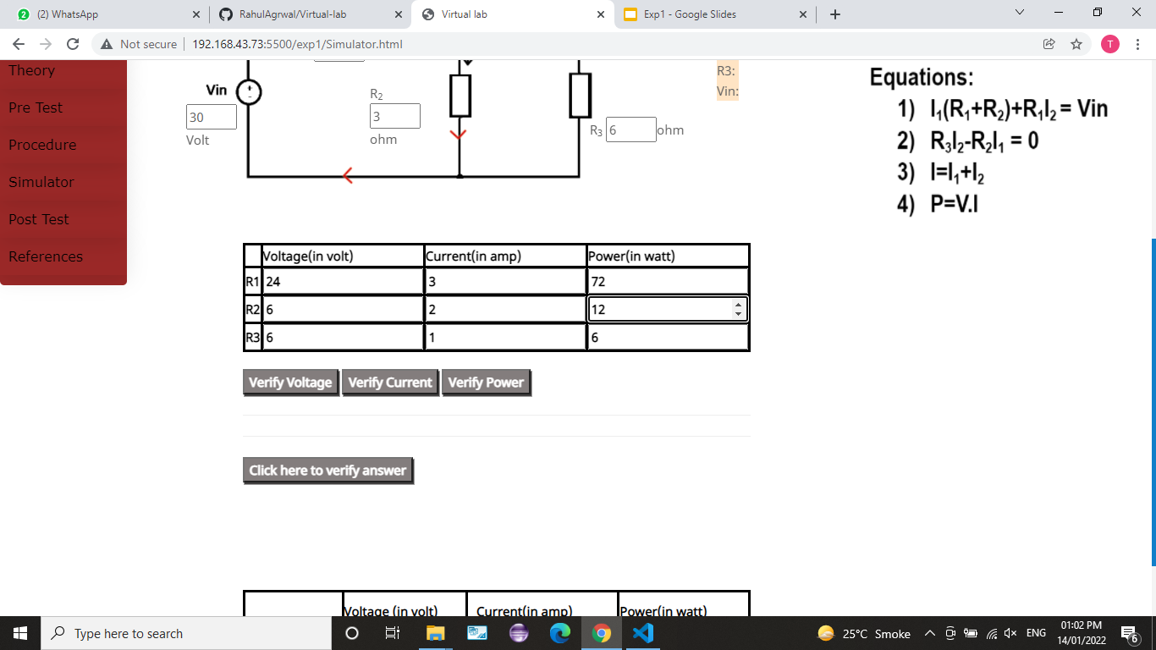
3) Put the values which you have calculated in tabular form as shown.

Slide 6
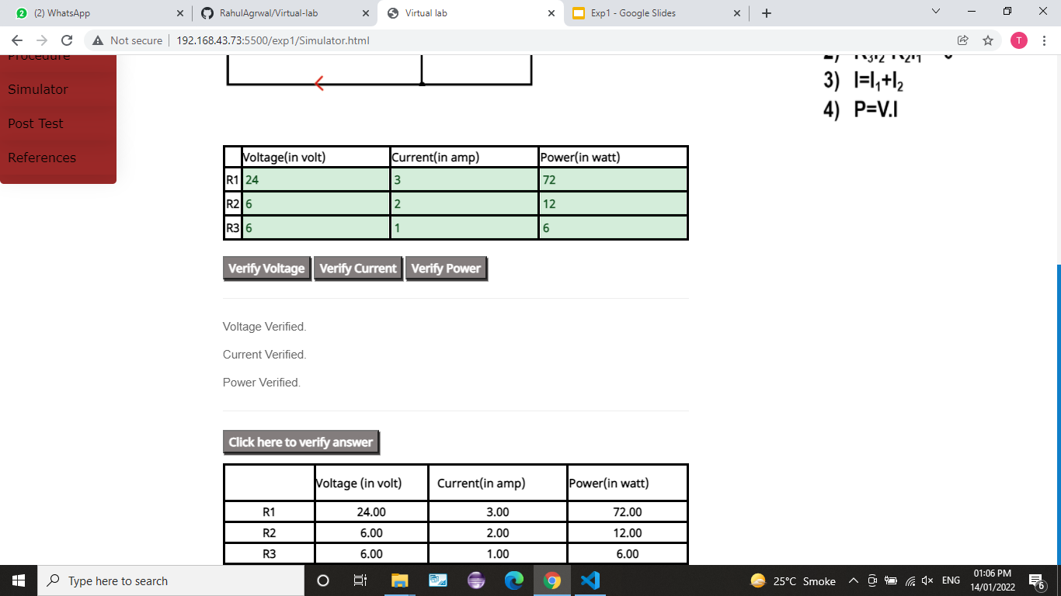
4) Click on Verify Voltage ,Verify Current ,Verify Power buttons to verify your answers.

Slide 7
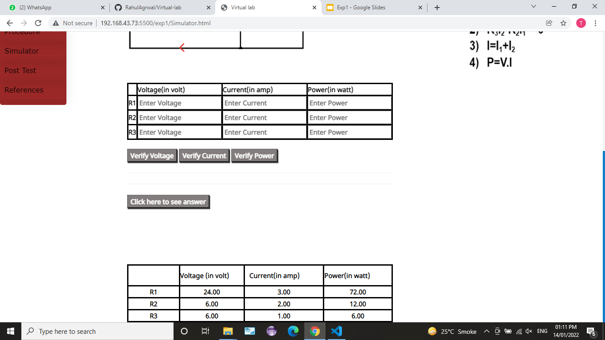
5) Click on the Click here to see answer button to see correct answers if you want. Answers will be displayed in the table.

