Slide 1

Dr. D. Y. Patil Unitech Society
DR. D. Y. PATIL INSTITUTE OF TECHNOLOGY
(formerly Dr. D. Y. Patil Institute of Engineering and Technology)
Sant Tukaram Nagar, Pimpri, Pune.
DEPARTMENT OF ELECTRONICS & TELECOMMUNICATION
Electrical Circuit Virtual Lab
Savitribai Phule Pune University
Second Year of E &TC Engineering (2019 Course)
204187: Electrical Circuits Lab

Slide 2
EXPERIMENT 1
To verify Kirchhoff’s Laws: Kirchhoff’s Current Law, Kirchhoff’s Voltage Law

Slide 3
AIM : To verify the Kirchhoff’s voltage law and Kirchhoff’s current law for the given circuit.

Slide 4
OBJECTIVE
To measure voltage and current in a DC circuit for each element.
To calculate analytically V and I.
Compare analytical and practical values.
Verify KCL and KVL.
To apply concepts of KCL and KVL in network theorems.

Slide 5
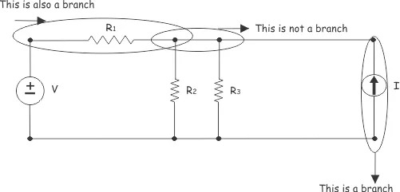
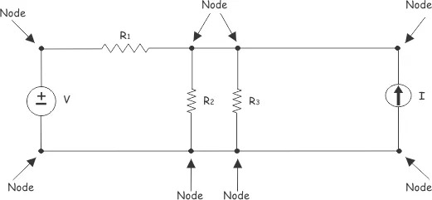
THEORY
Basic Laws of Electric Circuits
Nodes and Branches:
A branch: A branch is a single electrical element or device.
A node: A node can be defined as a connection point between two or more branches.

Slide 6
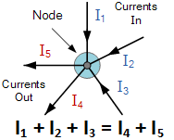
Kirchhoff’s Current Law
Kirchhoff’s Current Law or KCL, states that the “total current or charge entering a junction or node is exactly equal to the charge leaving the node as it has no other place to go except to leave, as no charge is lost within the node“.
In other words the algebraic sum of ALL the currents entering and leaving a node must be equal to zero, I(exiting) + I(entering) = 0.
This idea by Kirchhoff is commonly known as the Conservation of Charge.

Slide 7
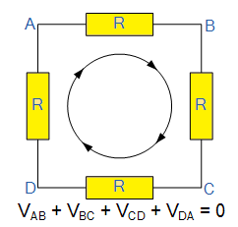
Kirchhoff’s Voltage Law
Kirchhoff’s Voltage Law or KVL, states that “in any closed loop network, the total voltage around the loop is equal to the sum of all the voltage drops within the same loop” which is also equal to zero.
In other words the algebraic sum of all voltages within the loop must be equal to zero.
This idea by Kirchhoff is known as the Conservation of Energy.

Slide 8
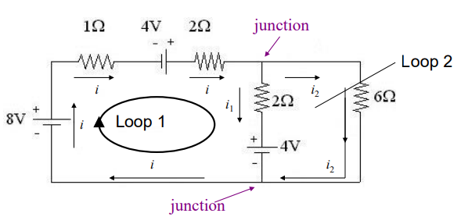
Kirchhoff’ s Rules
Many practical resistor networks cannot be reduced to simple series-parallel combinations (see an example below).
Terminology:
-A junction in a circuit is a point where three or more conductors meet.
-A loop is any closed conducting path.

Slide 9
Kirchhoff's Rules
Junction Rule: The sum of the magnitudes of the currents directed into a junction equals the sum of the magnitudes of the currents directed out of the junction.
Loop Rule: Around any closed circuit loop, the sum of the changes in potential around any closed path of a circuit must be zero.

Slide 10
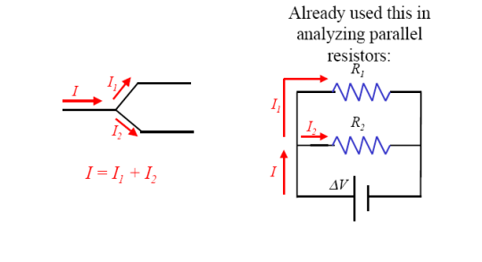
Kirchhoff's Rules
Kirchhoff’s junction rule: The algebraic sum of the currents into any junction is zero.
∑ I=0 at any junction

Slide 11
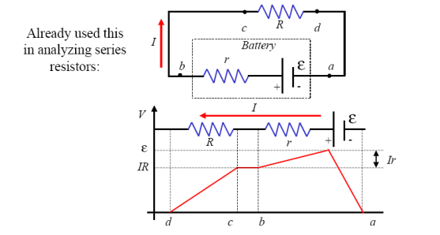
Kirchhoff's Rules
Kirchhoff’s Loop Rule: The algebraic sum of the potential differences in any loop, including those associated with emfs and those of resistive elements, must equal zero.
∑ V=0 at any Loop

Slide 12
Kirchhoff's Rules
Rules for Kirchhoff’s loop rule:
When a resistor is traversed in the same direction as the current, the change in potential is −IR.
When a resistor is traversed in the direction opposite to the current, the change in potential is +IR.
When an emf is traversed from – to + (the same direction it moves positive charge), the change in potential is +emf.
When an emf is traversed from + to – (opposite to the direction it moves positive charge), the change in potential is − emf.

Slide 13
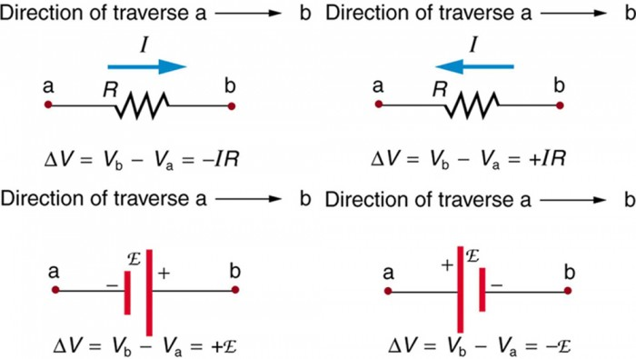
Kirchhoff's Rules
Rules for Kirchhoff’s loop rule

Slide 14
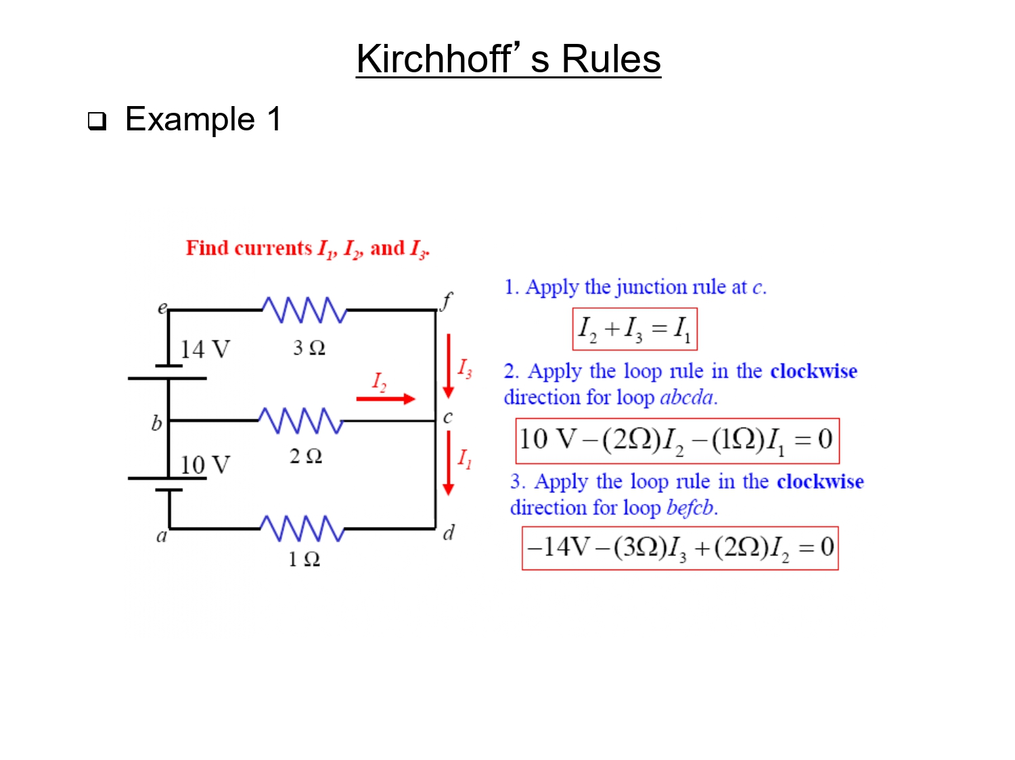

Slide 15
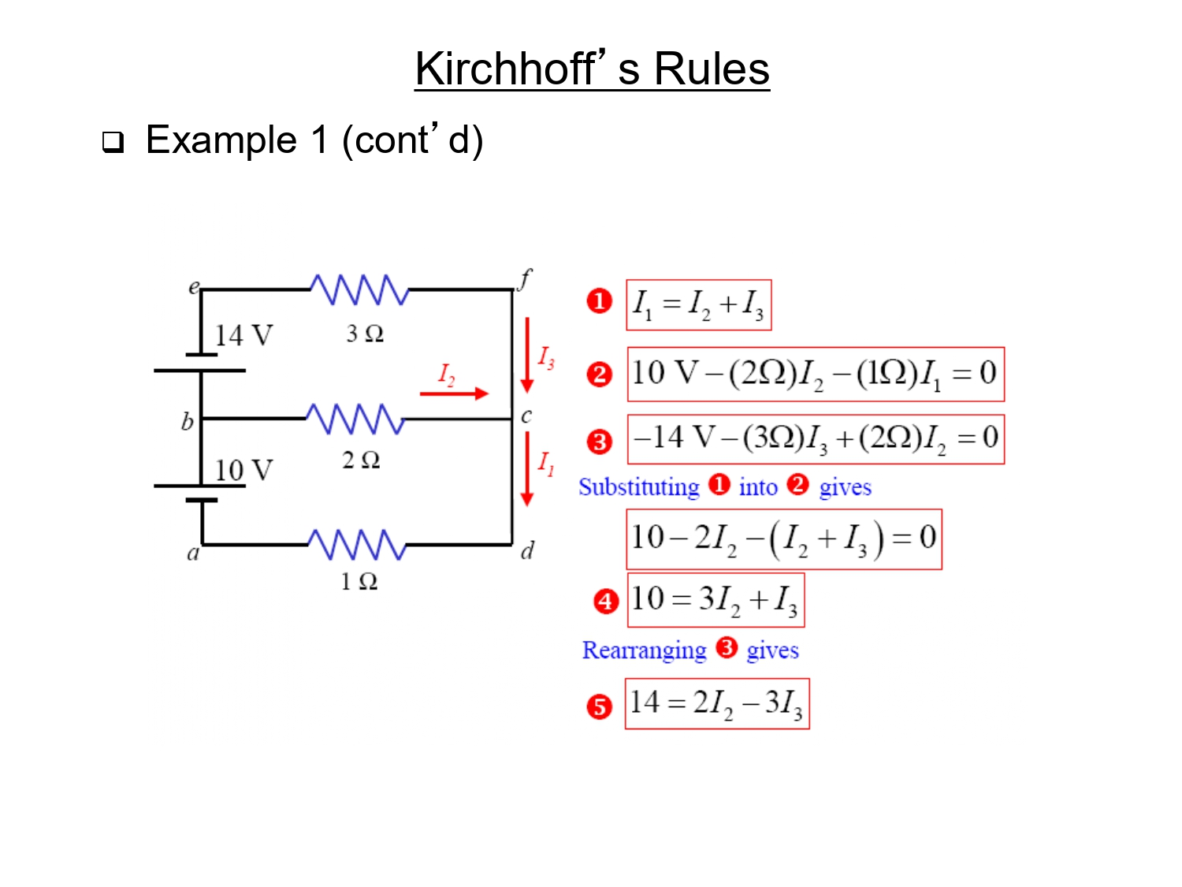

Slide 16
