Slide 1

Dr. D. Y. Patil Unitech Society
DR. D. Y. PATIL INSTITUTE OF TECHNOLOGY
(formerly Dr. D. Y. Patil Institute of Engineering and Technology)
Sant Tukaram Nagar, Pimpri, Pune.
DEPARTMENT OF ELECTRONICS & TELECOMMUNICATION
Electrical Circuit Virtual Lab
Savitribai Phule Pune University
Second Year of E &TC Engineering (2019 Course)
204187: Electrical Circuits Lab

Slide 2
EXPERIMENT 3
To study the Load Characteristics of DC shunt generator

Slide 3
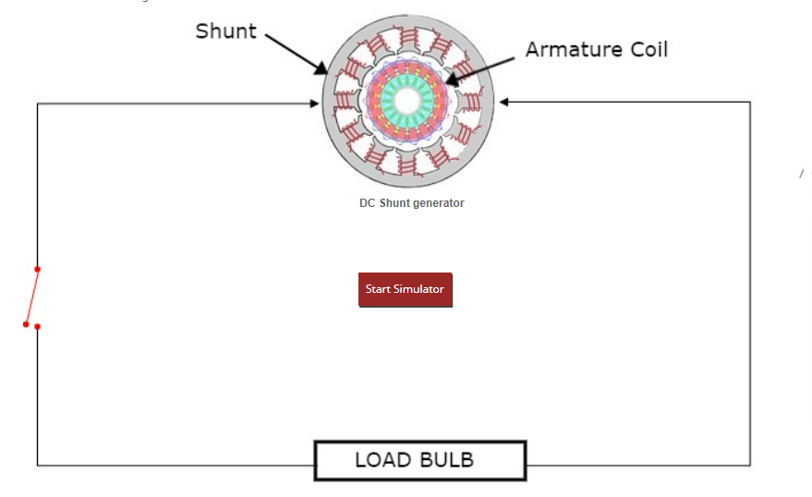
Procedure:
Go to the Simulator tab and click on Start Simulator.

Slide 4
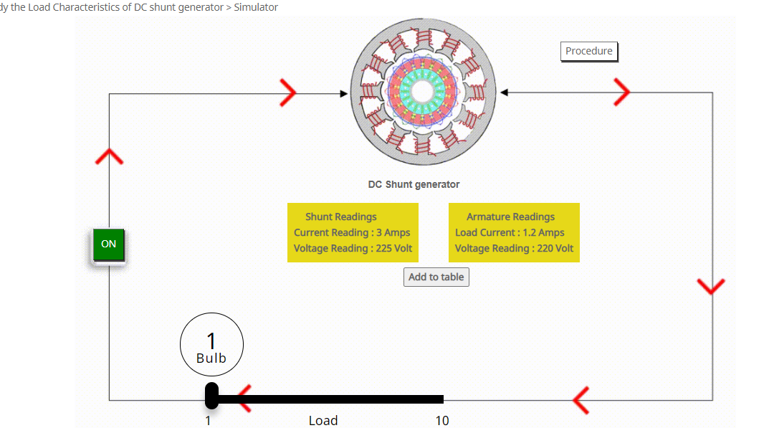
2) Note the shunt and armature readings for current and voltage when the load is of 1 bulb.Click on Add to table button to save the readings.

Slide 5
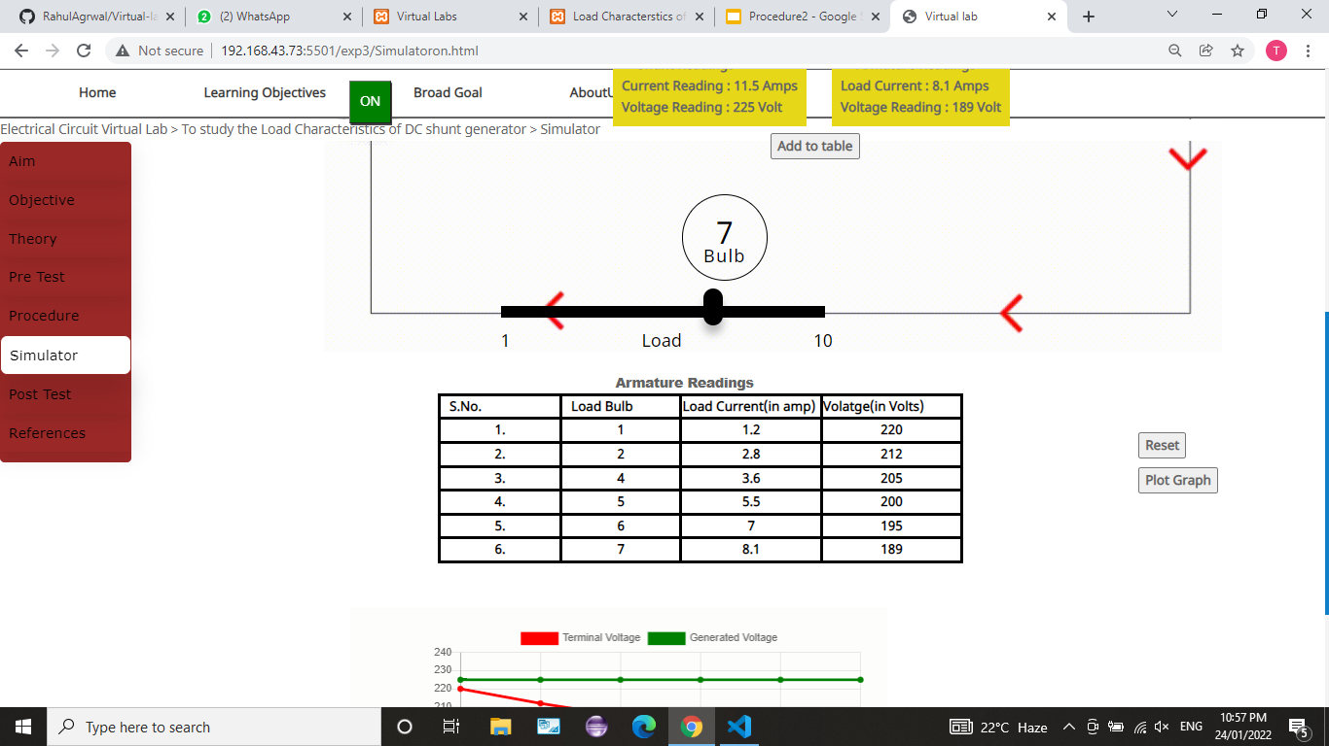
3) Now,increase the number of bulbs i.e.load gradually and observe the change in current and voltage.Also click on the Add to table button for each increment.Maximum 6 readings are possible.

Slide 6
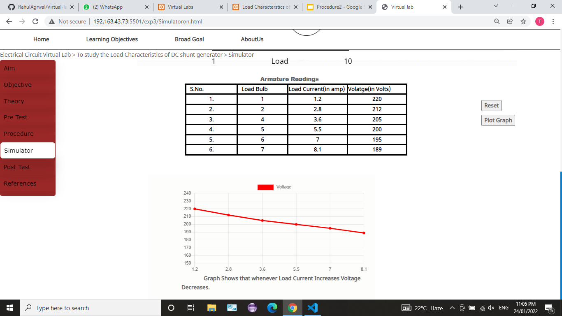
4) Click on Plot Graph button.Load characteristics of DC generator will be displayed according to the values in the table.Observe the relation between load current and terminal voltage.

Slide 7
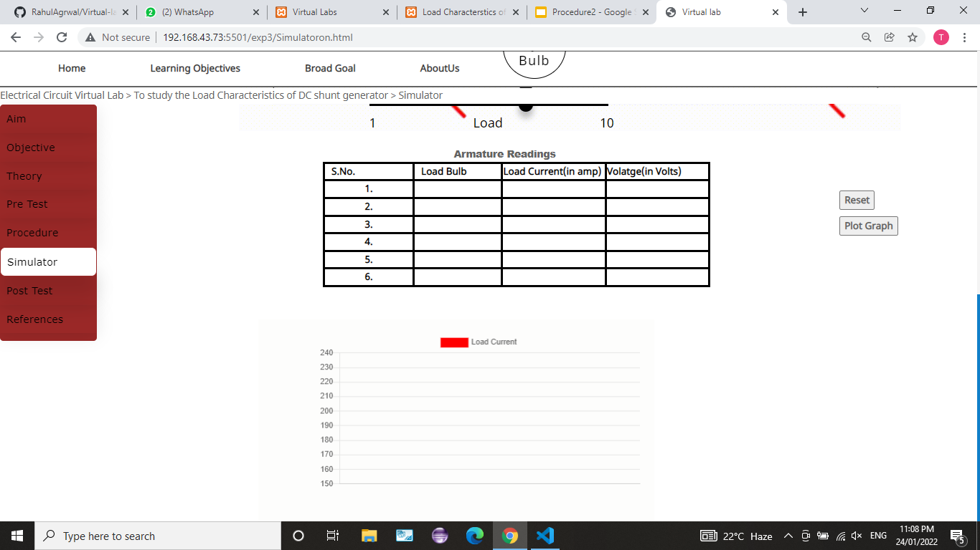
5) Click on Reset button to reset all the values and to take the new set of readings.

