Slide 1

Dr. D. Y. Patil Unitech Society
DR. D. Y. PATIL INSTITUTE OF TECHNOLOGY
(formerly Dr. D. Y. Patil Institute of Engineering and Technology)
Sant Tukaram Nagar, Pimpri, Pune.
DEPARTMENT OF ELECTRONICS & TELECOMMUNICATION
To study and verify Parallel RC & RL Circuit
Electrical Circuit Virtual Lab
Savitribai Phule Pune University
Second Year of E &TC Engineering (2019 Course)
204187: Electrical Circuits Lab

Slide 2
EXPERIMENT 2
To verify Kirchhoff’s Laws: Kirchhoff’s Current Law, Kirchhoff’s Voltage Law

Slide 3
OBJECTIVE
To design parallel RC circuit and find out the current flowing through each component.
To design parallel RL circuit and find out the current flowing through each component.

Slide 4
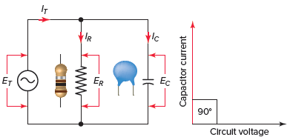
THEORY
Parallel RC Circuit
Figure 1 : Parallel RC circuit

Slide 5
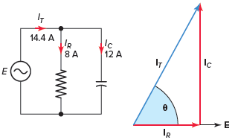
Parallel RC Circuit Phasor Diagram
Figure 2 : Parallel RC circuit vector (phasor) diagram

Slide 6
Parallel RC Circuit Phasor Diagram
The relationship between the voltage and currents in a parallel RC circuit is illustrated in the vector (phasor) diagram of Figure 2 and summarized as follows:
The reference vector is labeled E and represents the voltage in the circuit, which is common to all elements.
Since the current through the resistor is in phase with the voltage across it, IR (8 A) is shown superimposed on the voltage vector.
The capacitor current IC (12 A) leads the voltage by 90 degrees and is positioned in an upward direction, leading the voltage vector by 90 degrees.

Slide 7
Parallel RC Circuit Phasor Diagram
The relationship between the voltage and currents in a parallel RC circuit is illustrated in the vector (phasor) diagram of Figure 2 and summarized as follows:
The reference vector is labeled E and represents the voltage in the circuit, which is common to all elements.
Since the current through the resistor is in phase with the voltage across it, IR (8 A) is shown superimposed on the voltage vector.
The capacitor current IC (12 A) leads the voltage by 90 degrees and is positioned in an upward direction, leading the voltage vector by 90 degrees.

Slide 8
Kirchhoff's Rules
Junction Rule: The sum of the magnitudes of the currents directed into a junction equals the sum of the magnitudes of the currents directed out of the junction.
Loop Rule: Around any closed circuit loop, the sum of the changes in potential around any closed path of a circuit must be zero.

Slide 9
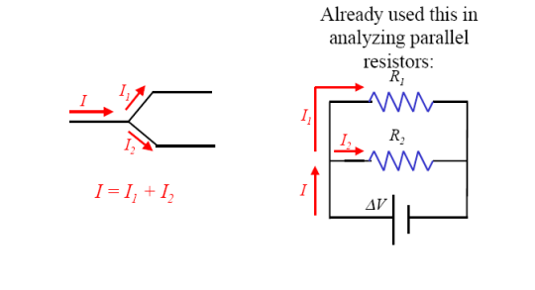
Kirchhoff's Rules
Kirchhoff’s junction rule: The algebraic sum of the currents into any junction is zero.
∑ I=0 at any junction

Slide 10
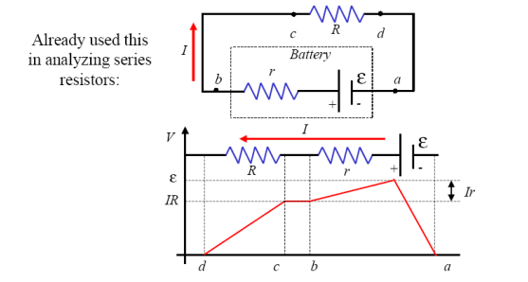
Kirchhoff's Rules
Kirchhoff’s Loop Rule: The algebraic sum of the potential differences in any loop, including those associated with emfs and those of resistive elements, must equal zero.
∑ V=0 at any Loop

Slide 11
Kirchhoff's Rules
Rules for Kirchhoff’s loop rule:
When a resistor is traversed in the same direction as the current, the change in potential is −IR.
When a resistor is traversed in the direction opposite to the current, the change in potential is +IR.
When an emf is traversed from – to + (the same direction it moves positive charge), the change in potential is +emf.
When an emf is traversed from + to – (opposite to the direction it moves positive charge), the change in potential is − emf.

Slide 12
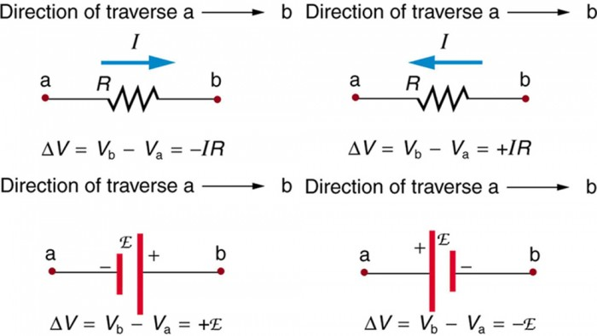
Kirchhoff's Rules
Rules for Kirchhoff’s loop rule

Slide 13
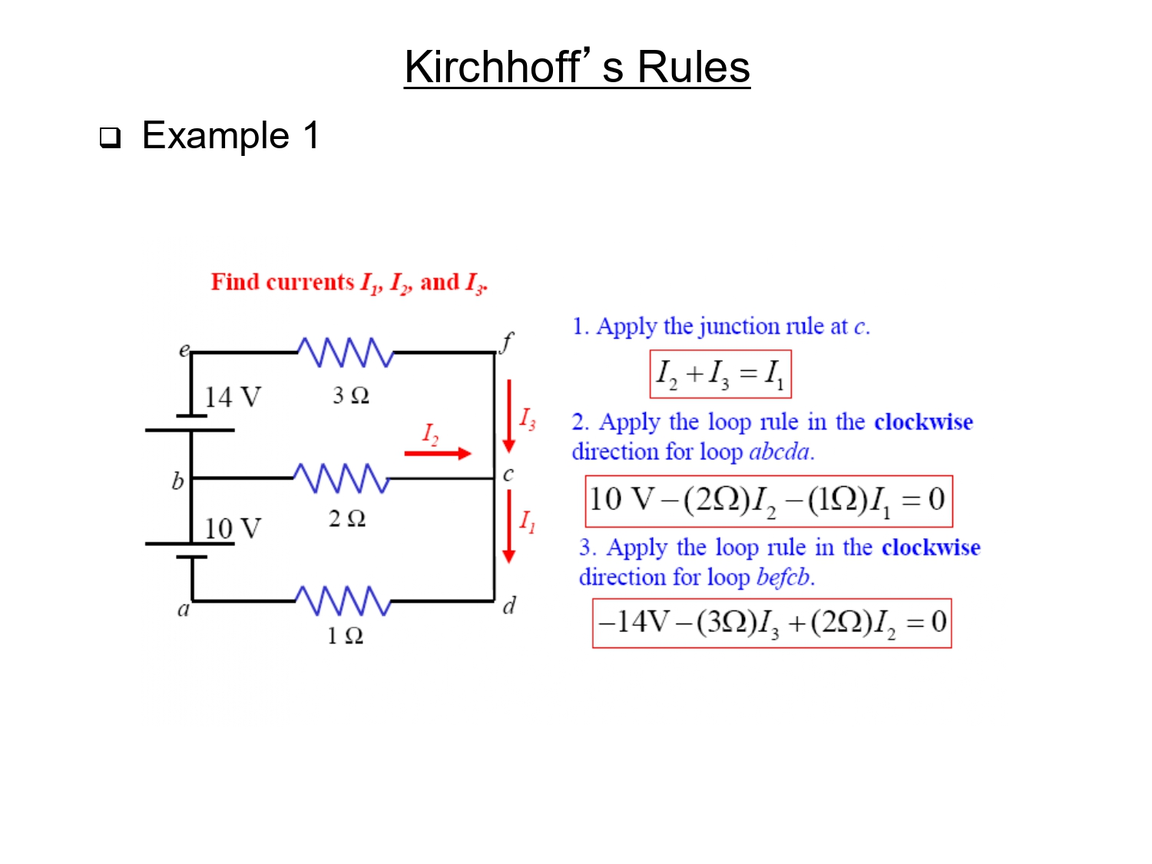

Slide 14
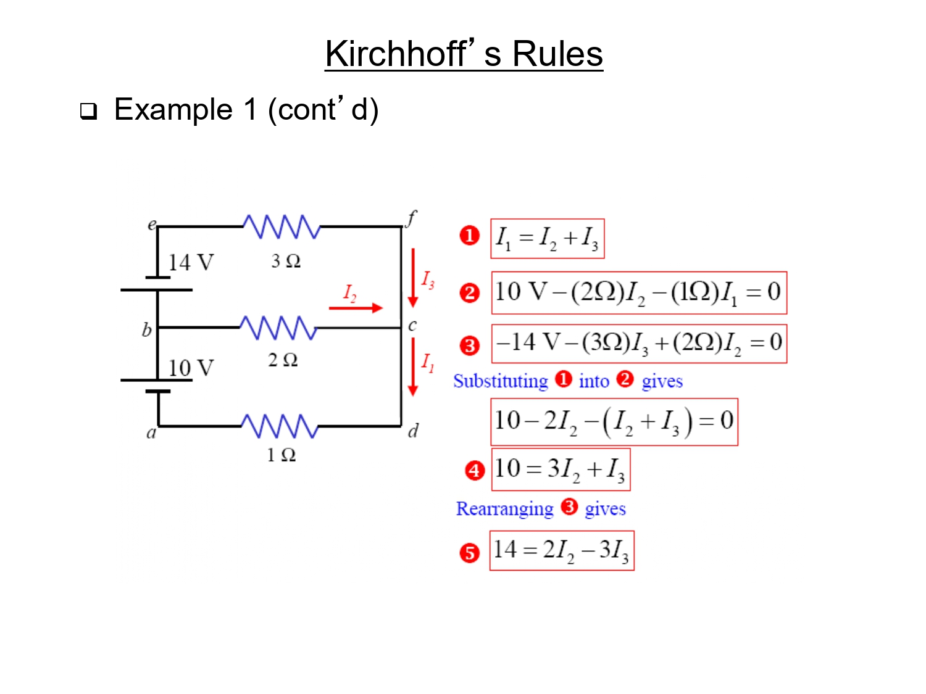

Slide 15
