Slide 1

Dr. D. Y. Patil Unitech Society
DR. D. Y. PATIL INSTITUTE OF TECHNOLOGY
(formerly Dr. D. Y. Patil Institute of Engineering and Technology)
Sant Tukaram Nagar, Pimpri, Pune.
DEPARTMENT OF ELECTRONICS & TELECOMMUNICATION
Electrical Circuit Virtual Lab
Savitribai Phule Pune University
Second Year of E &TC Engineering (2019 Course)
204187: Electrical Circuits Lab

Slide 2
EXPERIMENT 2
To study and verify Parallel RC & RL Circuit

Slide 3
OBJECTIVE
To design parallel RC circuit and find out the current flowing through each component.
To design parallel RL circuit and find out the current flowing through each component.

Slide 4
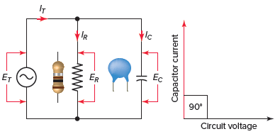
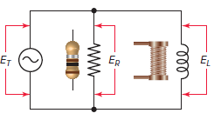
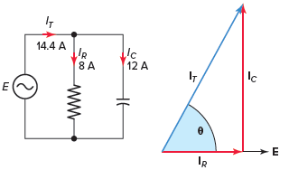
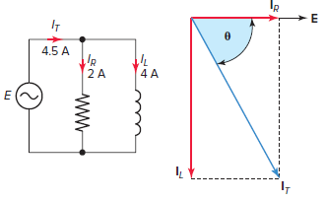


THEORY
Parallel RC Circuit | Parallel RL Circuit
Parallel RC Circuit | Parallel RL Circuit
Parallel RC Circuit Phasor Vector Diagram | Parallel RL Circuit Phasor Vector Diagram

Slide 5


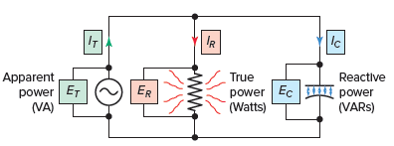
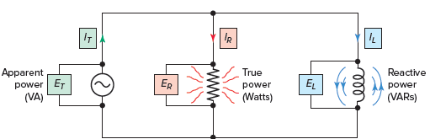

THEORY
Parallel RC Circuit | Parallel RL Circuit
Impedance | Impedance
Power components of a RC parallel circuit | Power components of a RL parallel circuit

Slide 6
THEORY
Parallel RC Circuit
Figure 1 : Parallel RC circuit

Slide 7
Parallel RC Circuit Phasor Diagram
Figure 2 : Parallel RC circuit vector (phasor) diagram

Slide 8
Parallel RC Circuit Phasor Diagram
The relationship between the voltage and currents in a parallel RC circuit is illustrated in the vector (phasor) diagram of Figure 2 and summarized as follows:
The reference vector is labeled E and represents the voltage in the circuit, which is common to all elements.
Since the current through the resistor is in phase with the voltage across it, IR (8 A) is shown superimposed on the voltage vector.
The capacitor current IC (12 A) leads the voltage by 90 degrees and is positioned in an upward direction, leading the voltage vector by 90 degrees.

Slide 9
Parallel RC Circuit Phasor Diagram
The relationship between the voltage and currents in a parallel RC circuit is illustrated in the vector (phasor) diagram of Figure 2 and summarized as follows:
The reference vector is labeled E and represents the voltage in the circuit, which is common to all elements.
Since the current through the resistor is in phase with the voltage across it, IR (8 A) is shown superimposed on the voltage vector.
The capacitor current IC (12 A) leads the voltage by 90 degrees and is positioned in an upward direction, leading the voltage vector by 90 degrees.

Slide 10
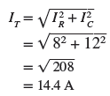
Parallel RC Circuit Phasor Diagram
The vector addition of IR and IC gives a resultant that represents the total (IT) or line current (14.4 A).
The angle theta (θ) represents the phase between the applied line voltage and current.

Slide 11
Parallel RC Circuit Phasor Diagram
In a parallel RC circuit, the line current leads the applied voltage by some phase angle less than 90 degrees but greater than 0 degrees. The exact angle depends on whether the capacitive current or resistive current is greater. If there is more capacitive current, the angle will be closer to 90 degrees, while if the resistive current is greater, the angle is closer to 0 degrees.
The value of the phase angle can be calculated from the values of the two branch currents using the following equation:

Slide 12
THEORY
Parallel RL Circuit
Figure 1 : Parallel RL circuit

Slide 13

Parallel RC Circuit
The combination of a resistor and inductor connected in parallel to an AC source, as illustrated in Figure 1, is called a parallel RL circuit. In a parallel DC circuit, the voltage across each of the parallel branches is equal. This is also true of the AC parallel circuit.
The voltages across each parallel branch are:
The same value.
Equal in value to the total applied voltage ET.
All in phase with each other.
Therefore, for a RL parallel circuit

Slide 14
Parallel RL Circuit Phasor Diagram
Figure 2 : Parallel RL circuit vector (phasor) diagram

Slide 15
Parallel RL Circuit Phasor Diagram
The relationship between the voltage and currents in a parallel RL circuit is illustrated in the vector (phasor) diagram of Figure 2 and summarized as follows:
The reference vector is labeled E and represents the voltage in the circuit, which is common to all elements.
Since the current through the resistor is in phase with the voltage across it, IR (2 A) is shown superimposed on the voltage vector.
The inductor current IL (4 A) lags the voltage by 90 degrees and is positioned in a downward direction lagging the voltage vector by 90 degrees.
The vector addition of IR and IL gives a resultant that represents the total (IT), or line current (4.5 A).
The angle theta (θ) represents the phase between the applied line voltage and current.

Slide 16

Parallel RL Circuit Phasor Diagram
As is the case in all parallel circuits, the current in each branch of a parallel RL circuit acts independent of the currents in the other branches. The current flow in each branch is determined by the voltage across that branch and the opposition to current flow, in the form of either resistance or inductive reactance, contained in the branch.
Ohm’s law can then be used to find the individual branch currents as follows:

Slide 17

Parallel RL Circuit Phasor Diagram
The resistive branch current has the same phase as the applied voltage, but the inductive branch current lags the applied voltage by 90 degrees. As a result, the total line current (IT) consists of IR and IL 90 degrees out of phase with each other.
The current flow through the resistor and the inductor form the legs of a right triangle, and the total current is the hypotenuse. Therefore, the Pythagorean theorem can be applied to add these currents together by using the equation:

Slide 18
Parallel RL Circuit Phasor Diagram
In all parallel RL circuits, the phase angle theta (θ) by which the total current lags the voltage is somewhere between 0 and 90 degrees. The size of the angle is determined by whether there is more inductive current or resistive current.
If there is more inductive current, the phase angle will be closer to 90 degrees. It will be closer to 0 degrees if there is more resistive current. From the circuit vector diagram you can see that the value of the phase angle can be calculated from the equation:

