Slide 1
SecureWatch
Failed Login
username • source IP • attempts
Cybersecurity Event Monitoring System
Malware
hostname • malware • file path
Graduate NoSQL Database Project using Apache CouchDB
Phishing
sender • recipient • subject
Network Anomaly
IPs • ports • protocol
Apache CouchDB stores each event as a flexible JSON document.
Rahul Akula • Bhargava Karthik Boddeda • Sandeep Kumar Chavan • Vamshi Padakanti
Database: Apache CouchDB

Slide 2
What are we trying to solve?
A lightweight system to record, review, and manage heterogeneous cybersecurity incidents.
1. Capture events
2. Investigate
3. Query
4. Protect data
Record failed logins, malware detections, phishing reports, and network anomalies.
Track severity, status, analyst notes, and event-specific details.
Filter incidents by type, severity, or status using CouchDB Mango queries.
Use CouchDB revisions and database replication for controlled updates and backup.
SecureWatch turns raw security events into an analyst-friendly workflow
Create → Review → Filter → Update → Resolve → Replicate

Slide 3
Why Apache CouchDB?
The database choice is driven by flexible document structures and simple HTTP-based integration.
Same database, different document shapes
Flexible JSON documents
Different security events can have different fields without forcing one rigid relational schema.
Failed Login
username: rsmith • source_ip: 192.168.1.25 • failed_attempts: 8
REST/HTTP API
Malware
hostname: WS-104 • malware_name: ExampleTrojan • file_path: /downloads/file.exe
Flask communicates directly with CouchDB through standard HTTP requests.
Network Anomaly
source_ip: 10.0.0.24 • destination_port: 22 • protocol: TCP
Built-in database features
Mango queries, indexes, document revisions, and replication are available natively.

Slide 4
System architecture
A simple three-layer application with CouchDB running inside Docker.
Browser / UI
Flask Backend
Apache CouchDB
Docker
HTML • CSS • JavaScript
Python application logic
JSON documents • Mango
Local deployment
Database setup
Installed Docker Desktop • Pulled official couchdb:3 image • Started with docker compose up -d
CouchDB exposed on port 5984 • Fauxton used for database administration
Development & administration
PyCharm • Fauxton • Git / GitHub • .env configuration

Slide 5
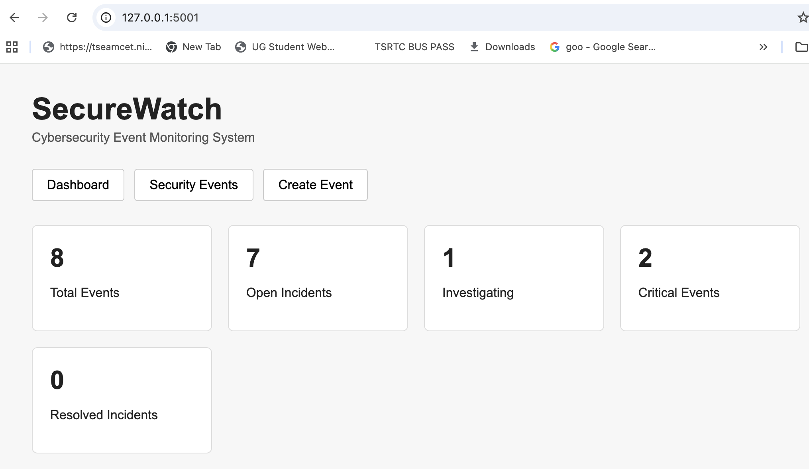
Application dashboard
Live summary cards are calculated from the security-event documents currently stored in CouchDB.
Dashboard counts update automatically as events are created, investigated, resolved, or deleted.

Slide 6
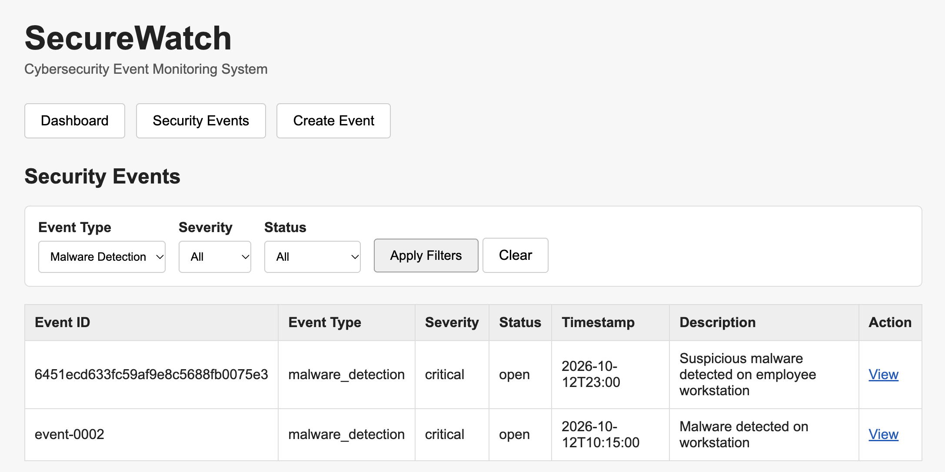
Mango queries through the UI
Users filter by event type, severity, and status; Flask converts those selections into CouchDB Mango selectors.
The filtering is database-side - CouchDB returns only matching documents.

Slide 7
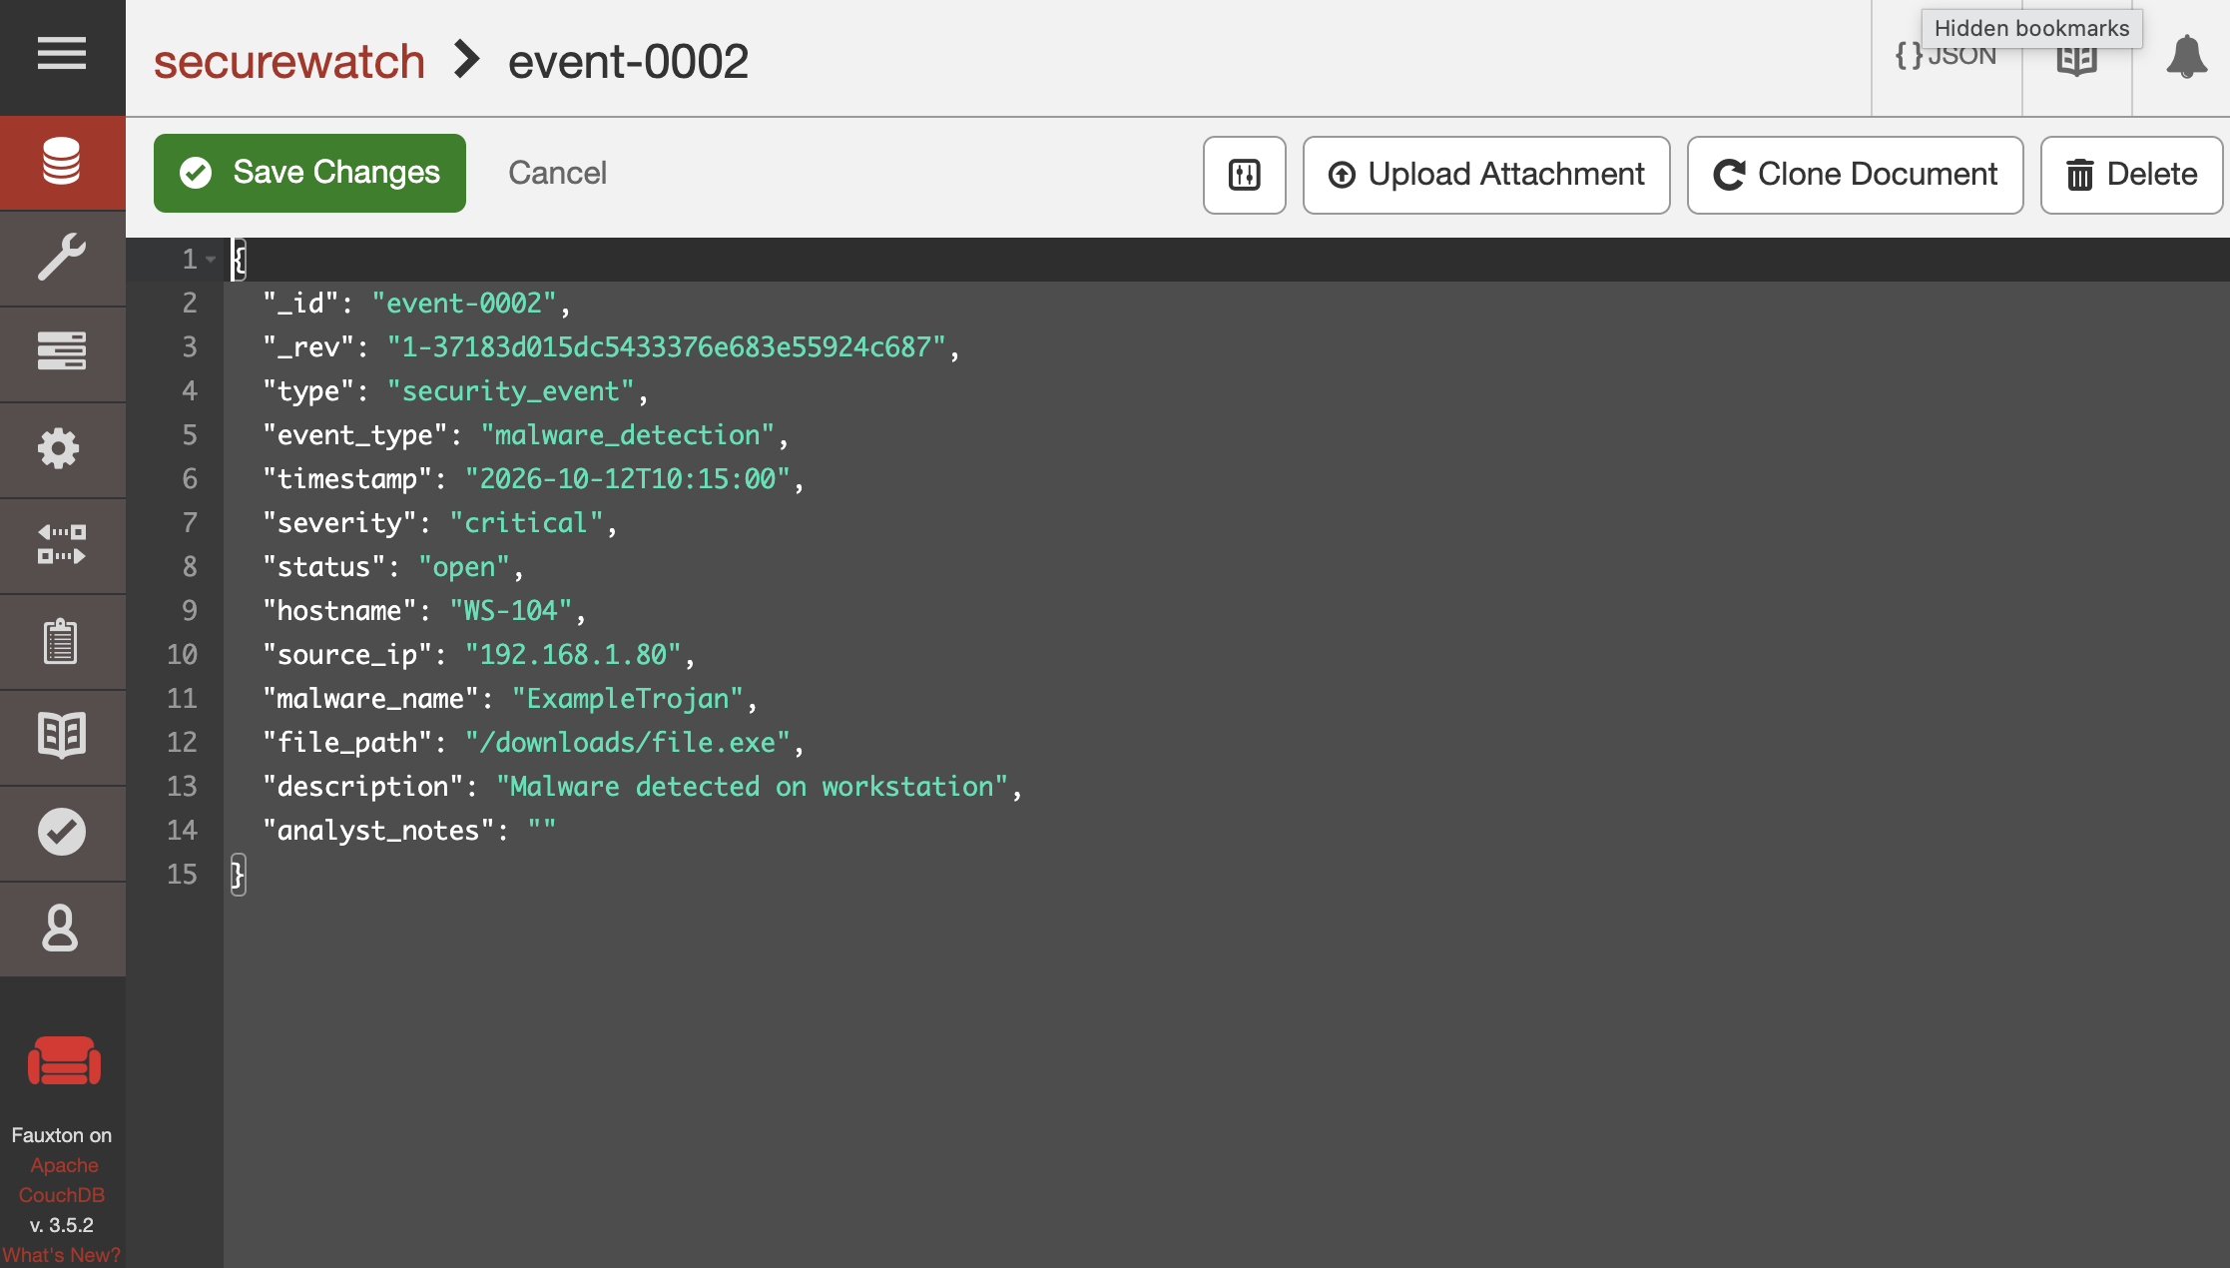
CouchDB documents, CRUD, and revisions
Each event is a JSON document with common fields plus event-specific attributes.
CRUD operations
Create, retrieve, update, and delete documents through the Flask application.
Revision control
CouchDB uses the current _rev when updating or deleting a document.
Indexes
JSON indexes support more efficient Mango queries on frequently filtered fields.

Slide 8
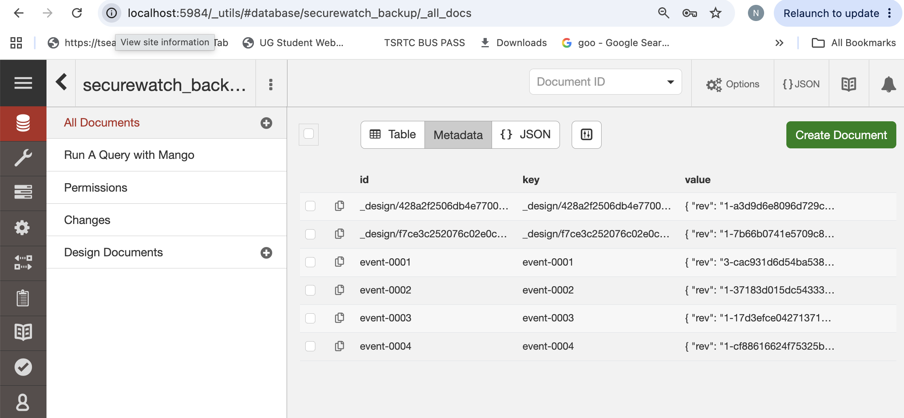
Database replication
A one-time CouchDB replication copies the primary database into a backup database.
securewatch → securewatch_backup

Slide 9
Current status and project handoff
The SecureWatch implementation, database functionality, testing, documentation, and GitHub repository are complete.
Completed
CouchDB deployed with Docker
Flask ↔ CouchDB integration
Flexible event-specific JSON documents
CRUD operations
Mango filters and indexes
Dashboard statistics
Document revisions
One-time database replication
Team roles
Rahul Akula - CouchDB & integration
Bhargava Karthik Boddeda - Flask backend & query logic
Sandeep Kumar Chavan - Front end & UI
Vamshi Padakanti - Testing, documentation & presentation
GitHub repository
github.com/RahulAkula17/SecureWatch
SecureWatch demonstrates how a document-oriented NoSQL database can support a practical cybersecurity workflow.

