Slide 1
DEMAND DYNAMICS
GROUP 10
Your go-to solution for grocery inventory management!
"The most reliable way to forecast the future is to try and understand the past as well as the present."
-John Naisbitt

Slide 2
Project Outline
Title: Demand Dynamics - Your go-to solution for grocery inventory management!​
Objective: Predict next 3 months of sales item wise using a deep learning model.
Data: Dataset comprising of id, date, store, item, and sales. Preprocessed by normalizing and converting date to datetime format.
Model: Built a Long Short-Term Memory (LSTM) model, suitable for time series data.
Training: Model trained on 80% of the data.
Evaluation: Predictions made on the test set; evaluated using Root Mean Squared Error (RMSE).
Results: Plotted actual vs predicted sales; calculated Mean Absolute Percentage Error (MAPE) for each store-item pair.
Conclusion & Future Work: Summarized findings, discussed potential improvements and real-world applications.

Slide 3
Index
4
5
6
7-8
9
10
11
12
13
14
15
16
17
18-19
20
1.We the Team!
2.What are we trying to build?
3.Abstract
4.Business Use Case and Important Use Case
6. Concepts Used
7.Our data
8.How we processed data
9.Algorith Used
10.Comparision of Models
11.Optimal Case
12.Diagrams/Visualizations
13.Final Recommendations
14.Challenges Faced
15.Our learning and future enhancements
16.Demo

Slide 4





THE TEAM
.
SAKETH REDDY
TEAM LEADER,
BACKEND
RAHULKUMAR
BACKEND DEVELOPER
SHRAVAN
DATA ANALYST
MOUNIKA
FRONTEND DEVELOPER
GANGA
FRONTEND
DEVELOPER

Slide 5
What we are trying to build?
Traditional grocery store inventory management lacks accuracy and adaptability, leading to waste and lost sales. The absence of a Deep Learning solution analysing historical sales data hampers optimal stock levels, profitability, and customer satisfaction. To overcome this problem, we are building a model that gives retailers:
- the capacity to save costs
-boost profits
-provides customers a smooth shopping experience by precisely forecasting demand

Slide 6
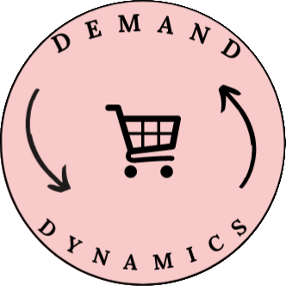
Abstract
We at Demand Dynamics are confident that deep learning will revolutionise how supermarket retailers manage their inventories. By doing this project, we guarantee optimum stock levels at all times, minimising waste from overstocking and avoiding missed sales opportunities as a result of under-stocking.
By analysing client wants and modifying inventory as necessary, our innovative technology enables stores to stay one step ahead of the competition.

Slide 7
Business Use Case
Business Scenario:
A business use case for forecasting grocery demand can be highly valuable for a variety of stakeholders in the grocery industry, including retailers, suppliers, and logistics providers. Here's an example of a business use case for grocery demand forecasting:
Scenario: Consider a grocery store or online grocery delivery business retailer that wants to optimize its inventory and ensure timely delivery to customers while minimizing stockouts and overstocks.
Inventory planning
Supply chain optimization
Promotions and improved pricing strategies
Enhanced delivery efficiency
Better Product Assortment planning
Customer satisfaction

Slide 8
Important Use Case
An important use case of forecasting the demand of groceries is optimizing inventory management and seasonal and promotional planning. Here's how it goes:
Inventory Planning and Optimization: By accurately forecasting the demand for groceries, businesses can plan their inventory levels more effectively. Based on expected consumer demand, they may decide how much of each grocery item to stock optimally. Overstocking is avoided in this way, which frees up money and lowers the risk of waste or obsolescence. Additionally, it reduces understocking, which can result in lost sales and dissatisfied customers.
Seasonal and Promotional Planning: Demand forecasting helps businesses prepare for seasonal fluctuations and promotional campaigns. By analyzing historical data and considering external factors, such as holidays or events, businesses can accurately predict spikes or dips in demand for specific grocery items. This allows them to adjust their inventory levels and plan targeted promotions or marketing strategies to capitalize on these opportunities.

Slide 9
Concepts Used
Deep Learning: Deep learning is a subfield of machine learning that focuses on training artificial neural networks with multiple layers (deep neural networks) to learn and make predictions or decisions. While deep learning techniques can be used for demand forecasting, "SMOOTH CNN" Convolutional neural networks, which are typically used for image recognition tasks, can also be adapted for time series forecasting, including demand forecasting for groceries.
Market Research and Customer Surveys: Market research and customer surveys provide valuable insights into consumer preferences, purchasing behaviors, and trends. Gathering feedback directly from customers through surveys, focus groups, or interviews can help understand their needs, expectations, and preferences for different grocery items. This qualitative information can complement quantitative data and be used to validate or enhance demand forecasting models.
Historical Sales Data Analysis: Analyzing historical sales data is a fundamental component of demand forecasting. It involves examining past sales patterns, identifying trends, and seasonality. Historical data can provide a baseline for understanding demand patterns and serve as a reference for predicting future sales. It is crucial to consider factors such as day of the week, month, year, holidays, and other events that might impact grocery demand.

Slide 10
Our Data
The Demand Dynamics project used data that came from retailers from various places. The dataset consists of item-level sales data from various shops from training and test sets spanning a certain time period, although it must be at least one year. The data columns include the sale date, the item ID, and the daily average number of goods sold in each store. Data is collected on a daily basis from the user. This dataset is the basis for developing and testing the project's prediction algorithms.

Slide 11
How we Processed Data
The data was relatively clean, requiring minimal cleaning efforts. In order to give more detailed insights, the date field was then divided into smaller characteristics such the year, month, day, and day of the week. Seasonality, a critical factor in sales data, was majorly addressed using time series decomposition. The data was then simulated, with the best prediction model being selected after deciding whether to treat stores individually or collectively.

Slide 12
Algorithm Used
CNN and MLP:
In order to improve the efficiency of model learning, CNN weight division can minimise the number of parameters. As CNN enables dilated convolutions, in which filters may be used to compute cell dilations, it is appropriate for forecasting time-series data. The neural network can comprehend the links between the many observations in the time-series better because of the magnitude of the space between each cell.

Slide 13
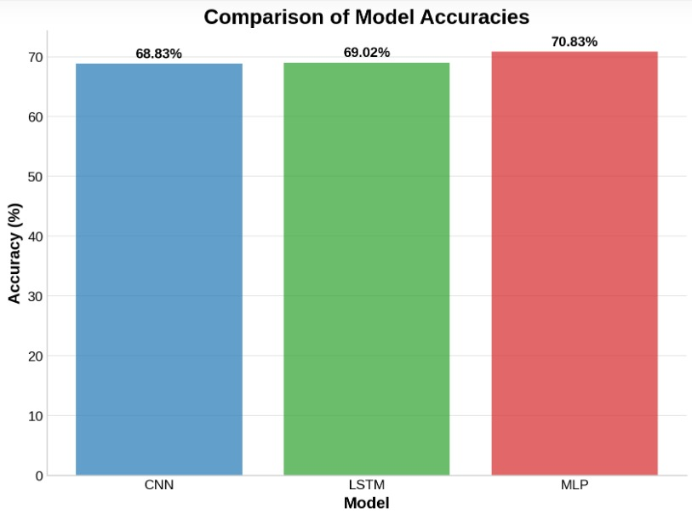
Comparison of Models
CNN - 68.83% Accuracy
LSTM - 69.02% Accuracy
MLP* - 70.83% Accuracy
Accuracy is computed after calculating
overall MAPE of Actual vs Predicted of all the items.
*Some features of CNN where also used in the model.

Slide 14
Optimal Case
This model is a combination of a Convolutional Neural Network (CNN) and a Multi-Layer Perceptron (MLP). It uses a 1D Convolutional layer and a Max Pooling layer, which are characteristic of CNNs, to extract features from the input sequence. After these layers, the Flatten layer transforms the 2D output of the previous layers into a 1D array, which can then be fed into the Dense layers. The Dense layers form a Multi-Layer Perceptron that can learn from the extracted features to make the final prediction.

Slide 15
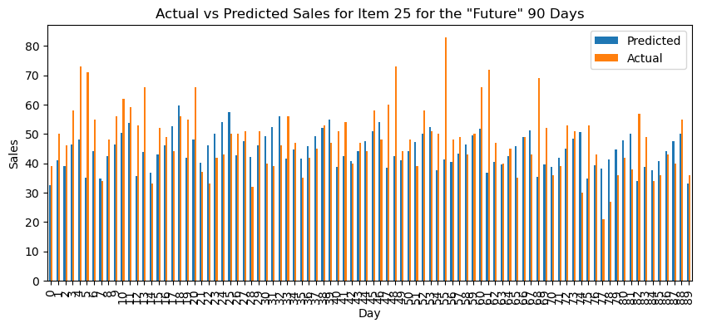
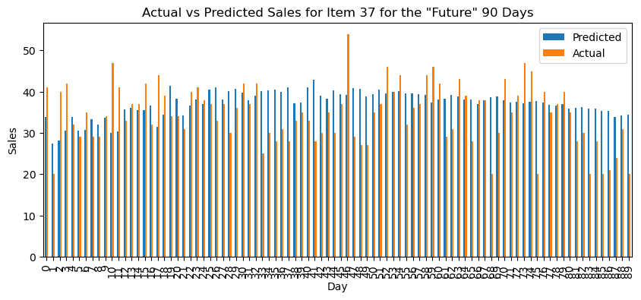
Diagram(s) or Visualization(s)

Slide 16
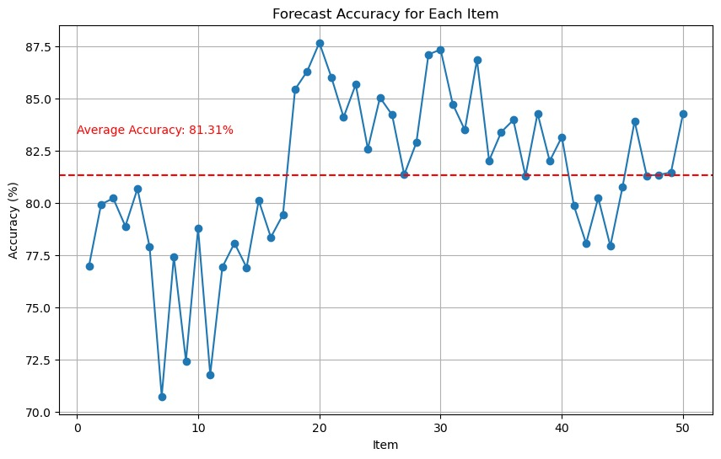

Slide 17
Final Recommendation
Model Performance: The combination of Convolutional Neural Networks (CNN) and Multi-Layer Perceptron (MLP) yielded an accuracy of approximately 71%. This result indicates a strong performance given the complexity of time series forecasting tasks.
Model Selection: CNN and MLP were chosen due to their ability to handle complex patterns and dependencies in data, making them well-suited for time series forecasting. CNN excels at learning spatial hierarchies or patterns within the data, while MLP is effective in learning from these extracted features and making final predictions.
Improvements: While the model performs reasonably well, there is room for enhancement. Techniques like hyperparameter tuning, ensemble methods, or experimenting with different architectures could potentially improve the model's performance.
Real-world Application: The model can be utilized in a real-world retail setting for predicting item-wise sales, aiding in inventory management, and improving business strategies.
Data Quality: The accuracy of the model strongly depends on the quality of the data. Regularly updating the dataset and ensuring its accuracy can help improve the model's performance over time.
Next Steps: Consider implementing a real-time data pipeline for continuous training and prediction, which could make the model more responsive to recent trends in sales data.

Slide 18
Challenges Faced
Coming up with a custom data pipeline since the data which user has entered might not be in the right format for the model. So necessary data transformations has to be done automatically in the backend.
The model accuracy is solely dependent on the amount of data given by the user in years. 1 year being the minimum, we have tried multiple Deep learning models and architectures to come up with a minimum accuracy of 70%. Hence, The more data the user provides the more accurately the model predicts.
Since the history of sales for each store is different. We have to come up with a data pipeline in the backend, so that the model automatically trains on the data given by different user's each and every time. This requires a lot of training time and computation.

Slide 19
Our Learning
Time Series Understanding: Gained knowledge about time series data, its unique characteristics, and how it influences the choice of modeling techniques.
Modeling Techniques: Learned to implement and combine CNN and MLP neural network architectures for time series forecasting.
Data Preprocessing: Realized the significance of preprocessing steps like normalization and creation of lag variables in time series data.
Model Evaluation: Learned to quantify model accuracy using metrics like RMSE and MAPE.
Tools and Libraries: Got hands-on experience with Python libraries like Keras, sklearn, pandas, and matplotlib for data manipulation, model building, and visualization.
Model Improvement: Learned that model building is iterative, and initial results can be improved through techniques like hyperparameter tuning and model architecture modification.
Real-world Application: Recognized the real-world impact of machine learning in forecasting sales, managing inventory, and effective strategizing in businesses.

Slide 20
Future Enhancements
Future enhancements have a significant potential to boost grocery forecasting's precision, responsiveness, and effectiveness, which will improve inventory control, cut down on waste, and boost consumer pleasure. Below are few enhancements that we look forward to:
Enhanced collaboration with small scale retailers in India
Social Media and Sentiment Analysis

Slide 21
Demo

Slide 22
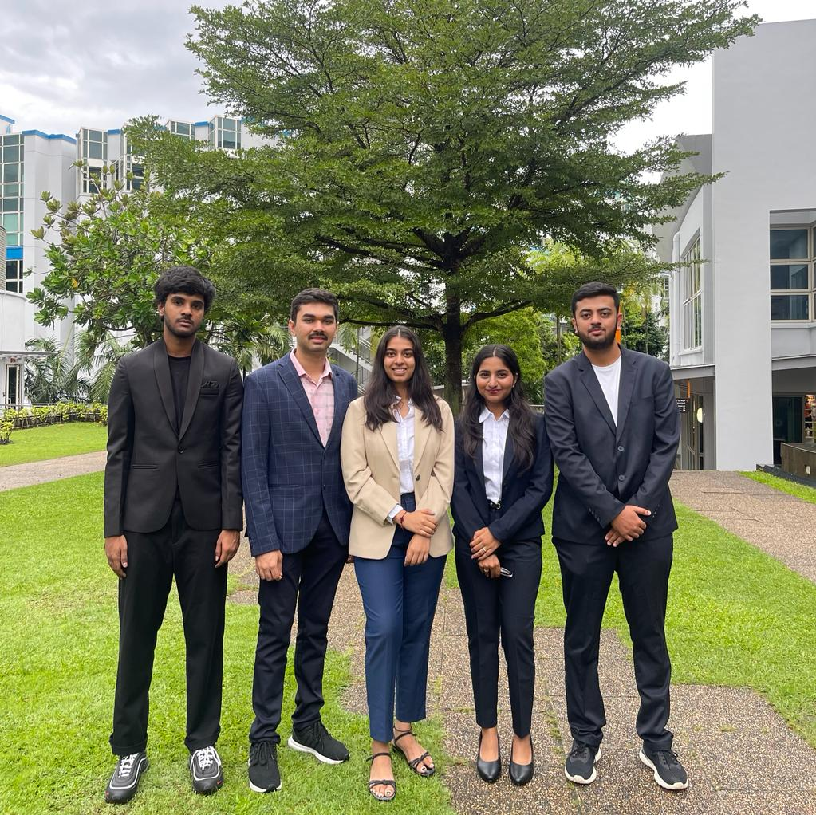
Demand Innovators-GROUP 10
Thank You

