Slide 1



Securing ERC-4337 Paymasters
A Defense Framework Against Abuse and Deposit Drain Attacks
Presenter:
Rahulkumar Ankola
Date:
February 2026
1/13

Slide 2
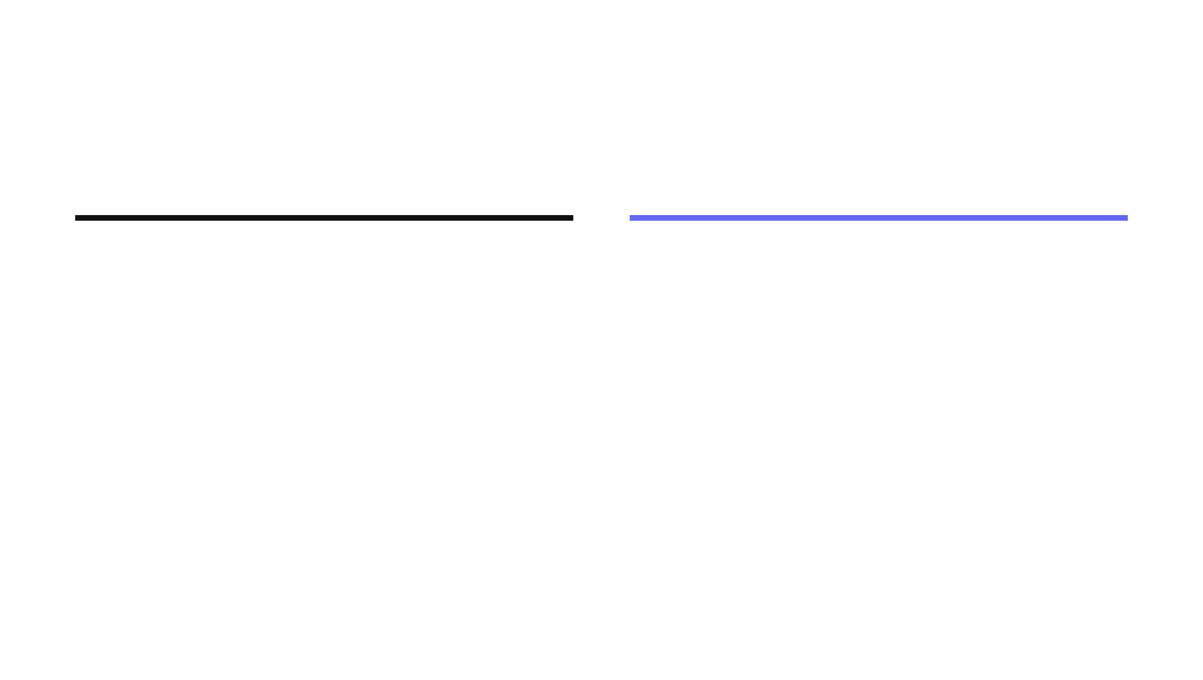




The Foundation
What is ERC-4337 and Paymasters?
ERC-4337
Paymasters
An Ethereum standard for Account Abstraction
Removes the need for traditional EOAs (Externally Owned Accounts)
Indroduces smart contract wallets
Enables features like: Gas sponsorship, social recovery, custom signature schemes
A smart contract that pays gas fees on behalf of users.
Validates transaction before execution
Settle gas costs with bundler after execution.
Enables features like: Gasless transactions, Pay with ERC-20 tokens
User
EntryPoint
Paymaster
Execution
2/13
Notes:
User operation -> bundler processes multiple operations -> entrypoint invoked -> validates and calls paymaster -> executes -> postop: gas costs settled COMPONENTS: User operation, Bundler ,Entrypoint, smart wallet, paymaster,

Slide 3




Deployment Context
Where is ERC4337 used?
Active Networks:
Ethereum
Arbitrum
Optimism
Polygon
Base
Web3 Gaming
DeFi Protocols
Enterprise
Sponsors millions of micro-transactions to enable seamless gameplay without wallet friction.
Examples:
Immutable
Sequence
Gods Unchained
Enables complex multi-step operations and token-based gas payments for traders.
Examples:
Safe
Instadapp
Biconomy
Corporate treasury management with programmable spending limits and controls.
Examples:
Coinbase
Alchemy
ZeroDev
Security failure leads to direct financial loss and service disruption for thousands of users.
3/13

Slide 4



Context & Challenge
The Promise and Peril of Paymaster
The Breakthrough
The Security Gap
•
Paymasters sponsor gas fees, eliminating ETH requirement for users
•
Paymasters hold large ETH deposits vulnerable to drain
•
Enables seamless onboarding for Gaming and DeFi applications
•
Standard implementations lack rate limiting or spam protection
•
Decouples user identity from gas payment mechanics
•
Open to griefing attacks and gas penalty exploitation
CRITICAL RISK:
Baseline paymasters can be drained of thousands in ETH within hours by coordinated spam attacks
4/13

Slide 5






Problem Statement
Default Paymasters Are Vulnerable
Spam & Griefing Attacks
Systemic Flaws
Attackers submit unlimited valid UserOperations. Without rate limits, these legitimate-looking requests rapidly drain the paymaster's deposited ETH.
No Rate Limits
No User Quotas
Gas Penalty Exploitation
Malicious users specify artificially high gas limits. This triggers the EntryPoint's 10% penalty on unused gas, charging the paymaster significantly more than the execution cost.
Unpredictable Gas
No Approval Layer
PostOp Failure Loop
In token paymasters, if the token collection fails in postOp, the bundler is still paid from the deposit, but the paymaster collects nothing from the user.
Economic Impact
Total Deposit Drain
5/13

Slide 6

Research Foundations
Literature Review
1. ERC-4337 Security & Gas Abuse
Arxiv 2309.00448
Academic analysis highlights that expanding transaction abstraction shifts security burdens onto smart contracts. Research in "Account Abstraction, Analysed" notes that programmability at the Paymaster layer introduces significant risks if validation logic is unsafe or incomplete.
2. UserOp Encoding & Signature Weaknesses
Alchemy Research
Technical analysis uncovered that
improper hashing of UserOperations
can allow signature reuse for unintended payloads. Signing fewer
fields than required allows attackers to substitute
callData
or
initCode
, leading to unauthorized sponsorship.
3. Defensive Patterns: Quotas & Whitelisting
Calibraint Analysis
Industry research advocates for the enforcement of caps, budgets, and approved targets to limit the impact surface. These defensive controls are essential to transform Paymasters from experimental tech into production-grade infrastructure.
6/13

Slide 7







Modification 1
Quota & Rate Limiting Architecture
Sponsorship Signature
Enforced Limits
OFF-CHAIN
SIGNATURE
{ userAddr:0x71C...9A2, maxGas:500,000, expiry:1735689000, chainId:1
nonce: “random-uuid-or-increment” }
Per-User Daily Budget
Strict cap (e.g., 0.01 ETH) on gas sponsorship per user address per day. Prevents individual attackers from draining the pool.
Per-dApp Aggregate Budget
Global limits for specific applications. If a dApp is compromised, the damage is contained to its specific quota.
Users must obtain a short-lived signature from an off-chain service before submitting. The Paymaster verifies this signature on-chain before paying any gas.
Short-Lived Expiry
Signatures expire in 5-10 minutes. Mitigates replay attacks and limits the window for stolen signature exploitation.
Result: Attacks become economically infeasible and deposit drain is mathematically impossible.
7/13

Slide 8


Modification 2
Target Contract Whitelisting
Proposed Solution
Default Paymasters sponsor any contract calls requested by users.
Maintain a whitelist of allowed target contract addresses.
Opens the door for malicious requests to non-intended protocols.
Paymaster validates
userOp.callData
against
whitelist on-chain.
No control over which dApps consume the Paymaster's ETH deposit.
Blocks unauthorized dApps while still sponsoring approved operations.
8/13

Slide 9


Modification 3
Limiting Max Gas Fee
The 10% Penalty
Gas Capping
In ERC-4337, if a UserOperation's actual gas usage is significantly lower than its limit, the EntryPoint charges a 10% penalty on the unused gas. Attackers exploit this by setting massive gas limits for simple operations, forcing the Paymaster to pay high penalties for "nothing."
The Paymaster enforces a strict Max Gas Limit per transaction type. Transactions exceeding this cap are rejected during validation, preventing the Paymaster from being exposed to inflated penalty costs.
Security Outcome
Zero Exposure to Penalty Spam
9/13

Slide 10






Methodology
Comparative Security Analysis
Attack Vector Testing
Gas Cost Analysis
—
Systematic injection of spam UserOps
—
Total ETH consumed during attacks
—
Gas penalty exploitation attempts
—
Cost per operation metrics
—
PostOp failure simulation
—
Penalty charges tracking
Simulation Accuracy
Operational Impact
—
Off-chain vs. On-chain parity check
—
Authorization service latency
—
Unexpected revert frequency
—
False positive blocking rate
—
Gas estimation precision
—
User experience friction analysis
10/13

Slide 11

Research Roadmap
Project Timeline
Week 1-2
Week 3-4
Week 5-6
Week 7-9
Final
1
2
3
4
Research
Default ERC-4337 Implementation
Secured Paymaster Implementation
Attack Strategies, Comparative Analysis & Documentation
Literature review, vulnerability mapping, and security specification design.
Establishing a baseline infrastructure with standard Paymaster logic.
Integrating defensive modifications: Quotas, Whitelisting, and Gas Capping.
Stress testing and benchmarking baseline vs. secured versions.
Current Phase: Phase 1 - Theoretical Security Analysis
11/13

Slide 12





Impact & Significance
Enabling Secure Scale
Transforming paymasters from experimental technology into production-grade infrastructure for high-value applications.
Gaming
DeFi Protocols
Enterprise
Enables truly gasless onboarding. New players start immediately without wallet friction, with risk strictly bounded by quotas.
Sponsors complex multi-step operations. Per-dApp limits prevent any single protocol from exhausting the shared deposit.
Provides the cost predictability and compliance controls required for corporate treasury management.
Strategic Outcome
95% Reduction in Attack Surface
12/13

Slide 13

THANK YOU
Questions?
Securing ERC-4337 Paymasters Proposal
February 2026
13/13

