Slide 1







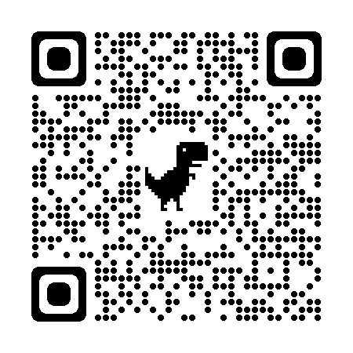
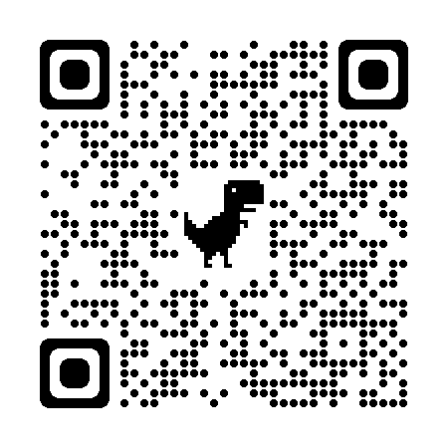



Coaching Classes
N-1/25 Patuli, Kol 94
Near Fire Brigade & Krishi Vikas
9073 700094
Bring in a Friend
OR
Study Multiple Subjects
50% OFF
Follow
for Discounts
App Download
NEET, IIT-JEE, VIII-XII - All Subjects & Boards
Artificial Intelligence, IoT, Robotics, Coding
IT – Full-Stack Training & Projects
BCom, BBA, CA, CMA, CS, CFA, CLAT, LLB, LLM
Grooming, Spoken Eng, Ielts, Toefl, Gre, French, German
Finest Teachers, Study Materials, Mock Tests, Doubt Clearing, PTM, Counselling
400+ Courses, 20 Smart Classrooms, AC, CCTV
Professional Courses are Proj-Based, Certification Oriented & Career Focused
www.anodiam.com || anirban@anodiam.com

Slide 2
Artificial Intelligence
Your Time to join the Party
9073 700094
Bring in a Friend
OR
Study Multiple Subjects
50% OFF
Follow
for Discounts
App Download
Best Teachers, Doubt Clearing, Mock Tests, PTM, Counselling
400+ Courses, 20 Smart Classrooms, AC, CCTV
Professional Courses are Proj-Based, Certification Aimed & Career Focused
www.anodiam.com || anirban@anodiam.com

