Slide 1


AI & Robotics
Mentoring for ICSE Class IX & X
Make India an AI
Super Power
IoT, Robotics
& AI Study
IT
Competency
Scientific
Knowledge
Expert industry veterans
Dependable competency partners
Highest quality advisory

Slide 2


Our Credentials
Pricing for batch of 30 students ICSE board, class IX and X
Lab Equipment – Anodiam provides at actual price with our mentoring services
Less than ₹50,000 (approximately) per year per batch
Robotics & AI including labs – ICSE syllabus comprehensive coverage
₹1,00,000 per year per batch
Python Programming including labs – ICSE syllabus comprehensive coverage
₹1,00,000 per year per batch
Total ₹2,50,000 approximately per year per batch

Slide 3
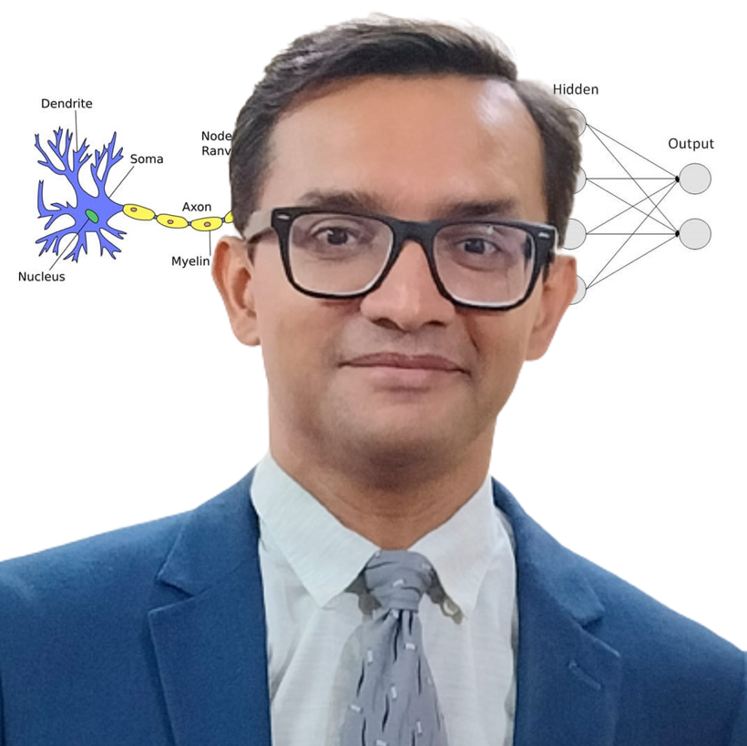
AI & Python Faculty
Caring Like Elder Brother
Loves Teaching
Anirban Chakrabarty, C.E.O.
B.E.(Electronics), M.B.A. (Finance)
anirban@anodiam.com
+91 9073 700094 / +61 470 142 229

Slide 4

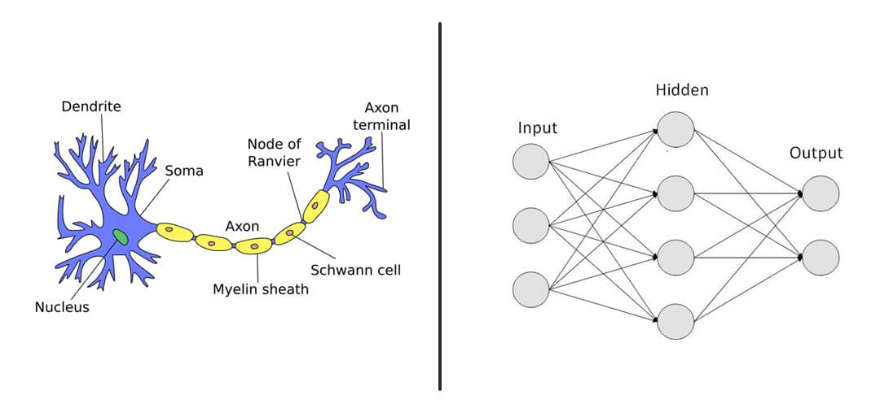
We provide Classes and Labs for ICSE, CBSE, WB syllabi, Advanced classes fro school kids
Projects for Engineering colleges
Industry professional and engineering faculty development training

