Slide 1
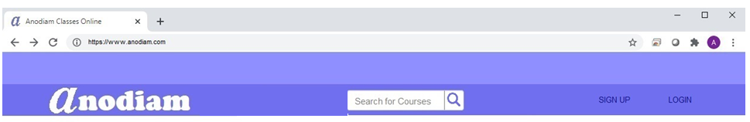
Logo
Arial Narrow, Bold, 12; #ffffff, (cOLOR WILL CHANGE WITH MOUSE HOVER)
50px; #8f8fff
50px; #6f6fef
Arial Narrow, Bold, 12; #8f8fff
Arial Narrow, Bold, 12; #0f0f7f
Arial Narrow, Bold, 12; #0f0f7f (COLOR WILL CHANGE TO THIS WHEN START WRITING)

Slide 2
100px; #8f8fff
Arial Narrow, Bold, 12; #0f0f7f

Slide 3

33%; #8f8fff
34%; linier color gradient
Arial Narrow, Bold, 12; #0f0f7f
100px; #8f8fff
33%; #ffffff

Slide 4
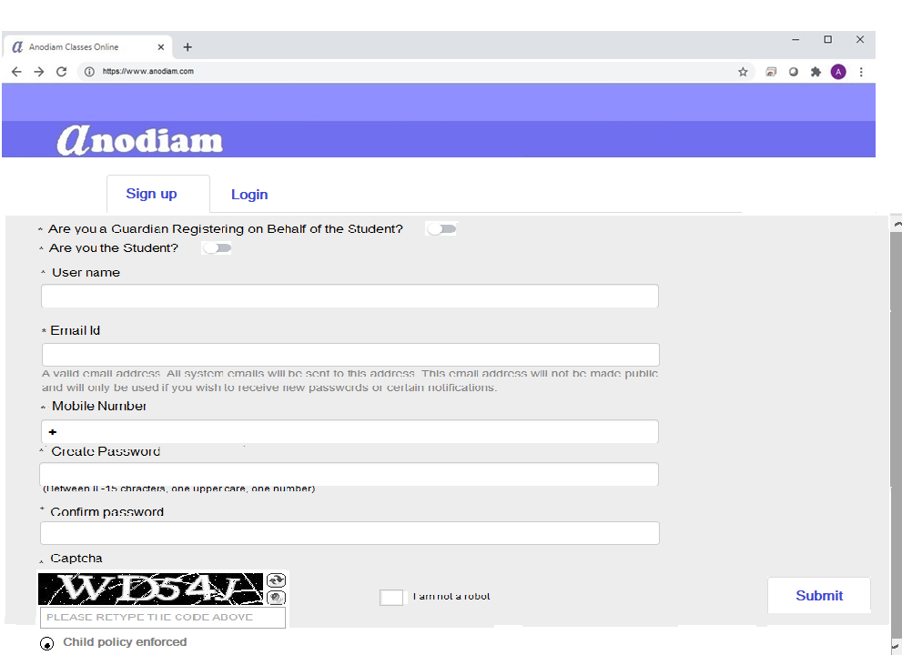
Button, Arial Narrow, Bold, 12; #2f2faf
Arial Narrow , 9; #0f0f7f
Arial Narrow , 9; #4f4fcf,(sam e applies to all other fields)
Arial Narrow, 9; #0f0f7f
Arial Narrow, 9; #0f0f7f
Arial Narrow, 8; #7f7fff
80% , #dfdfff
Plus symbol, Arial Narrow, 9; #0f0f7f
Arial Narrow, 9; #0f0f7f
40px, #8f8fff
Arial Narrow, 8; #7f7fff
Arial Narrow, 9; #0f0f7f
Button, Arial Narrow, Bold, 12; #2f2faf
Arial Narrow, 9; #0f0f7f
check box when blank fill color #ffffff, round, border color 9f9fff, when checked color #0f0f7f
Arial Narrow , 9; #0f0f7f
Tick box when blank fill color #ffffff, square, border color 9f9fff, when ticked color #0f0f7f
Arial Narrow, 9; #0f0f7f

Slide 5
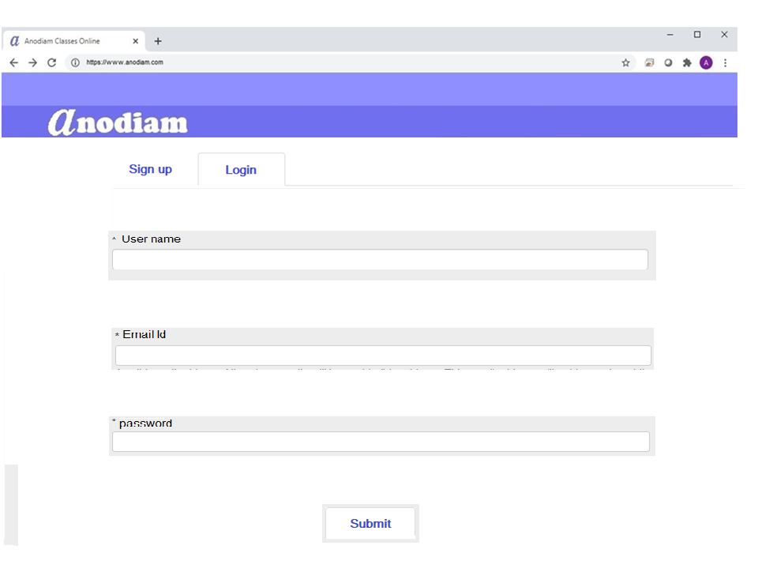
Button, Arial Narrow, Bold, 12; #2f2faf
Arial Narrow, 9; #0f0f7f
80% , #dfdfff
Arial Narrow , 9; #4f4fcf,(sam e applies to all other fields)
Button, Arial Narrow, Bold, 12; #2f2faf

