Slide 1
JAY SIR
Subhamay Dey
History - VIII – XII
Geography - VIII – X
Visual Storyteller
8 Yrs Exp. & Detail Oriented
Caring Like Elder Brother
Loves Teaching
His diligent care helped Trisha score so well !
– Trisha’s mother
Explains well, takes tests & clears all doubts. Excellent!
– Emon Kalsa’s mother

Slide 2
JAY SIR
Subhamay Dey
Accountancy & Business Studies - VIII – XII
Visual Storyteller
8 Yrs Exp. & Detail Oriented
Caring Like Elder Brother
Loves Teaching
His diligent care helped Trisha score so well !
– Trisha’s mother
Explains well, takes tests & clears all doubts. Excellent!
– Emon Kalsa’s mother

Slide 3
Dipanwita Biswas
M.A. (English), B.Ed.
English - VIII
Motherly & Empathetic
Innovative Techniques
Diligent & Adaptive
16 Yrs Experienced
Excellent teacher, I owe so much to this wonderful lady for my career!
– Susanta Das, ex student

Slide 4

Avishek Sir
Avishek Adhikari
Maths - VIII – XII
Cracked IIT, ISI PhD (Ongoing)
8 Yrs Exp. & Detail Oriented
Lots of Successful Students
$\frac{100}{100}$ in Maths in HS & 10th
B.Sc. Math CU 1st Class 1st
M.Sc. Math CU 1st Class 1st
Neel depended on him so much to score !
– Neel’s mother
Explains well, takes tests & clears all doubts. Excellent!
– Emon Kalsa’s mother

Slide 5
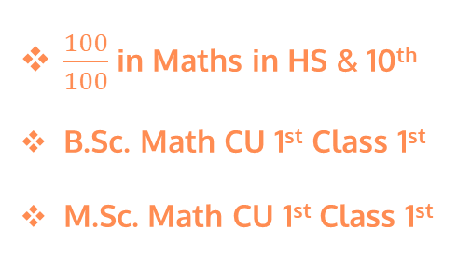
Avishek Sir
Avishek Adhikari
Physics - VIII – XII
Cracked IIT, ISI PhD (Ongoing)
8 Yrs Exp. & Detail Oriented
Lots of Successful Students
$\frac{100}{100}$ in Maths in HS & 10th
B.Sc. Math CU 1st Class 1st
M.Sc. Math CU 1st Class 1st
Neel depended on him so much to score !
– Neel’s mother
Explains well, takes tests & clears all doubts. Excellent!
– Emon Kalsa’s mother

Slide 6
Arijit Sir
Arijit Bhattacharya
accounts - IX – XII (All Boards)
Taught in Gurukul Institution
5 Yrs Exp. & Detail Oriented
Lots of Successful Students
Adrija gots 95% marks in CBSC Accounts
Subham gots 87% marks in CBSC Accounts
Ruchi gots 97% marks in CBSC Accounts

Slide 7
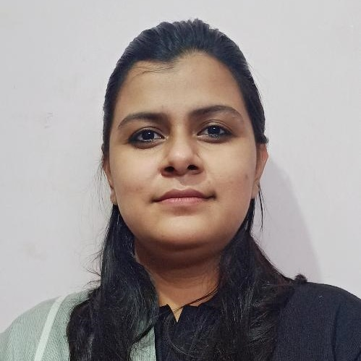
Abhipsha Ma’am
Abhipsha Dutta M.Sc., B.Ed.
Chemistry - VIII – XII
Excellent Mentor
Great Academics
Caring & Meticulous
Brilliant Experience
Explains so well and clears all doubts. I am really happy!
– Suparno’s mother (ICSE 97%)

Slide 8
Anupam Sen
H.O.D, Commerce
Loves to Teach
35 Yrs Corporate Exp.
Grass Root to Board Room
Friendly Caring, Mentor
Lucid Storytelling Teaching

Slide 9
Debashish Sir
Debashish Nath
IT Professional
Ex Best Faculty in CMC
Great Problem Solver
Teach with Patience
Experienced
Walks extra mile to make difficult concept seem cake walk
– IT Head of Recent Engagement
– IT Head of Recent Engagement

Slide 10
Anirban Chakrabarty B.E. (Electronics), M.B.A. (Finance)
H.O.D, AI & Robotics
Supportive, Cares for Kids
Global Corporate Exp.
Innovative & Dynamic
Truly Inspires Talent
Super brain, the best guy to take care of AI implementation!
– Corporate Client
Dynamo of energy, dependable and trusted for the job!
– Vish Coosa, Morgan Stanley Bank, U.S.A.

Slide 11
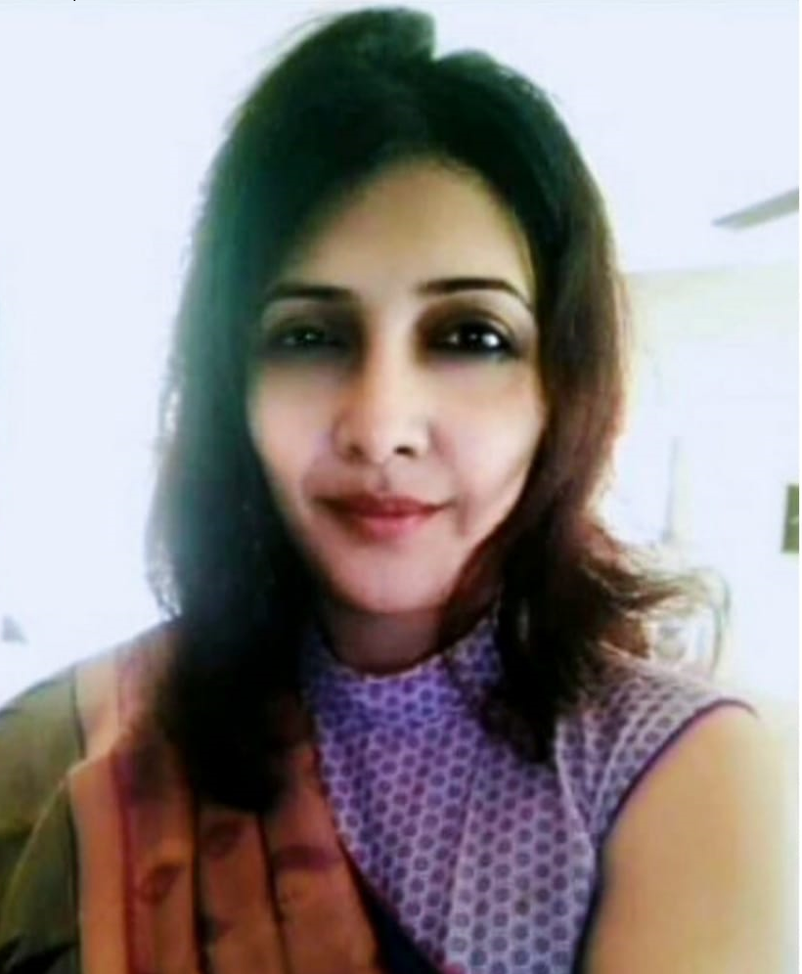
Pradipta Ma’am
Pradipta Bose
Teach like Motherly
25 Yrs, Experienced
Personality Developer

