Slide 1









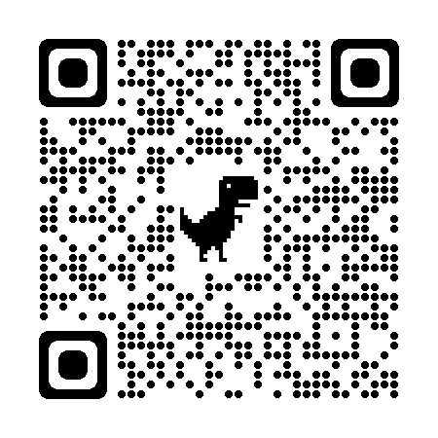
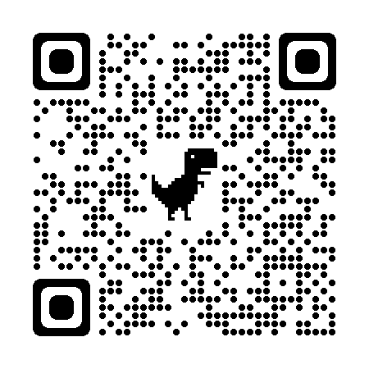



Coaching Classes
9073 700094
N-1/25 Patuli, Kol 94, Near Fire Brigade & Krisi Vikas
Upto 50% Off
T&C Applies
Follow
for Discounts
App Download
VIII-XII - ICSE/CBSE/WB - Science, Arts, Comm
NEET, IIT-JEE (Mains, Adv)
BCom, BBA, CA, CMA, CS, CFA, CLAT, LLB, LLM
AI & IT Training & Projects
Grooming, Ielts, Toefl, Foreign Languages
Finest Teachers, Study Materials, Mock Tests, Doubt Clearing, PTM, Counselling
400+ Courses, 20 Smart Classrooms, AC, CCTV
www.anodiam.com || anirban@anodiam.com

Slide 2

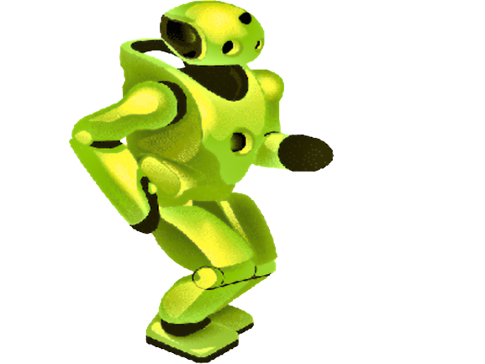
Artificial Intelligence
Upto 50% Off
T&C Applies
N-1/25 Patuli, Kol 94
Near Fire Brigade & Krisi Vikas
9073 700094
Follow
for Discounts
App Download
Artificial Intelligence, Robotics - Class III-XII
Professional AI & IT Training & Projects
Data Science, Computer Vision, NLP, DSP, Python, Data Analytics, C, C++, IoT, Robotics
Java, .NET, JavaScript, ReactJS, Native, PHP, DevOps, Docker, Kubernetes, Cloud
Database, Firebase, Cyber Sec, Automation Test, Pmp, Agile, Office, Adv Excel, Tally, Html, Css
Globally experienced faculty from prestigious organizations, fun & easy learning
Project based, Career Focused, Certification Help, Smart Classrooms, AC, CCTV
www.anodiam.com || anirban@anodiam.com

