Slide 1









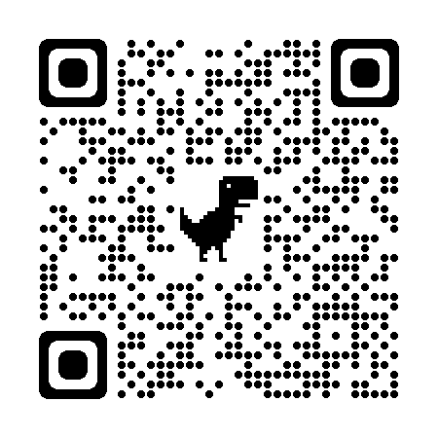



Coaching Classes
N-1/25 Patuli, Kol 94
Near Fire Brigade & Krishi Vikas
9073 700094
Upto 50% Off
T&C Applies
Follow
for Discounts
App Download
NEET, IIT-JEE, VIII-XII - All Subjects & Boards
Artificial Intelligence, IoT, Robotics, Coding
IT – Full-Stack Training & Projects
BCom, BBA, CA, CMA, CS, CFA, CLAT, LLB, LLM
Grooming, Spoken Eng, Ielts, Toefl, Gre, French, German
Finest Teachers, Study Materials, Mock Tests, Doubt Clearing, PTM, Counselling
Professional Courses are Proj-Based, Certification Oriented & Career Focused
400+ Courses, 20 Smart Classrooms, AC, CCTV
www.anodiam.com || anirban@anodiam.com

Slide 2


Coaching Classes
9073 700094
N-1/25 Patuli, Kol 94, Near Fire Brigade & Krisi Vikas
Upto 50% Off
T&C Applies
Follow
for Discounts
App Download
VIII-XII - ICSE/CBSE/WB - Science, Arts, Comm
NEET, IIT-JEE (Mains, Adv)
BCom, BBA, CA, CMA, CS, CFA, CLAT, LLB, LLM
AI & IT Training & Projects
Grooming, Ielts, Toefl, Foreign Languages
Finest Teachers, Study Materials, Mock Tests, Doubt Clearing, PTM, Counselling
400+ Courses, 20 Smart Classrooms, AC, CCTV
www.anodiam.com || anirban@anodiam.com

Slide 3

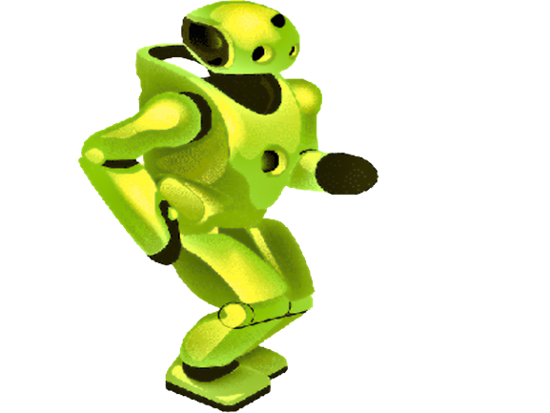
Artificial Intelligence
Your Time to join the Party
N-1/25 Patuli, Kol 94
Near Fire Brigade & Krisi Vikas
9073 700094
Upto 50% Off
T&C Applies
Follow
for Discounts
App Download
AI for ICSE/CBSE/WB Class III-XII
AI, Analytics, Comp Vision, NLP, DSP
Python, C, C++, IoT, Robotics
Java, .NET, JavaScript, ReactJS, Native, PHP
DevOps, Docker, Kubernetes, Cloud
Database, NoSQL, Cyber Sec, Automation Test
Pmp, Agile, Office, Adv Excel, Tally, Html, Css
Globally experienced faculty from prestigious organizations, fun & easy learning
Project based, Career Focused, Certification Help, Smart Classrooms, AC, CCTV
www.anodiam.com || anirban@anodiam.com

