Slide 1

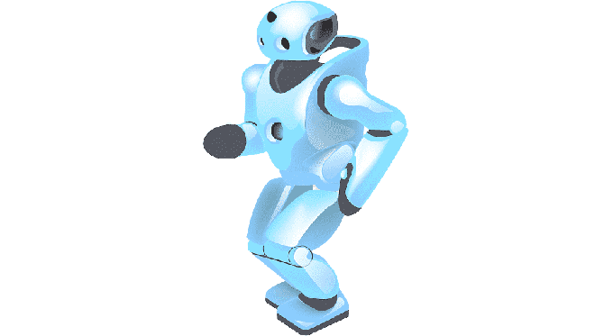


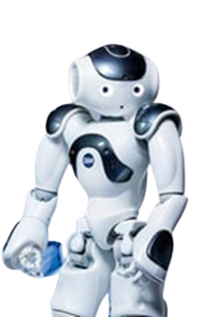






Artificial Intelligence
Time for Your Child to join the Party
65% of today's professions will succumb to AI in just 10 years
Prepare your child to take on the future
AI tuitions for ICSE/CBSE/WB Board, Class IX-XII
Robotics / AI / Coding for Kids Class III-VIII
Robotics & IoT – From Children’s Level till Hands-on with Microcontrollers
Python, C, C++ - Basics till TensorFlow, Keras & PyTorch, OpenCV etc.
Data Science Concepts / AI – Lucid details till Professional Mathematical Models
Clear Each Concept with Data Visualization & Analytics
Computer Vision, NLP – Cool Play around to Advanced Professional Projects
Cyber Security - Essential basics to Ethical Hacking
Technical Communication Skills & Business Intelligence
Project based, fun & easy learning
Globally experienced faculty from prestigious organizations
Bring a friend & get
50% OFF
Multiple Subjects
50% OFF
N-1/25 Kunal Road, Patuli,
Kolkata 700094
Near Fire Brigade & Krishi Vikas
anirban@anodiam.com
9073 700094
www.anodiam.com

Slide 2


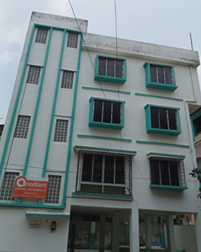
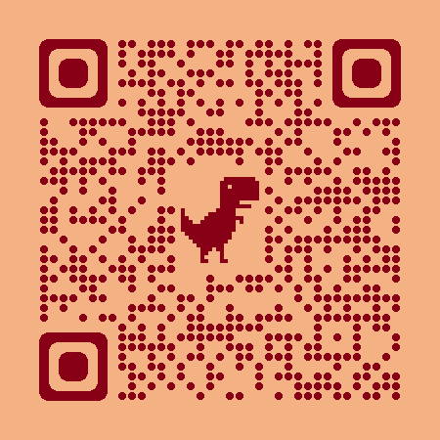

Coaching Classes
ARTIFICIAL
INTELLIGENCE
& IoT
NEET &
IIT JEE
Top-quality Teachers
Latest Techniques
400+ Courses
PTM, Counselling
Doubt Clearing, Mock Tests
Smart Classrooms, AC, CCTV
International Management
App Arriving Soon
VIII-XII
ICSE/CBSE/WB
All Subjects
IT/AI Training
Engg Projects
BCom, BBA,
CA, CMA, CS, CFA
Spoken Eng,
Grooming
Bring a friend & get
50% OFF
Multiple Subjects
50% OFF
Scan &
Follow for
Discounts
N-1/25 Kunal Road, Patuli, Kolkata 700094, Near Fire Brigade & Krishi Vikas
www.anodiam.com || anirban@anodiam.com
9073 700094

