Slide 1
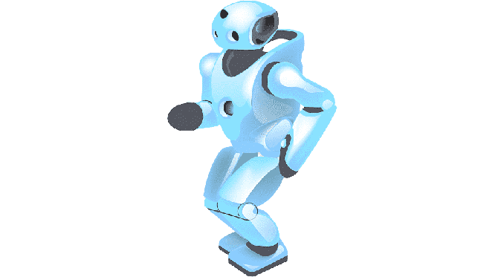



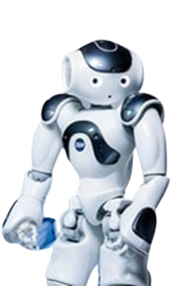






Artificial Intelligence Time for Your Child to join the Party
70% of today's professions will succumb to AI in 20 years
Prepare your child to take on the future
AI tuitions for ICSE/CBSE/WB Board, Class IX-XII
Data Science Concepts – Lucid details
Python - Basics
Having fun with Data Visualization
Computer Vision - Cool projects
Natural Language Processing
Cyber Security - Essential basics
IoT & Robotics - Getting hands-on with Microcontrollers
Technical Communication Skills & Business Intelligence
Project based, fun & easy learning
Globally experienced faculty from prestigious organizations
Bring a friend
& get
50% OFF
Learn Other Subjects
& get
50% OFF
N-1/25 Kunal Road, Patuli,
Kolkata 700094
Near Fire Brigade & Krishi Bikash,
anirban@anodiam.com
9163685448 / 9073 700094
www.anodiam.com

Slide 2
Artificial Intelligence Time for Your Child to join the Party
Bring a friend
& get
50% OFF
Learn Other Subjects
& get
50% OFF
N-1/25 Kunal Road, Patuli,
Kolkata 700094
Near Fire Brigade & Krishi Bikash,
anirban@anodiam.com
9163685448 / 9073 700094
www.anodiam.com

