Slide 1
Anodiam Core Student App: Wireframes
Version | Editor | Reviewer | Date | Note
1.0 | AC |  | 30/04/2021 | Core App Web

Slide 2
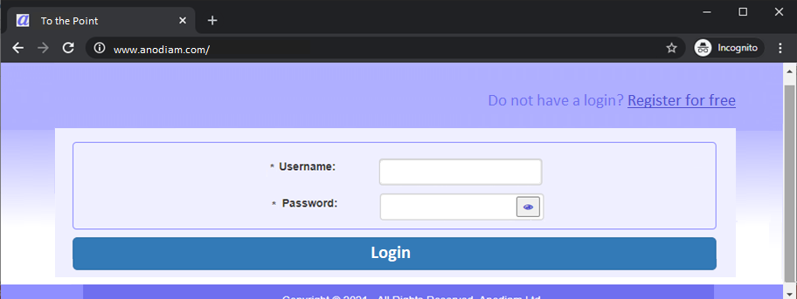
Student Login Page
Link: https://anodiam.com/

Slide 3
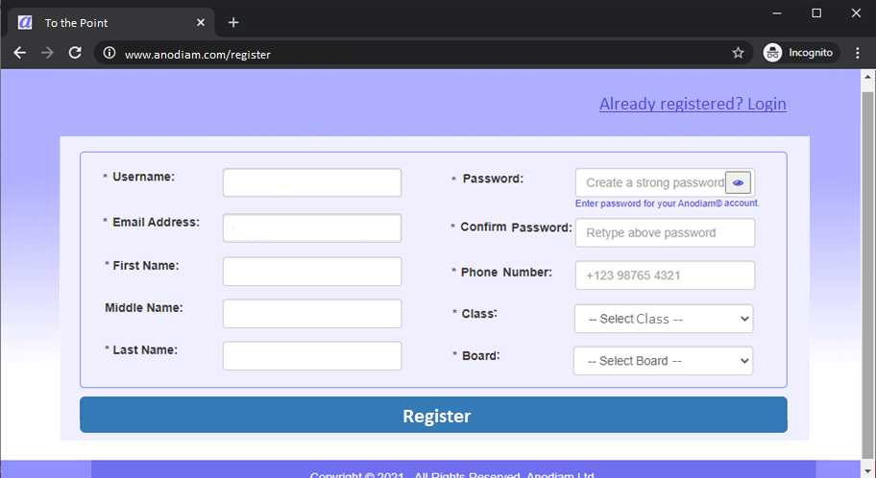
Student Registration Page
Link: https://anodiam.com/register

Slide 4
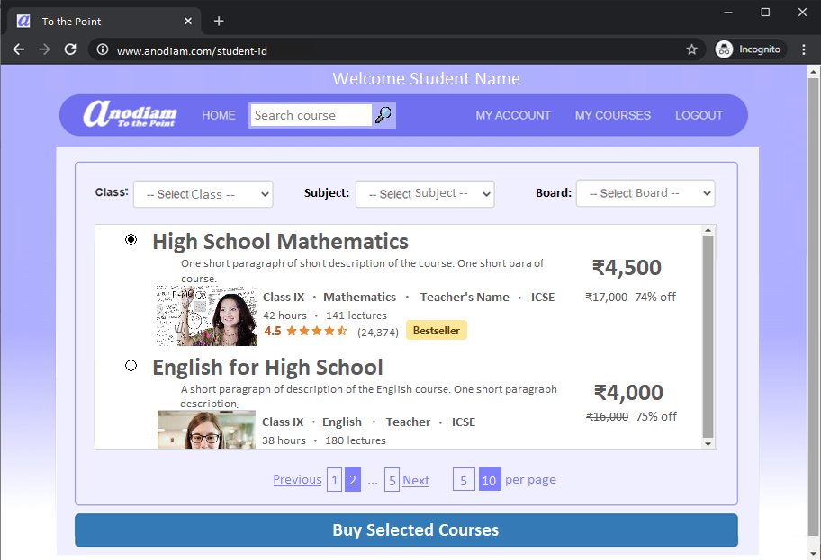
Student Home Page
Link: https://anodiam.com/student-id

Slide 5

Course Detail Page
Link: https://anodiam.com/course-id

Slide 6
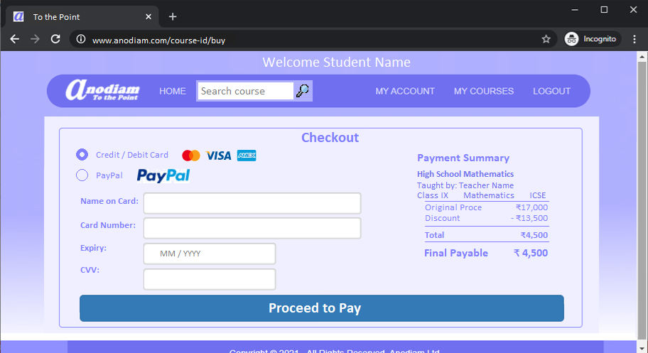
Buy Course Page
Link: https://anodiam.com/course-id/buy

Slide 7
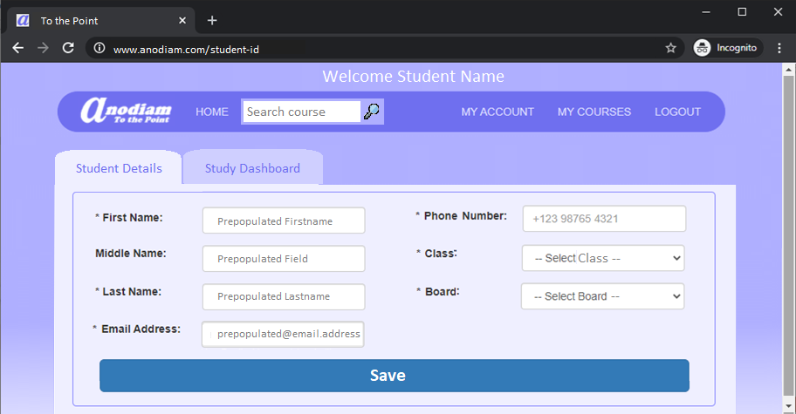
Student Profile Page: Student Details
Link: https://anodiam.com/student-id/profile

Slide 8
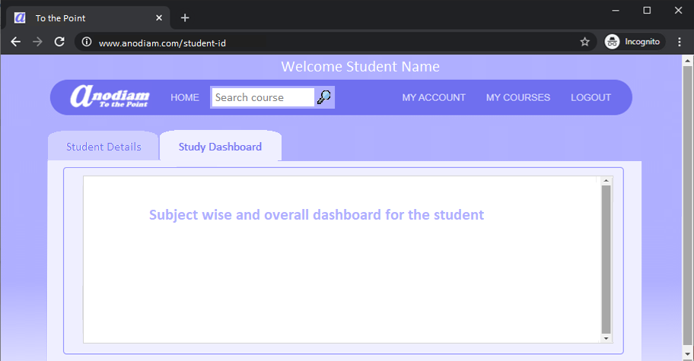

Student Profile Page: Study Dashboard (to be done later)
Link: https://anodiam.com/student-id/profile

Slide 9
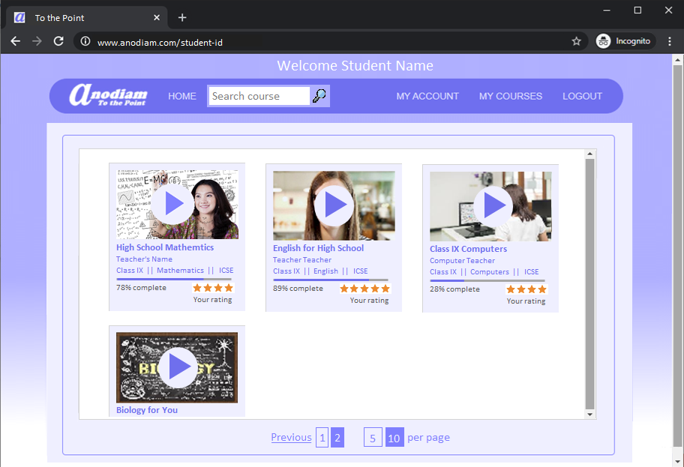
My Courses Page
Link: https://anodiam.com/student-id/courses

Slide 10
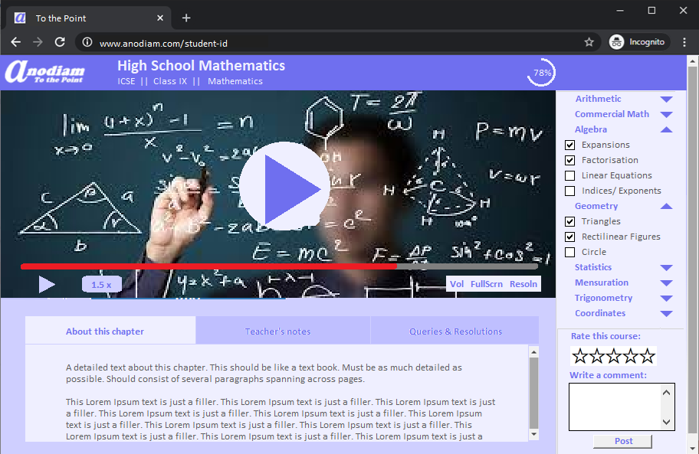
Course Page
Link: https://anodiam.com/course-id

Slide 11
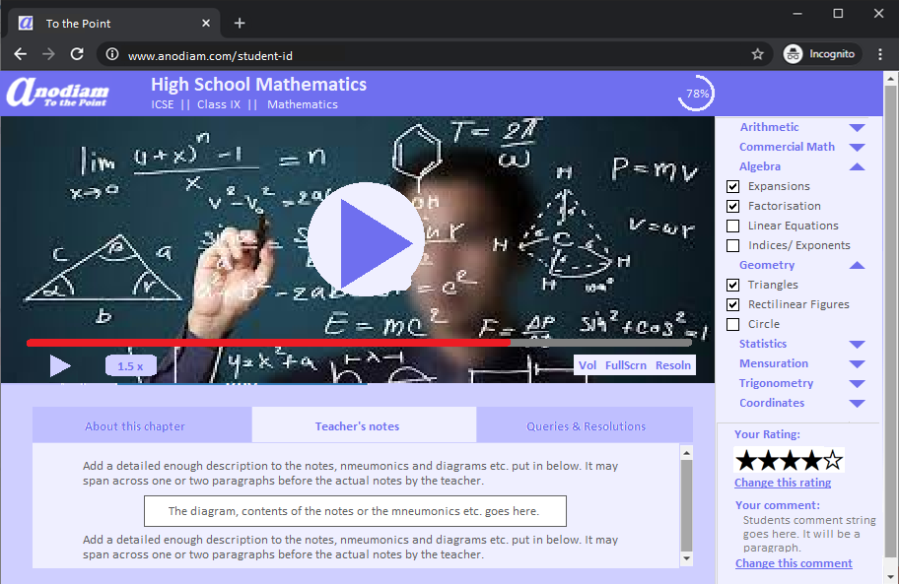
Course Page (Teacher’s Notes)
Link: https://anodiam.com/course-id

Slide 12

Course Page (Queries & Resolutions)
Link: https://anodiam.com/course-id

