Slide 1








Coaching Classes
N-1/25 Patuli, Kol 94
Near Fire Brigade & Krishi Vikas
9073 700094
Upto 50% Off
T&C Applies
Finest Teachers, Study Materials, Mock Tests
Doubt Clearing, PTM, Counselling
400+ Courses, 20 Smart Classrooms, AC, CCTV
Professional Courses are Proj-Based Certification Oriented & Career Focused
NEET, IIT-JEE, VIII-XII - All Subjects & Boards
Artificial Intelligence, IoT, Robotics, Coding
IT – Full-Stack Training & Projects
BCom, BBA, CA, CMA, CS, CFA, CLAT, LLB, LLM
Grooming, Spoken Eng, Ielts, Toefl, French, German

Slide 2


Coaching Classes
9073 700094
N-1/25 Patuli, Kol 94, Near Fire Brigade & Krisi Vikas
Upto 50% Off
T&C Applies
Finest Teachers, Study Materials, Mock Tests, Doubt Clearing
PTM, Counselling, 400+ Courses, 20 Smart Classrooms, AC, CCTV
AI & IT for Schools Students & Professionals
VIII-XII - All Subjects & Boards
NEET, IIT-JEE (Mains & Advanced)
BCom, BBA, CA, CMA, CS, CFA, CLAT, LLB, LLM
Grooming, Ielts, Toefl, Foreign Languages

Slide 3

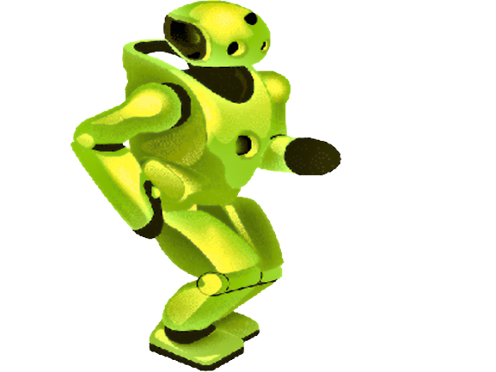
Upto 50% Off
T&C Applies
Artificial Intelligence
N-1/25 Patuli, Kol 94
Near Fire Brigade & Krisi Vikas
9073 700094
Globally experienced faculty from prestigious organizations
fun learning, Project based, Career Focused, Certification Help
Artificial Intelligence ICSE/CBSE/WB III-XII
Professional AI & IT Training and Projects Data Science, Comp Vision, NLP, DSP
Python, Data Analytics, C, C++, IoT, Robotics
Java, .NET, JavaScript, ReactJS, Native, PHP
DevOps, Docker, Kubernetes, Cloud
Database, NoSQL, Cyber Sec, Automation Test
Pmp, Agile, Office, Adv Excel, Tally, Html, Css

