Slide 1








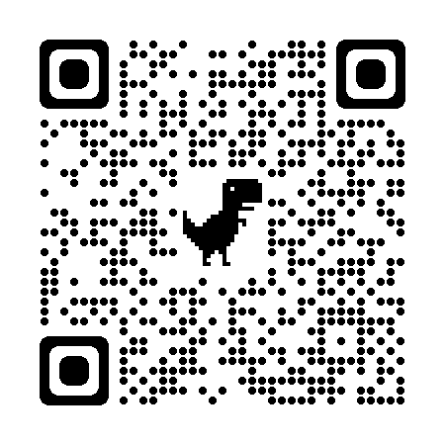



Coaching Classes
N-1/25 Patuli, Kol 94
Near Fire Brigade & Krishi Vikas
9073 700094
Upto 50% Off
T&C Applies
Follow
for Discounts
App Download
NEET, IIT-JEE, VIII-XII - All Subjects & Boards
Artificial Intelligence, IoT, Robotics, Coding
IT – Full-Stack Training & Projects
BCom, BBA, CA, CMA, CS, CFA, CLAT, LLB, LLM
Grooming, Spoken Eng, Ielts, Toefl, Gre, French, German
Finest Teachers, Study Materials, Mock Tests, Doubt Clearing, PTM, Counselling
400+ Courses, 20 Smart Classrooms, AC, CCTV
Professional Courses are Proj-Based, Certification Oriented & Career Focused
www.anodiam.com || anirban@anodiam.com

Slide 2



Coaching Classes
9073 700094
N-1/25 Patuli, Kol 94, Near Fire Brigade & Krisi Vikas
Upto 50% Off
T&C Applies
Follow
for Discounts
App Download
Artificial Intelligence, Robotics, Coding - III - XII
Professional AI & IT Training & Projects
VIII-XII - All Subjects & Boards
NEET, IIT-JEE
BCom, BBA, CA, CMA, CS, CFA, CLAT, LLB, LLM
Grooming, Ielts, Toefl, Foreign Languages
Finest Teachers, Study Materials, Mock Tests, Doubt Clearing, PTM, Counselling
400+ Courses, 20 Smart Classrooms, AC, CCTV
Professional Courses are Proj-Based, Certification Oriented & Career Focused
www.anodiam.com || anirban@anodiam.com

Slide 3

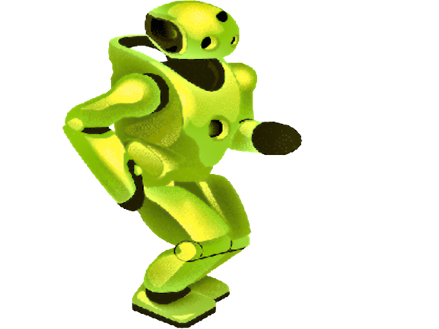
Artificial Intelligence
N-1/25 Patuli, Kol 94
Near Fire Brigade & Krisi Vikas
9073 700094
Upto 50% Off
T&C Applies
Follow
for Discounts
App Download
Artificial Intelligence ICSE/CBSE/WB III-XII
Professional AI & IT Training and Projects Data Science, Comp Vision, NLP, DSP
Python, Data Analytics, C, C++, IoT, Robotics
Java, .NET, JavaScript, ReactJS, Native, PHP
DevOps, Docker, Kubernetes, Cloud
Database, NoSQL, Cyber Sec, Automation Test
Pmp, Agile, Office, Adv Excel, Tally, Html, Css
Globally experienced faculty from prestigious organizations, fun & easy learning
Project based, Career Focused, Certification Help, Smart Classrooms, AC, CCTV
www.anodiam.com || anirban@anodiam.com

