Slide 1
Anodiam Teacher App: Wireframes
Link: https://github.com/anodiamadm/Docs > ProjectExecution > BA > SpecsWireframes
Version | Editor | Reviewer | Date | Note
1.0 | AC | AM | 26/11/2020 | Teacher App wireframes
2.0 | AC | AM | 22/02/2021 | Updated with screen prints from real app.

Slide 2
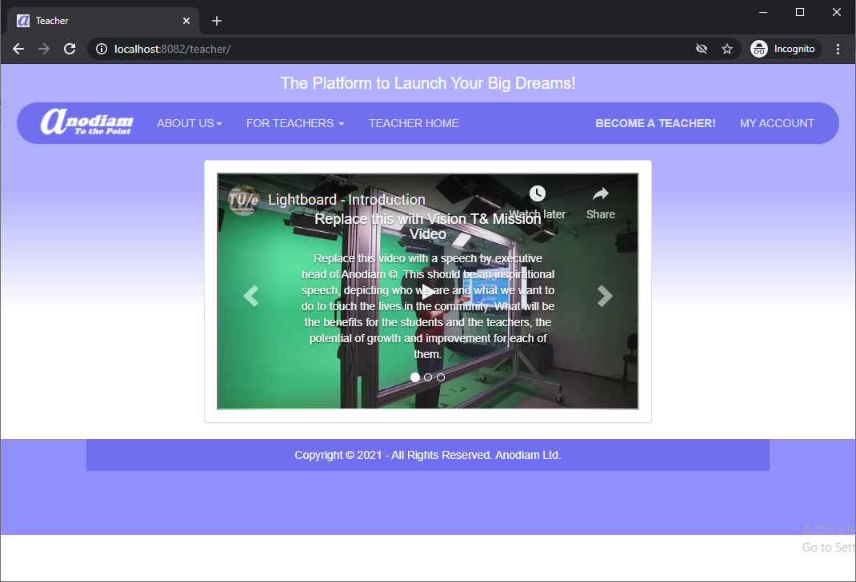
Teacher App: Home Page
Link: https://anodiam.com/teacher/

Slide 3
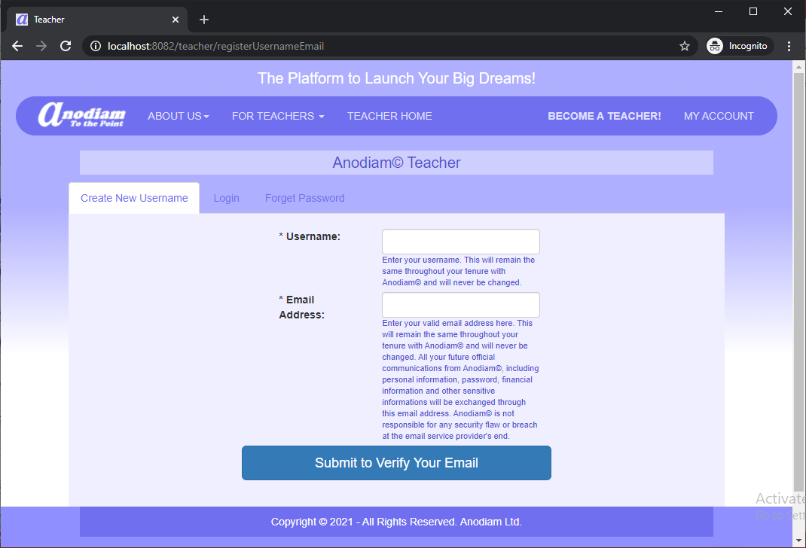
Teacher App: Create New Username Page
Link: https://anodiam.com/teacher/registerUsernameEmail

Slide 4
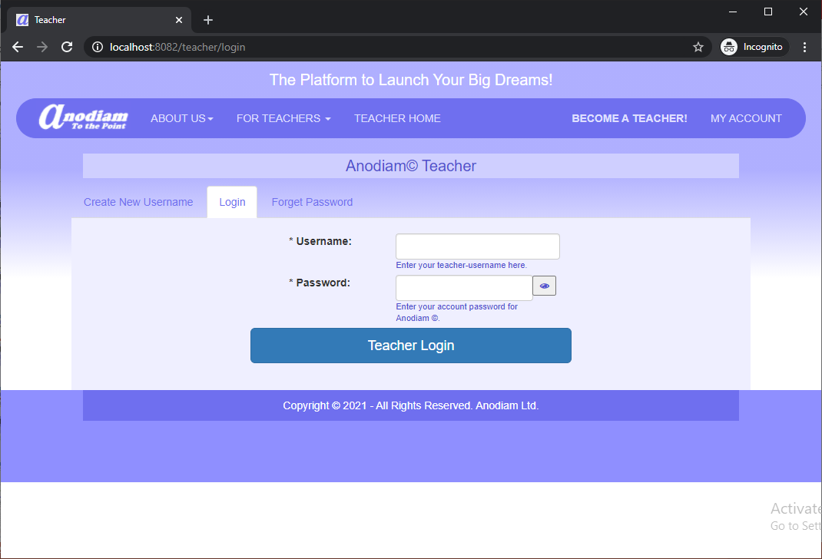
Teacher App: Login Page
Link: https://anodiam.com/teacher/login

Slide 5
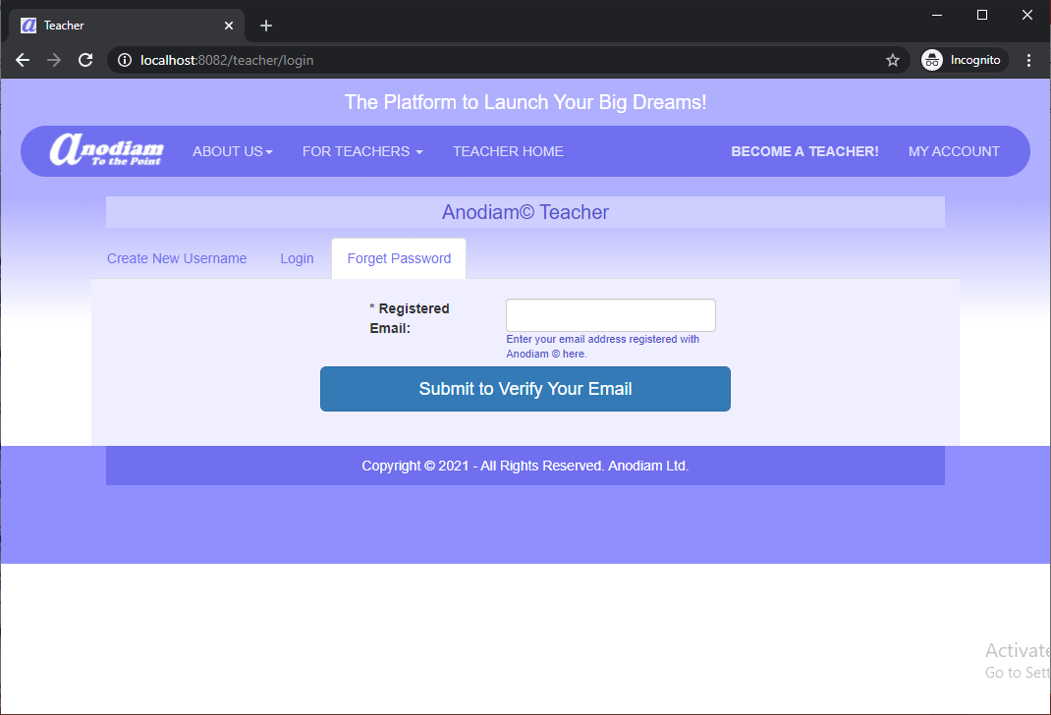
Teacher App: Forget Password Page
Link: https://anodiam.com/teacher/login

Slide 6
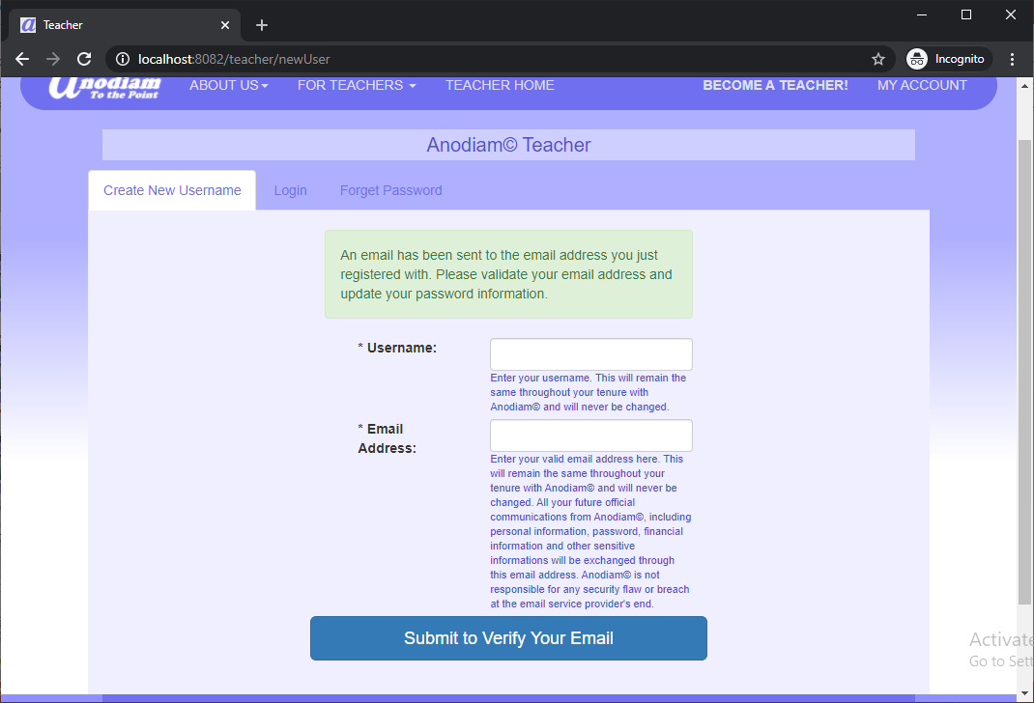
Teacher App: Create New Username (Email Sent) Page
Link: https://anodiam.com/teacher/newUser/

Slide 7
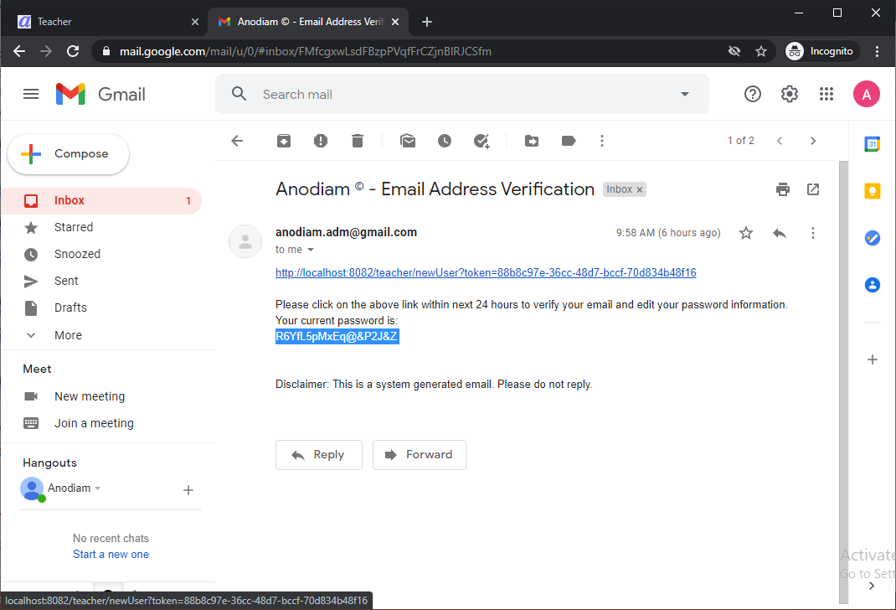
Teacher App: Verification Email
Link: user’s mailbox

Slide 8
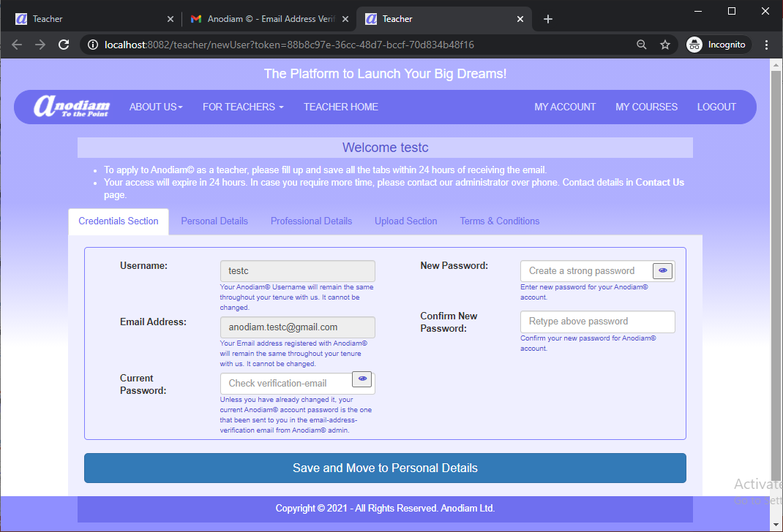
Teacher App: New User Page,
Link: https://anodiam.com/teacher/teacher/newUser?token=hex-token

Slide 9
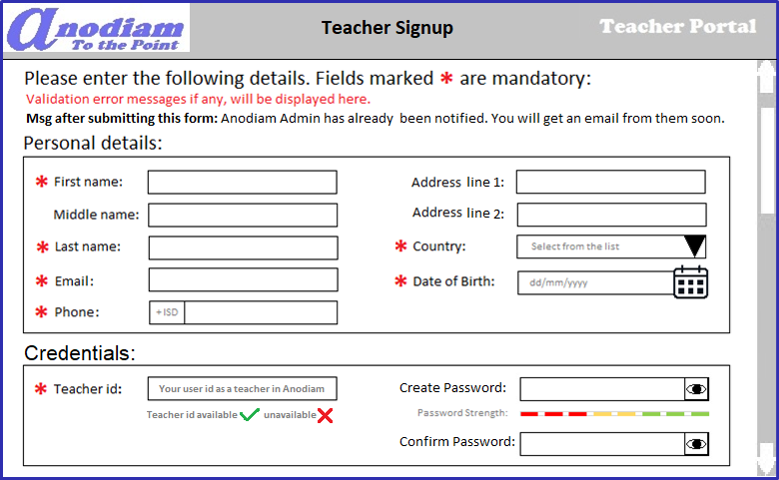
Teacher App: Signup – Teacher Signup page
Link: https://anodiam.com/teacher/signup

Slide 10
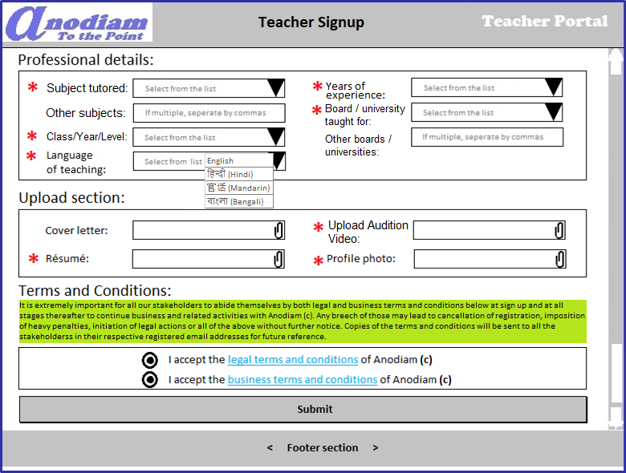
Teacher App: Signup – Teacher Signup page (continued)
Link: https://anodiam.com/teacher/signup

Slide 11
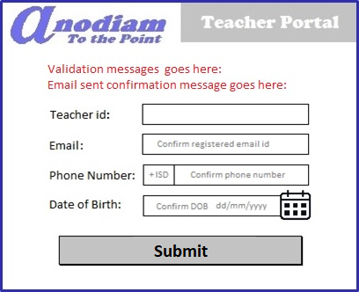
Teacher App: Signup – Forget / Change Password page
Link: https://anodiam.com/teacher/changepassword/{userid}

Slide 12
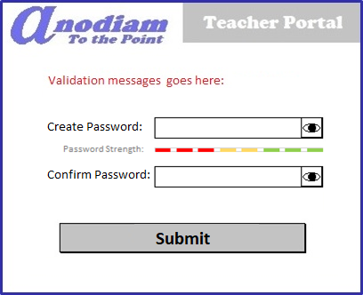
Teacher App: Signup – Create New Password page
Link: https://anodiam.com/teacher/createpassword/{userid}

Slide 13
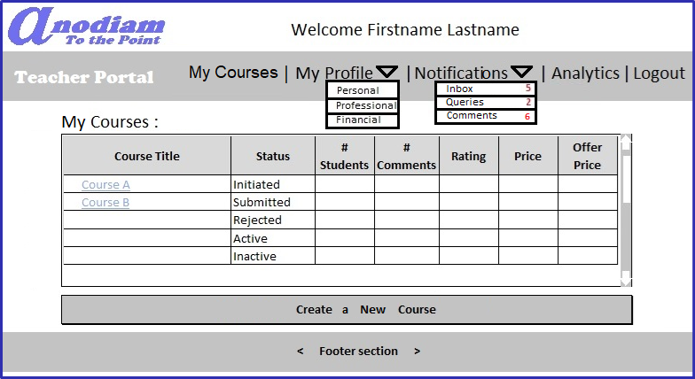
Teacher App: My Teacher Home / View All Courses page
Link: https://anodiam.com/teacher/myhome/{userid}

Slide 14
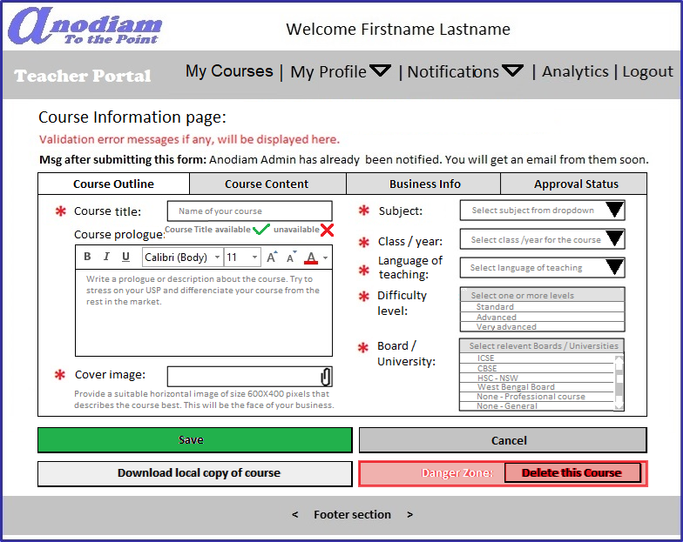
Teacher App: Create Course page Outline tab
** Only non-active courses can be deleted
Link: https://anodiam.com/teacher/addnewcourse

Slide 15
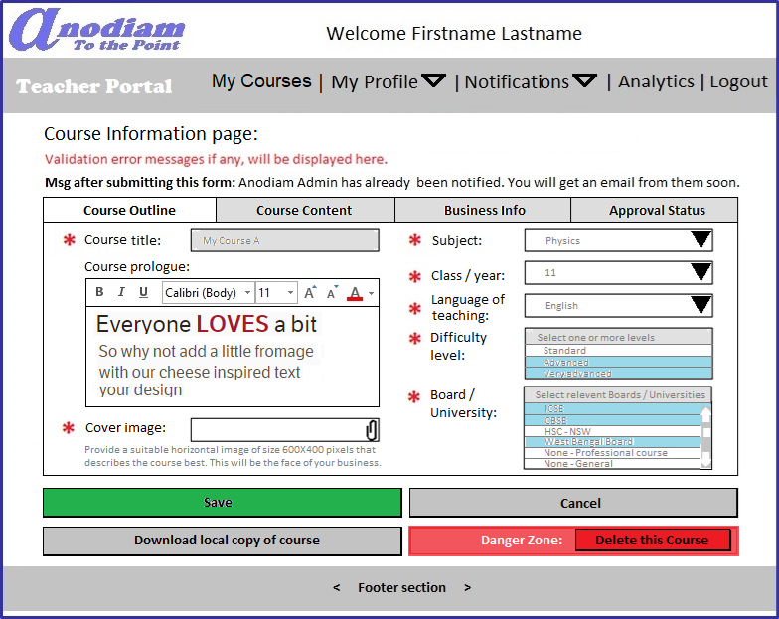
Teacher App: View, Update Course page Outline tab
** Only non-active courses can be deleted
Link: https://anodiam.com/teacher/course/{courseid}

Slide 16
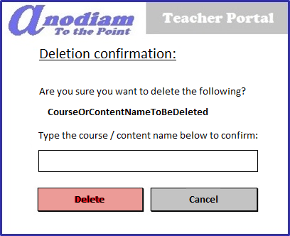
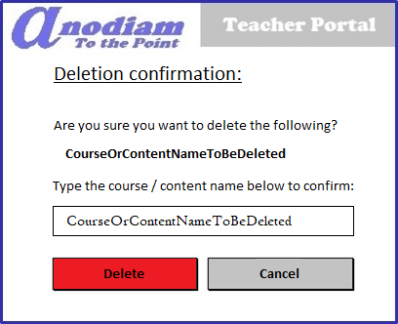
Teacher App: Confirm Deletion dialogue
** Only non-active courses can be deleted
Link: https://anodiam.com/teacher/deletecourse/{courseid}
On confirmation of Course / Content name
Delete button is enabled

Slide 17
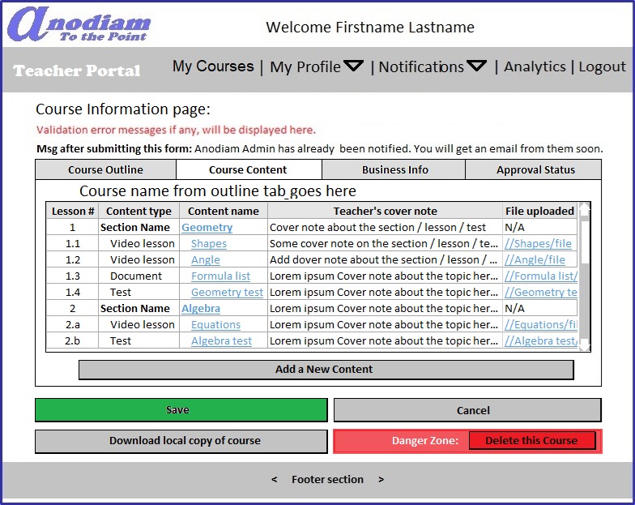
Teacher App: Create / Edit Course page Content tab
Link: https://anodiam.com/teacher/addnewcourse
https://anodiam.com/teacher/course/{courseid}

Slide 18
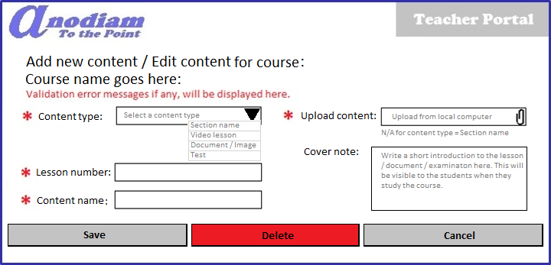
Teacher App: Content Detail (Add / Update / Delete) dialogue
Link: https://anodiam.com/teacher/addnewcontent
https://anodiam.com/teacher/content/{contentid}

Slide 19
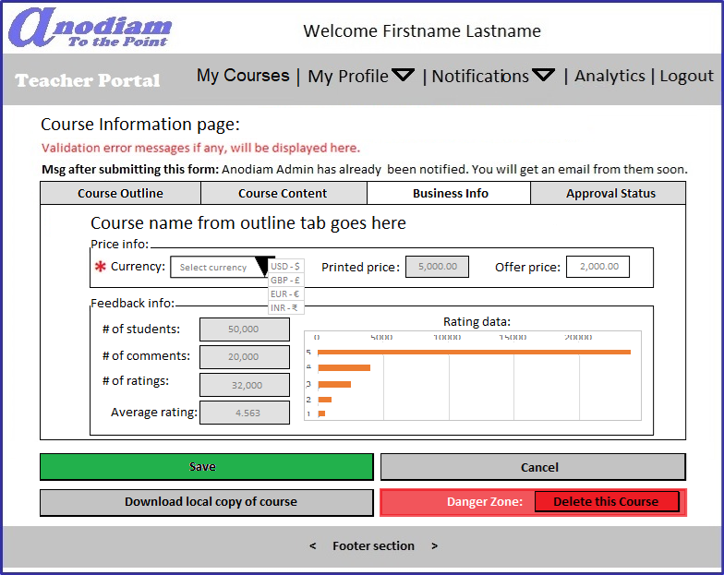
Teacher App: Create / Edit Course page Business Info tab
Link: https://anodiam.com/teacher/addnewcourse
https://anodiam.com/teacher/course/{courseid}

Slide 20
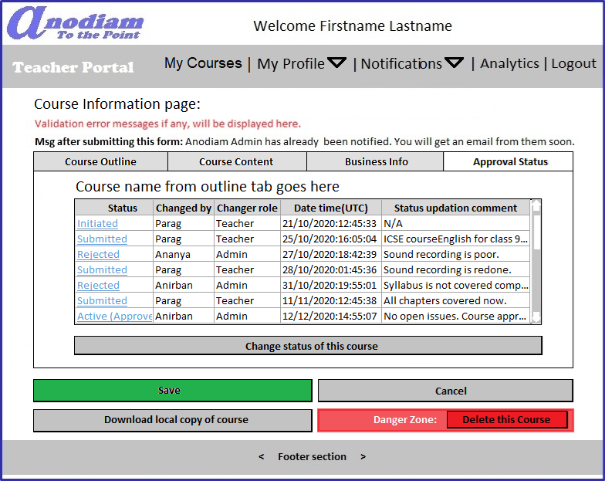
Teacher App: Create / Edit Course page Approval Status tab
Link: https://anodiam.com/teacher/addnewcourse
https://anodiam.com/teacher/course/{courseid}

Slide 21
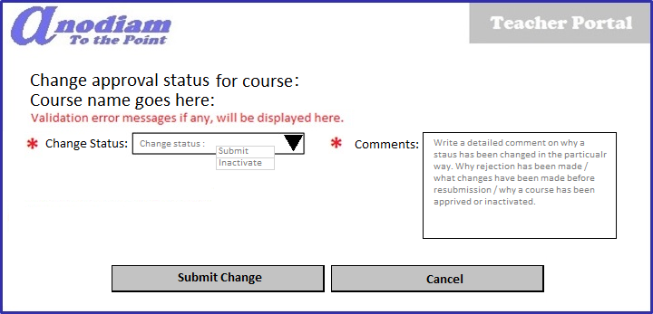
Teacher App: Approval Status dialogue
Link: https://anodiam.com/teacher/addnewstatus

Slide 22
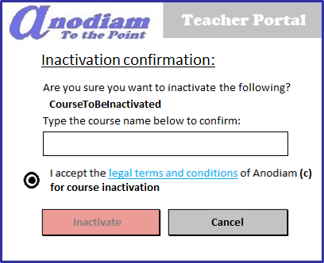
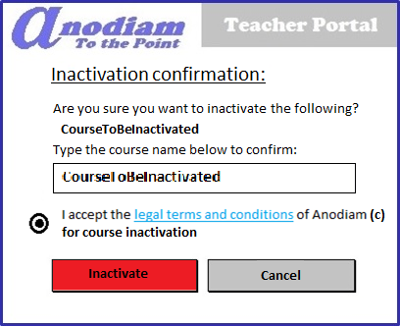
Teacher App: Confirm Course Inactivation dialogue
** Only active courses can be inactivated
Link: https://anodiam.com/teacher/inactivatecourse/{courseid}
On confirmation and T&C acceptance, Inactivate button is enabled

Slide 23
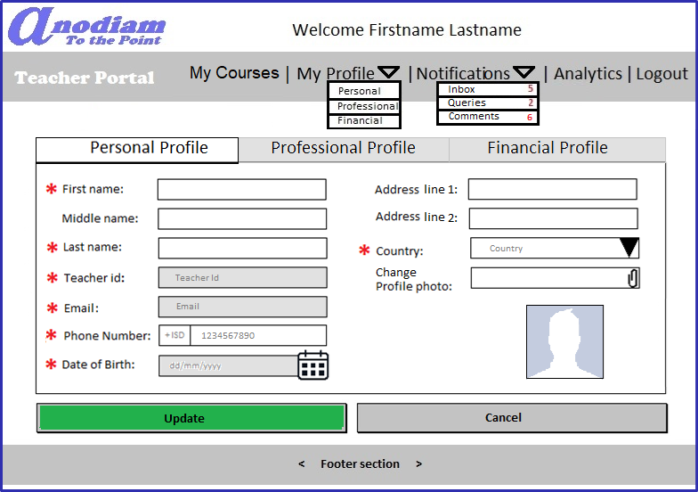
Teacher App: Personal Profile page
Link: https://anodiam.com/teacher/myprofile/{userid}

Slide 24
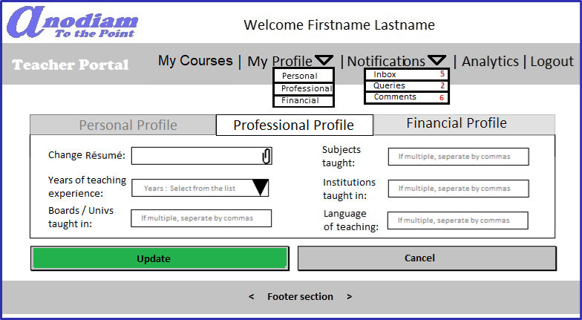
Teacher App: Professional Profile page
Link: https://anodiam.com/teacher/myprofile/{userid}

Slide 25
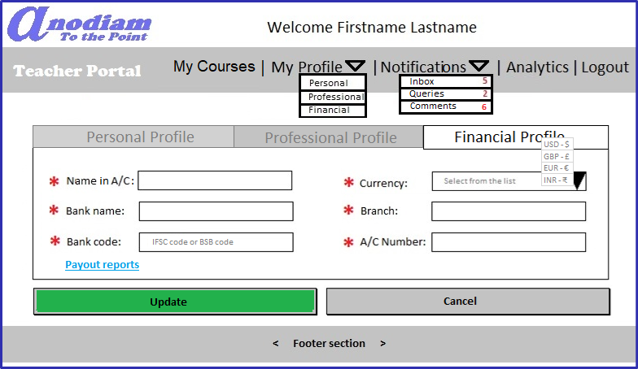
Teacher App: Financial Profile page
Link: https://anodiam.com/teacher/myprofile/{userid}

Slide 26
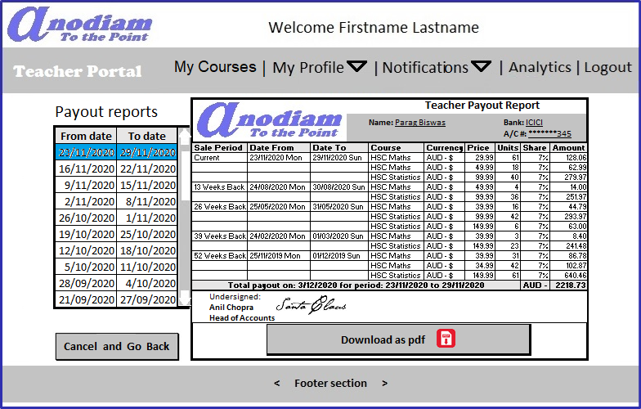
Teacher App: Payout Reports page
Link: https://anodiam.com/teacher/payouts/{userid}

Slide 27
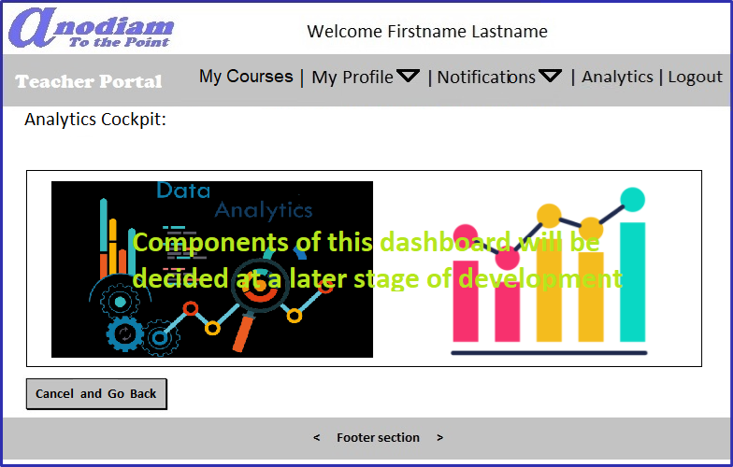
Teacher App: Analytics page
Link: https://anodiam.com/teacher/analytics/{userid}

Slide 28
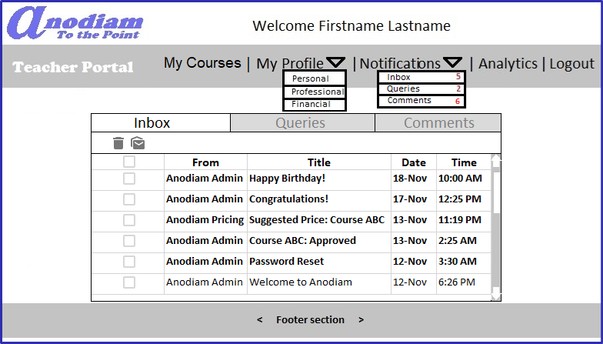
Teacher App: Notifications > Inbox page
Link: https://anodiam.com/teacher/messages/{userid}

Slide 29
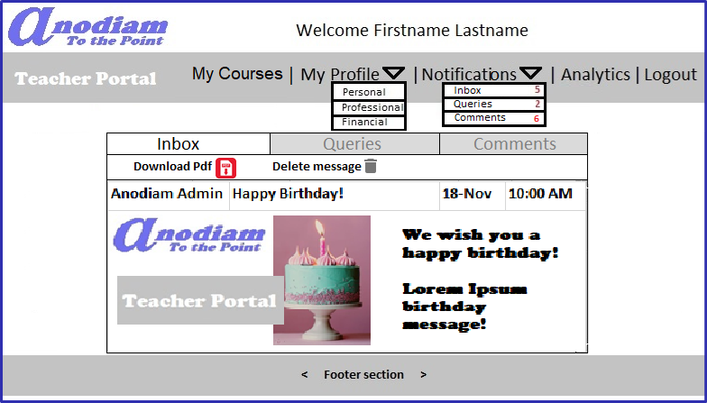
Teacher App: Notifications > Inbox > Message page
Link: https://anodiam.com/teacher/message/{messageid}

Slide 30
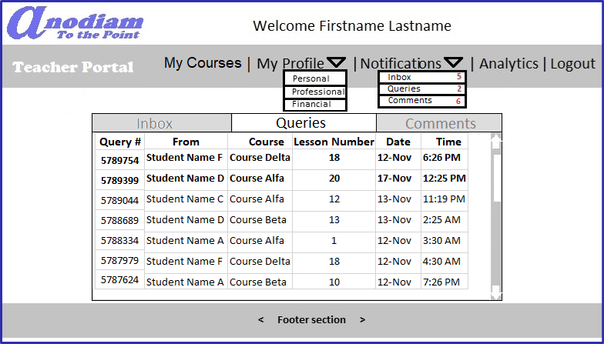
Teacher App: Notifications > Queries page
Link: https://anodiam.com/teacher/queries/{userid}

Slide 31
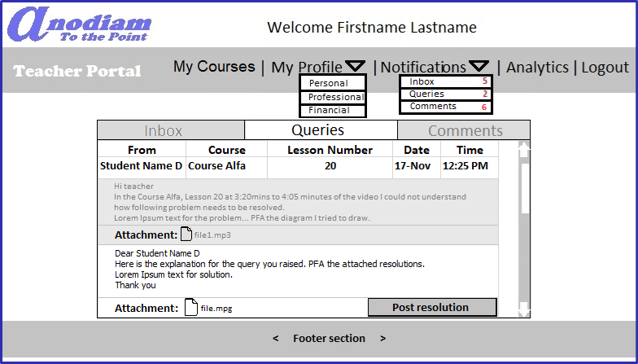
Teacher App: Notifications > Query > Resolution page
Link: https://anodiam.com/teacher/query/{queryid}

Slide 32
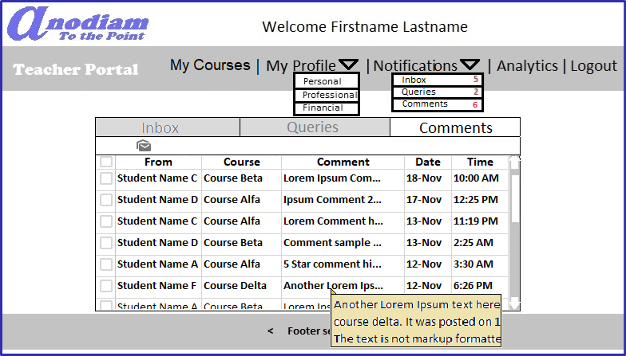
Teacher App: Notifications > Comments page
Link: https://anodiam.com/teacher/comments/{userid}

