Slide 1

ICSE/CBSE/WB Board, All Subjects, Class VI-XII
IIT/JEE/NEET & Other Competitive Exams
Best Teachers in Town, Innovative Teaching Process
Best Location, Largest Coaching center in Kolkata
Smart and Air-Conditioned Classrooms
Supporting Edtech Mobile App and Website
Professional IT Courses - Java, Python, Web, AI, Project Management
Co-curricular Activities - Robotics, Coding, IoT etc.
Spoken English, Grooming, IELTS & Foreign Languages
Well-Managed Australian Organization

Slide 2



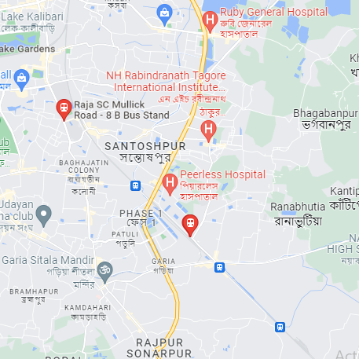
Most Professional & Caring Institute
Individual Guidance for Each Student
Doubt Clearing Sessions
Regular Mock Exams
Parent-Teacher Meetings & 360º Feedbacks
Professional Counselling
Most Convenient Location, 5 Floors, 15 classrooms
We Care For Our Talented Teachers
Professional & Gratifying Environment
Teamwork & Synergy
Effective Marketing Support
Most Rewarding Package & Astronomical Growth

Slide 3
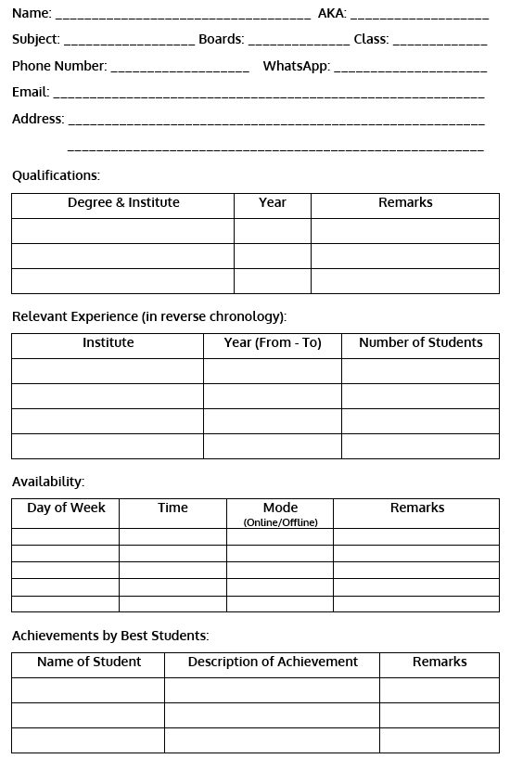

Slide 5
