Slide 1

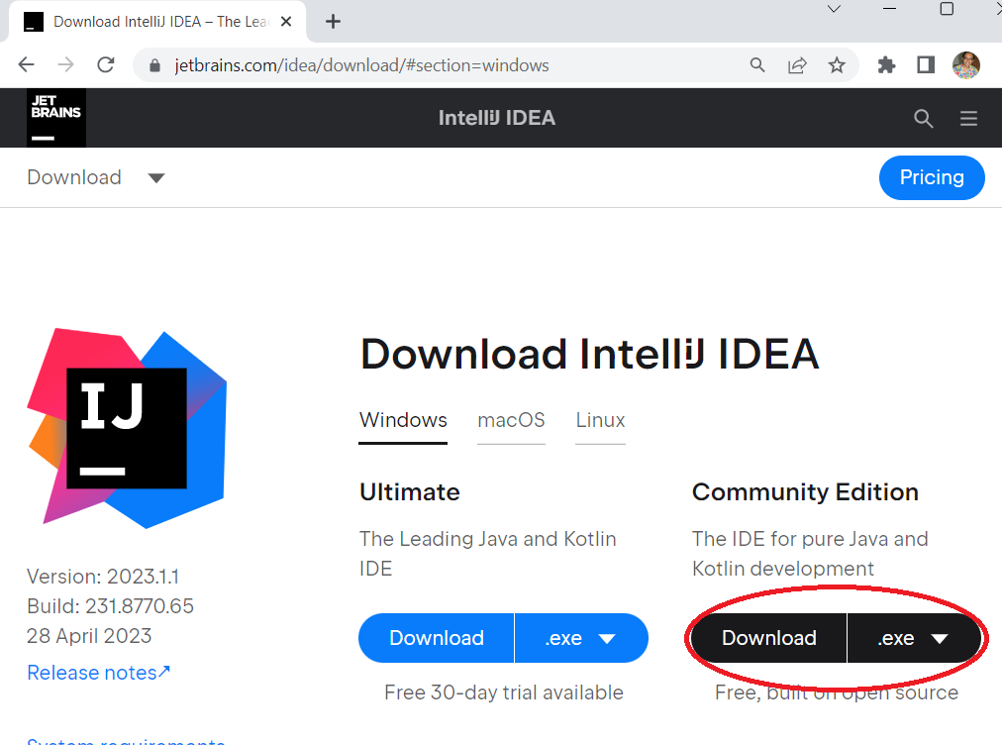
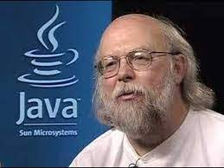
INTRODUCTION TO JAVA
Why Java?
Open source, free
Easy to implement
Secure, robust & powerful
Object oriented
High-level language
Platform-independent, Portable
Environment & Tools
Processor speed 3.6 GHz +
8 GB + RAM
JDK (Java Development Kit)
IDE (Integrated Dev Tool) (IntelliJ /Eclipse/ Net Beans)
JVM (Java Virtual Machine)
Java was created by
James Arthur Gosling - 1995
CONCEPTION >> PRACTICE >> CONFIDENCE >> HIGHEST GRADES © PROTECTED ANODIAM 2023 || PRIVATE & CONFIDENTIAL

Slide 2
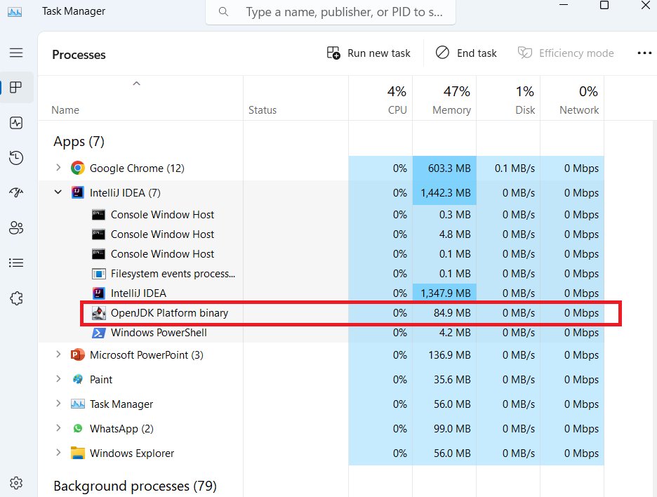
JVM (Java Virtual Machine)
IDE
JVM Running as Windows Process
Main.java
public class Main { public static void main(String[] args){ System.out.printf("Hello and welcome!"); } }
JDK
Compile
Main.class
> Byte code (o’s and 1’s)
> Portable to any OS (Win/Linux/Android/Mac)
Port to Any Device Running Java
JVM
Run
OUTPUT
> Hello and welcome!
CONCEPTION >> PRACTICE >> CONFIDENCE >> HIGHEST GRADES © PROTECTED ANODIAM 2023 || PRIVATE & CONFIDENTIAL

Slide 3
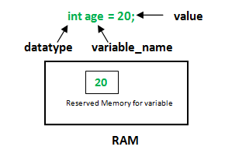
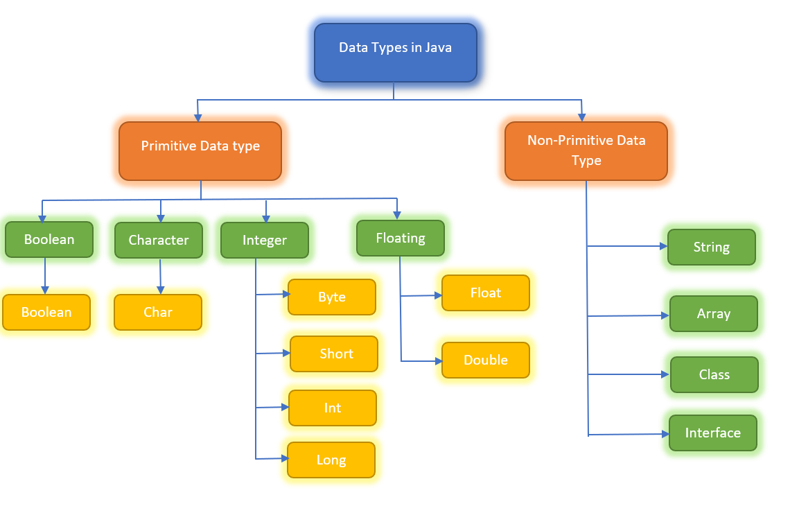
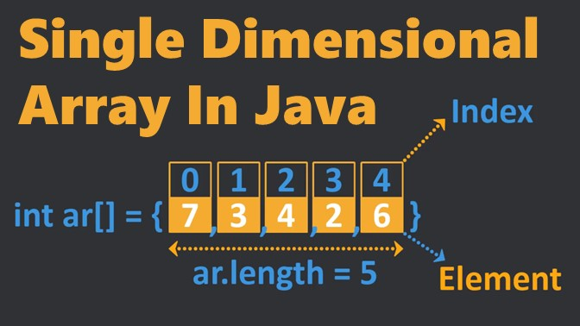
Variables, Data Types and Arrays
CONCEPTION >> PRACTICE >> CONFIDENCE >> HIGHEST GRADES © PROTECTED ANODIAM 2023 || PRIVATE & CONFIDENTIAL

Slide 4
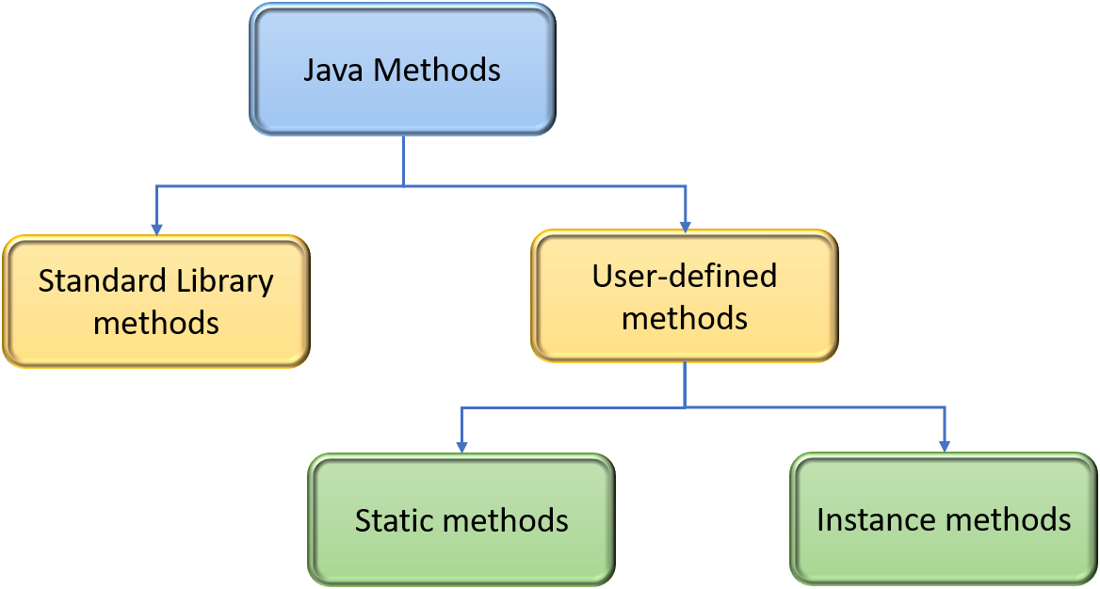
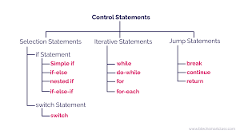
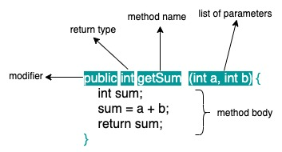
Control Flow Statements and Methods
CONCEPTION >> PRACTICE >> CONFIDENCE >> HIGHEST GRADES © PROTECTED ANODIAM 2023 || PRIVATE & CONFIDENTIAL

Slide 5
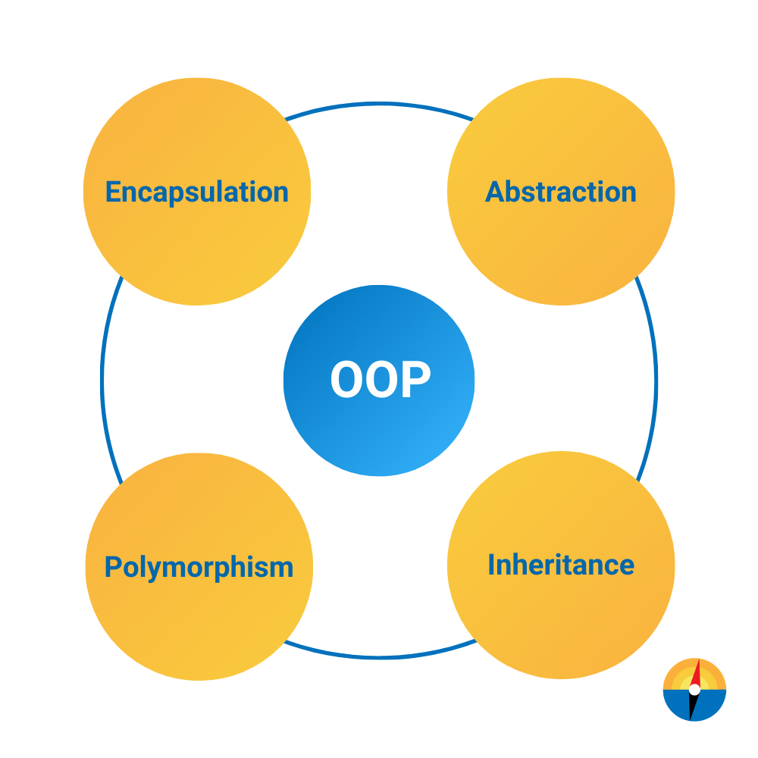
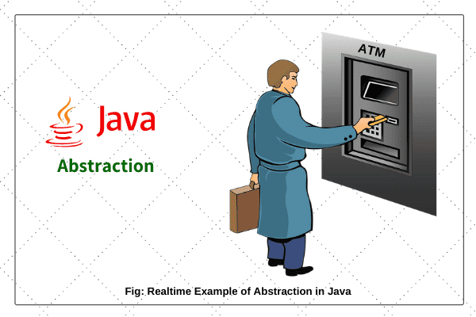
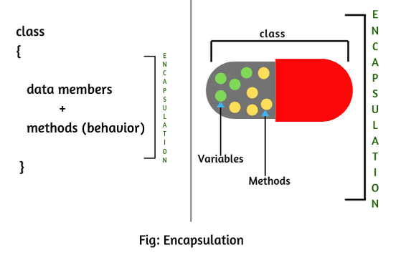
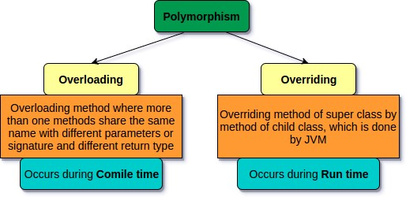
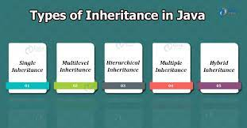
OOPS
CONCEPTION >> PRACTICE >> CONFIDENCE >> HIGHEST GRADES © PROTECTED ANODIAM 2023 || PRIVATE & CONFIDENTIAL

Slide 6
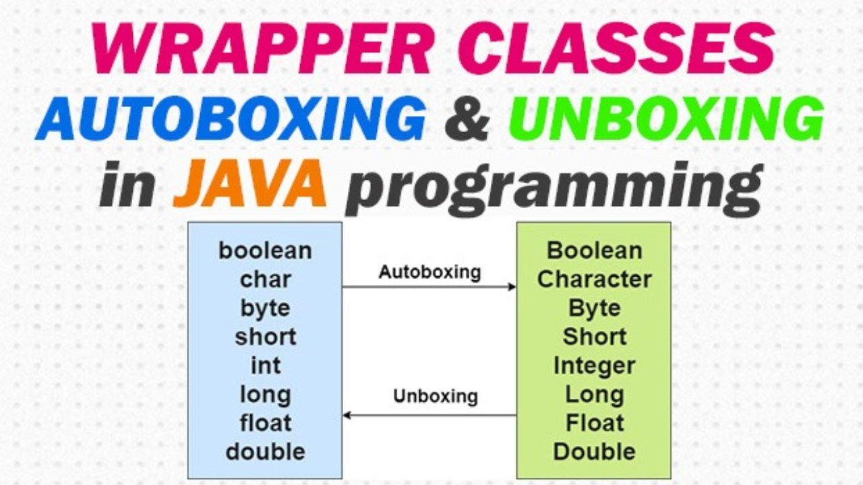
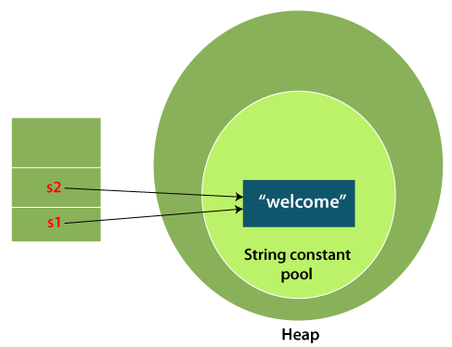
Strings and Wrapper Classes
CONCEPTION >> PRACTICE >> CONFIDENCE >> HIGHEST GRADES © PROTECTED ANODIAM 2023 || PRIVATE & CONFIDENTIAL

Slide 7
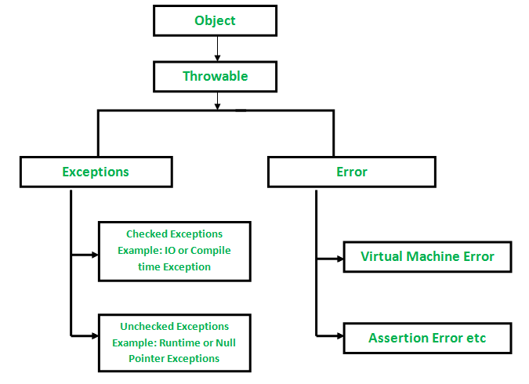
Exceptions in Java
CONCEPTION >> PRACTICE >> CONFIDENCE >> HIGHEST GRADES © PROTECTED ANODIAM 2023 || PRIVATE & CONFIDENTIAL

Slide 8
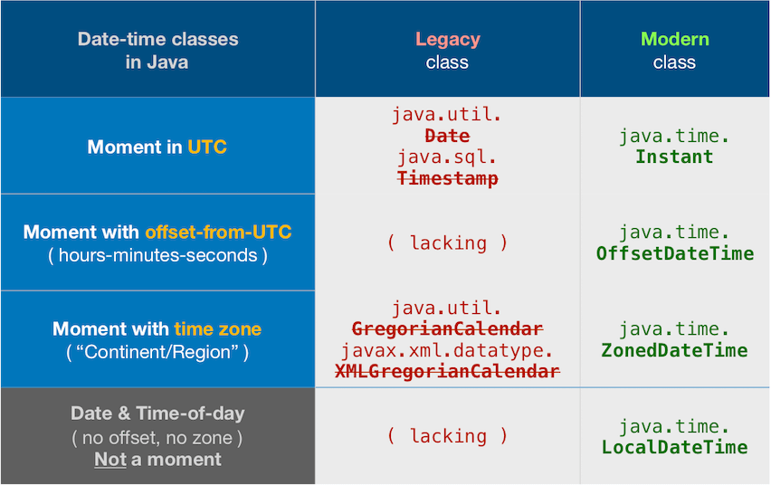
Java Date and Time
CONCEPTION >> PRACTICE >> CONFIDENCE >> HIGHEST GRADES © PROTECTED ANODIAM 2023 || PRIVATE & CONFIDENTIAL

Slide 9

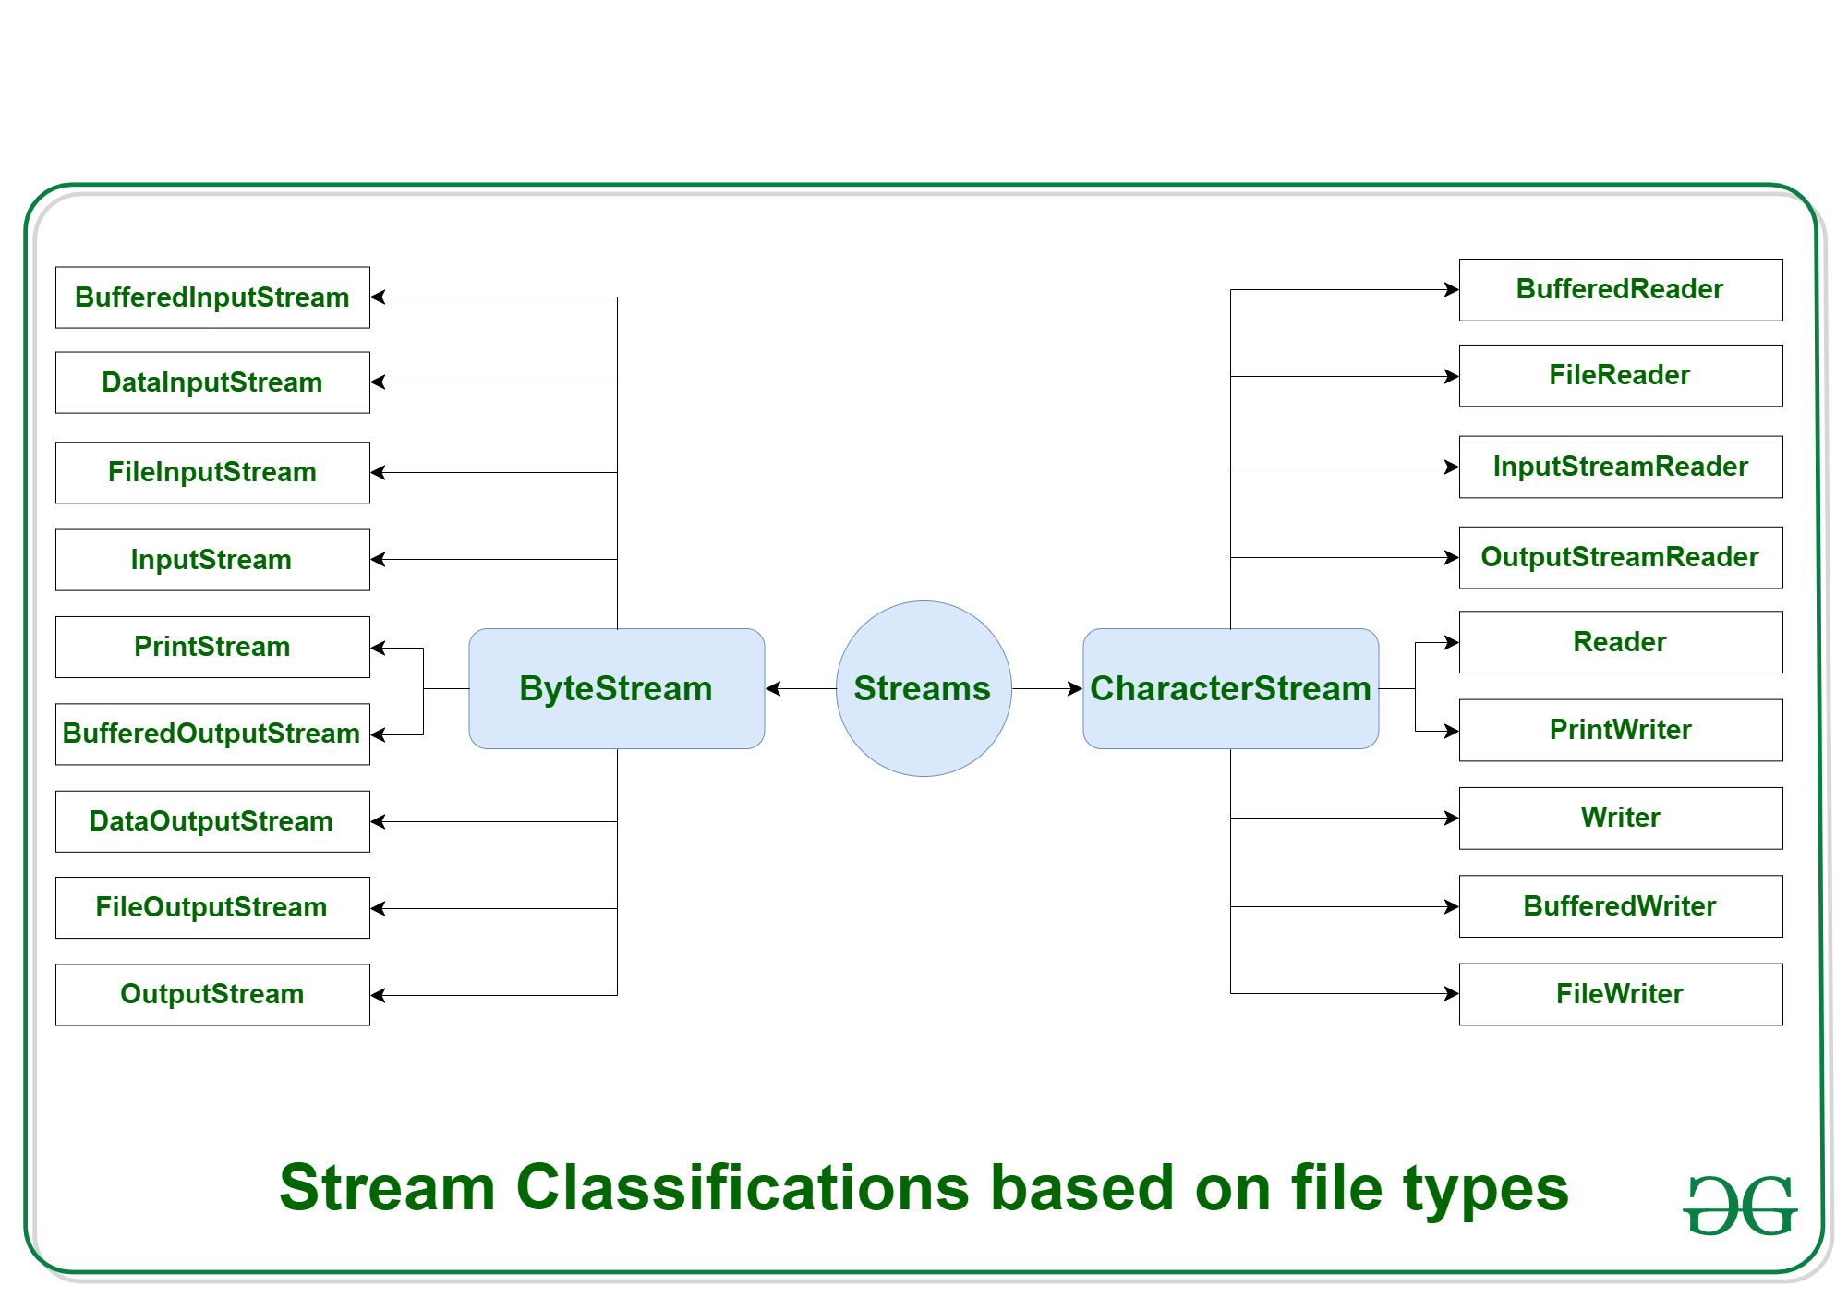
Java Input/Output
CONCEPTION >> PRACTICE >> CONFIDENCE >> HIGHEST GRADES © PROTECTED ANODIAM 2023 || PRIVATE & CONFIDENTIAL

Slide 10
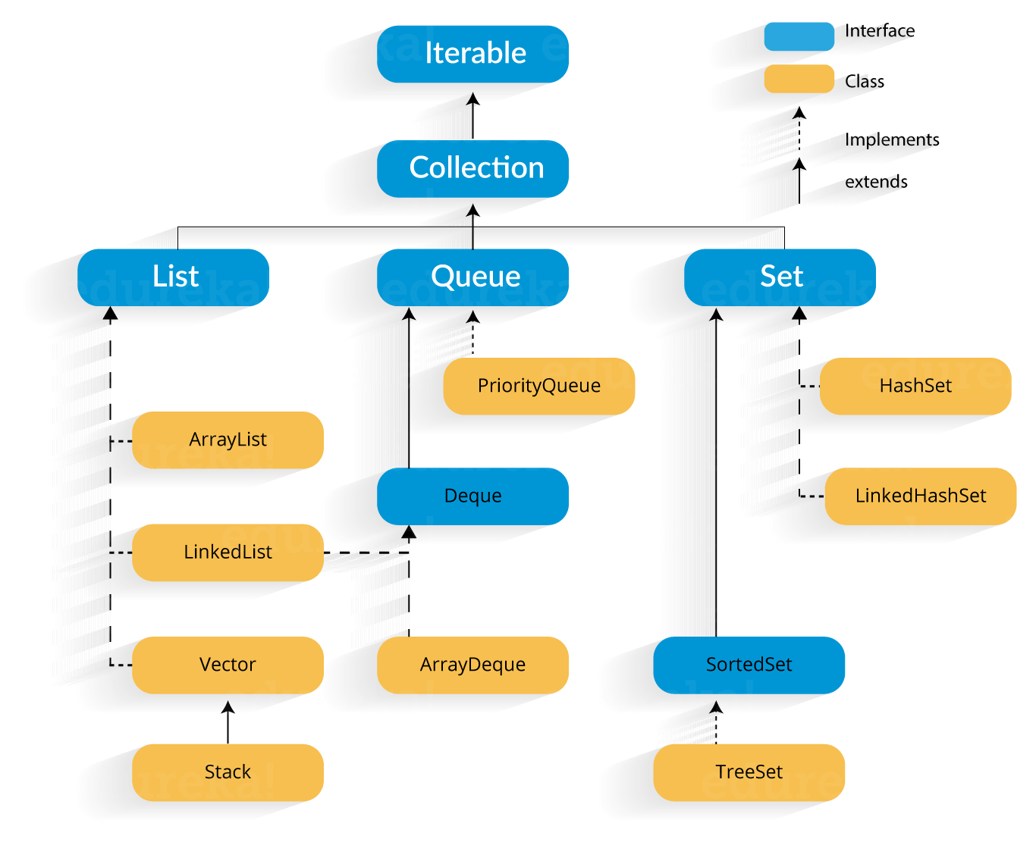
Java Input/Output
CONCEPTION >> PRACTICE >> CONFIDENCE >> HIGHEST GRADES © PROTECTED ANODIAM 2023 || PRIVATE & CONFIDENTIAL

